Slide 1
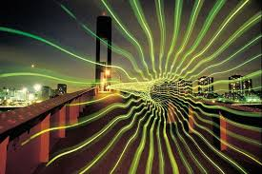
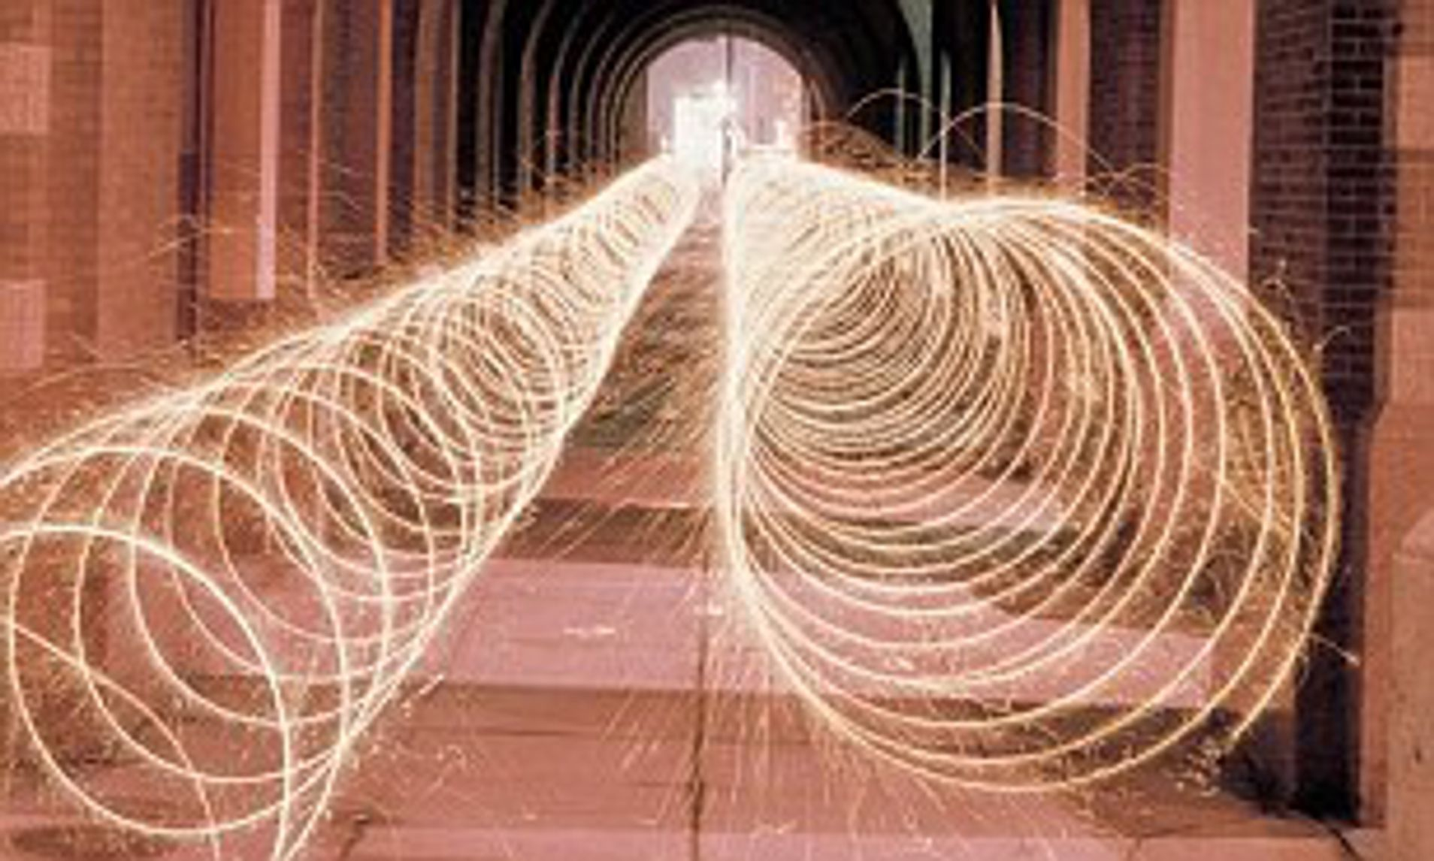
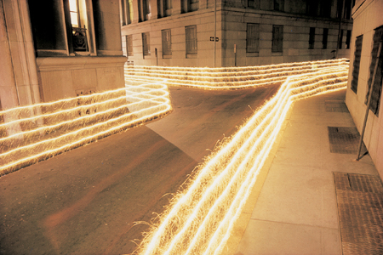
Line
Eric Staller
Light painting photography
Research into what light painting photography is. Complete one slide on this.

Slide 2
Artist Research
Your opinion of the artist
Must include good quality images (x6)
Information about the artist – brief
Information about their art – lots
Why they produce those kind of photographs and any meanings attached to them
How does this artist use line
What do you think of their work?
How will you use their work to inspire you?
How does their work link to the question?
You must remember to use key words throughout your annotations!!

Slide 3

Select one of Sebastian Magnani pieces of art and analyse it.
Make sure it is a photograph that you can discuss space
Writing about a photographer’s work
To analyse a photographer's work, you need to talk about:
- what is in the picture?
- how they have taken the photograph?
- What camera or editing techniques have they used?
- how have they used the formal elements? (shape, colour, composition, lighting, viewpoint etc)
- what do you like about the work? Explain your answer.
- how could their work inspire your own photographs?
If you need help getting started, you can use these sentence starters but make sure you write a paragraph not bullet points...
Artist's Name takes photographs of...
He/she takes his/her photos by…
The photography techniques he/she uses are…
These are effective because...
This photographer considers formal elements in their work by...
Something I like about Artist's Name's photography style is...
I could take inspiration from this photographer in my own work by...

