Slide 1
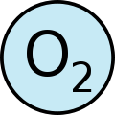
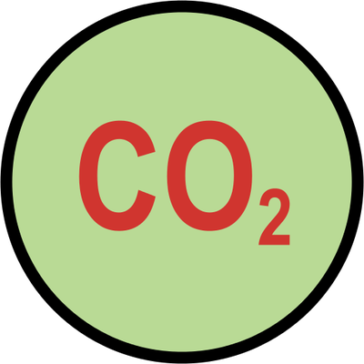
Gas Tests
Year 10

Slide 2
Three Common Gases:
The three most common gases given off in reactions are:
Oxygen
Hydrogen
Carbon dioxide
All these gases are colorless and odourless.
There are tests we can do to establish which gas is given off in an experiment.

Slide 3
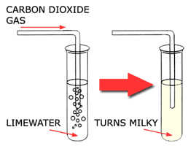
To test for Carbon dioxide
Use Lime water (Calcium Hydroxide)
When Carbon dioxide is bubbled through lime water, the lime water becomes cloudy.
A precipitate is formed.

Slide 4
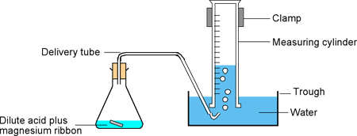
To test for Hydrogen
Magnesium will react with acid and hydrogen gas is given off.
If this gas is collected and ignited it will explode making a squeaky pop!

Slide 5
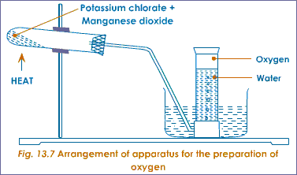
To test for Oxygen
Oxygen will relight a glowing splint.
There are a number of ways of producing oxygen in the lab.

Slide 6
What to do next
Draw your own diagrams to show how you test for each gas.
Which gases are elements?
Which gas is a compound?
Why are the gas tests need to identify these gases?
Research how to produce oxygen in the lab.

