Slide 1

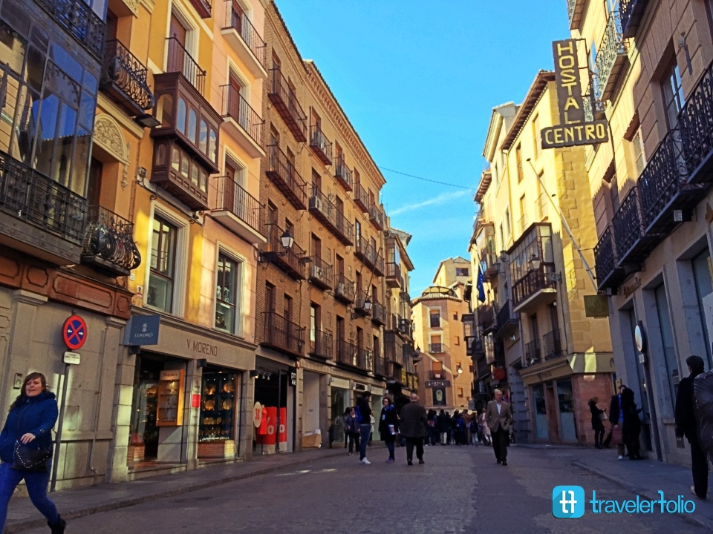
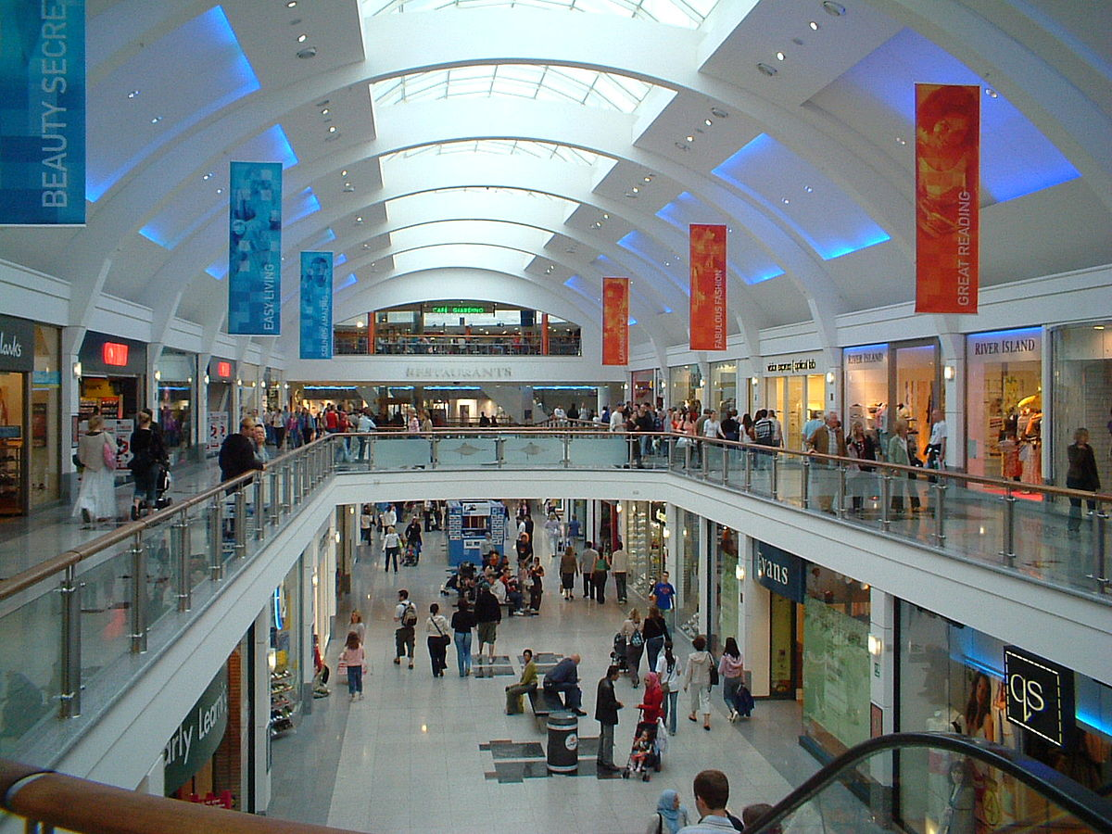
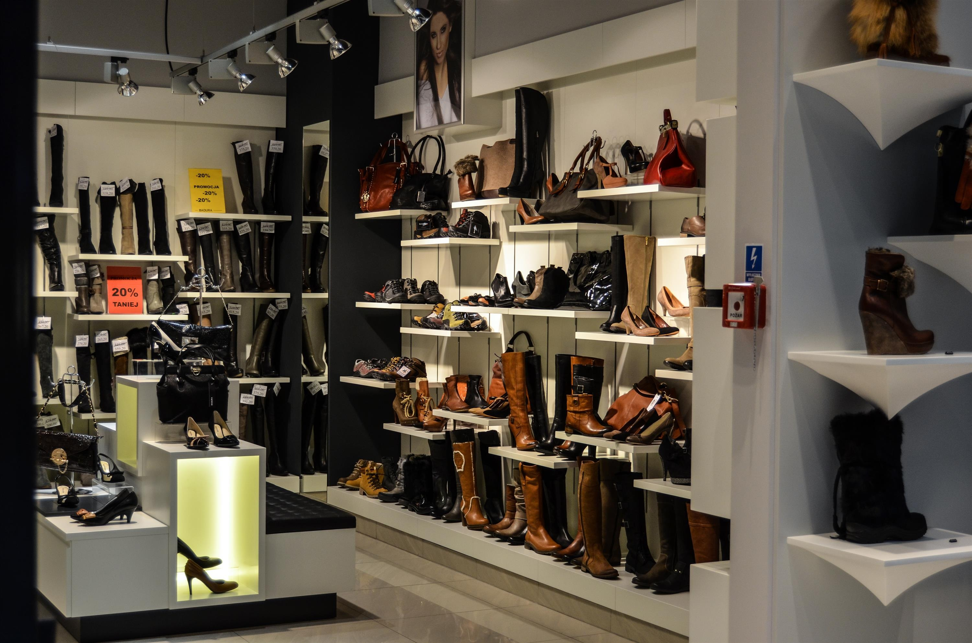
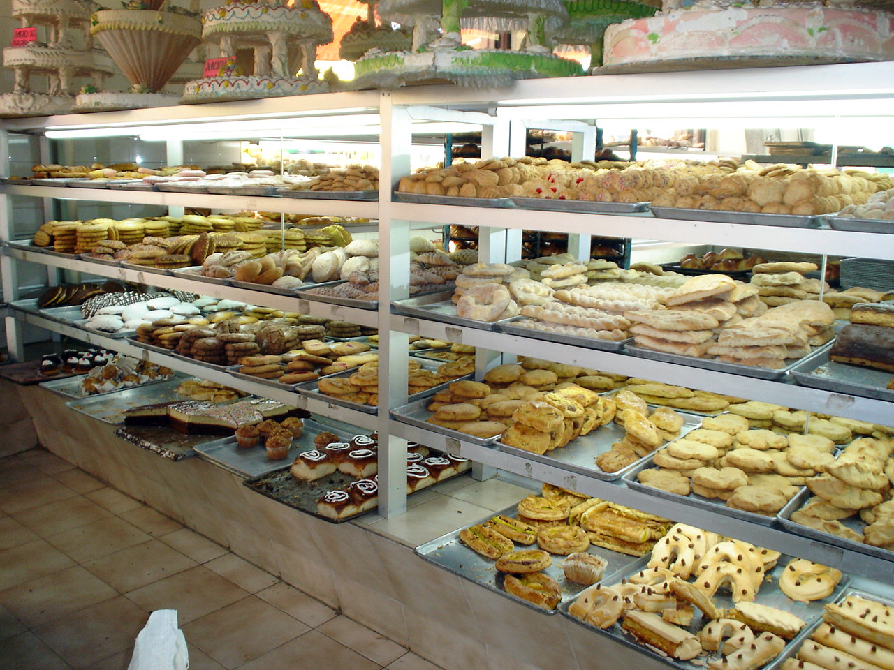
Term 6 Lesson 3
De tiendas
LO: to talk about shops on the high street and your shopping plans
( /26)
This Photo by Unknown Author is licensed under CC BY-SA

Slide 2
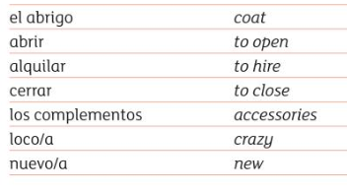
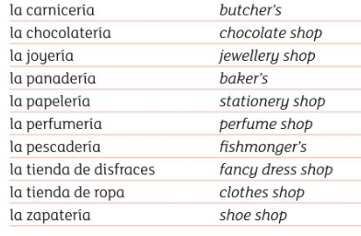
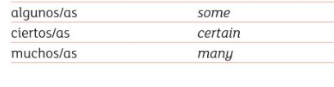
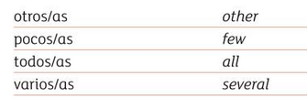
Vocabulario
Copy this down

Slide 3
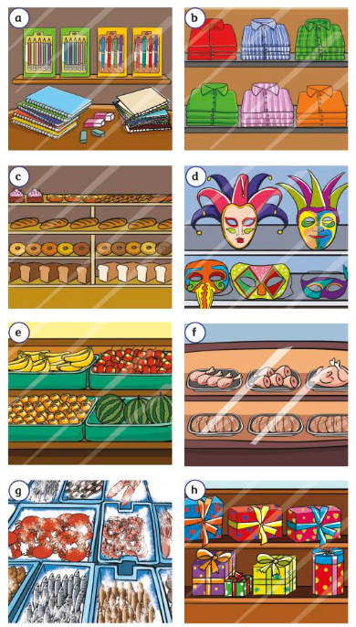
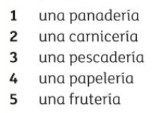
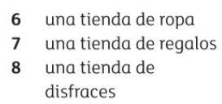
Empareja
Match up the shops with the words.
Write the letter in the blue box
1.
2.
3.
4.
5.
6.
7.
8.
/8

Slide 4
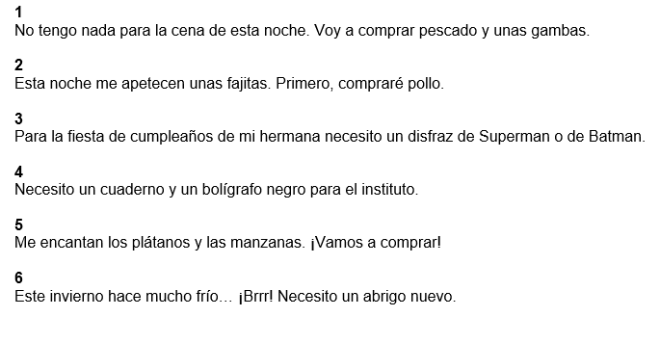
Leer
Read the statements and write down which shop each person should go to.
Drag the yellow box to the correct statement
frutería
papelería
pescadería
carnicería
tienda de ropa
tienda de disfraces
/6

Slide 5
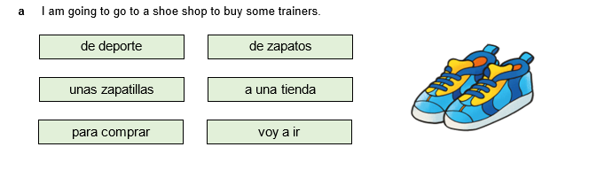
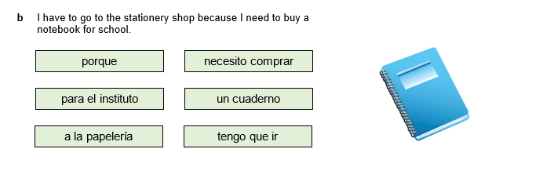
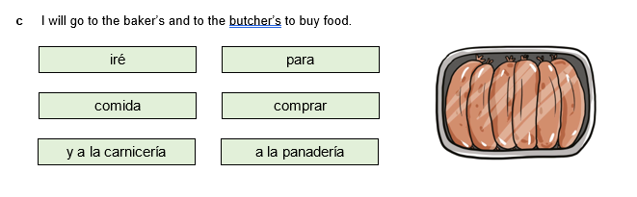
Leer Write the three sentences in Spanish in the correct order. Use the words and phrases in the green boxes.
a.
b.
c.
/6

Slide 6
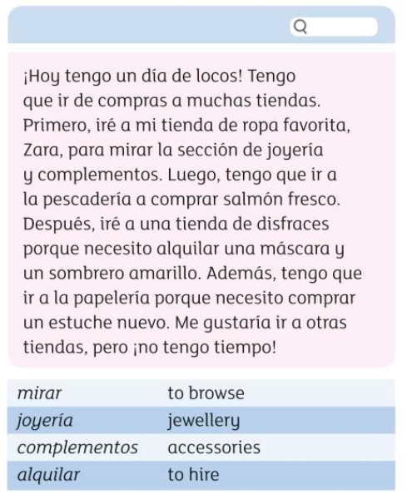
Leer Read about Sara’s busy shopping day and complete the table in English
Shop | Reason
(1) | To browse the jewellery and accessories
Fishmonger’s | (1)
Fancy dress shop | (2)
(1) | (1)
(The numbers in brackets indicate how many details you should write)
/6

Slide 7
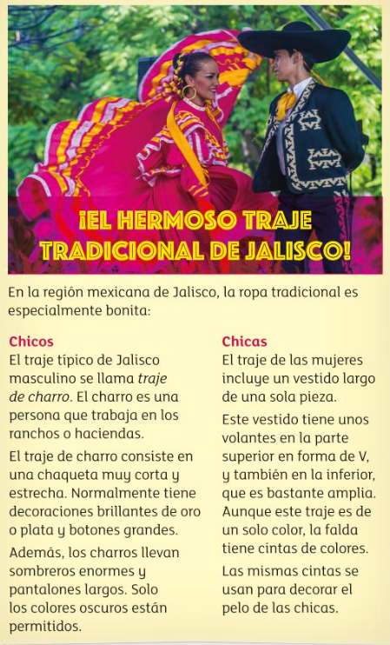
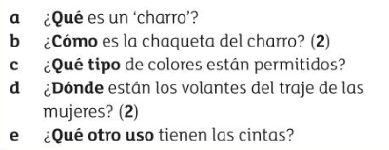
Extension
Group 1/pre-GCSE students should complete this!
Read the text and traditional outfits in a region of Mexico. Then answer the questions in Spanish.
a.
b.
c.
d.
e. /7

