Slide 1

IMPORTANT – PLEASE READ!
Log on every Spanish lesson, complete the work and submit in Assignments on Teams. Work = present in register!
Let’s work together! Ask for help if you need it. If work is too difficult/easy – tell me. If you have technical problems – tell me. Be pro-active and responsible for your learning. Don’t wait for me to chase you!
Don’t send the original Powerpoint with no answers. Open the Powerpoint online, complete the activities, save a copy and rename, submit in Assignments
Complete all the activities in each lesson, especially the graded tasks in the blue boxes. These are the ones that give you the total mark for the lesson and shows how much you have learnt.
Follow the instructions given eg. Translate, match up, write the letters, answer in English etc.
With the written tasks use the language you know and have practised in the lesson. When doing the graded tasks, go back and use the previous slides and activities to help you.
Do not use Google Translate or other online translators – you will not learn this way!
Make sure you make notes and copy new words as you are working. You will need to bring these when we return to school

Slide 2
Term 6
Talking about places in town
Describing where you go in town
Discussing plans for the weekend
Learning about Spanish towns and cities
Comparing town and country

Slide 3

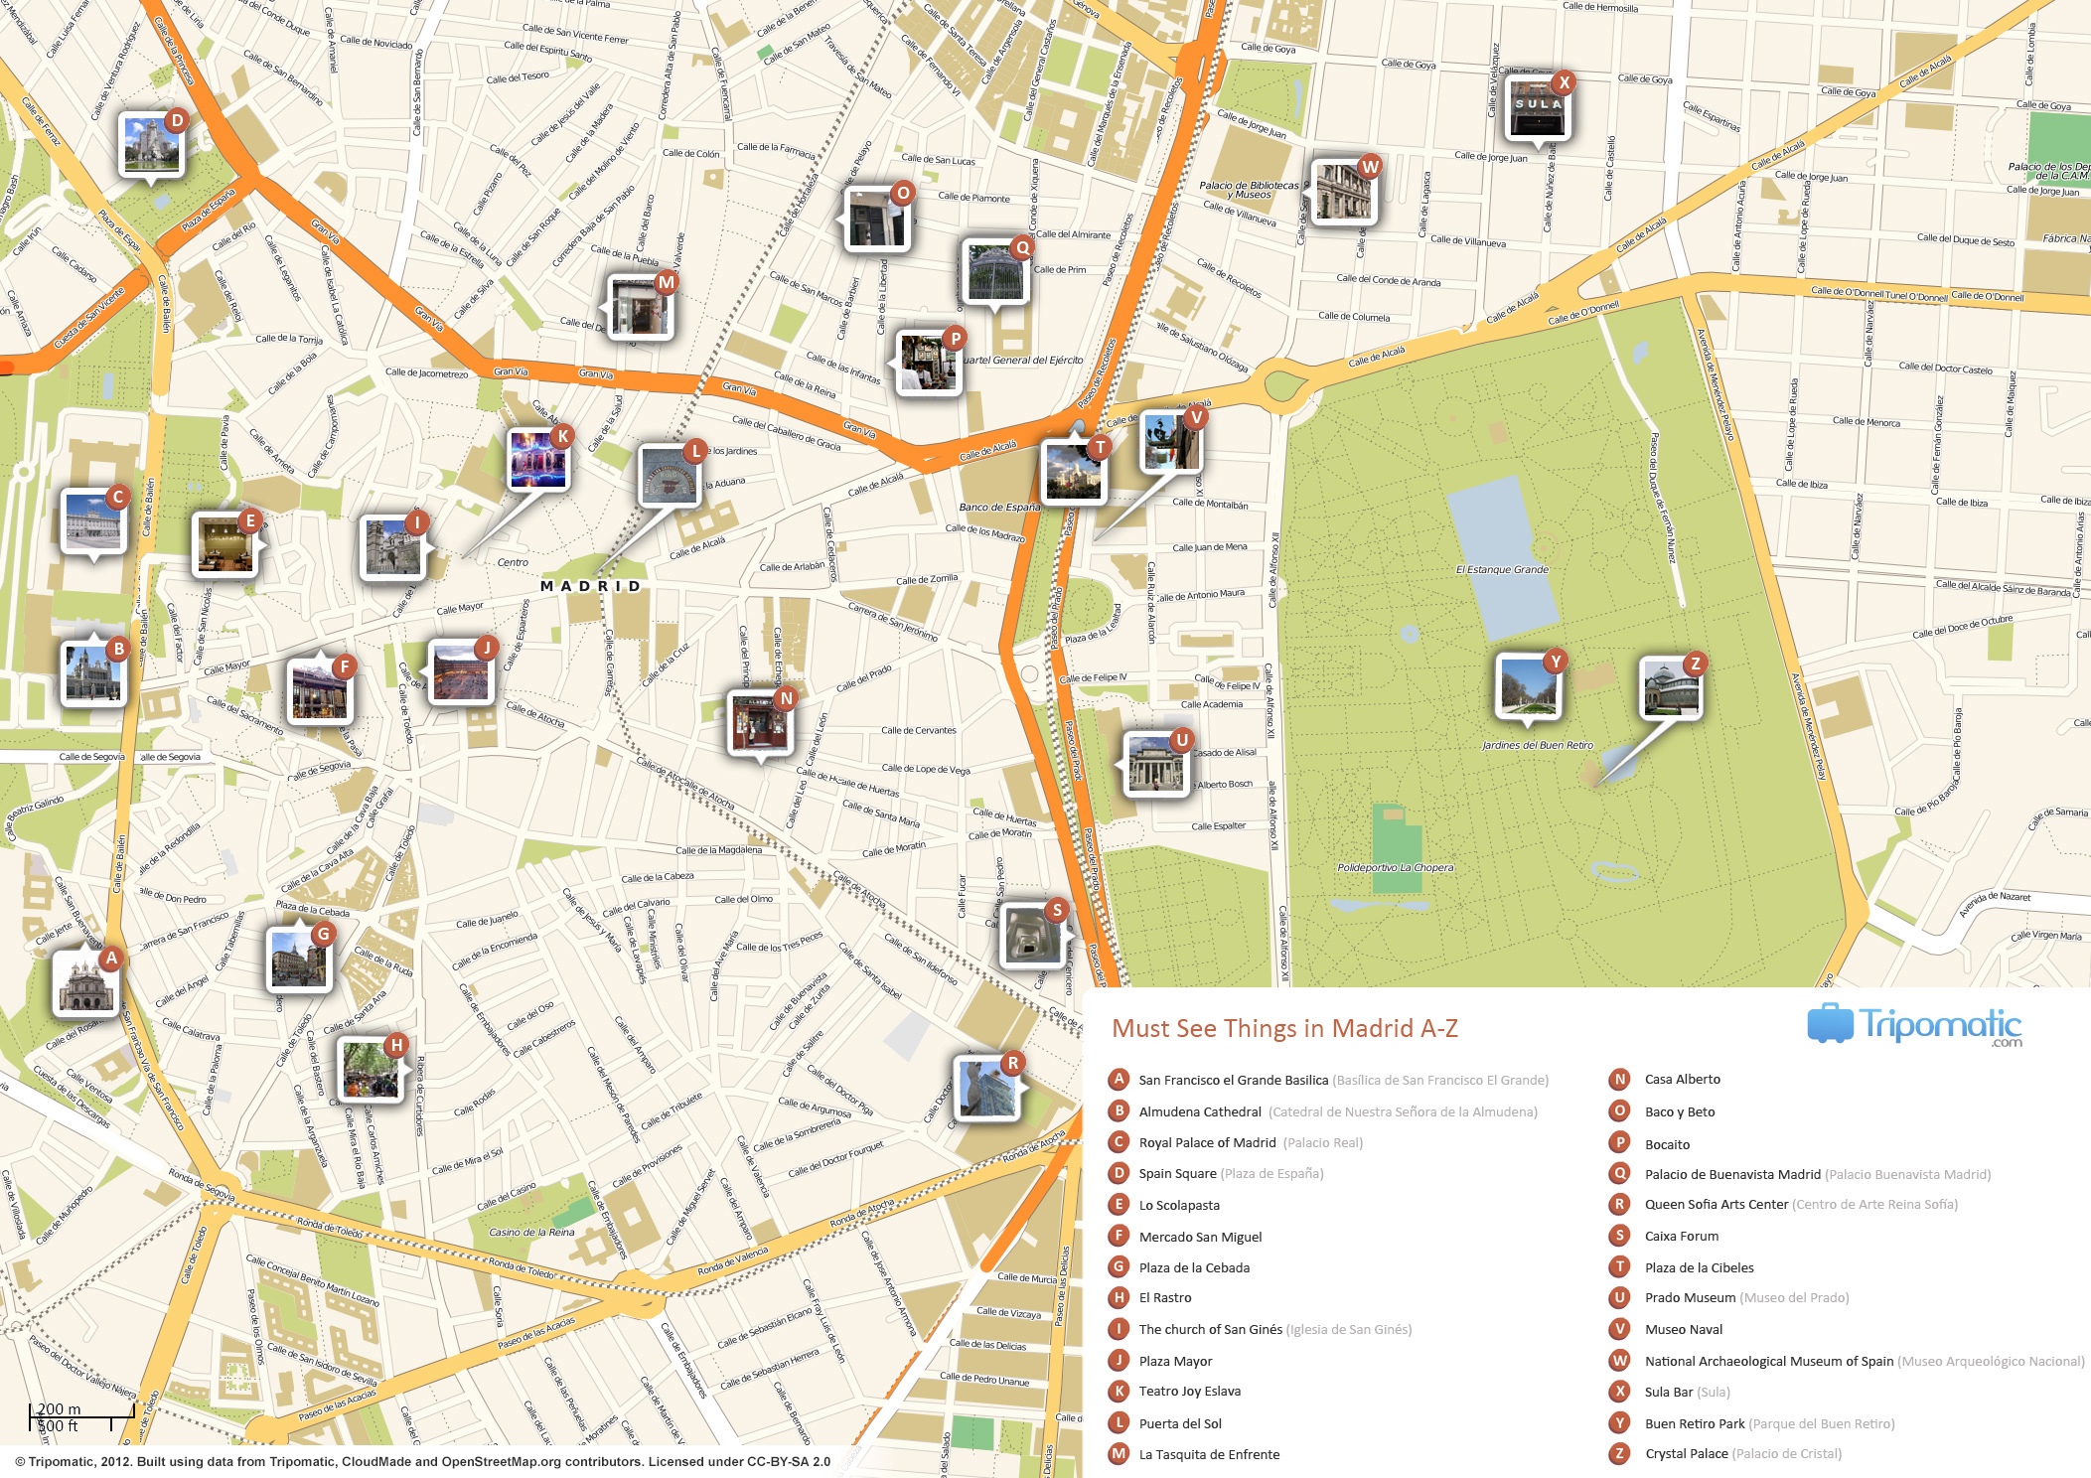
Term 6 lesson 1
De paseo por mi ciudad
LO: talking about places in town
/32

Slide 4
STARTER
Make a list of places in a town or city.
How many can you think of in a minute?
eg. Bus station, post office,

Slide 5
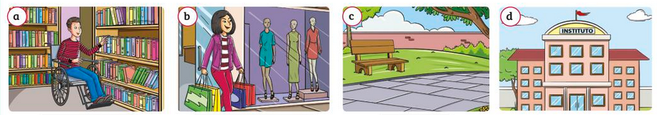
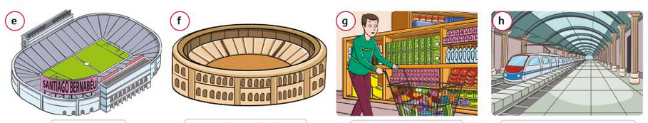
Empareja
Match the places in town to the words
1. un parque
2. un instituto
3. una estación de trenes
4. un estadio
5. una biblioteca
6. un supermercado
7. una tienda de ropa
8. una plaza de toros

Slide 6
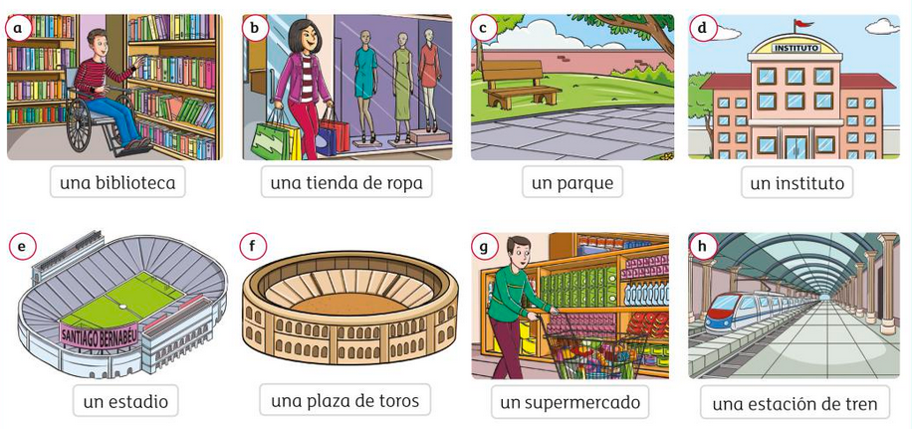

Slide 7
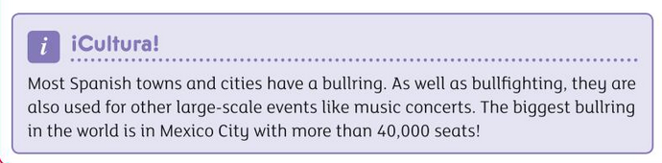
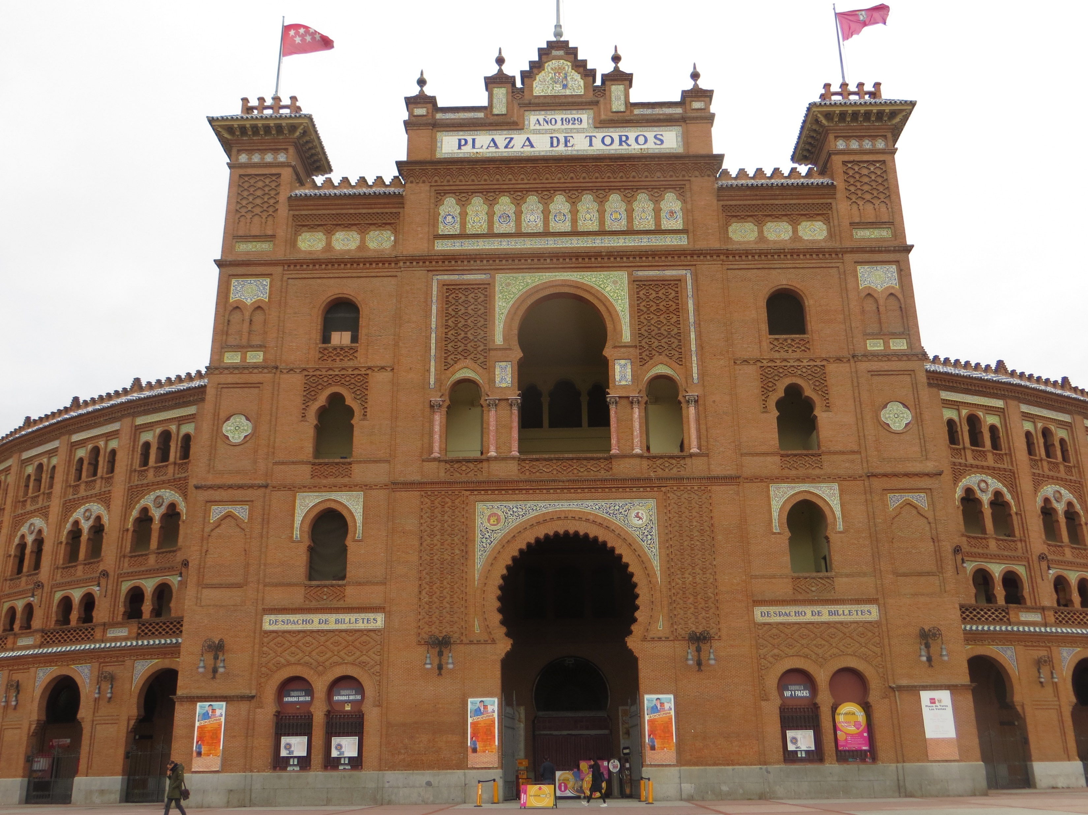
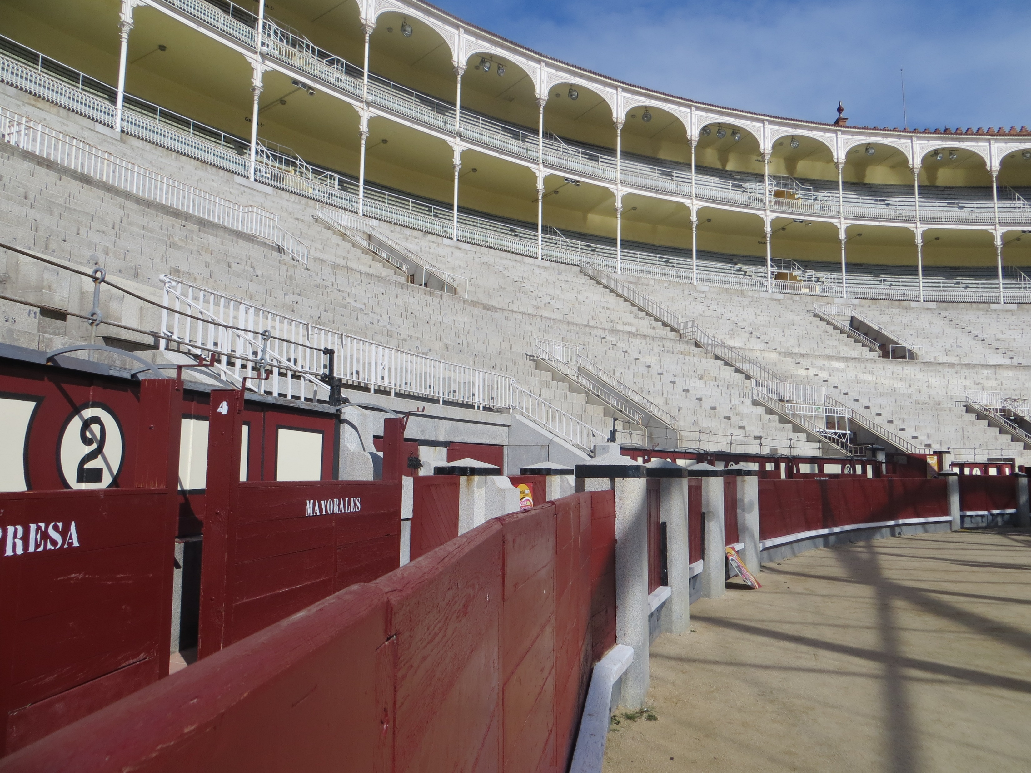
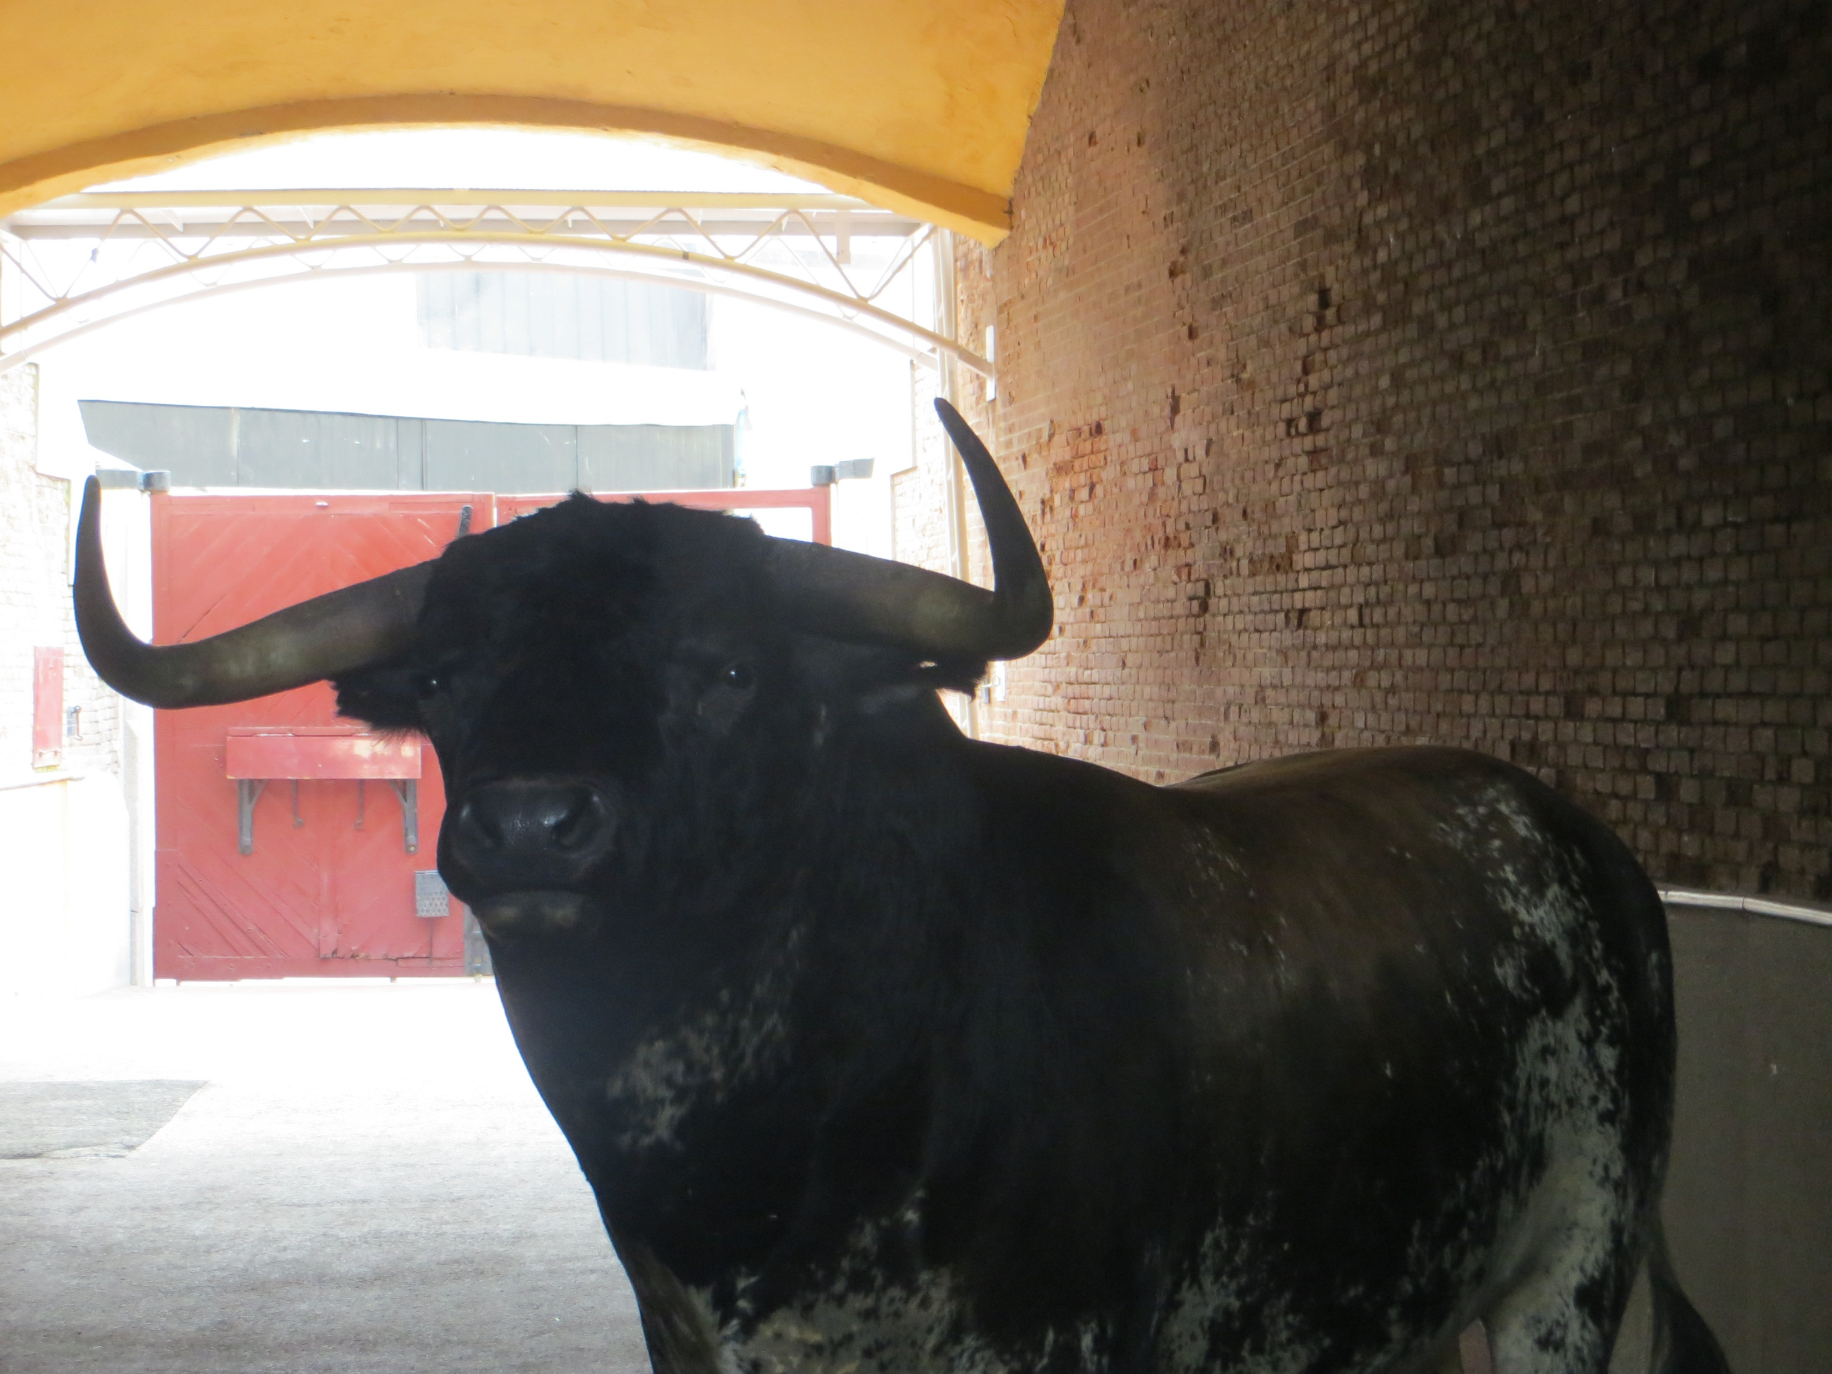
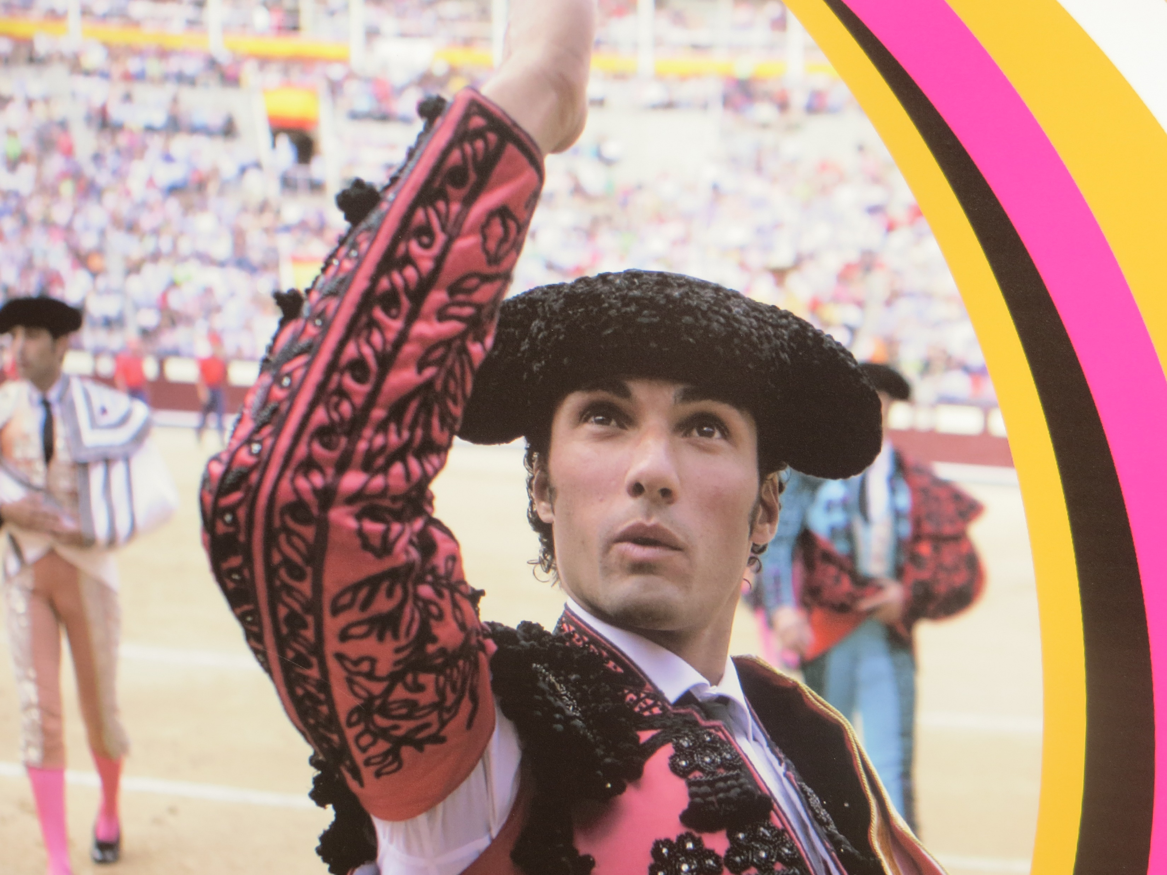
Here are some photos I took at the ‘Plaza de Toros’ in Madrid two years ago…….

Slide 8
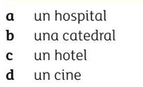
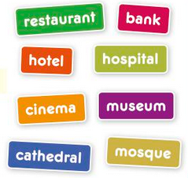
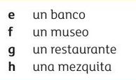
Empareja
Now match up these places. Write the English word in the box
a.
b.
c.
d.
e.
f.
g.
h.
/8

Slide 9
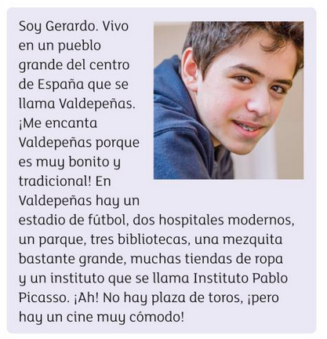
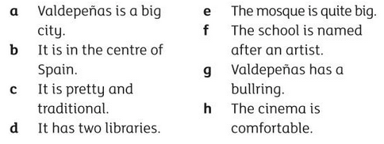

Leer
Read Gerardo’s description of Valdepeñas , then read the sentences
(a-h). Choose the five correct sentences according to the text
I think the five correct sentences are;
Find out where Valdepeñas is. What is it like?
/5

Slide 10
Hay
‘Hay’ is a very useful word that is used with both singular or plural nouns. It means both ‘there is’ and ‘there are’.
En mi ciudad hay una estación de tren.
En mi casa hay tres dormitorios.
The ‘un/una’ is often missed out when ‘no hay’ is used:
No hay estadio.

Slide 11






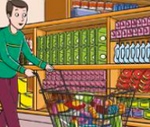
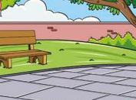
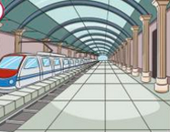

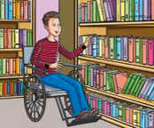
Escribir
Write sentences using hay and no hay
Remember you don’t need to use un/una with no hay
Example:
En mi ciudad hay una biblioteca pero no hay plaza de toros.
/7

Slide 12
Traduce
Translate the sentences into Spanish
In my village there is a bank.
In my town there is a cinema and a restaurant.
In my city there is a hotel but there is not a stadium.
There is no cinema in my town.
There are two parks in my city.
There is a mosque and a cathedral in my city.
/12

Slide 13
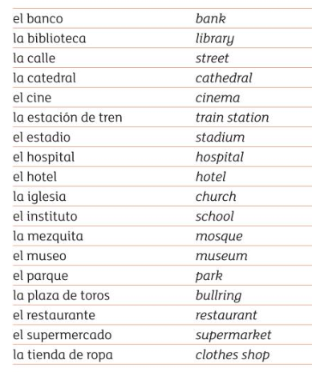
Learn today’s vocabulary for a test next lesson
How am I going to learn the words?
Test myself
Get someone else to test me
Copy them out
Make flashcards
Draw pictures and label
Colour code them
Record myself saying them
Look Say Cover Write Check

