Slide 1
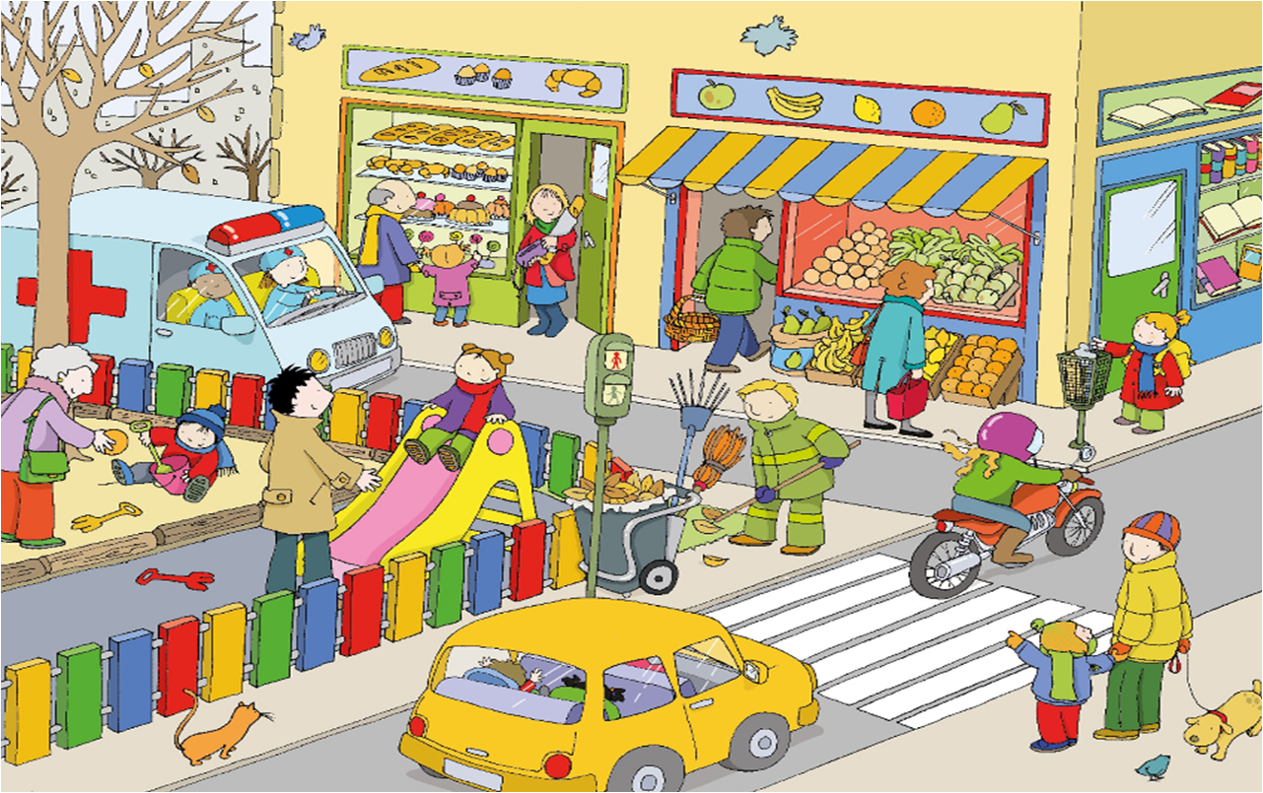

Picture this!
Name as many Spanish words as you can!
30 seconds!

Slide 2

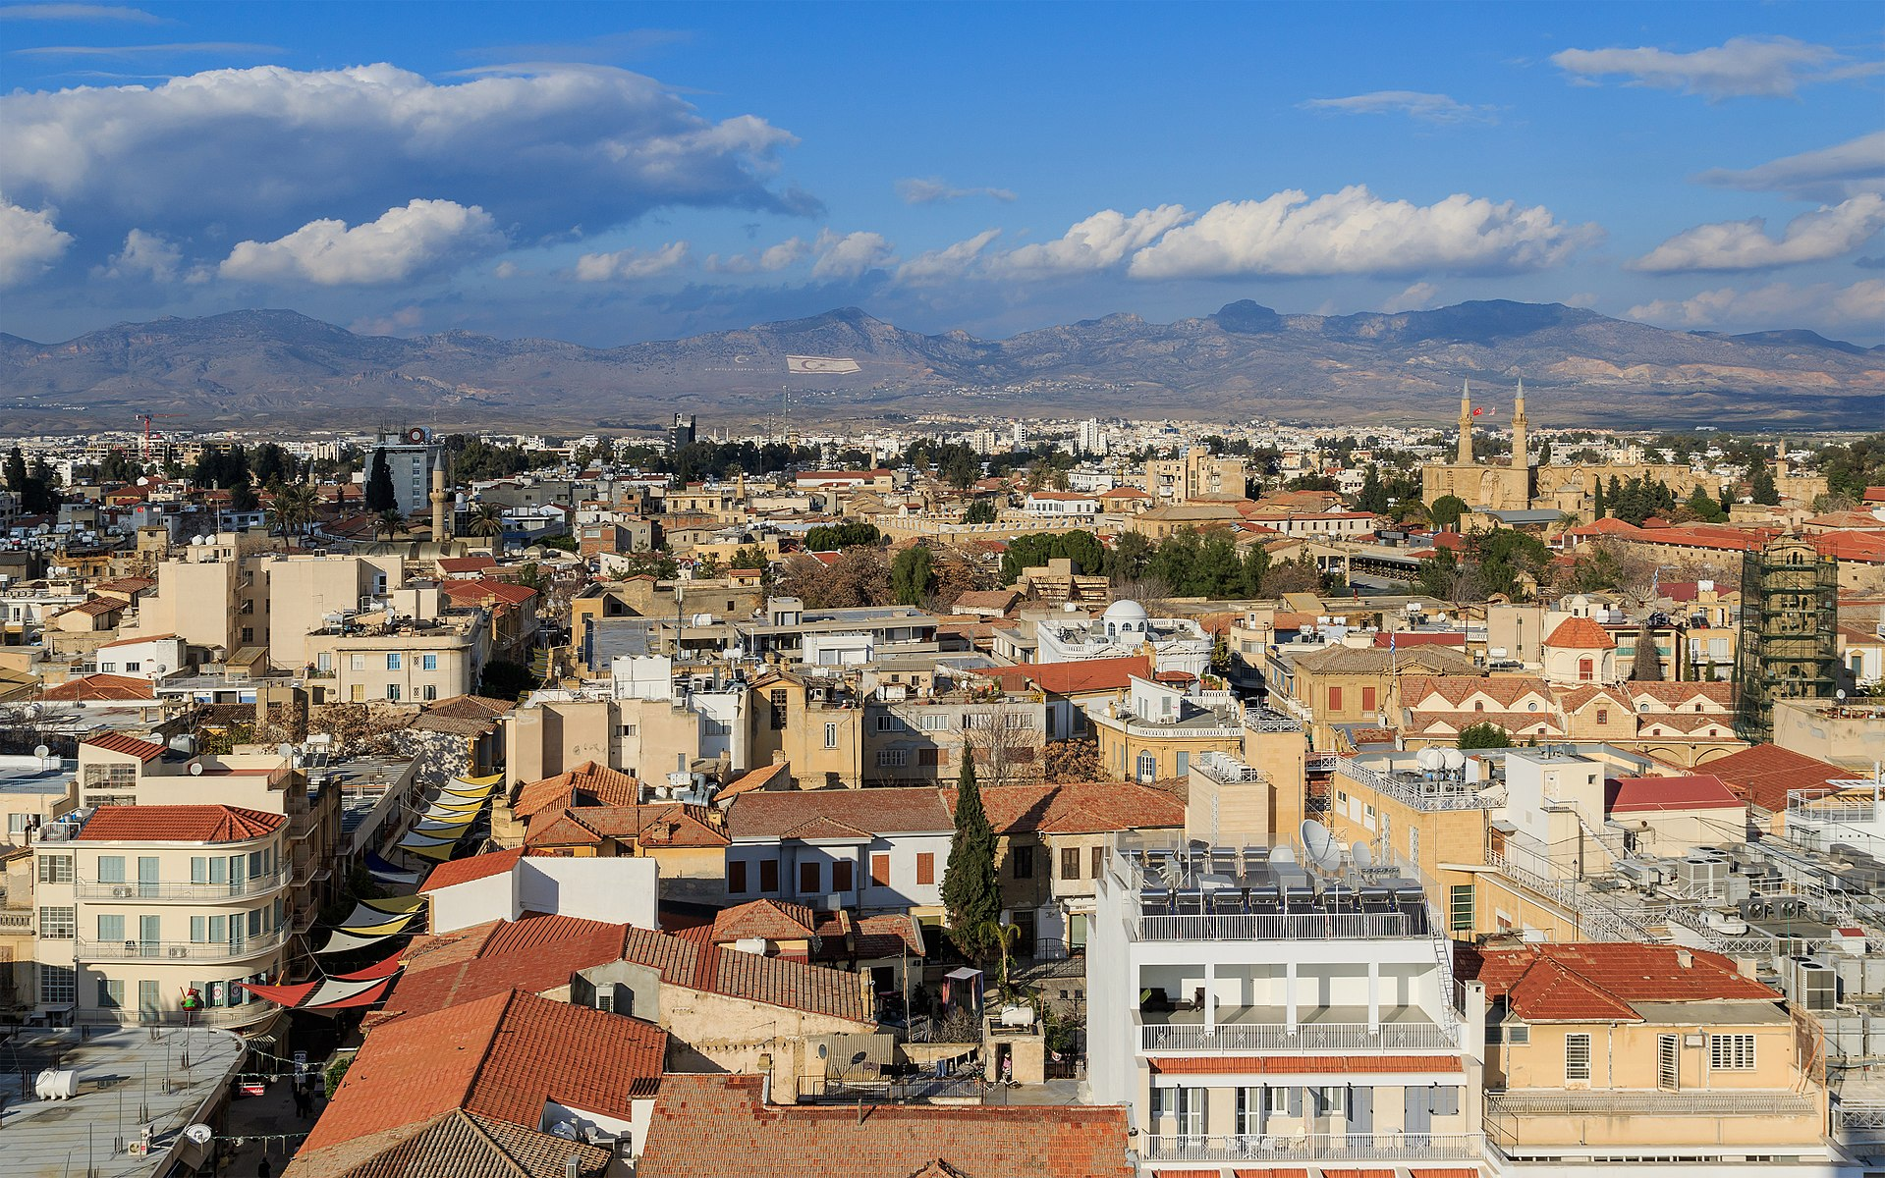
Term 6 lesson 3
Mi ciudad imaginaria
LO: designing an imaginary city

Slide 3
Un video: How to describe common places in town in Spanish
https://www.youtube.com/watch?v=O1uh3OOko2I
Watch the video and answer these questions;
Which new places in town did you hear?
What does ‘Cómo es…’ mean?
Write down at least 4 adjectives used in the video to describe towns.

Slide 4

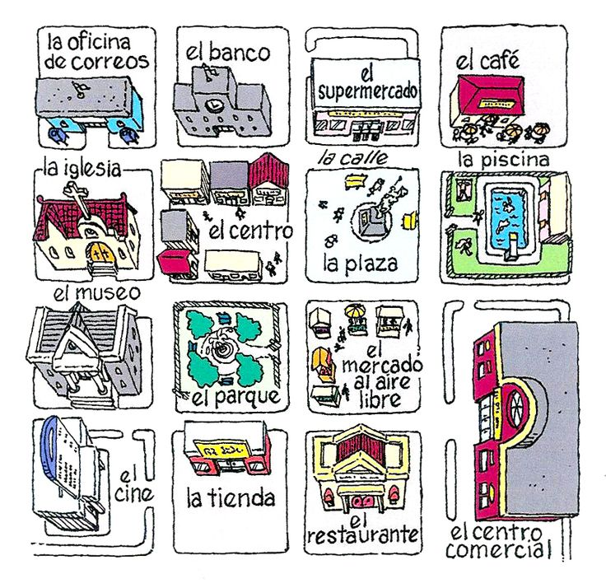
Design your own town.
You are going to design your own town. You will do it on a Powerpoint and label all the places in Spanish that will be in your city.
At least 10 places.
Add two places that we have not seen in class.
All places must be labelled in Spanish.
Make it creative and use different colours.
Use the vocabulary in Lessons 1 and 2
Use the examples on the next 3 slides to help
TOTAL: 20 marks
Extension: Write a few sentences about your city. Use the video link to help you (the descriptions start about half way through)

Slide 6
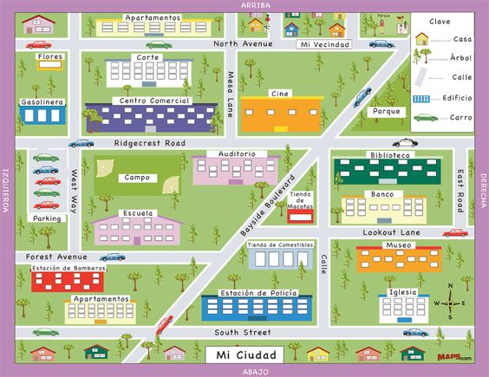

Slide 7
