Slide 1

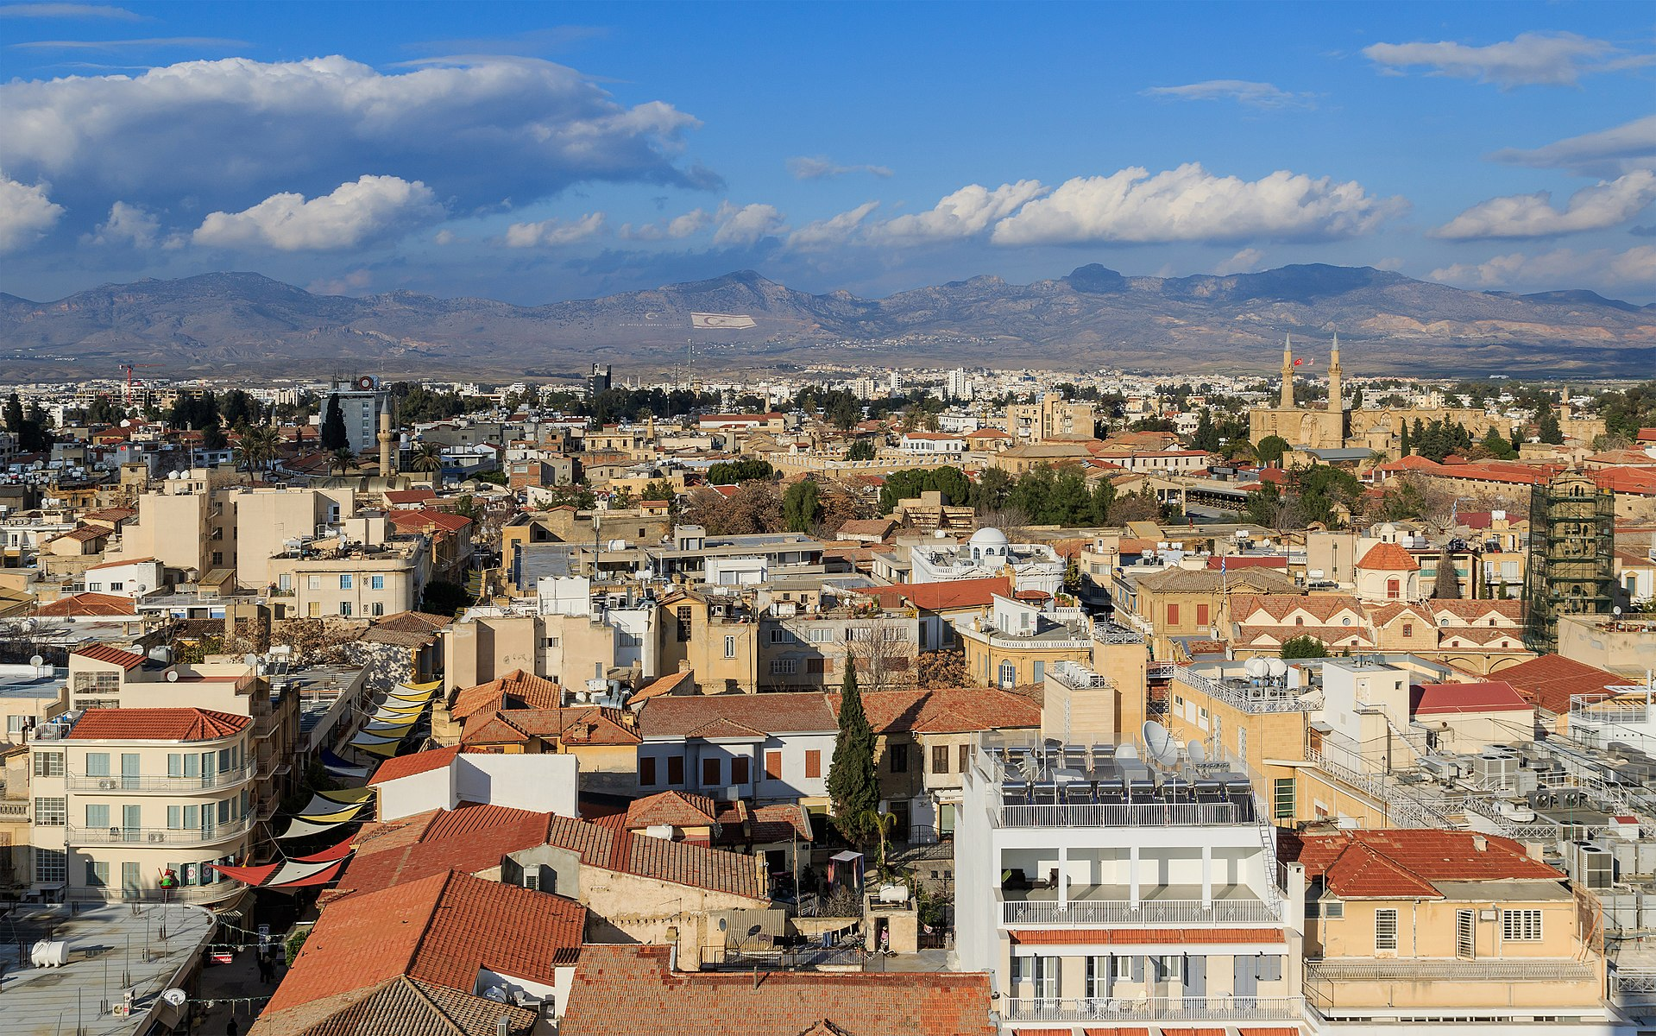
Term 6 lesson 2
De paseo por mi ciudad
LO: writing about places in town
/40

Slide 2
STARTER
Unjumble the places in town.
uan cblaotebii
aun aestción ed retn
nua natied ed proa
anu lapza de roots
uan giailes
nu oumse
nu satuenrtaue
aun imqauetz

Slide 3
Please answer these questions!
How did you learn these words?
What would you do differently next time?
Vocabulary test
Write these places in Spanish:
1. bank
2. park
3. school
4. shop
5. library
6. stadium
7. supermarket
8. restaurant
9. cinema
10. hotel
/10

Slide 4
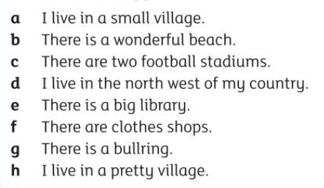
Leer Read about Gloria and Fernando describing where they live.
Decide if each of the sentences (a-h) relates to Gloria (G) or Fernando (F)
Gloria
Vivo en una aldea muy pequeña que se llama San Agustinillo, en el sur de México. Hay una biblioteca grande, dos hoteles, tres restaurantes y una playa maravillosa. Me gusta mi aldea porque es muy bonita y tranquila.
Fernando
Vivo en una ciudad grande y tropical que se llama Maracaibo, en el noroeste de Venezuela. En el centro hay cines, tiendas de ropa y dos estadios de fútbol. Además, tiene una plaza de toros bastante famosa.
a.
b.
c.
d.
e.
f.
g.
h.
/8

Slide 5
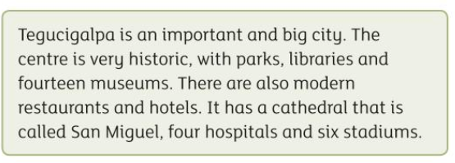
Traduce
Read this paragraph about Teucigalpa, the capital of Honduras.
Then translate it into Spanish
Helpful words!
Es = is
Hay = There is/are
Tiene = it has
También = also
con = with
y = and
que se llama = that is called
/12

Slide 6
Escribir
Write a short paragraph about your town or city
Use the keywords in the box to guide you.
Also use the texts on slide 4.
Remember to include an opinion and write in full sentences.
Vivo en = I live in
que se llama = that is called
en…. Hay = In….there is/are
no hay = there isn’t
en el centro = in the centre
Me gusta = I like
Me encanta = I love
porque = because
es = it is
Mi pueblo = my town
Mi ciudad = my city
/10

Slide 7
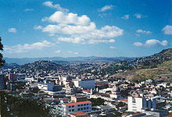

Extension
Find out some interesting facts about Tegucigalpa, the capital of Honduras.
Can you write some sentences in Spanish about it? (using your own words you have learnt in this lesson)

