Slide 1
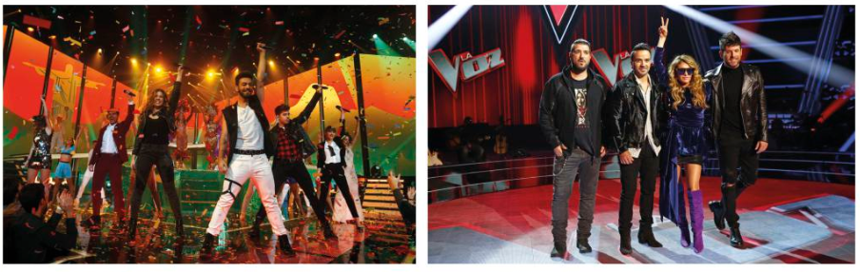
Term 5 Lesson 7
More music!
LO: to learn about Spanish music programmes and famous musicians

Slide 2
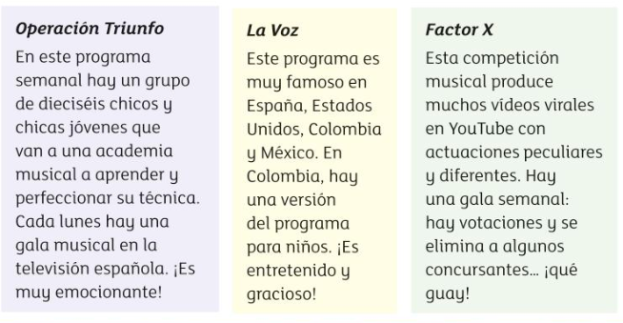
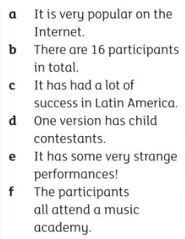
Leer Read about the most popular musical programmes in Spain and Latin America, then read the statements (a-f) and decide which programme they refer to
a.
b.
c.
d.
e.
f.

Slide 3

Leer Read about the Alfred and Amaia who both became famous when they appeared on Spanish TV in the reality music show ‘Operación Triunfo’.
Who won?
Who came 4th?
Where can you find out more about them?

Slide 4
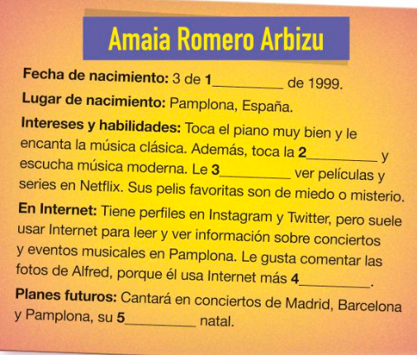
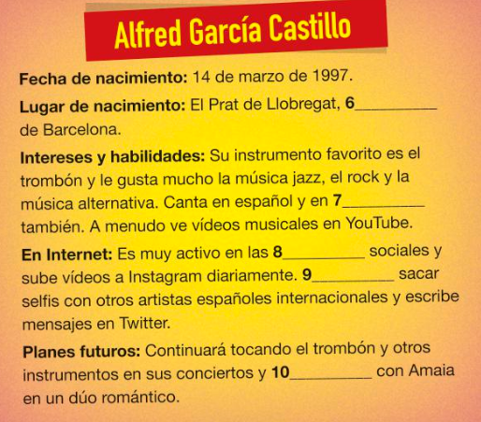
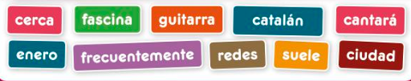
Leer Read the profiles about Alfred and Amaia and complete the texts with the correct words. Write the word in the blue box.
1.
2.
3.
4.
5.
6.
7.
8.
9.
10.

Slide 5
Escribir Write a profile about your favourite singer . Use the examples of Alfred and Amaia to help you.
Mention;
Fecha de Nacimiento (Date of birth):
Lugar de Nacimiento (Place of birth):
Intereses y habilidades (interests and skills):
Actividades en las redes sociales (activity on social media):
Planes para el futuro (future plans)
Success criteria
Content (10 marks)
Write about all 5 bullet points
Language (10 marks)
Correct spelling
Verbs in correct tense
Different adjectives
Relevant ‘music’ vocab
Similar layout and structure to the examples​
Language from today’s lesson
(Total 20 marks)​

Slide 7
Extension – Music during lockdown
Look at the following link about ten songs supporting the world during lockdown.
https://www.bbc.co.uk/news/entertainment-arts-52366162
Which do you like the best?
Watch the Spanish song (number 7) - how much can you understand?
Write a review about it (in Spanish or English)
Has music helped you during lockdown?

