Slide 1
Para empezar!
How many Spanish words and phrases can you remember from last lesson 'Where I live'?
Write down/say as many as you can without looking at your notes/the slides
Time limit = 2 minutes!

Slide 2
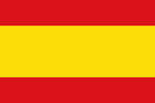
el 21 de abril
Where others live
LO: to understand written texts about where other people live

Slide 3
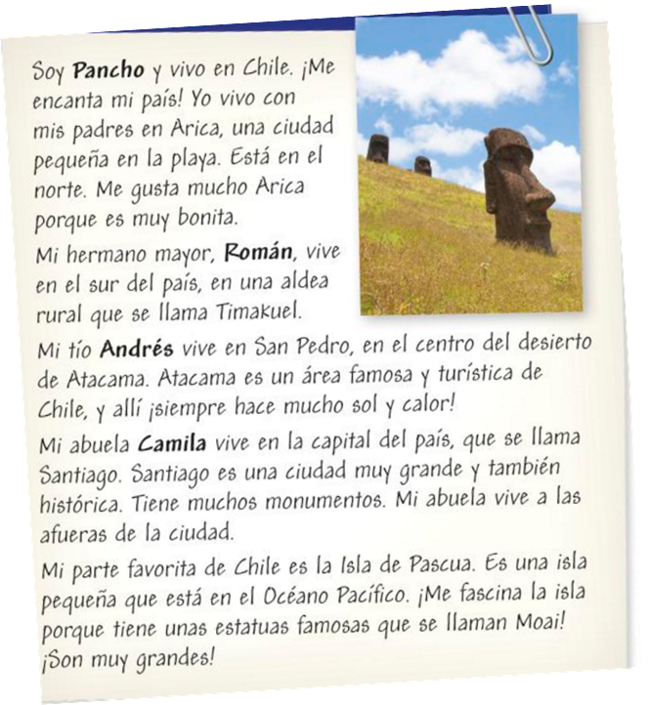
Leer – Section 1
Read the text about Pancho's family. Then answer these questions...
1. Which family members does he mention?
2. What are their names?
3. Which country do they live in?

Slide 4
Leer Answers!
Read the text about Pancho's family. Then answer these questions...
1. Which family members does he mention?
His older brother, uncle and grandma
2. What are their names?
Román, Andrés and Camila
3. Which country do they live in?
Chile

Slide 5
Leer – Section 2
Read the text again and decide who (Pancho, Román, Andrés or Camila)…......
a. lives in a very sunny and hot place.
b. lives in the capital of Chile
c. lives with their parents
d. lives in the south of the country
e. thinks where they live is pretty
f. is fascinated by an island

Slide 6
Leer Answers!
Read the text again and decide who (Pancho, Román, Andrés or Camila)…......
a. lives in a very sunny and hot place. Andrés
b. lives in the capital of Chile. Camila
c. lives with their parents. Pancho
d. lives in the south of the country. Román
e. thinks where they live is pretty. Pancho
f. is fascinated by an island. Pancho
c
e
d
a
b
f

Slide 7
Leer – Section 3
Read the text once more and find the Spanish for the following phrases
1. I live in
2. a small city
3. in the north
4. a rural village
5. a famous area
6. the capital of the country
7. the outskirts of the city
8. a small island

Slide 8
Leer Answers!
1. I live in vivo en
2. a small city una ciudad pequeña
3. in the north en el norte
4. a rural village una aldea rural
5. a famous area un área famosa
6. the capital of the country la capital del país
7. the outskirts of the city las afueras de la ciudad
8. a small island una isla pequeña

Slide 9
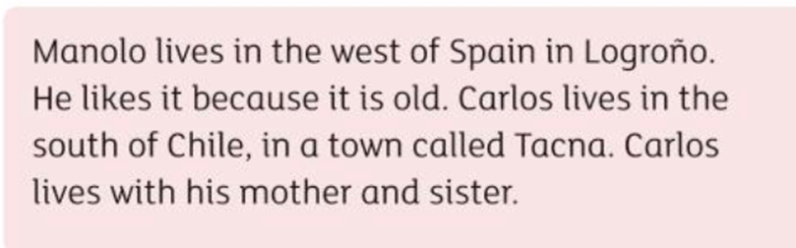
Spot the difference!
Read the two texts about Carlos and Manolo. Find the 4 differences between the English and Spanish texts.
Spanish text
English text
Manolo vive en el oeste de España en Logroño. Le gusta porque es grande. Carlos vive en el norte de Chile, en una aldea que se llama Tacna. Carlos vive con su padre y hermana.
1.
2.
3.
4.

Slide 10

Final challenge for today!
Complete the quiz 'Where I Live'
(Go to the Assignments section on Teams)
Send your points (out of 20)

