Slide 1

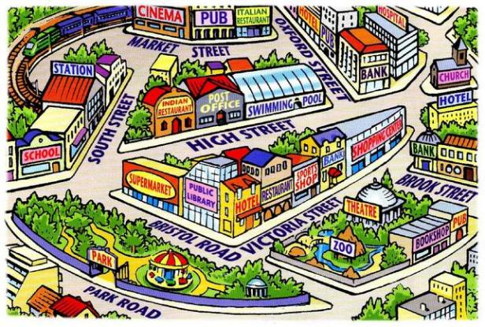

Term 6 lesson 5
En mi ciudad
LO: describing where I go in my town
/22

Slide 2
FEEDBACK
It is an important part of your learning
Take time to read my comments (WWW and EBI in the feedback box on Teams)
Look at my corrections on your work;
Orange – your mistakes
Red – my corrections
Complete your NTIW comments and return ( answer a question, do corrections, add more details/opinions etc.)

Slide 3
Empareja Match up the days of the week. Then copy them down
Monday
Tuesday
Wednesday
Thursday
Friday
Saturday
Sunday
lunes
sábado
martes
miércoles
viernes
domingo
jueves

Slide 4
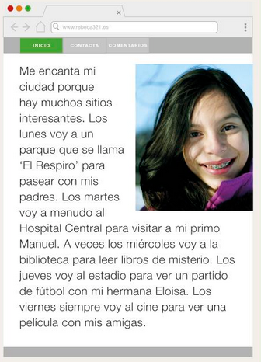
Leer Read this page from Rebecca’s blog, describing what she does from Monday to Friday. Complete the table in English
Day? | Where? | Why?
Monday | park | To go for a walk
/12

Slide 5
¿Cómo se dice…….? Find the following words and phrases in Rebecca’s blog
On Mondays
On Tuesdays
I go
Sometimes
often
Always
I go to the library
I go to the park
To watch a film
To visit my cousin
To watch a football match
There are lots of interesting places
I love my town
With my family
With my friends

Slide 6
¿Cómo se dice…….? Check your answers here
On Mondays
On Tuesdays
I go
Sometimes
often
Always
I go to the library
I go to the park
To watch a film
To visit my cousin
To watch a football match
There are lots of interesting places
I love my town
With my family
With my friends
Los lunes
Los martes
Voy
A veces
A menudo
Siempre
Voy a la biblioteca
Voy al parque
Para ver una película
Para visitar a mi primo
Para ver un partido de fútbol
Hay muchos sitios interesantes
Me encanta mi ciudad
Con mi familia
Con mis amigos

Slide 7
Where do you go in your town during the week and why?
Write a blog in Spanish mentioning the following details;
- at least five different places you go to
- three reasons why you go to these places
(using para + infinitive)
- at least one opinion
Escribir - Mi blog
/10
(Try to write your blog as if we weren’t in lockdown and having to stay at home!)

Slide 8
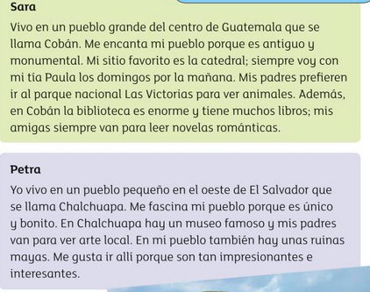
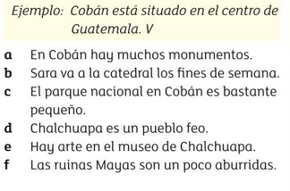
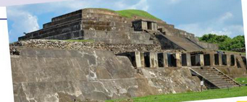
Extension
Read about the activities you can do in Sara and Petra’s towns.
Then write whether the sentences (a-f) are true (T), false (F), or not mentioned (NM)
a.
b.
c.
d.
e.
f.

