Slide 1


Term 6 lesson 6
Mis planes
LO: discussing plans for the weekend
forming the near future
/28

Slide 2
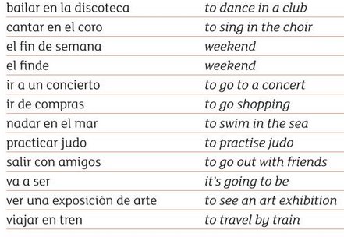
Vocabulario

Slide 3
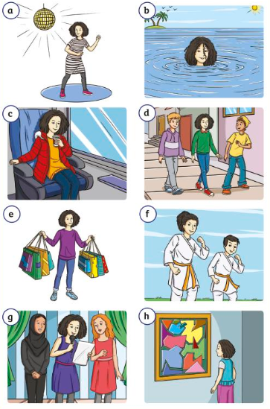
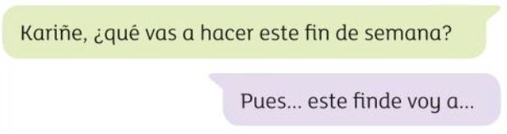
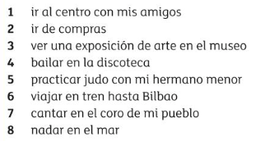
Empareja Read about Kariñe’s plans for the weekend.
Then match them up with the correct picture. Write the letter in the blue box
1.
2.
3.
4.
5.
6.
7.
8.
/8

Slide 4
The near future tense
By combining a form of the verb ir in the present tense with the preposition a and an infinitive you can say what you or others are going to do in the near future.
voy (I am going)
vas (you are going)
va (he/she is going)
vamos (we are going)
vais (you are going)
van (they are going)
a
Infinitive
eg.
comprar
jugar
ver…
Voy a visitar a mi primo = I am going to visit my cousin
Lola va a cantar = Lola is going to sing
Vamos a ver la tele = we are going to watch TV.

Slide 5
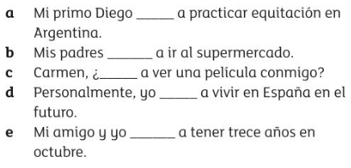
Escribir Complete the sentences with the correct form of the verb ‘ir’
Ejemplo: Yo voy a nadar en la piscina.
voy (I am going)
vas (you are going)
va (he/she is going)
vamos (we are going)
vais (you are going)
van (they are going)
a.
b.
c.
d.
e.
/5

Slide 6
Traduce Can you now translate the sentences on the previous slide into English?
a.
b.
c
d.
e.
f.
/5

Slide 7
Escribir Imagine: Lockdown is over! Life is returning to normal!
Write a paragraph in Spanish about your plans for next weekend.
Mention;
At least 5 activities
The days when you are going to do these activities
Your opinion on 3 of these activities
2 people who you will do them with
Ejemplo: El sábado voy a ir al parque con mi amigo Pepe. ¡Va a ser fantástico!

Slide 8
Mis planes para el finde
/10

Slide 9
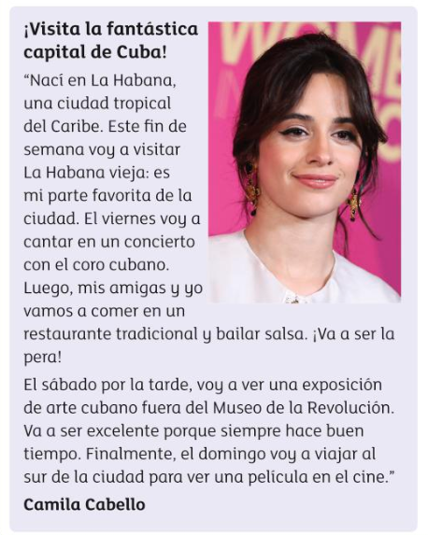
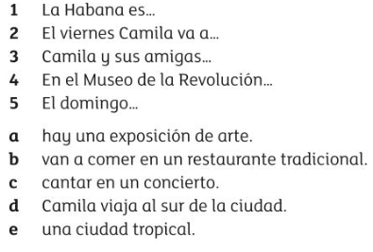
Extension Read the text about Camilla’s plans for the weekend in her home town of La Habana. Then match up the sentence halves

