Slide 1
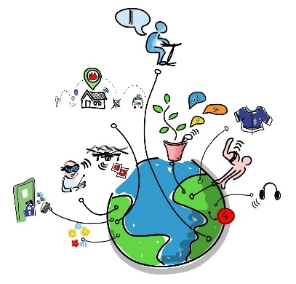
Assignment 3 – Technology
Escribir
Write a short blog in Spanish about how you use technology. This should be an easy topic to write about! Technology has been so important to keep us all connected at this difficult time
Mention;
How you use the Internet and your devices
How often you use it/them
Your favourite apps/platforms and why
Use the vocabulary on the next slide and the texts you have read in this lesson
Write your blog on the last slide and send to me

Slide 2
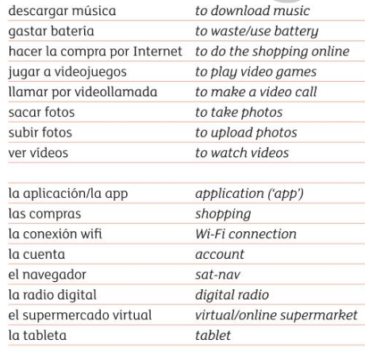
Vocabulario
Uso Internet = I use the Internet
Descargo música = I download music
Hago la compra por Internet = I do Internet shopping
Veo vídeos en YouTube = I watch YouTube videos
Juego a videojuegos por Internet = I play online games
Subo fotos a Facebook/Snapchat = I upload photos on…
Mi aplicación es = my favourite app is…..
Siempre = always
Todos los días = every day
A veces = sometimes
De vez en cuando = from time to time
Por la tarde = in the evening
Los fines de semana = at the weekend
Nunca = never
(En mi casa) nadie = (In my house) no-one
Ya no = I don’t ….anymore

Slide 3
Assignment 3

