Slide 1

Term 6 Lesson 4
LO: to learn from feedback
to find out about shops in Spain
( /25)

Slide 2
FEEDBACK
It is an important part of your learning
Take time to read my comments (WWW and EBI in the feedback box on Teams)
Look at my corrections on your work;
Orange – your mistakes
Red – my corrections
Complete your NTIW comments and return ( answer a question, do corrections, add more details/opinions etc.)

Slide 3
QUIZ!
1. Does the colour go before or after the item of clothing? (1)
2. What is the difference between un and el? (2)
3. Name the 4 definite articles. (4)
4. Name the 4 indefinite articles. (4)
5. What do the words singular and plural mean? (2)
6. How do you make a noun plural? (1)
7. What does gender mean? (1)
8. What does ‘make the adjective agree with the noun’ mean? (2)
/17

Slide 4
QUIZ!
Does the colour go before or after the item of clothing?
After eg. Un vestido negro
2. What is the difference between un and el?
Un = a El = the
3. Name the 4 definite articles.
El la los las (they all mean ‘the’)
4. Name the 4 indefinite articles.
Un (a) una (a) unos (some) unas (some)
5. What do the words singular and plural mean?
Singular means one. Plural means more than one
6. How do you make a noun plural?
Put an ‘s’ on the end (eg. Un chico = a boy unos chicos – some boys)
7. What does gender mean?
A word is either masculine or feminine
8. What does ‘make the adjective agree with the noun’ mean?
The adjective changes depending on the gender of the noun and if it is singular or plural
un jersey rojo (m sing)
una chaqueta amarilla (f sing)
unos vaqueros negros (m pl)
unas faldas blancas (f pl)

Slide 5
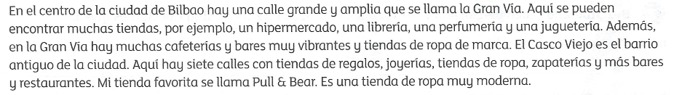
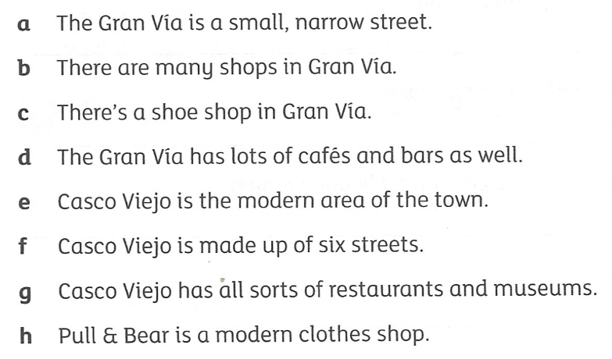
Leer Read the description of the shops in Bilbao and then decide if the statements are true (T), false (F) or not mentioned (NM)
a.
b.
c.
d.
e.
f.
g.
h.
/8

Slide 6
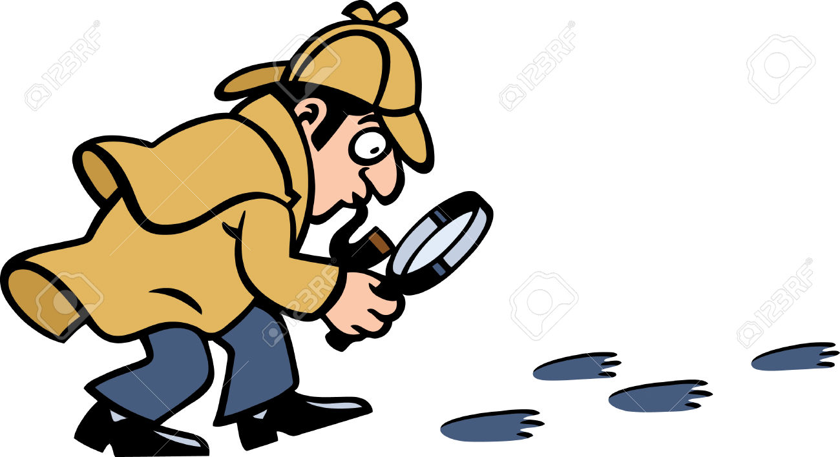
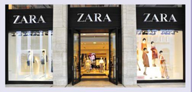
Shopping scavenger hunt en España!
Find the names of five clothes shops in Bilbao.
What is ‘El Corte Inglés’?
In which year was the shop Zara created?
Who founded the shop Zara?
What is special about the Maremagnum shopping area in Barcelona?
Find 5 shops that you can find in both England and Spain.
In which Spanish city is the ‘Las Arenas’ shopping centre?
What do the shops Mercadona, SuperCor, and Eroski have in common?
Which shop is located at the following address? Calle Gran Vía 31, 28013, Madrid , Spain
Name 5 things you could buy at ‘La Mallorquina’ in Madrid.
Just for fun!
How many of these clues can you find?

