Slide 1
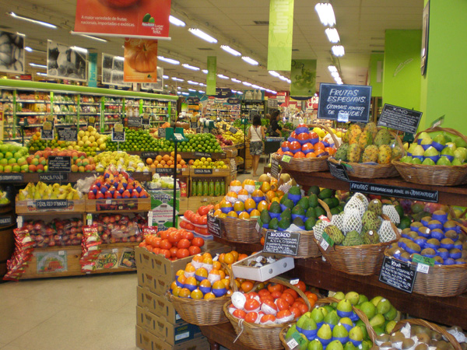
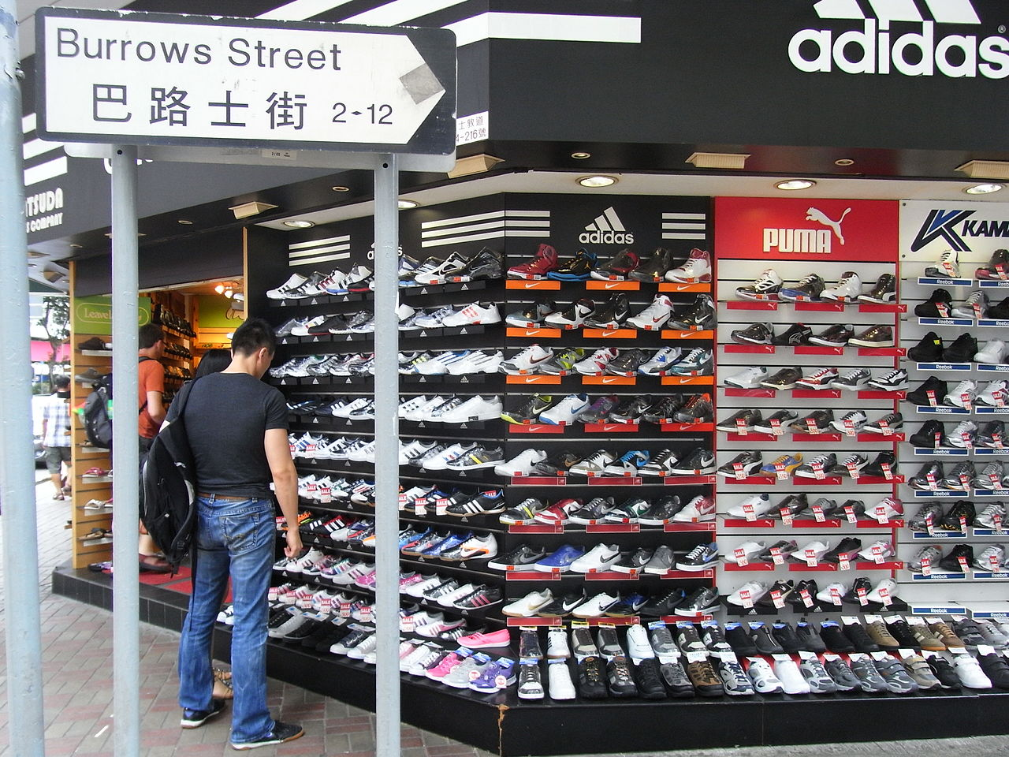
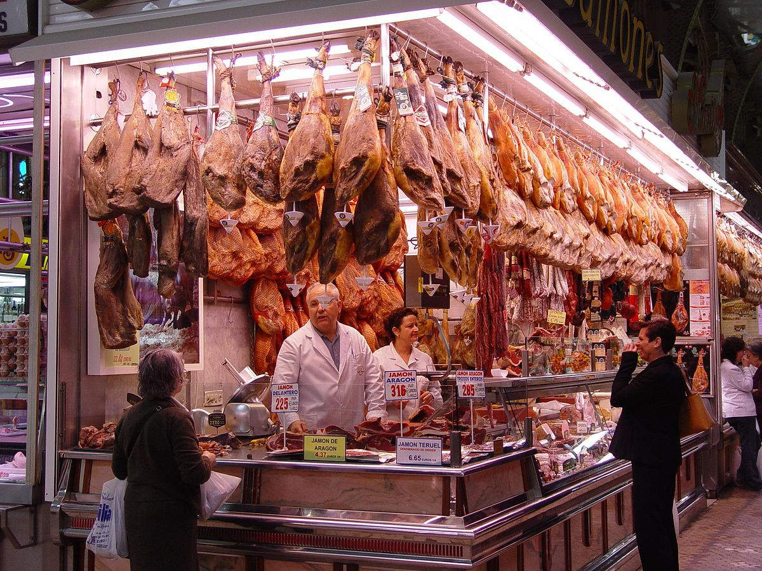
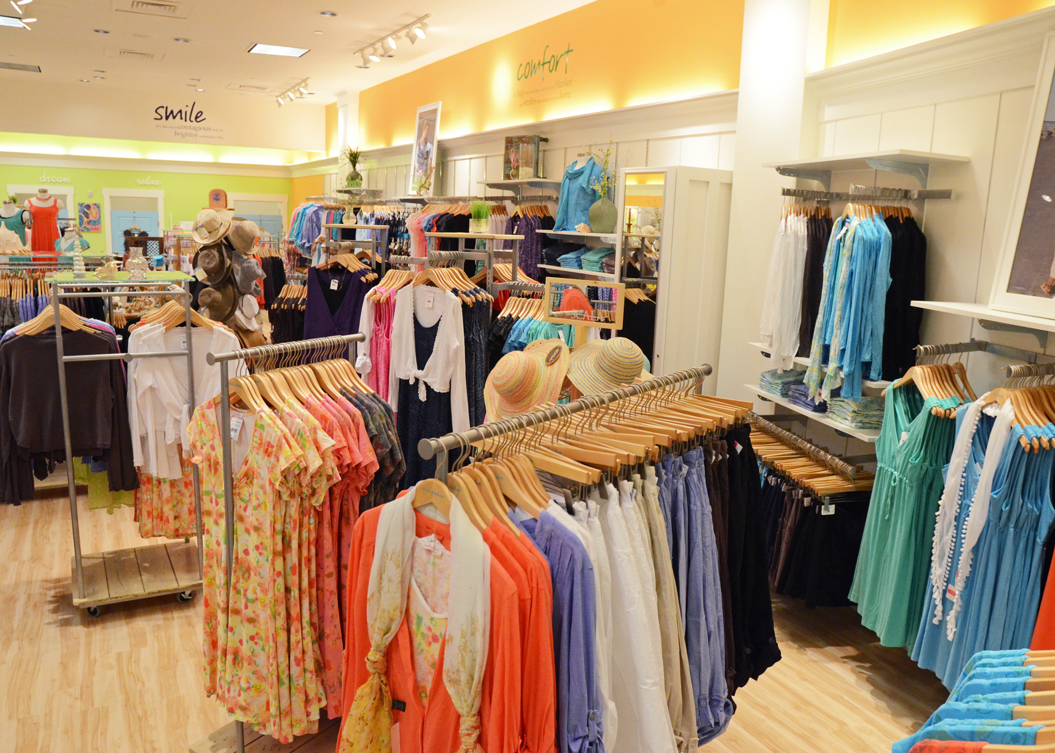
STARTER!
How many shops can you name in Spanish?

Slide 2

Term 6 Lesson 5
LO: to learn about shops in Madrid and Seville
to develop reading and writing skills
( /25)

Slide 3
In this lesson you are going to read two texts about shopping in Spain.
Task 1 - The first text is about Madrid – there is one text but 3 different sets of question. Complete the slide for your group
Group 1 – slide 4
Group 2 – slide 5
Group 3 – slide 6
Task 2 - The second text on slide 7 is about Seville – everyone completes the same questions
Task 3 – Follow the instructions on the slide

Slide 4
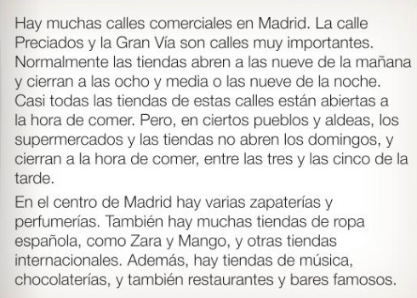
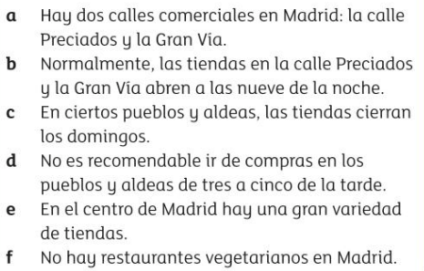
Group 1
Leer– Lee el folleto sobre una zona commercial en Madrid.
Decide si las frases son verdaderas (V), falsas (F) or no mencionadas (NM)
a.
b.
c.
d.
e.
f.
/6

Slide 5
Group 2
Leer– Read the leaflet about a shopping area in Madrid.
Decide if the statements are true (T), false (F) or not mentioned (NM)
There are two shopping streets in Madrid; Calle Preciados and La Gran Vía
b. Normally, shops in Calle Preciados and Gran Via open at 9 o’clock at night
c. Shops close on Sundays in some towns and villages
d. It isn’t advisable to go shopping in some towns between three and five o’clock.
e. In the centre of Madrid there a good selection of shops.
f. There are no vegetarian restaurants in Mdrid
a.
b.
c.
d.
e.
f.
/6

Slide 6
Group 3
Leer– Read the leaflet about shopping in Madrid, then write down 6 types of shop you could go to (eg. Sports shop…)
a.
b.
c.
d.
e.
f.
/6

Slide 7
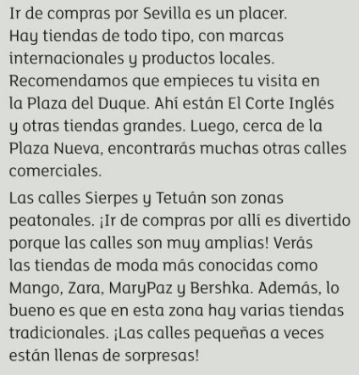
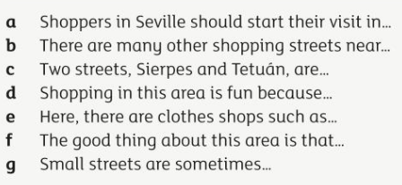
Leer – all groups!
Read the text about shopping in Seville and answer the questions
a.
b.
c.
d.
e.
f.
g.
/7

Slide 8
Traduce
Translate these sentences into Spanish
There are lots of shops in Windsor.
I like going shopping.
There are also lots of clothes shops.
Going shopping in London is a pleasure!
Shops normally open at nine in the morning.
/10

Slide 9
Extension
Write a paragraph in Spanish about a shopping area (in Spain, England or one near you)
Include types and names of shops, opening times, names of roads and your opinions.
Adapt the 2 texts about Madrid and Seville using the vocab and phrases already there

