Slide 1

Term 5 Lesson 3
Technology
LO: to discuss the Internet and Social Media
to form negative expressions

Slide 2
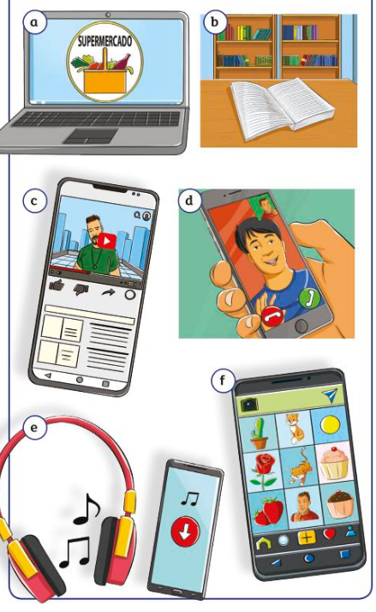
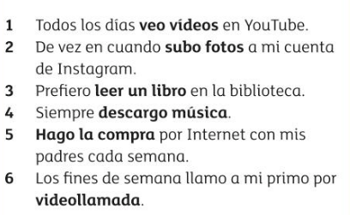
Empareja
Match the sentences with the pictures

Slide 3
Traduce
Translate the sentences into English

Slide 4
Leer Read the statements about how these students use the Internet. Then copy and complete the table in English
a
Los fines de semana prefiero leer un libro en la biblioteca de mi pueblo. La tecnología no me interesa nada.
b
A veces llamo a mis tíos por vídeollamada. ¡Nadie usa el teléfono tradicional actualmente!
c
Los lunes, hago la compra en Internet con mi madre. ¡Nunca compramos nada en las tiendas!
d
Todos los días cuando termino mis deberes, subo mis fotos y selfis a mi cuenta de Instagram.
e
Cada mes descargo música de Internet. ¡Ya no hay tiendas de música en mi pueblo!
f
Siempre veo vídeos en YouTube. No veo la tele y tampoco compro DVDs.
 | Frequency | Activity
Example a | weekends | Read a book in library
b
c
d
e
f

Slide 5
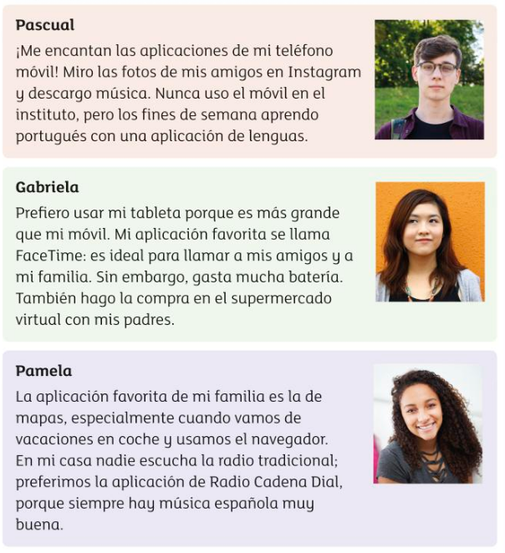
Leer Read the texts and answer the questions in English
Who……..
does shopping on the Internet?
Doesn’t use a phone at school?
Learns a language on Saturdays and Sundays?
Uses their phone to find addresses
Has problems with the battery on their tablet?
Listens to digital radio?

Slide 6

Assignment 3 – Technology
Escribir
Write a short blog in Spanish about how you use technology. This should be an easy topic to write about! Technology has been so important to keep us all connected at this difficult time
Mention;
How you use the Internet and your devices
How often you use it/them
Your favourite apps/platforms and why
Use the vocabulary on the next slide and the texts you have read in this lesson
Write your blog on the last slide and send to me

Slide 7
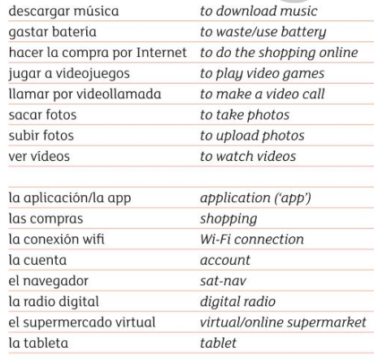
Vocabulario
Uso Internet = I use the Internet
Descargo música = I download music
Hago la compra por Internet = I do Internet shopping
Veo vídeos en YouTube = I watch YouTube videos
Juego a videojuegos por Internet = I play online games
Subo fotos a Facebook/Snapchat = I upload photos on…
Mi aplicación es = my favourite app is…..
Siempre = always
Todos los días = every day
A veces = sometimes
De vez en cuando = from time to time
Por la tarde = in the evening
Los fines de semana = at the weekend
Nunca = never
(En mi casa) nadie = (In my house) no-one
Ya no = I don’t ….anymore

Slide 8
Assignment 3

