Slide 1
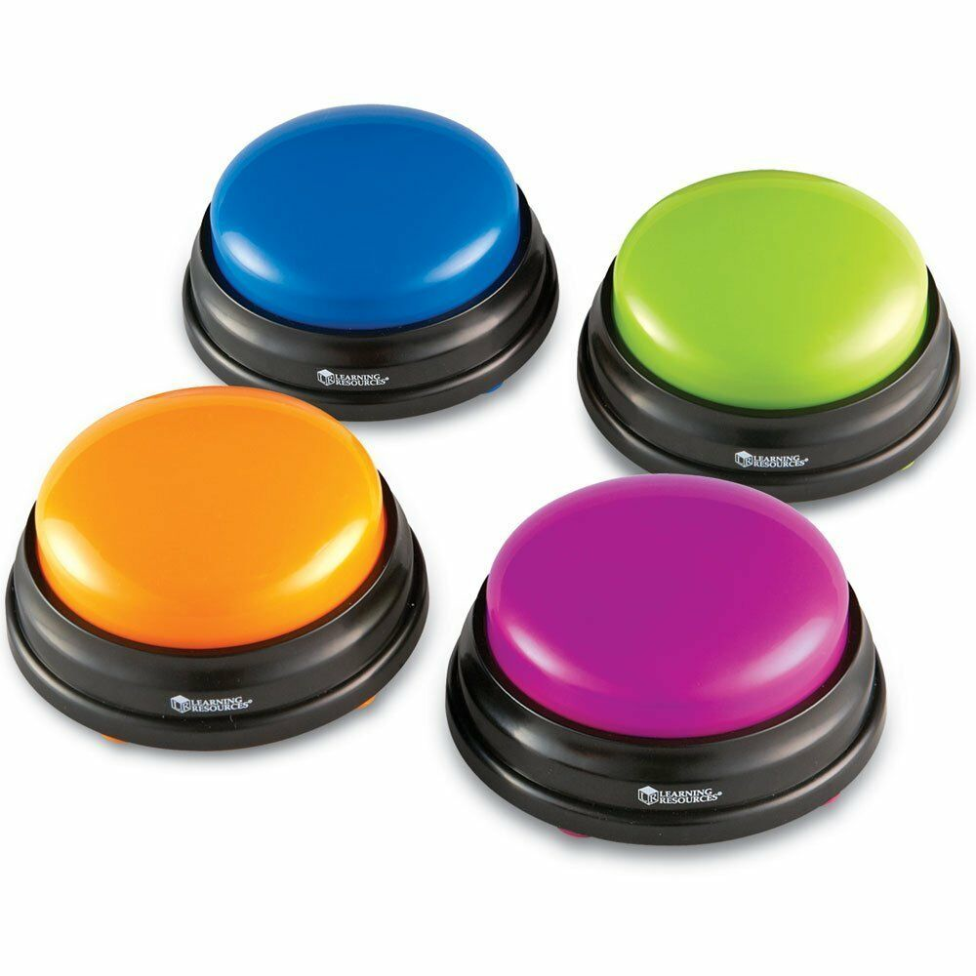

Drama Quiz
L.O. to consolidate and assess our knowledge.

Slide 2

First, select a category
Styles/genre
Roles and responsibilities
Drama skills and devices
Staging

Slide 3
Style/genre
Now, select a question.
1 2 3 4 5 6 7 8 9 10

Slide 4
Style/genre (1)
Which of these is not a style of theatre:
Melodrama
Slapstick
Greek
Spanish
Notes:
Spanish

Slide 5
Style/genre (2)
Which of these is not a feature of pantomime.
The good always wins.
Use of dramatic irony and aside
Use of music and dance
Naturalistic costumes
Notes:
4 – overexaggerated use of costumes

Slide 6
Style/genre (3)
Which of these is not a style of theatre:
Naturalistic
Brechtian
Commedia del arte
Non-musical theatre
Notes:
Non – musical theatre

Slide 7
Style/genre (4)
Which of these is not a feature of Brechtian (abstract theatre).
Use of multi-role
Use of big, elaborate props.
Use of choreography and music.
Use of minimalistic costume.
Notes:
2 – minimalistic props

Slide 8
Style/genre (5)
Which of these is not a feature of Naturalistic theatre.
Realistic and naturalistic costume and setting.
Realistic, relatable characters.
Use of narrator.
Notes:
3 – narrator is Brechtian

Slide 9
Style/genre (6)
Commedia dell'arte was an early form of professional theatre, originating from _____, that was popular in Europe from the 16th to the 18th century.
Fill in the missing word!
Notes:
Italy

Slide 10
Style/genre (7)
Pantomime is a type of musical comedy stage production designed for family entertainment. It was developed in _____and is performed throughout the _______ Ireland and in other English-speaking countries, especially during the Christmas and New Year season.
Fill in the missing word!
Notes:
England/UK

Slide 11
Style/genre (8)
_______ is a style of humour involving exaggerated physical activity which exceeds the boundaries of normal physical comedy. The term arises from a device developed during the broad, physical comedy style known as Commedia dell'arte.
Fill in the missing word.
Notes:
Slapstick

Slide 12
Style/genre (9)
Stanislavski is the practitioner responsible for creating naturalism. He believes many things, one being that actors need to express real emotion. To do this, he believes that actors should use their emotional memory.
What do you think emotional memory is?
Notes:
Using your memories to recall emotion felt and then using this memory to recall this emotion and express this on stage.

Slide 13
Style/genre (10)
Which of these is false.
Greek theatre often using a chorus.
Men and women performed in Greek theatre.
Play were often spoken or sung in rhyme.
Greek theatres were built on hillsides in the open air and could often hold more than 18,000 spectators.
Notes:
2 – only men performed.

Slide 14
Roles and responsibilities
Now, select a question.
1 2 3 4 5 6 7 8 9 10

Slide 15
Roles and responsibilities (1)
What is the role of a marketing manager?
Notes:
To market/advertise the show.

Slide 16
Roles and responsibilities (2)
Summarise the role of the sound designer.
Notes:
Sound design is the art and practice of creating sound tracks for a variety of needs. It involves specifying, acquiring or creating auditory elements using audio production techniques and tools

Slide 17
Roles and responsibilities (3)
Fill in the missing word.
The Costume Designer will possess the ability to create and build costumes that helps set the mood for the actors’ performances and conveys a message to the audience as a visual aid. The Costume Designer confers with the ____ regarding interpretation and costume requirements.
Notes:
Director

Slide 18
Roles and responsibilities (4)
What is the role of a Flymen and/or Mechanist?
Notes:
Flymen operate the flying system in venues with this equipment. This may be a counterweight or power-flying system which relieves a significant amount of strain on the technician, but historically, flying systems were operated by teams of men using ropes made of hemp.

Slide 19
Roles and responsibilities (5)
Summarise the role of a development manager.
Notes:
Not all of a theatre’s income will come from ticket sales. Many rely on grants, donations, sponsorship and membership schemes. The development manager creates fundraising strategies, writes grant applications, seeks sponsorship and looks for commercial partnerships.

Slide 20
Roles and responsibilities (6)
Summarise the role of a choreographer
Notes:
To choregraph/create movement.

Slide 21
Roles and responsibilities (7)
List three skills/qualities required to be a director.
Notes:
creativity and the ability to express yourself both orally and in writing
persuasiveness and a willingness to take artistic risks
excellent negotiation and interpersonal skills
self-motivation and the ability to motivate and inspire others
the ability to work as part of a team and time management skills
an awareness and understanding of technical issues, the workings of a theatre and the process of performance and acting
the ability to develop innovative ideas and to solve problems creatively and practically
organisational and research skills
knowledge of relevant health and safety legislation and procedures
dedication and enthusiasm.

Slide 22
Roles and responsibilities (8)
List three skills/qualities required to be a costume designer.
Notes:
the ability to work well with others
sensitivity and understanding
the ability to accept criticism and work well under pressure
the ability to come up with new ways of doing things
to be thorough and pay attention to detail
knowledge of the fine arts
excellent verbal communication skills
design skills and knowledge
being able to use a computer terminal or hand-held device may be beneficial for this job.

Slide 23
Roles and responsibilities (9)
List three of the responsibilities required of an actor.
Notes:
job seek and network
liaise with an agent
prepare for and attend auditions
learn lines and rehearse
research or undertake activities to help prepare for a part
discuss interpretation and delivery with other members of the company and the director
perform for a live audience
perform in a studio or 'on location' for film, television, internet and radio broadcast
do voice-overs for advertisements or record audiobooks
manage the performance area, costumes and props
undertake activities associated with touring, such as driving a van, 'get-ins' and 'get-outs' at theatres (i.e. setting up and dismantling the performance area)
liaise with venue managers and accommodation providers
keep records for company managers
work as a walk-on or extra for television or film.

Slide 24
Roles and responsibilities (10)
List three of the responsibilities required of a stage manager.
Notes:
set up and run rehearsal schedules
procure all props, furniture and set dressings, and in small companies, assist in set construction
arrange costume and wig fittings
distribute information to other theatre departments
manage the props and possibly the design budgets and liaise with the production manager regarding costs
supervise the 'get in' to the theatre, when the set, lighting and sound are installed, and the 'get out', when all the equipment is removed
compile and operate prompt copy - also known as the 'prompt script' or 'the book', which notes actors' moves and cues, and the requirements for props, lighting and sound
make alterations to the set between scene changes, prompt actors and cue technicians
ensure the company's welfare and maintain a good working knowledge of all relevant health and safety legislation and good working practice
run the backstage and onstage areas during performances
liaise with the director, stage personnel and other technical departments, e.g. costume, lighting, sound
call actors for rehearsals and performances
during a long run, maintain and replace props and costumes as required
liaise with resident staff at other performance venues (if touring).

Slide 25
Drama skills and devices
Now, select a question.
1 2 3 4 5 6 7 8 9 10

Slide 26
Drama skills and devices (1)
Name three vocal skills.
Notes:
clarity and articulation
Projection
breath control
remembering line
pitch, inflection and modulation
tone and vocal colour, phrasing,
pace, use of pause
tuning, rhythm, timing,
following an accompaniment communicating the meaning of a song
learning songs
projection and placing of the voice
interpreting lyrics
phrasing, musicality characterisation
expression

Slide 27
Drama skills and devices (2)
Name three physical skills.
Notes:
Actions
alignment
Accuracy
balance
coordination
Characterisation
communication,
energy, expression,
facial expression,
focus and control
gesture

Slide 28
Drama skills and devices (3)
Name three performance skills.
Notes:
awareness of the performance space and audience
interaction with and response to other performers
focus, energy and commitment
handling and use of props, set, costume, makeup and masks, emphasis
Projection
use of space
awareness and appreciation of sound accompaniment
Musicality
facial expression
tuning, rhythm and timing
stage presence and energy.

Slide 29
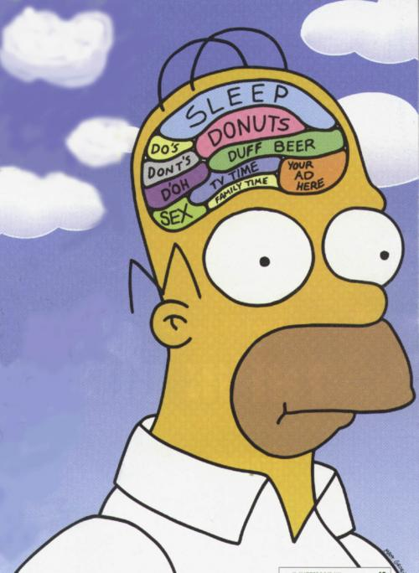
Drama skills and devices (4)
Identify the drama device. For an extra mark, can you describe it too?
Notes:
Thought in the head.

Slide 30
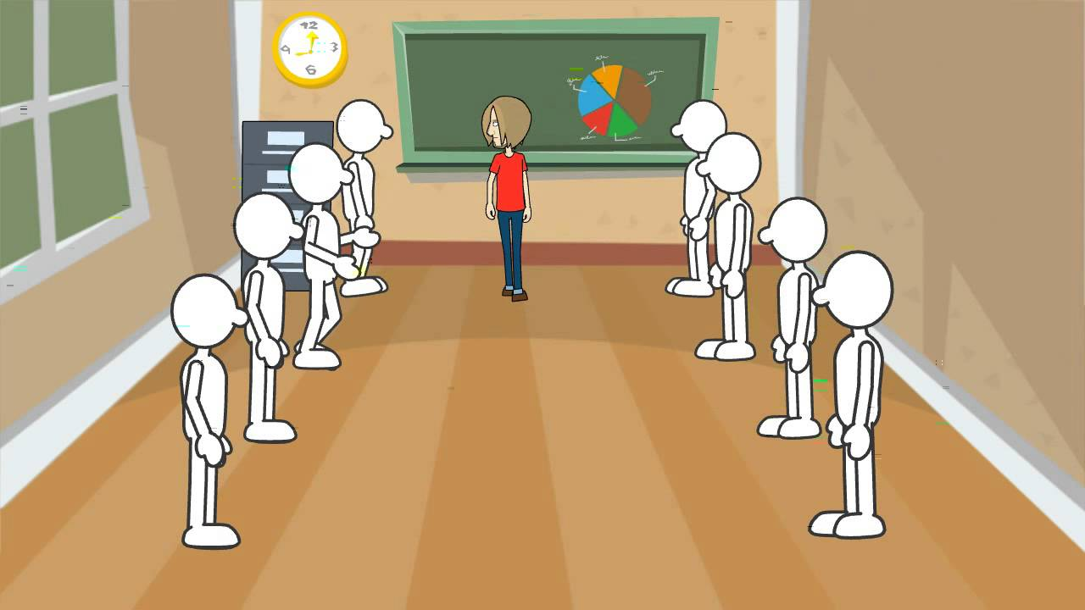
Drama skills and devices (5)
Identify the drama device. For an extra mark, can you describe it too?
Notes:
Conscious alley

Slide 31

Drama skills and devices (6)
Identify the drama device. For an extra mark, can you describe it too?
Notes:
Flashback/flashforward

Slide 32
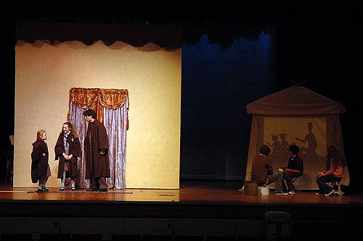
Drama skills and devices (7)
Identify the drama device. For an extra mark, can you describe it too?
Notes:
Split stage/screen

Slide 33
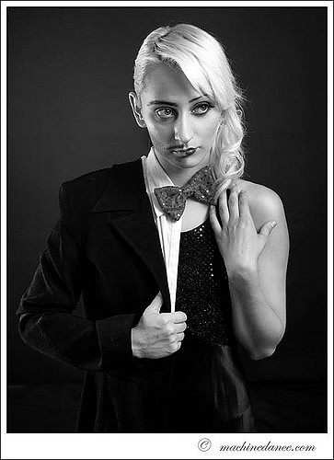
Drama skills and devices (8)
Identify the drama device. For an extra mark, can you describe it too?
Notes:
Multi-role

Slide 34
Drama skills and devices (9)
Fill in the missing word.
_____________ is the act of describing or creation of a character in a story or drama. An example of __________ is development of the characteristics and mannerism.
Notes:
Characterisation

Slide 35
Drama skills and devices (10)
Fill in the missing word.
The ______means the distances between character/actors in a play. It shows their relationships and feelings.
Notes:
proxemics

Slide 36
Staging
Now, select a question.
1 2 3 4 5 6 7 8 9 10

Slide 37
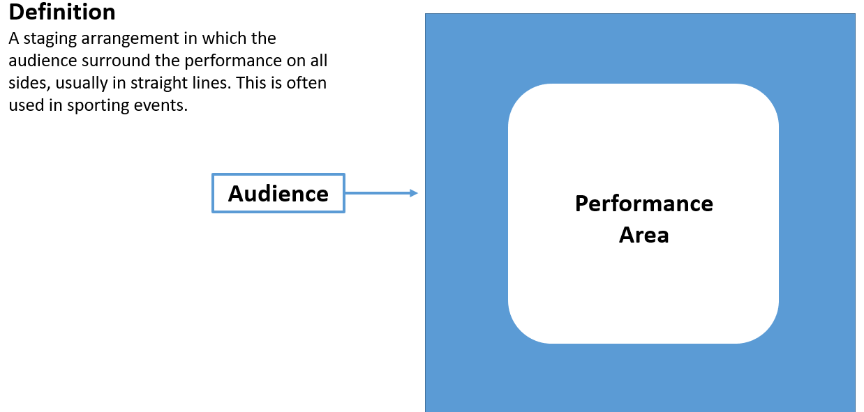
Staging (1)
Identify the type of stage.
Notes:
Arena Stage

Slide 38
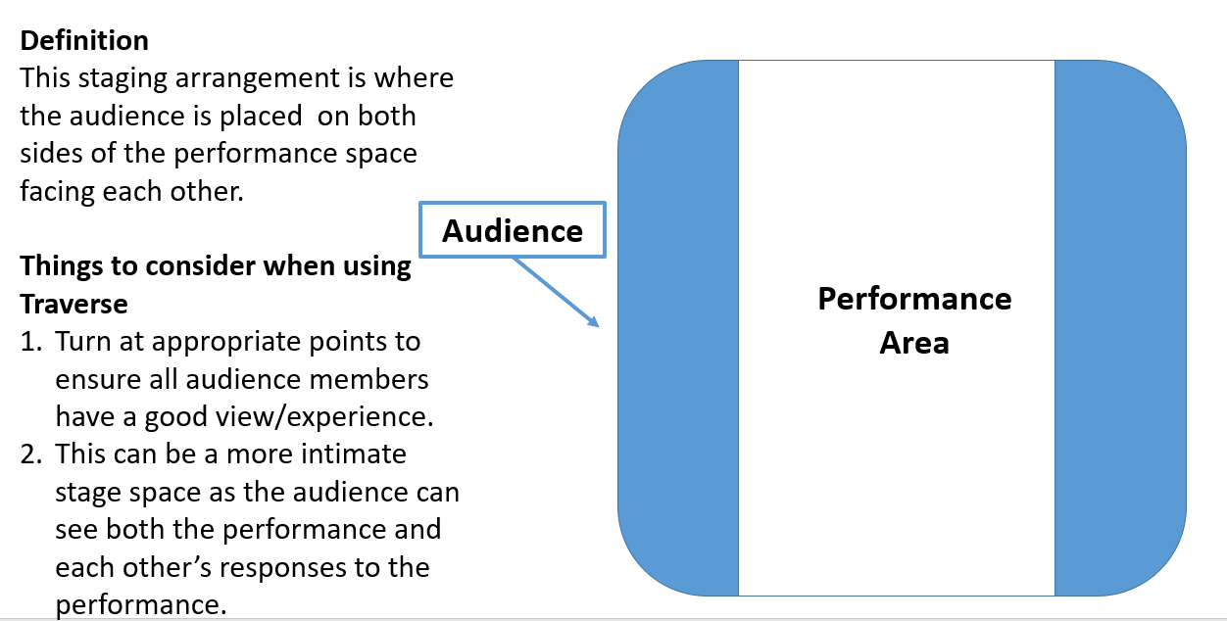
Staging (2)
Identify the type of stage.
Notes:
Traverse

Slide 39
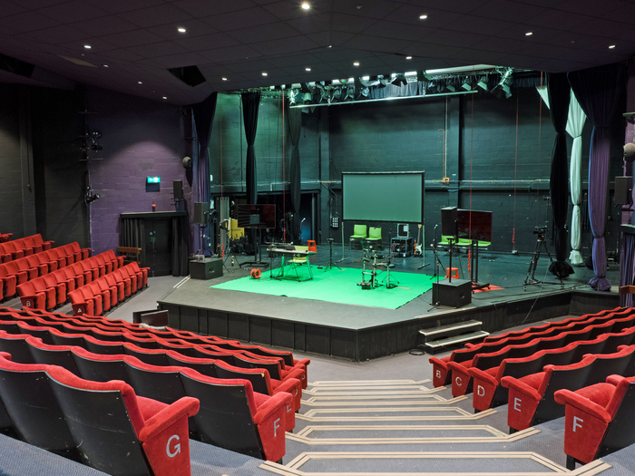
Staging (3)
Identify the type of stage.
Notes:
Thrust

Slide 40
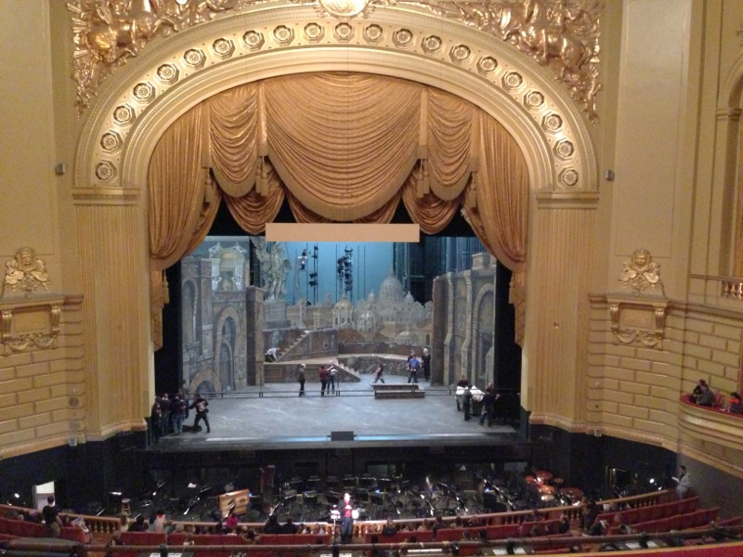
Staging (4)
Identify the type of stage.
Notes:
End on (Proscenium arch)

Slide 41
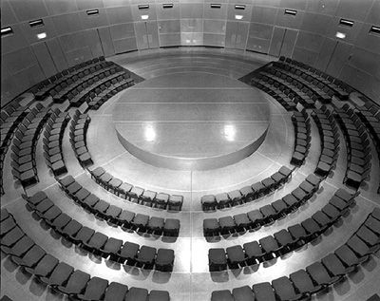
Staging (5)
Identify the type of stage.
Notes:
Theatre in the round.

Slide 42
Staging (6)
Identify downstage centre.
1 | 2 | 3 | 4 | 5
6 | 7 | 8 | 9 | 10
11 | 12 | 13 | 14 | 15
Audience
Notes:
13.

Slide 43
Staging (7)
Identify upstage, left centre.
1 | 2 | 3 | 4 | 5
6 | 7 | 8 | 9 | 10
11 | 12 | 13 | 14 | 15
Audience
Notes:
4

Slide 44
Staging (8)
Identify centre stage, right.
1 | 2 | 3 | 4 | 5
6 | 7 | 8 | 9 | 10
11 | 12 | 13 | 14 | 15
Audience
Notes:
6

Slide 45
Staging (9)
Identify downstage left.
1 | 2 | 3 | 4 | 5
6 | 7 | 8 | 9 | 10
11 | 12 | 13 | 14 | 15
Audience
Notes:
15

Slide 46
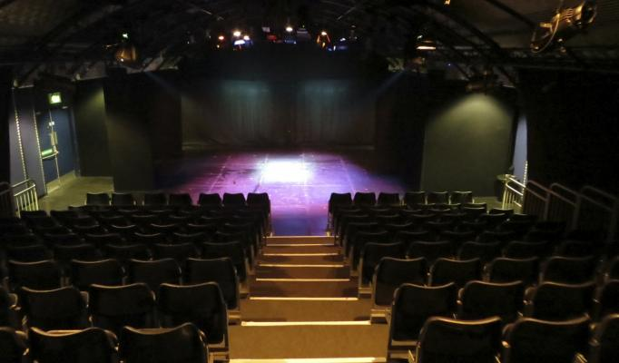
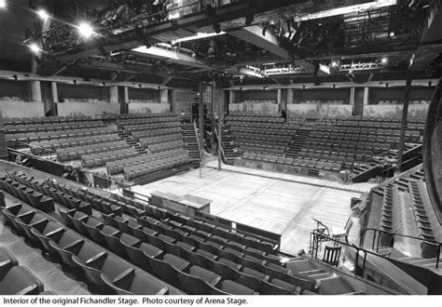
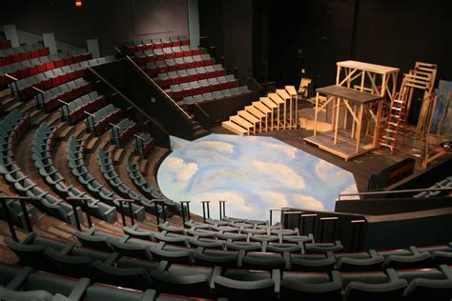
Staging (10)
1
2
Identify the arena stage.
3
4
Notes:
1 – in the round
2 – end on (Proscenium arch)
3 – arena
4 – thrust

