Slide 1
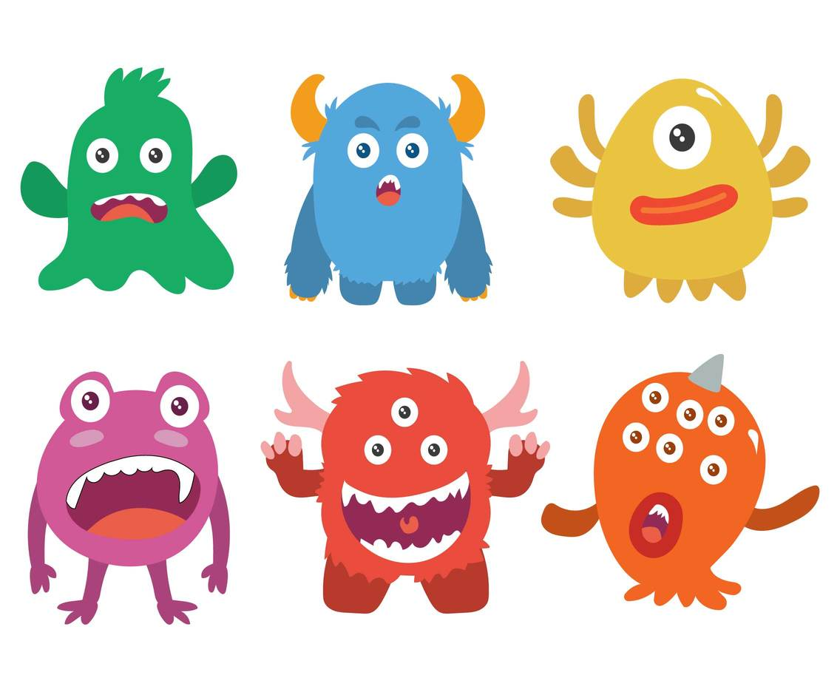


KS3 DT

Slide 2


It’s a scary time so I thought I would give you a few challenges that will hopefully make you and your family laugh.
On the next few pages you will find some fun challenges inspired by Monsters for each area of Design Technology.
The challenge is split into 4 areas which will be covered over the next term.
- Area 1 - Research
- Area 2 - Designing
Area 3 - Making
Area 4 - Evaluating

Slide 3
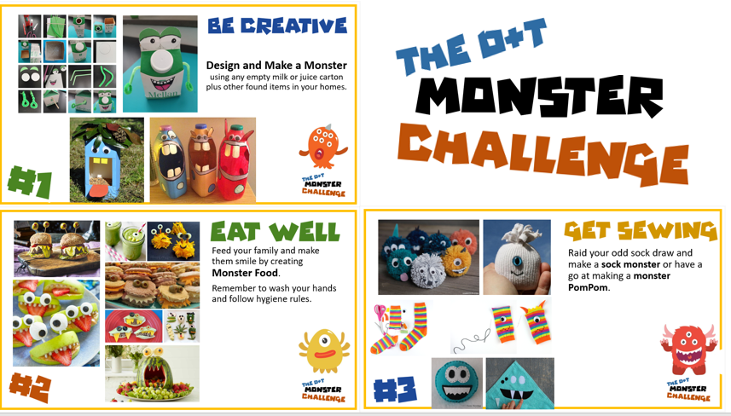

Slide 4
Area 1
Research Tasks

Slide 5

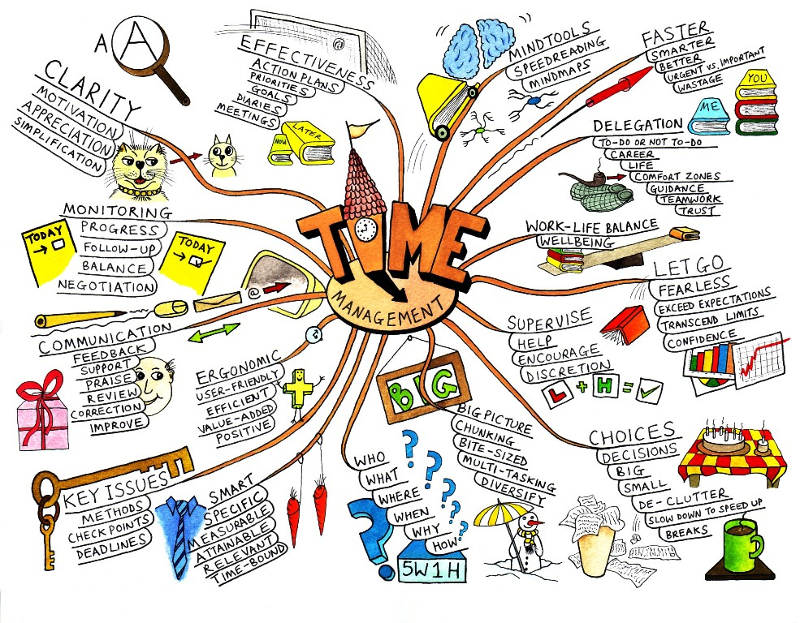



Research Tasks
Create a mind map based on the theme of monsters – think about the following areas colour, shape, user, materials, theme etc
Create a questionnaire for your friends and family (feel free to use the chat area of Teams too) and record your answers in a table/graph. These questions could be about interesting design ideas, colour, material choice (Food, Textiles, DT), etc.
Write a summary of your findings. Make sure it is detailed.
Extension – find some monster products and analysis them
Remember to check your work against the research criteria

Slide 6
Research criteria
Area 1 – Success criteria for research
4 | Gathered relevant information from a least three different sources to help you with your project including looking at existing products. You have analyzed in some depth what you found explaining how it will impact on your own design work.
3 | Gathered relevant information a least two difference sources to help you with your project and analyses what you found explaining how it will impact on your own design work.
2 | Gathered some information to help you with your project and carried out some analysis of what you gathered and explained how it will help you
1 | Gathered some information to help you with your project and carried out some superficial analysis of what you gathered.
0 | You have made some attempt to produce research but lacks detail.

Slide 7
Area 2
Design Tasks

Slide 8

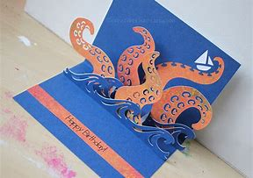
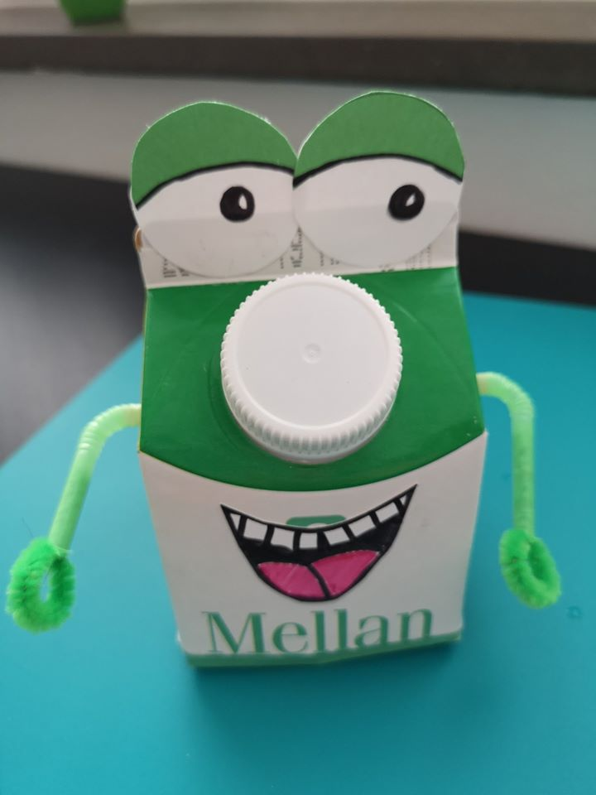
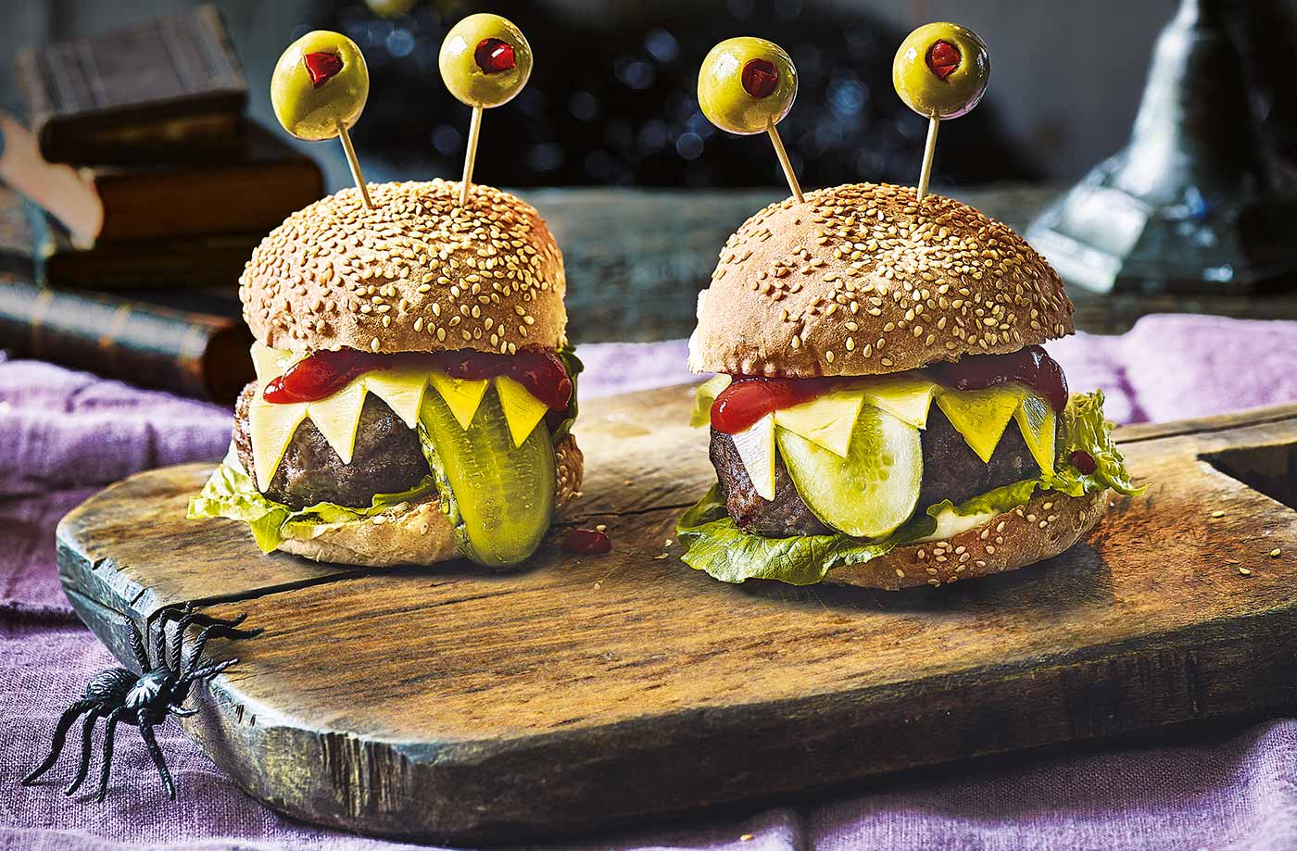
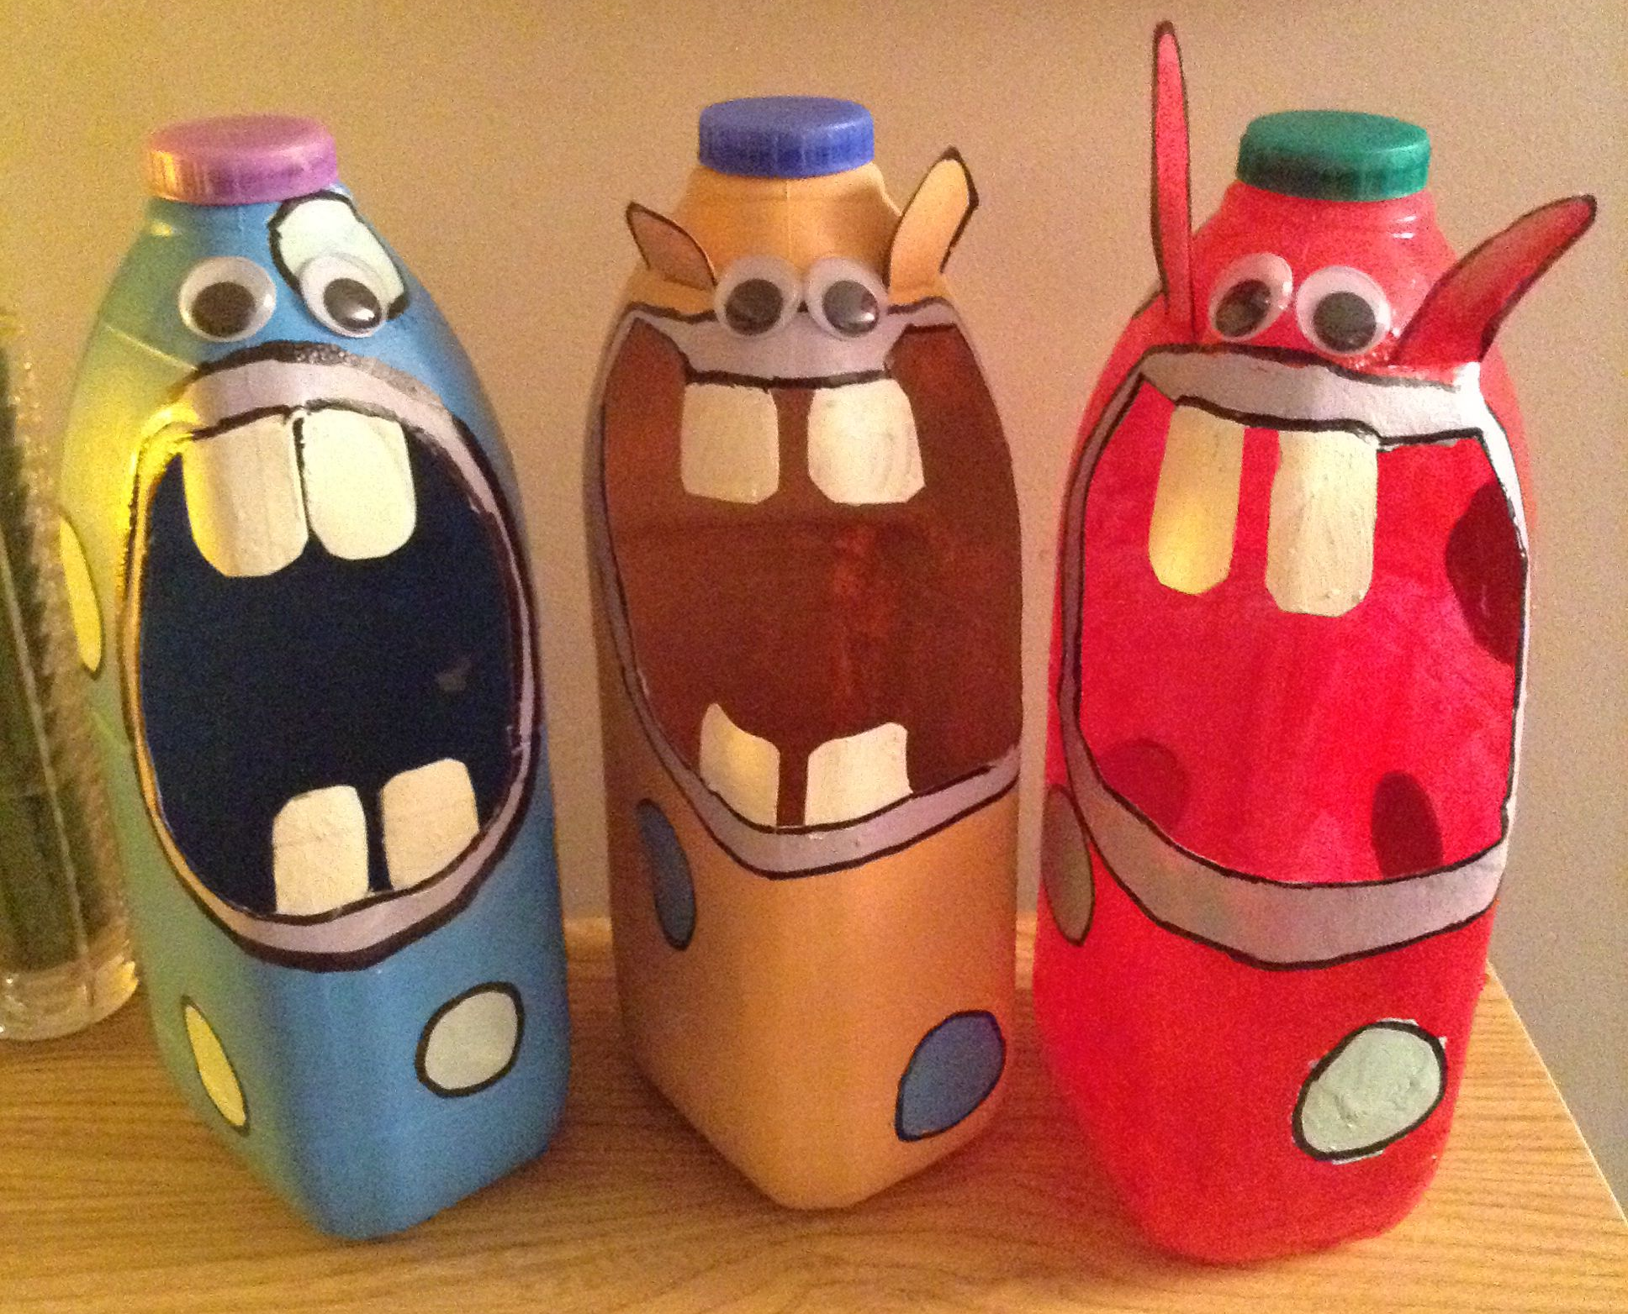
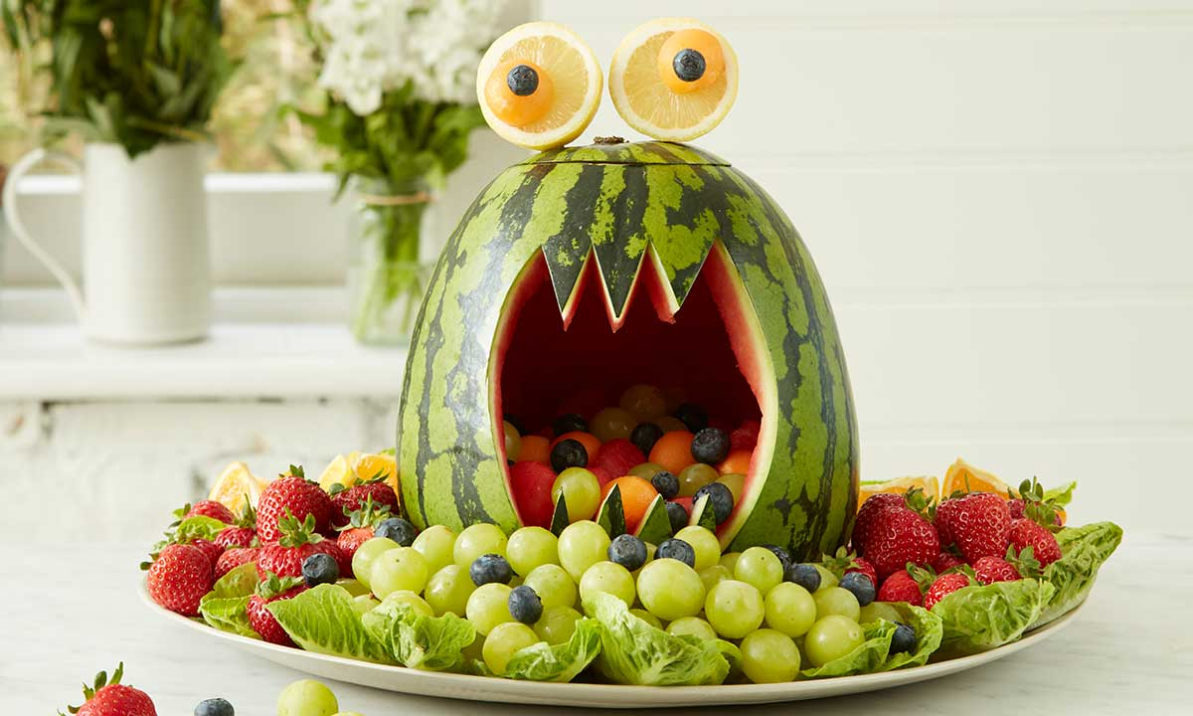
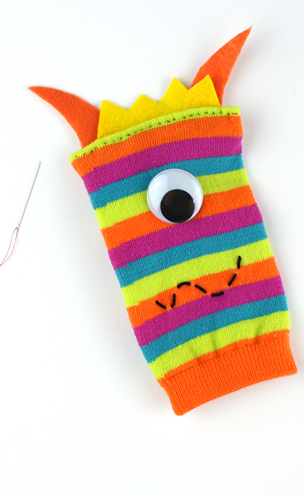
Design Tasks
Create a specification. This is list of things that your product should meet.
Create a mood board of images of the theme of monsters. This is page full of pictures to be inspired by.
Come up with a range of design ideas. Be creative and original. It can be made from anything that you can find. The final product could be a drawn graphic, 3D sculpture, Food, pop up card or textiles.
Remember to check your work against the designing criteria

Slide 9
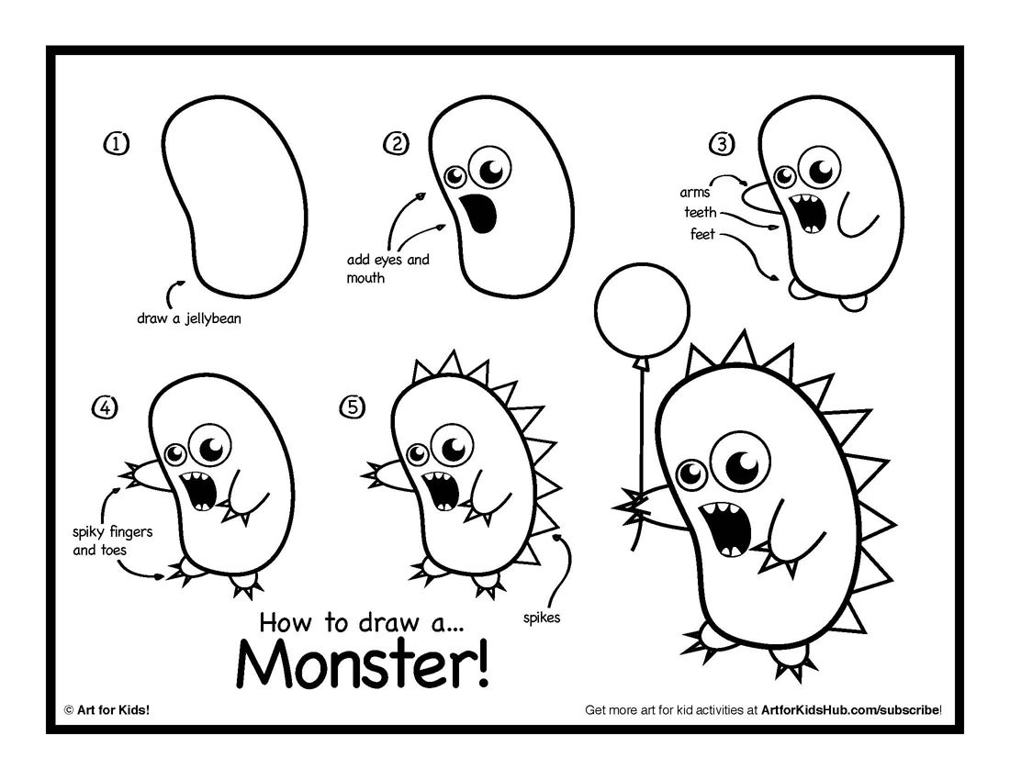
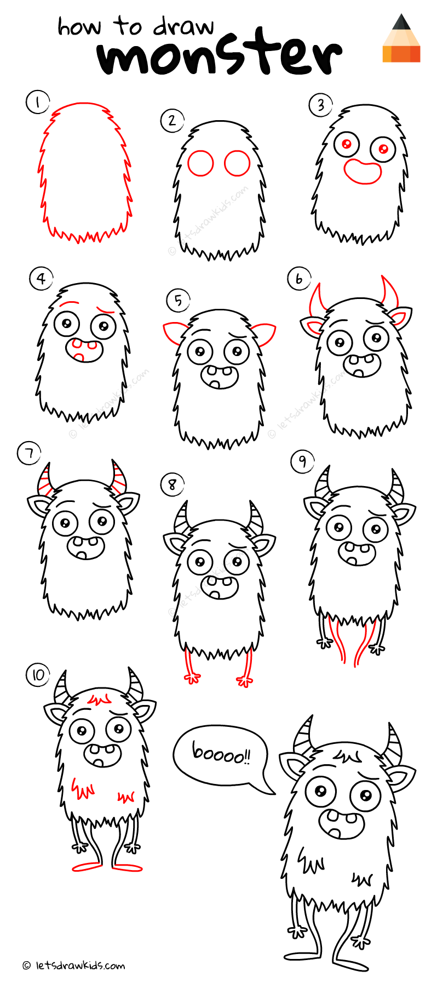


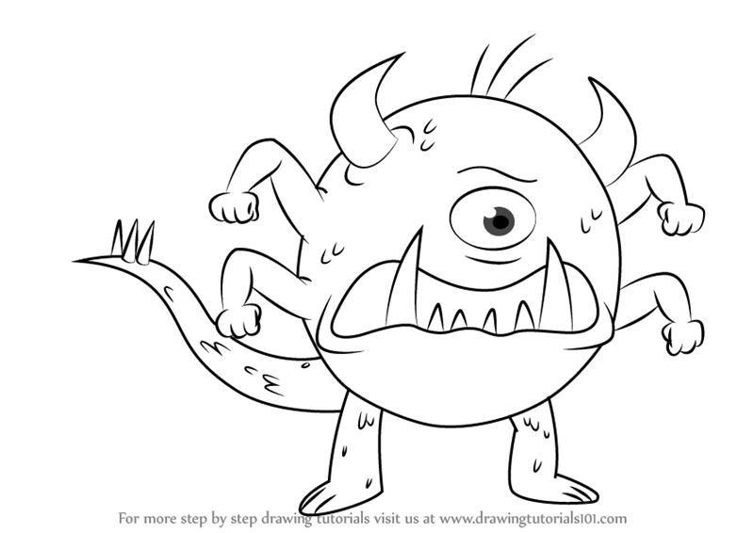
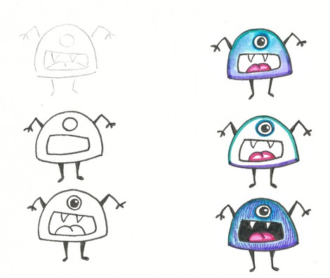
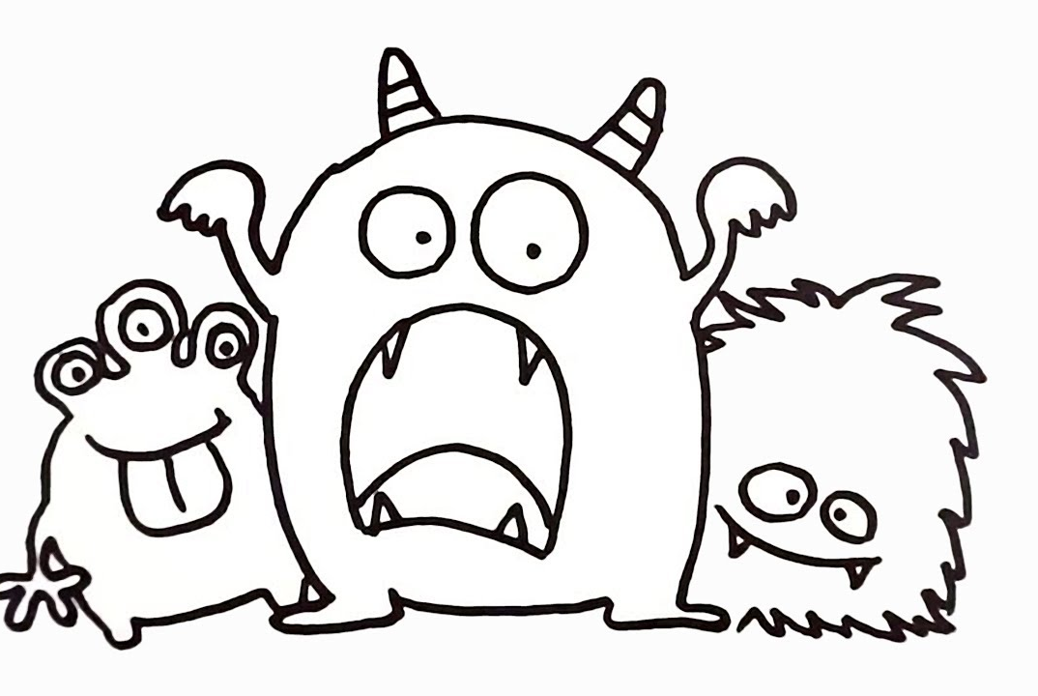
Practice your drawing skills by creating a unique monster. Maybe use your little brother/sister as inspiration!
Remember your drawings should mainly be 3D
Remember to check your work against the design criteria

Slide 10
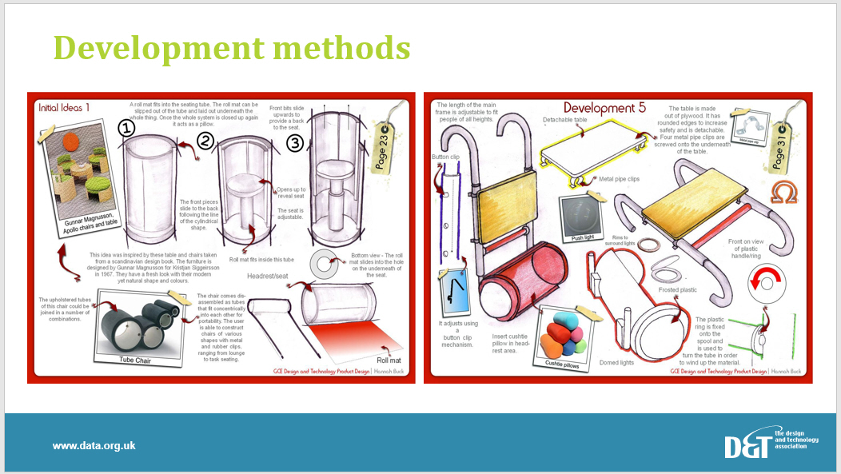
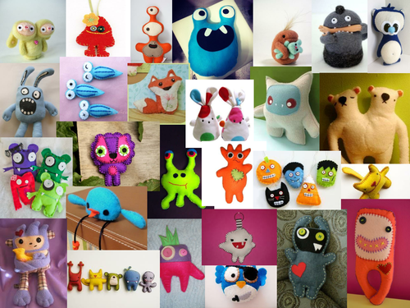
Design criteria
Area 2 – Success criteria for designing
 | Specification | Mood board | Design ideas
4 | You have produced a set of Design Criteria with at least eight key points which include the most important functional requirements for your final product with an explanation as to why they are important. | You have produce a mood board with a wide range of images. You have added key words to your mood board. You have taken consideration to presentation. | You have produced a variety of designs ideas, one( or more) of which has been developed into a viable solution including details relating to how it will be made / your materials selection. You have used 3D drawing techniques such as isometric projection to generate your ideas. You drawings have been rendered using pencil.
3 | You have produced a simple set of Design Criteria with at least six key points which include the most important functional requirements (i.e. what it needs to do) of your final product. | You have produce a mood board with 8 images. You have add some key words to your mood board. You have taken some consideration to presentation. | You have produced several designs but they lack variety. You have used appropriate (3D) drawing techniques and applied some colour to them. You have added some basic annotations to your drawings.
2 | You have produced a basic set of Design Criteria for your product with at least four key points | You have produced a basic mood board but lacks variety and imagination. | You have produced some basic designs using mainly 2D sketches.
1 | You have made some attempt to produce a set of Design Criteria for your product. | You have made some attempt to produce a mood board | You have made an attempt to produce some designs but they lack detail / may not be feasible

Slide 11
Area 3
Making Tasks

Slide 12

Making Tasks
Area 3 – Success criteria for making and planning
3 | You have used appropriate tools / equipment with accuracy / skill to make your design which has been finished to a good standard. You have produced a plan which includes most of the steps required to make your design, including the correct tools, with some basic Risk Assessment.
2 | You have used appropriate tools/equipment to make your design which has been finished to a reasonable standard but has some inaccuracies. You have produced a simple plan which includes most of the steps / tools required to make your design.
1 | You have used a limited range of tools/equipment to attempt to make your design. You have made an attempt to plan your work.
0 | You have attempted to make you design but your finished product lacks quality / is incomplete.
Create a plan of how you will make your product. Include any safety measures.
Make your product
Create a picture diary of your making process – photographs or storyboard
Take a pictures of your product from different views.
On the next couple of slides are some products to inspire you

Slide 13
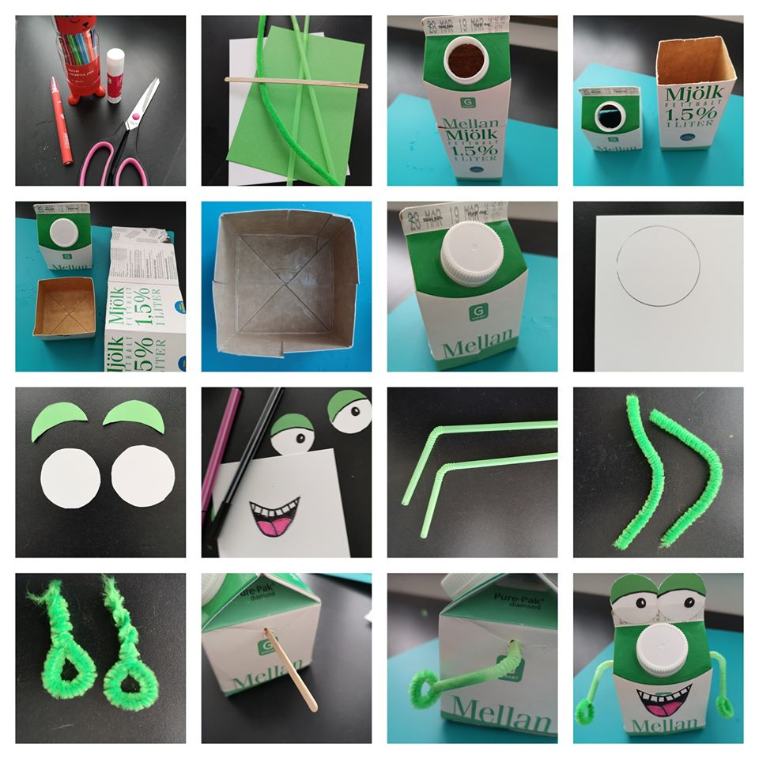

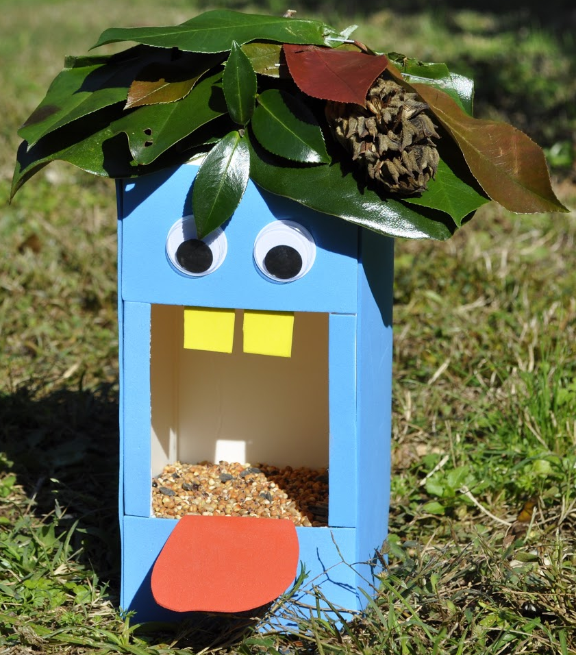
Design and Make a Monster
using any empty milk or juice carton plus other found items in your homes.

Slide 14
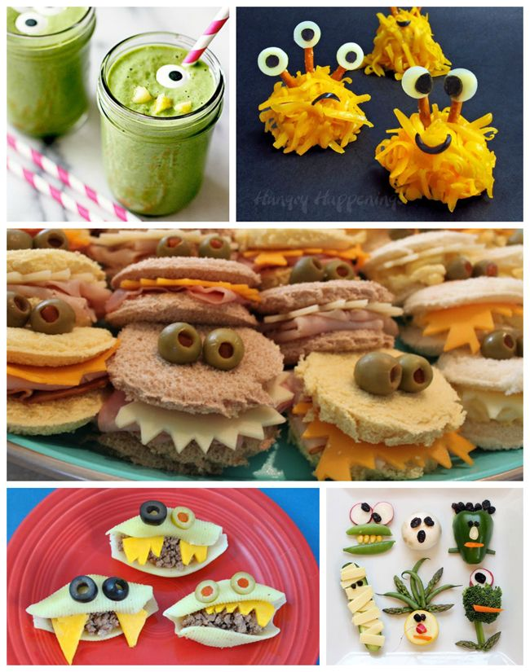

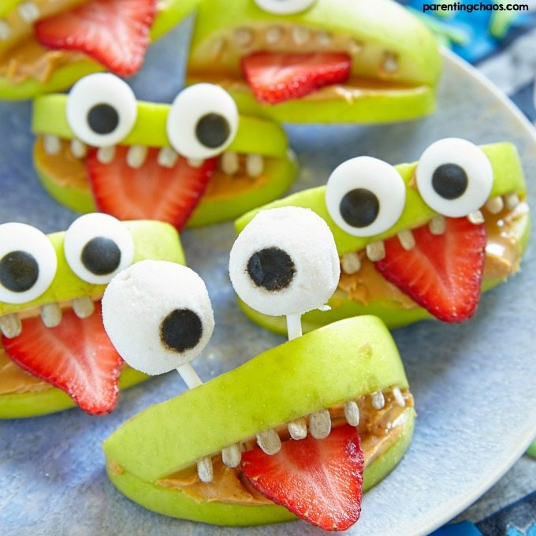
Feed your family and make them smile by creating Monster Food.
Remember to wash your hands and follow hygiene rules.

Slide 15
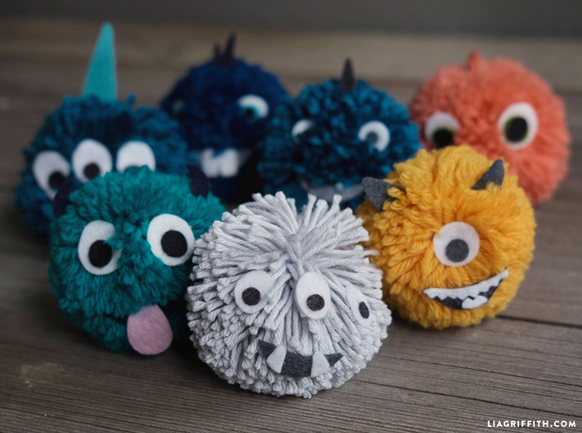
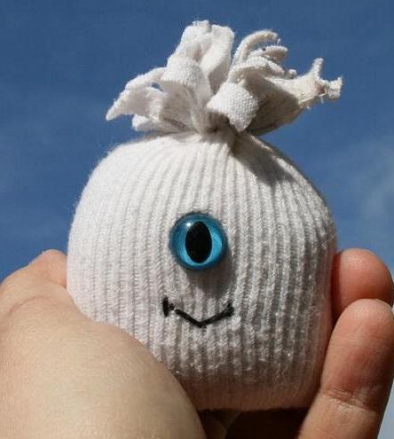

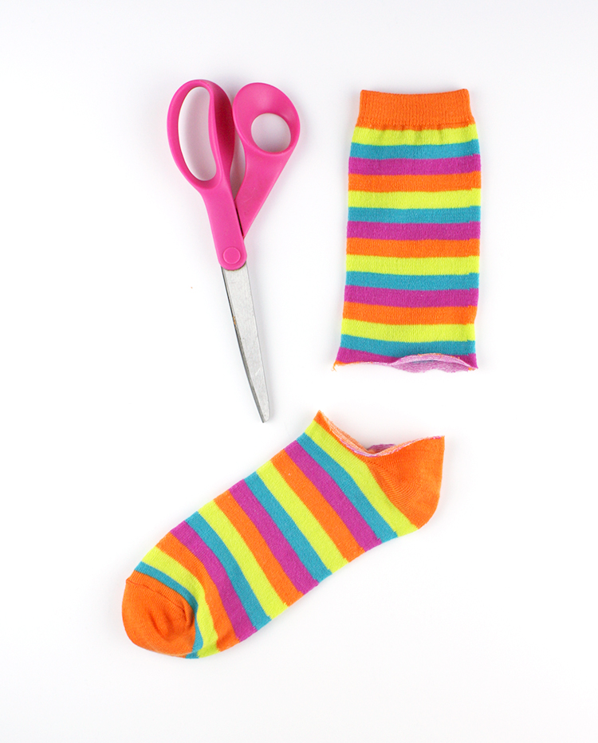
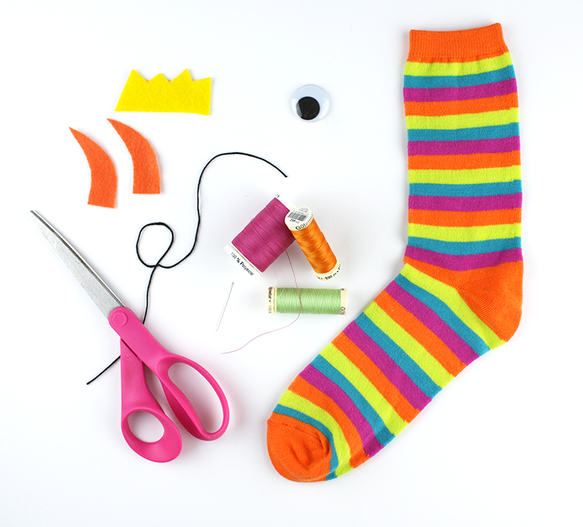
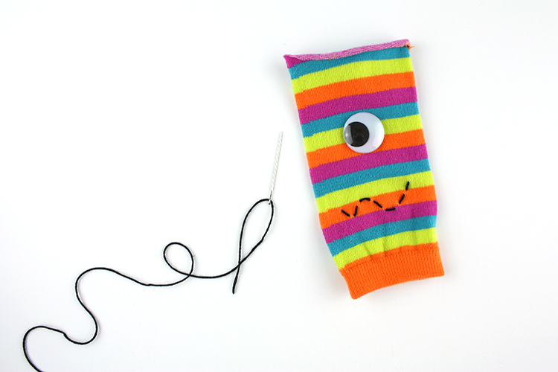
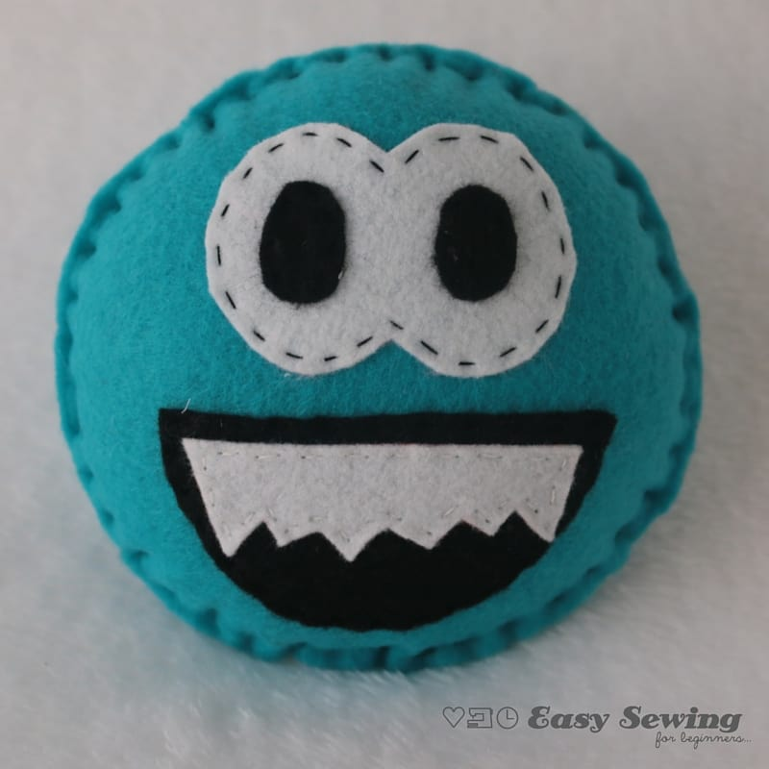
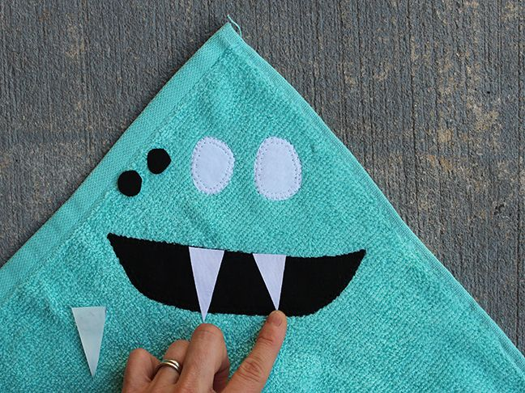
Raid your odd sock drawer and make a sock monster or have a go at making a monster Pompom.

Slide 16
Area 4
Evaluating Tasks

Slide 17
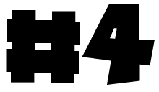
Evaluating Tasks
Area 4 – Success criteria for evaluating
4 | You have evaluated your finished design by comparing t to your design specification, taking some account of the view of others. You have described how well you feel you have satisfied the requirements and how you could have done better.
3 | You have evaluated your finished design by comparing it to your design specification and described how well you feel you have satisfied the requirements.
2 | You have evaluated your finished design by describing what you like and don't like about it.
1 | You have attempted to evaluate your finished design.
Write a report on how well you made your product.
What Went Well –
Even Better If –
How well did you meet your design specification?

Slide 18


