Slide 1

Miss Kaur’s Year 7 Drama task
This task and QUIZ in ‘assignments’ must be completed within the lesson and posted on our class page.

Slide 2
Task:
Design a Mind map/Thought map for the play ‘Romeo and Juliet’. Make sure it includes relevant images, key facts, characters and at least three key quotes from the play. See examples on the next slide.
It must be sent to Miss Kaur or posted on the page for your feedback.

Slide 3
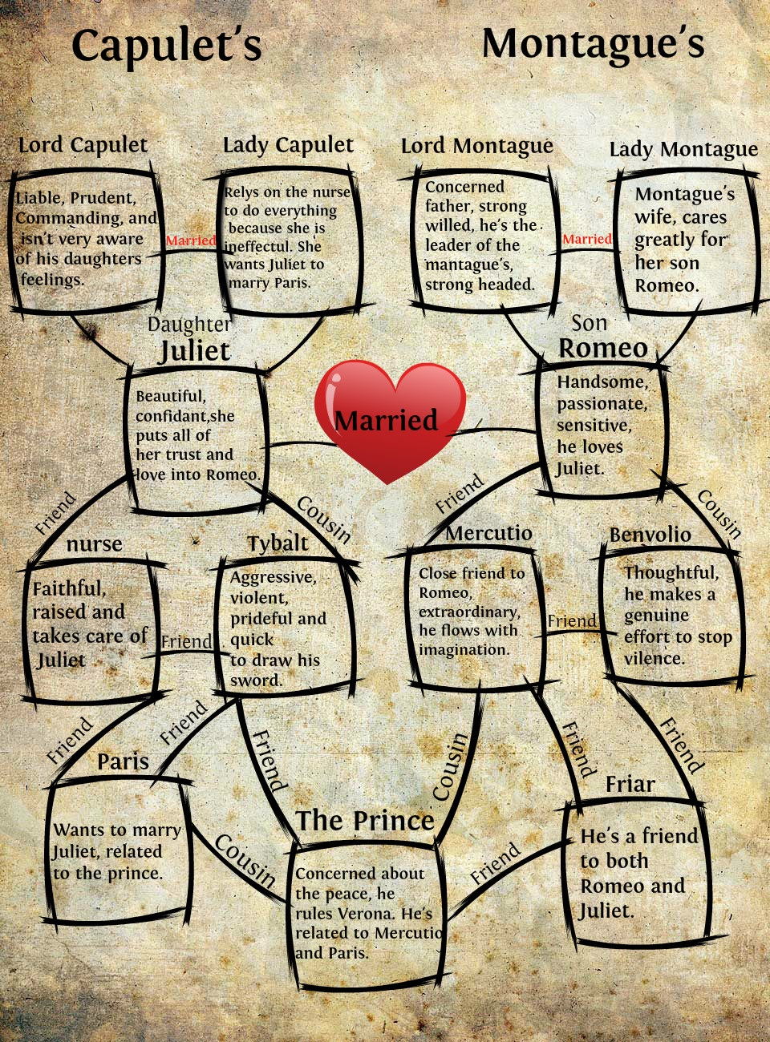
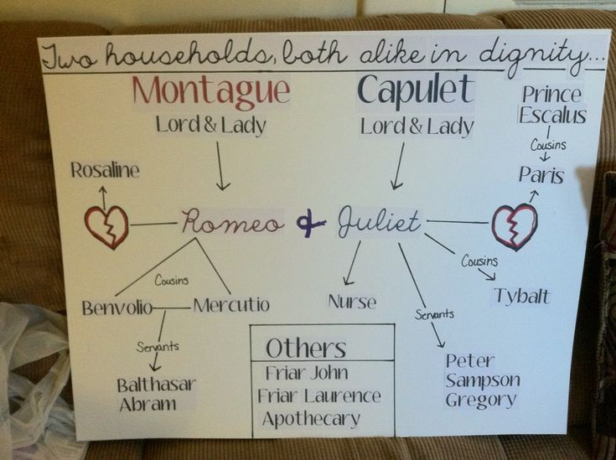

Slide 4


