Slide 1

Performing arts- dance activity 1
DUE IN 27th APRIL(AFTER EASTER HOLIDAY)

Slide 2

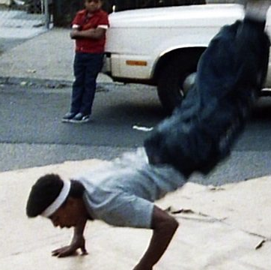
The history of Hip-Hop Dance
Hip Hop dance includes a wide range of "street dance" styles that are associated with the Hip Hop culture born in New York City in the mid-'70s
Traditionally, the original dance of Hip Hop was Breaking, which was the predominant style from the 1970s until the mid-'80s.

Slide 3
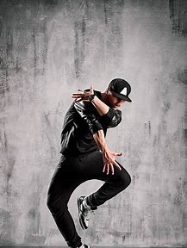
Originally performed to Funk and Rock "breaks", the music was more up-tempo and lent itself to what the dancers would refer to as "going off".
Breaking increasingly began to die out in the mid to late '80s as the culture changed. The music was slowing down, being replaced by more of a "head nod" or "boom bap" sound.

Slide 4
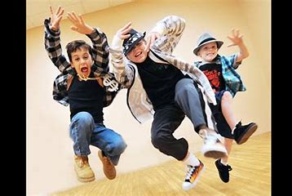
This led to the emergence of a new style of Hip Hop dance expression, more correctly termed Hip Hop Freestyle, and led to movements more suited to the music.
Club or Party dancing took over with the style and steps named or influenced by what was happening in popular culture.

Slide 5
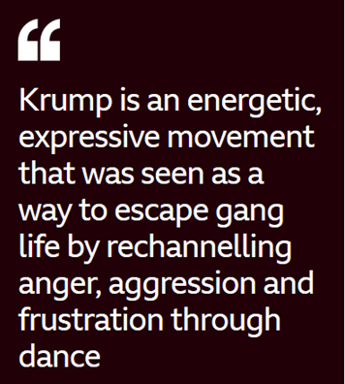

New steps were created at a fast pace and the vocabulary continues to grow.
Different groups were formed, and many danced for music artists of the time.
Additionally, other styles of dance from the US came under the Hip Hop umbrella through cross-pollination and their association with the culture by the media. These included Locking, Popping, Krump and many more.

Slide 6
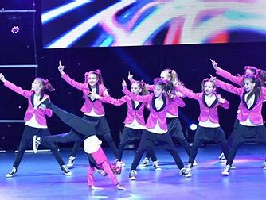
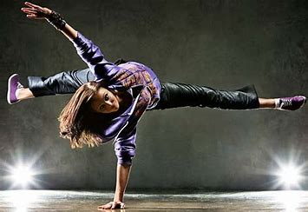
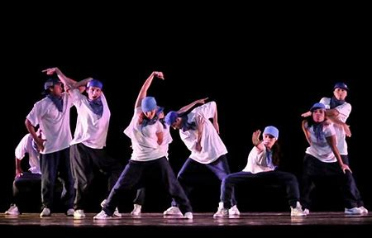
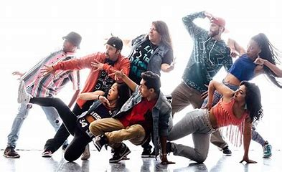
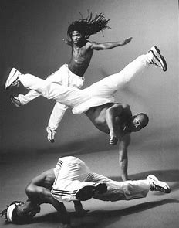
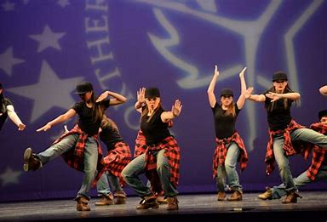

Slide 7
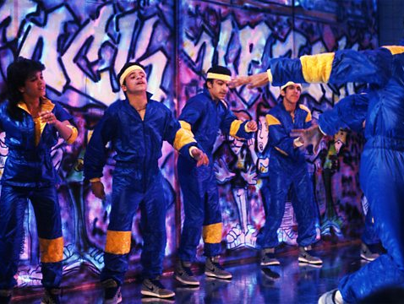
THIS WEEK’S challenge!
Watch the Hip Hop link and try to learn the three easy moves. Practice them, add in your own choice of appropriate music and record your dance! Upload it onto teams for us all to see your progress. If you have a sibling/parent/carer that wants to join in too then the more the merrier! Have fun with it and let’s flood our page with dancing!
https://www.youtube.com/watch?v=ujREEgxEP7g
Video and warm up stretches are on the next page too!

Slide 8
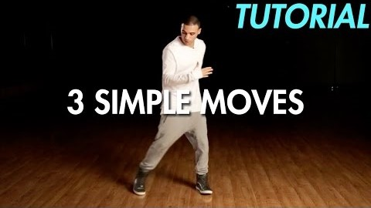
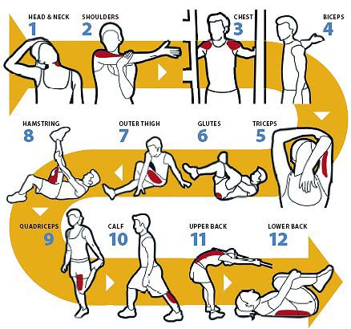
Here is the video Have fun and don’t forget to warm up first!

