Slide 1
The Crucible
An introduction

Slide 2
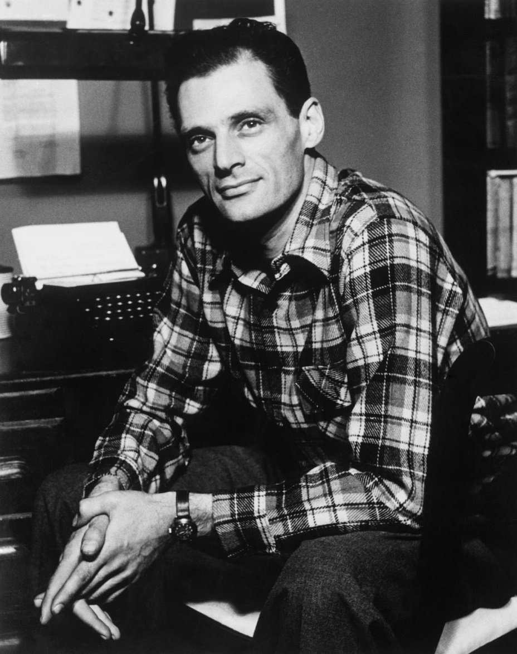
Arthur Miller (1915-2005)
Born in Harlem in 1915
Came from an Austrian Jewish family
Family lost everything in the Wall Street Crash of 1929
Joined the Federal Theater Project after graduating. Closed in 1939 due to Communist fears

Slide 3
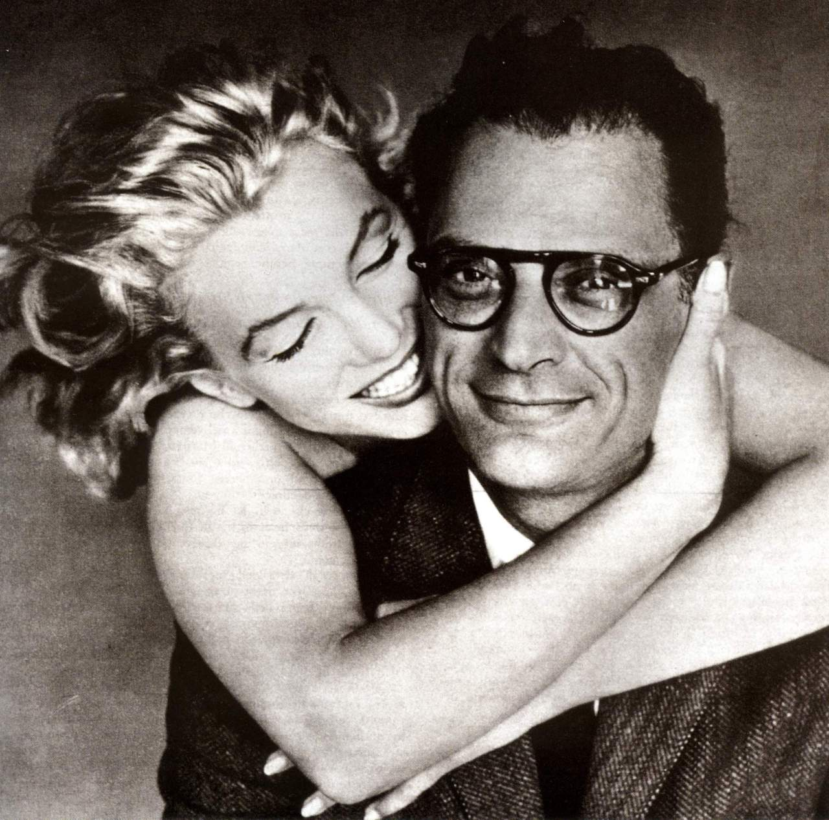
Arthur Miller (1915-2005)
Exempted from military service during WWII due to a football injury
He became known for his plays, All My Sons, Death of A Salesman, and A View from the Bridge.
On June 29 1956 he married Marilyn Monroe and later worked with her on her last film, The Misfits.

Slide 4
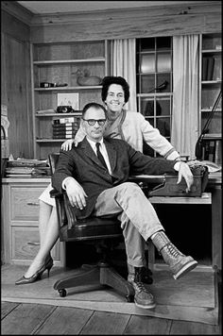
Arthur Miller (1915-2005)
The Misfits premiered in 1961 and Monroe and Miller divorced
In 1962 he married Inge Morath, a photographer on the film
Their son, Daniel, was born in November 1966. He had Down syndrome and was institutionalised

Slide 5
Arthur Miller (1915-2005)
In 1952 director and writer, Elia Kazan appeared before HUAC and named 8 actors he claimed were members of the Communist party
After speaking to Kazan, Miller went to Salem, Mass To research the witch trials of 1692 and ultimately wrote The Crucible.
The play attracted the attention of HUAC who refused to issue Miller a passport to attend the play’s premiere in London in 1954

Slide 6
Arthur Miller (1915-2005)
Miller was subpoenaed by HUAC in 1956 and agreed to appear before them, on the proviso that he not be asked to name names. The chairman, Francis E. Walter, agreed to this.
When he attended the hearing, the committee reneged on their word and pushed him for names. Miller refused stating: “I could not use the name of another person and bring trouble on him”.
As a result, he was found guilty of contempt of Congress in May 1957 and sentenced to pay a fine of $500 or thirty days in prison, in addition to being blacklisted, and disallowed a US passport

Slide 7
Arthur Miller (1915-2005)
In 1958, Miller’s conviction was overturned by the court of appeals which ruled that he had been misled by the chairmen of HUAC
This had an effect on his later life as Miller spoke often about the importance of freedom of speech and civil liberties. His works were banned in the USSR after he campaigned for the freedom of dissident writers
Miller died of heart failure after a battle with cancer in 2005.

Slide 8
The Puritans
A religious group, they opposed many traditions of the Protestant Church of England as they felt they were too Roman Catholic.
These traditions included the use of priestly vestments during services, the use of the Holy Cross during baptisms, and kneeling during the Sacrament.
King Charles I was hostile to this point of view and the Anglican Church tried to repress them.
As a result, a large number of Puritans migrated to the new colony of America.

Slide 9
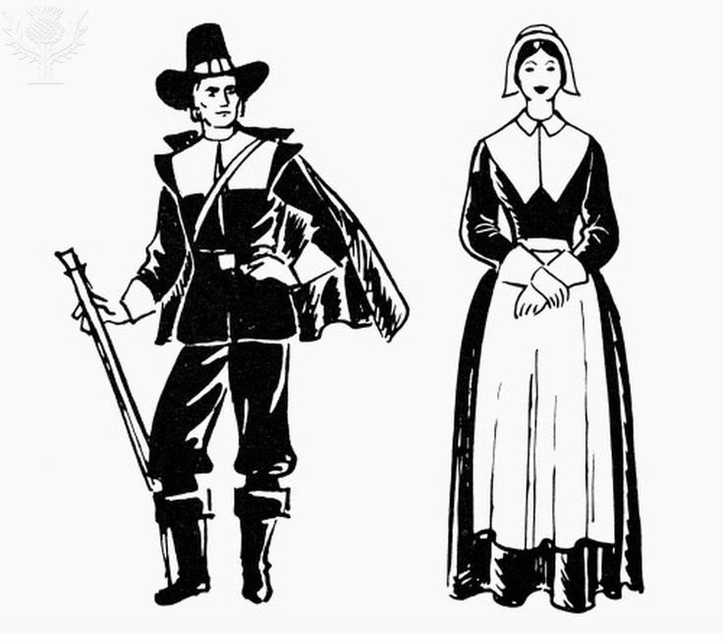
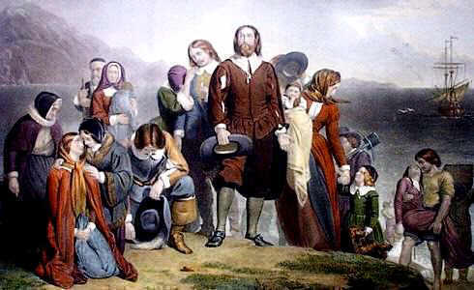
What do these pictures make you think?
What were these people like?
What was important to them?

Slide 10
Imagine living in a town where…
…holidays such as Christmas and Easter are forbidden
…children are not permitted to play with toys or dolls
…the only music which is allowed is the unaccompanied singing of hymns
…dancing is forbidden
…you had to attend a three hour sermon every Wednesday and Sunday night

Slide 11
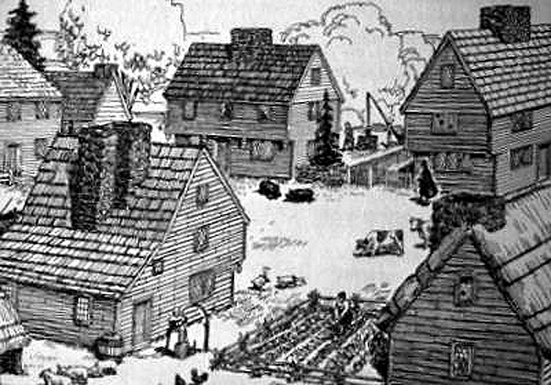
Would you want to live there?
That was what life in Salem, Massachusetts was like for the Puritans living there in the 1600s.
This is the setting for Miller’s play, The Crucible.

Slide 12
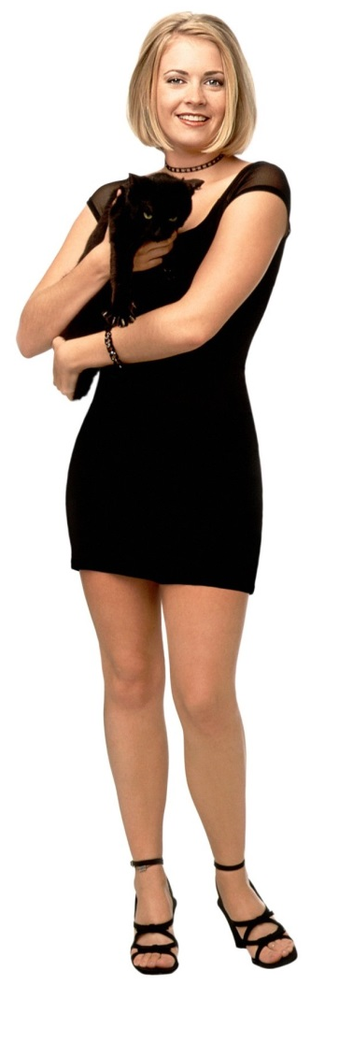
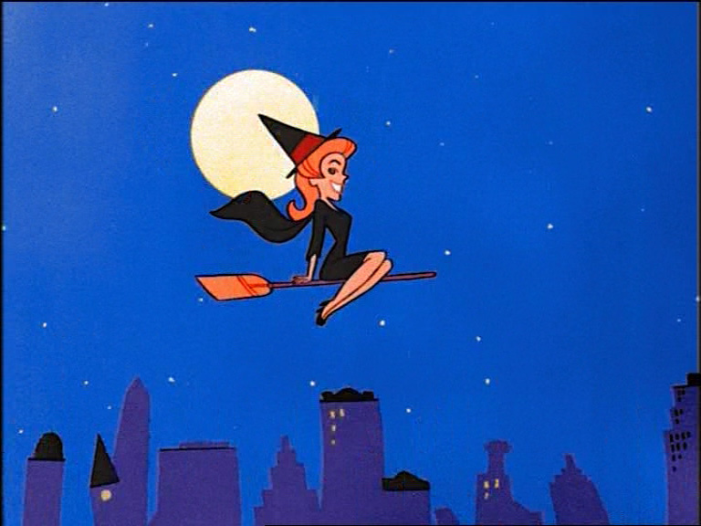
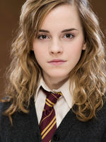
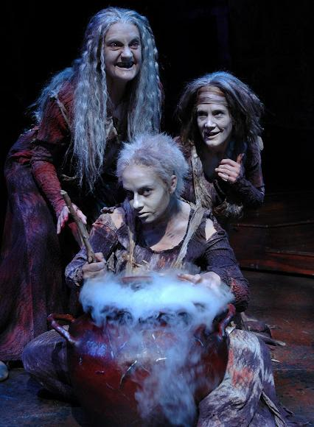
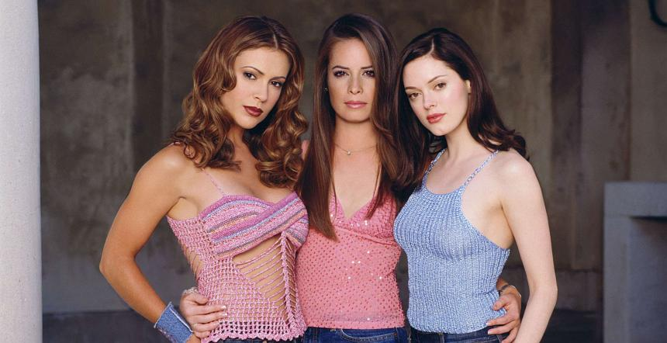
What do these people have in common?
What do you expect a witch to be like?

Slide 13
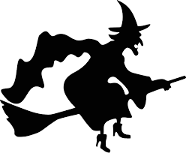
Brainstorm
What would be considered witchcraft for the people of Salem?
Remember that they were an extremely religious community!

