Slide 1

The Salem Witch trials and Main Characters
Friday 26th March
To develop understanding of the Salem Witch trials and Puritans.
To be able to explore the connection between the text and the social/historical context.

Slide 2
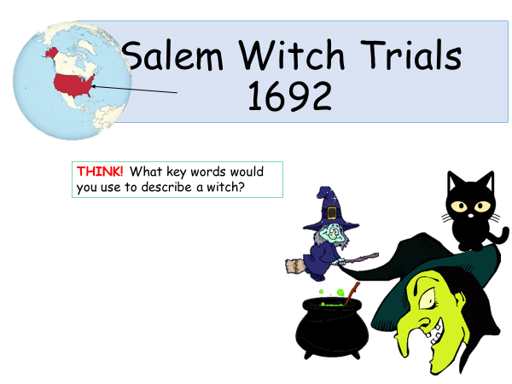

Slide 3
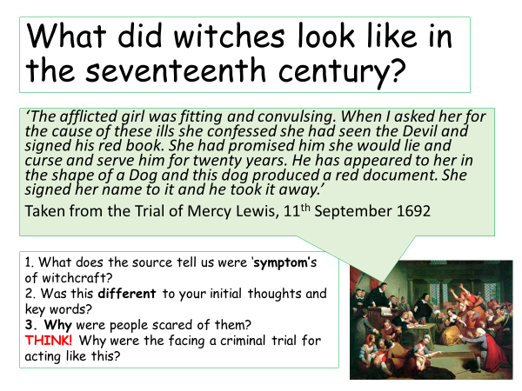

Slide 4

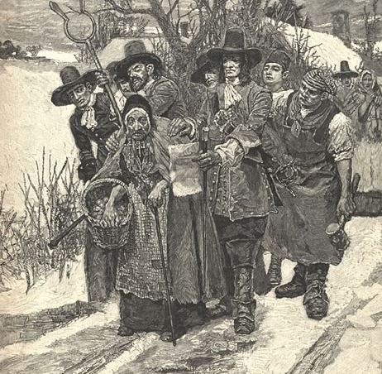
Witch trial

Slide 5
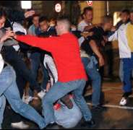
Football fans

Slide 6
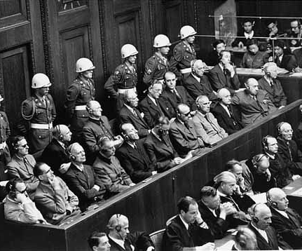
Nazi Party

Slide 7
The Individual
Mob
Rule

Slide 8
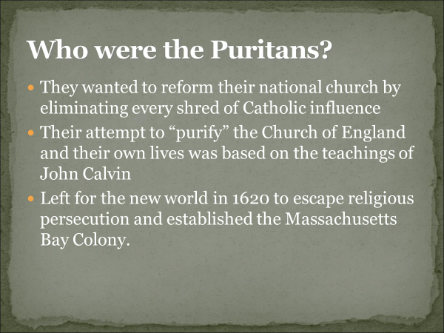

Slide 9
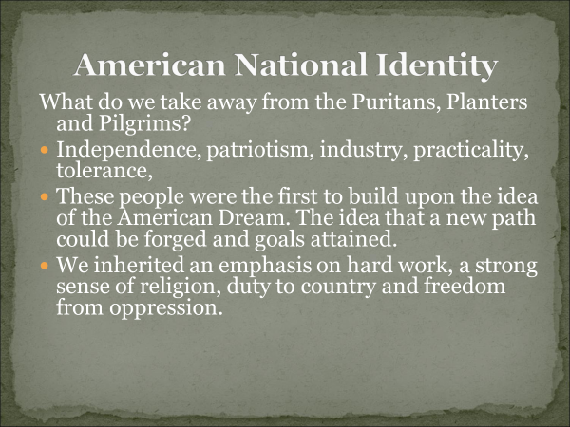

Slide 10
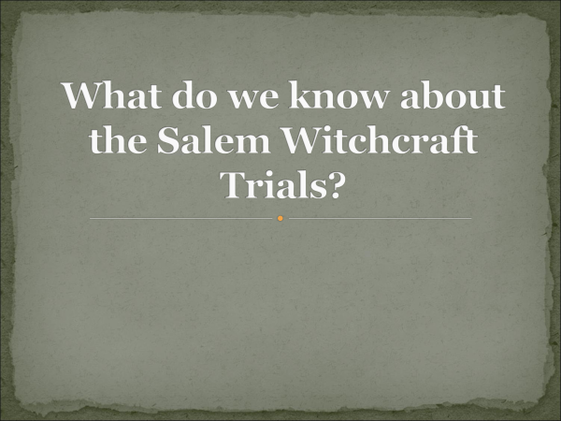

Slide 11
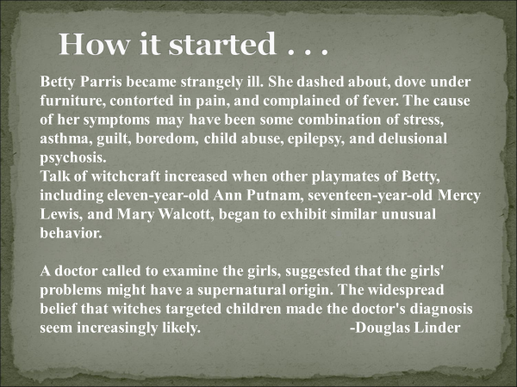

Slide 12
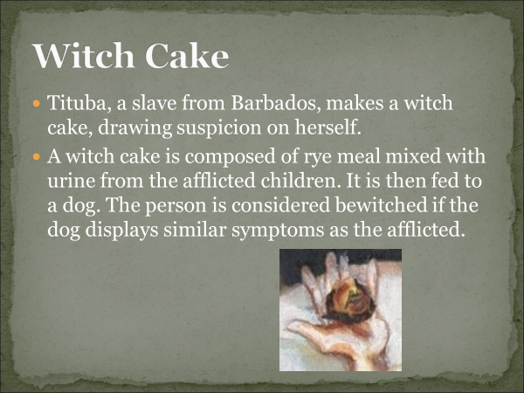

Slide 13
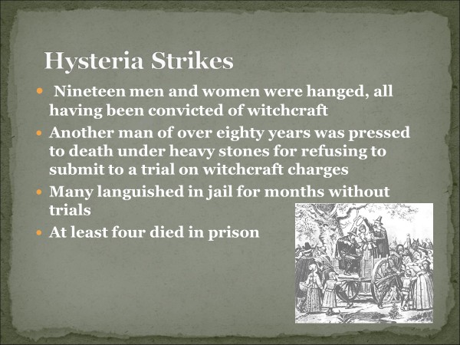

Slide 14

Questions
How would you describe the Puritan people?
Why do you think people were accused of being witches?

Slide 15
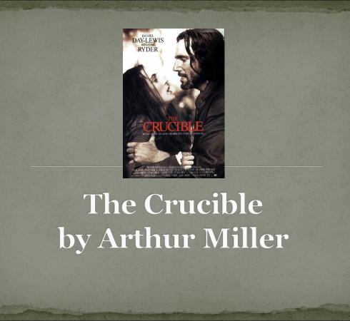

Slide 16

Abigail Williams
20 years old. Manipulative and selfish. Enjoys her power over the other girls and the court.

Slide 17

Tituba
A slave from Barbados working for Parris. Naïve, superstitious and easily scared by people in authority.

Slide 18

John Proctor
A Salem farmer in his 30s. Thinks hard about doing the right thing and
is not afraid to challenge authority.

Slide 19

Reverend Parris
The father of Betty and the uncle of Abigail.

Slide 20
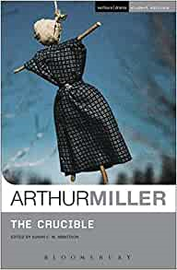
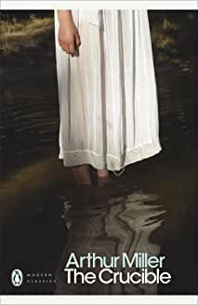
You need to buy the play text ASAP. It is compulsory for the course.
"The Crucible" (Student Editions) Paperback by Arthur Miller
Available on Amazon!

Slide 21
Task- Continue for homework-
1. Who are Reverend Parris, Betty, and Abigail? What is their relationship?
2. Who is Tituba? What is her relationship to the family?
3. What is wrong with Betty?
4. Why does Parris suggest calling in Reverend Hale?
5. Who are Ann and Thomas Putnam? What do they suggest is Betty's problem? What is their motivation for suggesting this?

