Slide 1
Idea development
- You will explore the theme further by combing two artist techniques
To be successful:
Experiment and develop your ideas based on two photographers.
You will explore and experiment in a similar style to the artists you have already researched.
Take your work to the next level, try to push yourself to improve your skills and techniques.

Slide 2
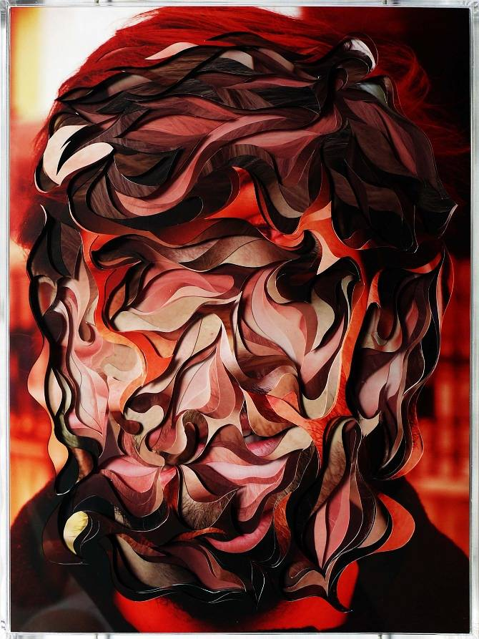
Artists you have looked at:
Trine Hisdal
Photograph some unflattering, like a dying flower, and make it look more visually appealing.
What else could you photograph that has an interesting texture?
Extension: How can you use the camera/ Photoshop to change how someone views it?
Carol Sharp
Isolating textures
Blurring background
Focus on textures
If you don’t have flowers what else has an interesting texture?
Edward Weston
One main focus, one subject.
Removes colour from photographs, can texture be shown clearer if the image is in black and white?
Composition is very important
Lucas Simões
Created textures
Layered images
**Some of you looked at additional artists that you can also use in your idea developments.

Slide 3
Last week you were asked to complete the following:
Slide 1 of idea development.
- Explain why you choose these two artists
How will this relate to the theme of texture?
Plan for the shoot (one slide)
Photo-shoot. At least 20 photographs
Contact sheet (one slide)
Annotate the contact sheet
*** If you do not have this complete please see the previous assignment titled ‘Idea development’ before continuing.

Slide 4
This week:
1. Select 3 of your most successful photographs.
2. Edit your 3 selected photographs in the style of your chosen artists.
3. Annotate each edit

Slide 5
Select 3 of your most successful photographs.
Consider what makes the photograph successful. – Is the composition interesting? Is there too much negative space?
Does the photograph show texture in the best light?
Does the photograph reflect what you have learned from previous artist research?

Slide 6
Edit your 3 selected photographs in the style of your chosen artists.
Consider if your edit has improved your image, if it hasn’t you might need to spend longer on Photoshop.
TEXTURE – can you see this clearly? Can you use Photoshop to show texture even more?
Do you need to crop your image to represent the artist’s work/to improve your work?
If you have a printer try printing off your images and physically manipulate the photograph – stitch into it, paint over it, tare it.

Slide 7
3. Annotate each edit
Please use the files placed in class material to help write appropriate annotations.
KEY WORDS

Slide 8
Extension:
Those of you that have your 3 edits complete before Friday please start to think of your final piece (photograph).
You might need to do a new photo-shoot for this.
You are bringing together all of your new skills and ideas to produce your most successful edit/photograph to date.
Remember: the theme is texture, your final piece needs to reflect this.

