Slide 1
Starting your GCSE Project!
During this project you are going to learn about the art elements in detail while also learning how to take your work from research, idea, photography shoots to final piece.

Slide 2
The Visual/Art Elements
The visual elements are the ‘things’ which make up an image - line, tone, shape, colour and so on.

Slide 3
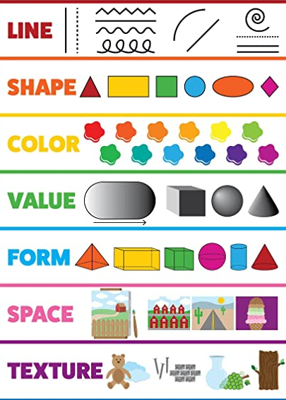
Art elements
…and how they relate to photography

Slide 4
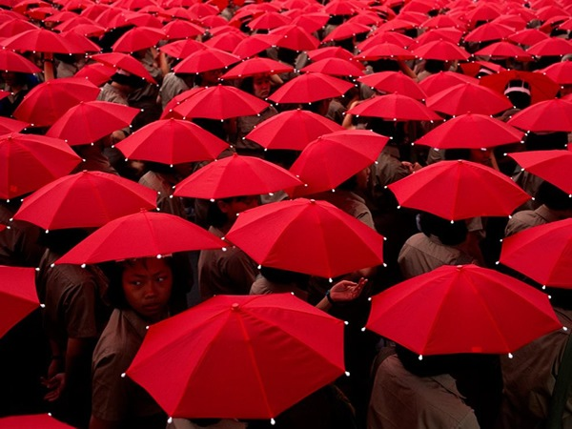
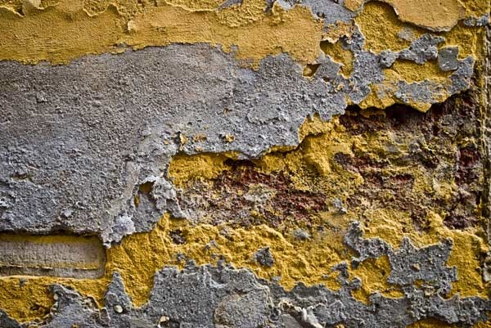
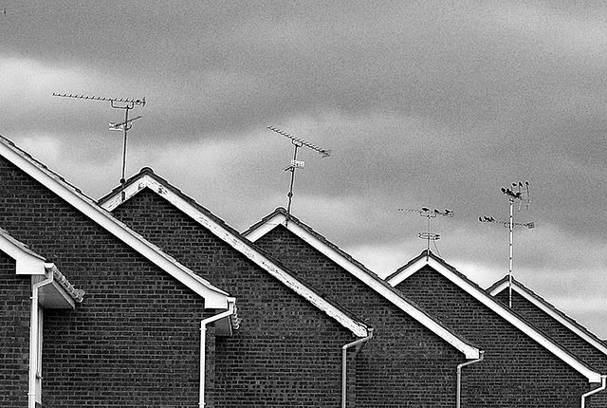
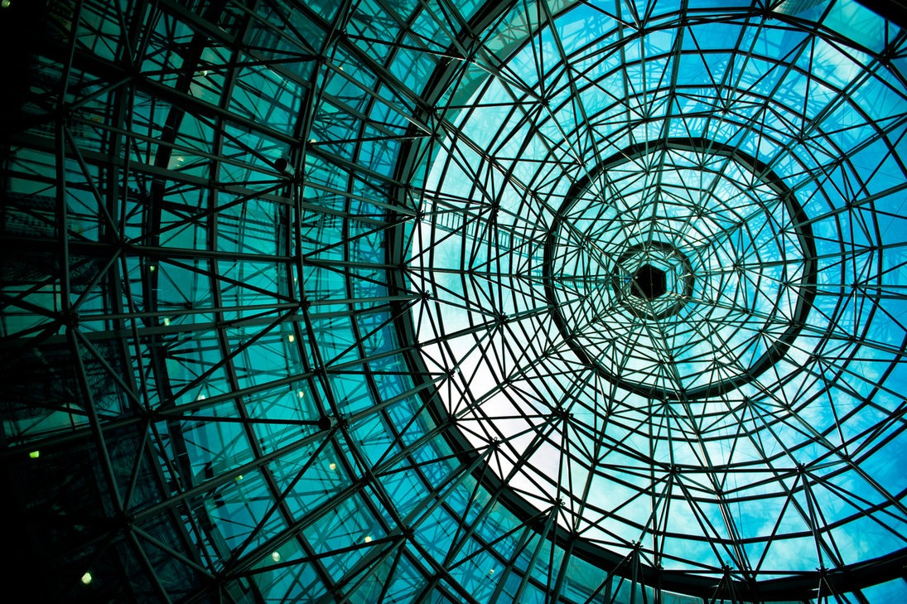
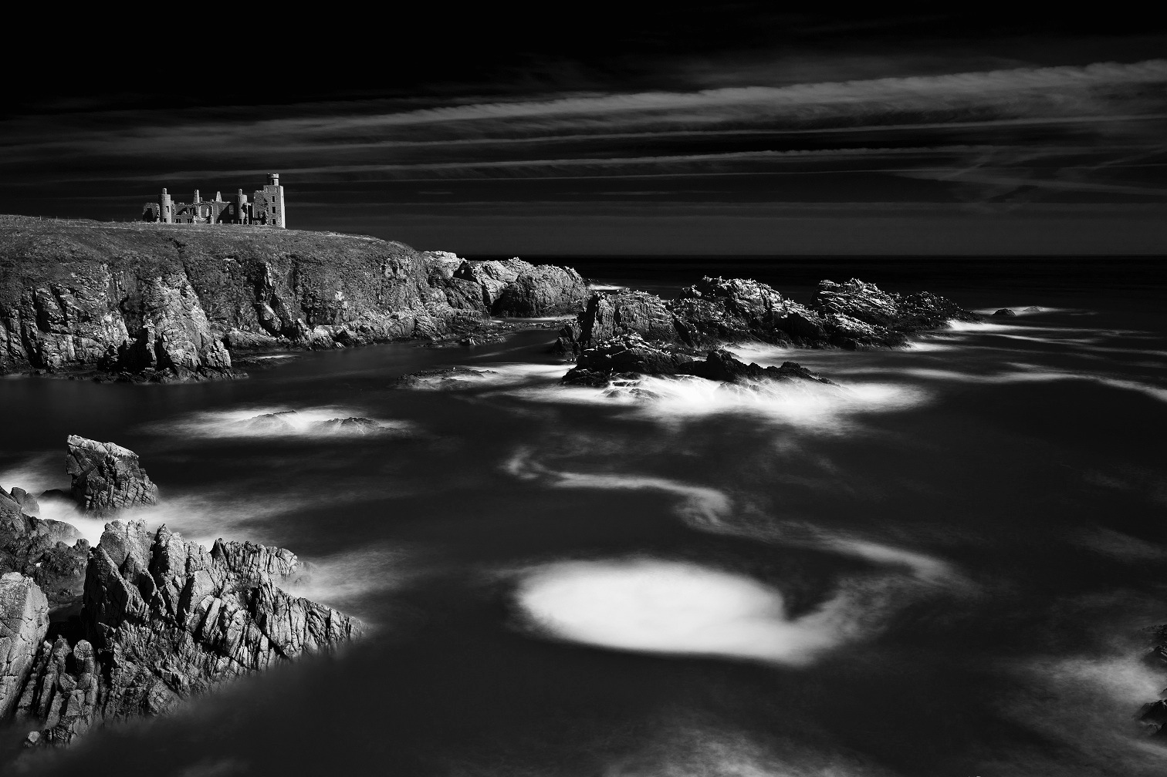
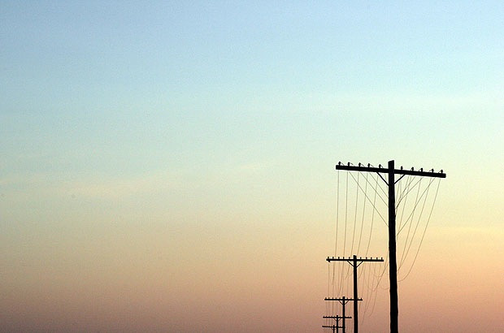
What are the formal art elements?

Slide 5
Colour
Texture
Shape
Line
Tone
Space
…..and form

Slide 6
The following list describes some of the elements in any photograph. Below the list is an example of how you can analyse a photograph looking for these things specifically and how this helps to give the image meaning:
Line: Are there objects in the photograph that act as lines? Are they straight, curvy, thin, thick? Do the lines create direction in the photograph? Do they outline? Do the lines show movement or energy?
Shape: Do you see geometric (straight edged) or organic (curvy) shapes? Which are they?
Space: Is there depth to the photograph or does it seem shallow? What creates this appearance? Are there important negative (empty) spaces in addition to positive (solid) spaces? Is there depth created by spatial illusions i.e. perspective?
Texture: If you could touch the surface of the photograph how would it feel? How do the objects in the picture look like they would feel?
Tone: Is there a range of tones from dark to light? Where is the darkest value? Where is the lightest?

Slide 7
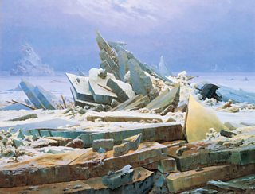
Line
The Polar Sea by Caspar David Friedrich shows how diagonal lines can lead a viewer into an image. The shallow diagonal along the light brown sheets of ice at the bottom leads the viewer from left to right. Here the large yellow triangle of ice leads the eye towards the main pyramid shape in the middle of the composition.
This is a great example of how the placement of lines can help lead the viewer through the composition.
The Polar Sea, Caspar David Friedrich, 1824, oil on canvas, DEA Picture Library

Slide 8
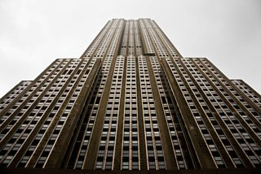
Geometric lines
Low angle shot - try this at home
Geometric lines are ones that relate to perfect mathematical shapes and man-made objects. They are straight, regular and uniform. They often follow a specific pattern and can be symmetrical or repeat in a specific way.
The photograph on the right is architecture made up entirely of straight lines
Empire State Building, New York, USA, Gabriel Parra / Alamy Stock Photo

Slide 9
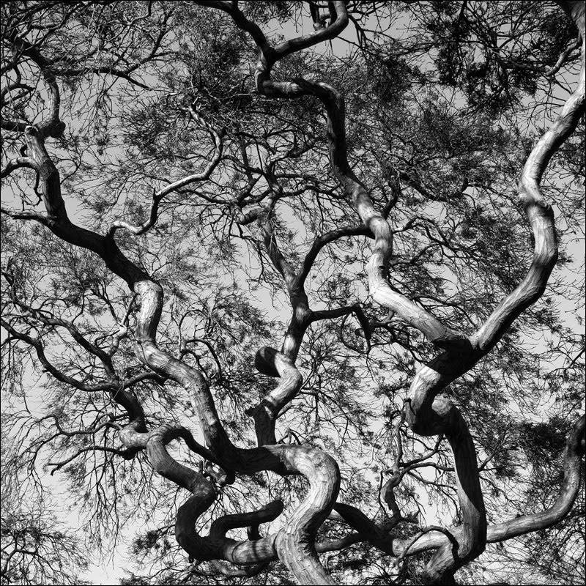
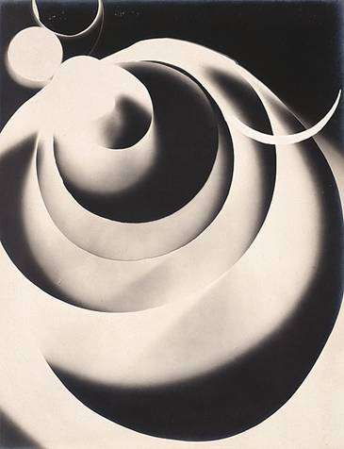
Organic/curved lines
Usually imperfect and less structured
Paul Rider

Slide 10
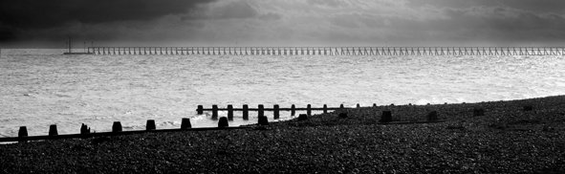
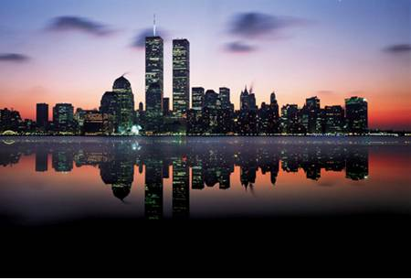
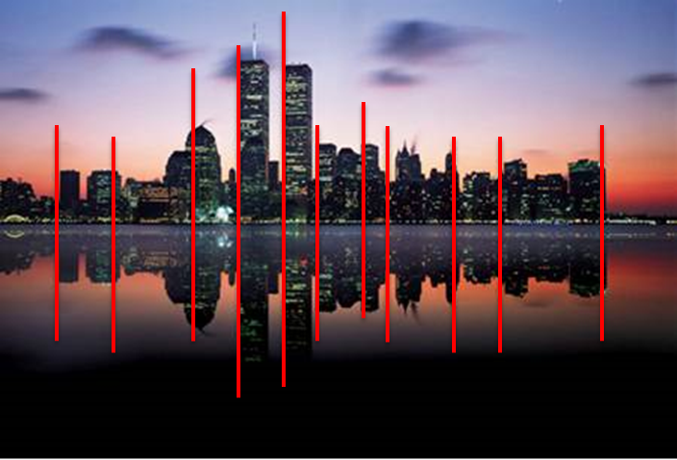
Horizontal And Vertical Lines
Horizontal lines
Chris Monaghan
Vertical lines
Usually seen in landscapes. Where else might you see horizontal and vertical lines in photography?

Slide 11
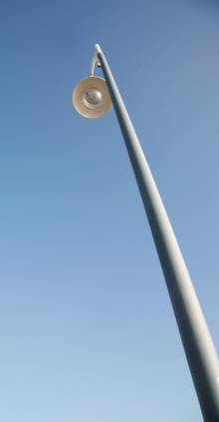
Diagonal Lines
Chris Monaghan

Slide 12
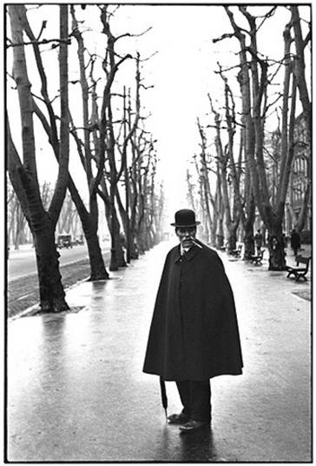
Implied lines – you can not see physical lines in the photograph but they are implied by the direction of the trees and branches.
Henri Cartier Bresson

Slide 13
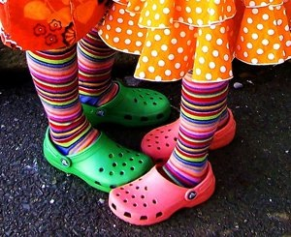
Colour
How a work of art or design looks and what we feel about it depends on a number of colour choices

Slide 14
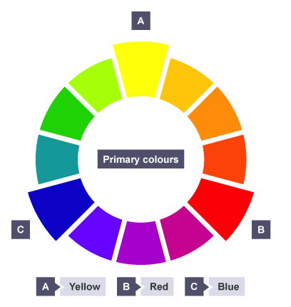
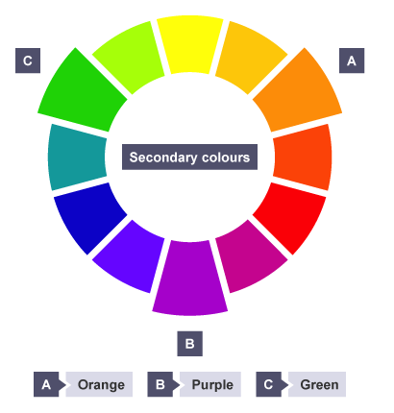
(Recap from yr 8 art)
Primary colours
Secondary colours

Slide 15
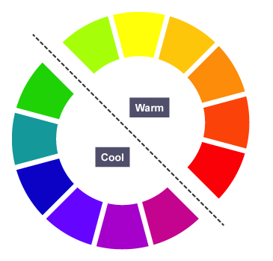
Warm and cool colours
Warm colours remind us of things associated with the concept of heat such as summer, beaches, the sun, fire etc. The warm colours are:
Red-purple
Red
Red-orange
Orange
Yellow-orange
Yellow
Cool colours remind us of things associated with the absence of heat – such as winter, ice, water, etc. The cool colours are:
Purple
Blue-purple
Blue
Blue-green
Green
Yellow-green

Slide 16

Complementary colours
Complementary colours sit across from each other on the colour wheel.
Yellow – Purple
Red – Green
Blue – Orange
When complementary colours are placed next to each other the colours appear more vivid and brighter.

Slide 17
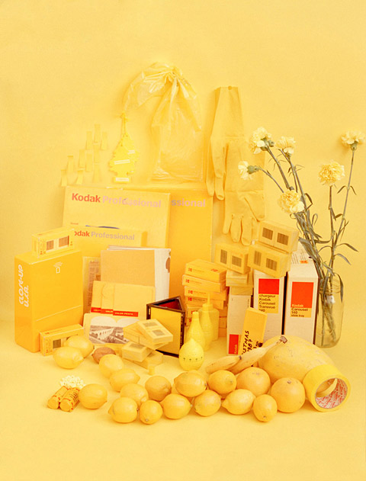

Monochromatic
This means that the photograph is made up of different tints, shades and tones of a single colour.
Sara Cwynar

Slide 18
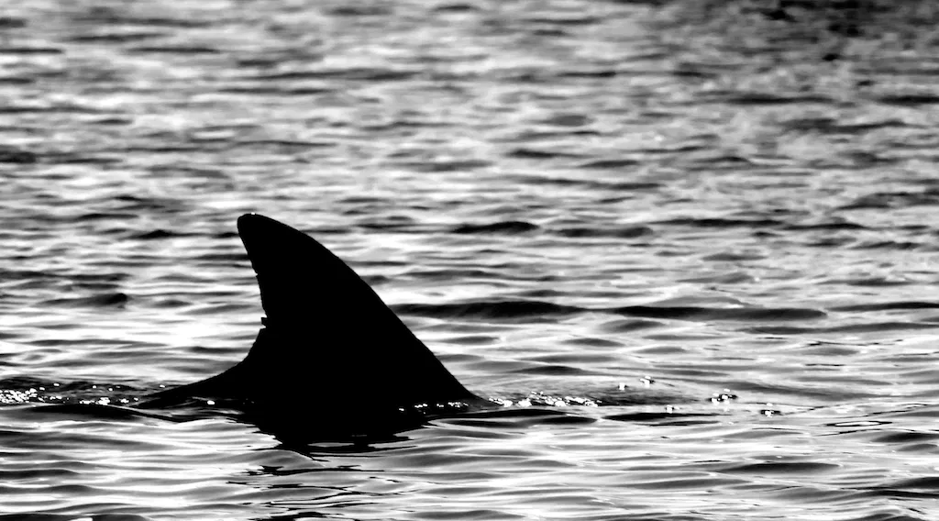
Shape
Shapes are 2 dimensional (2D)
A shape is flat.
Shape is a closed line.

Slide 19
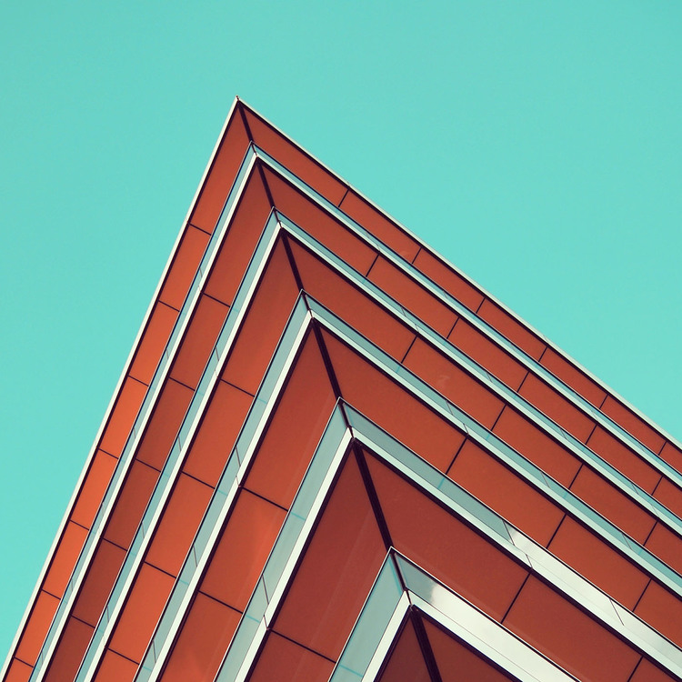
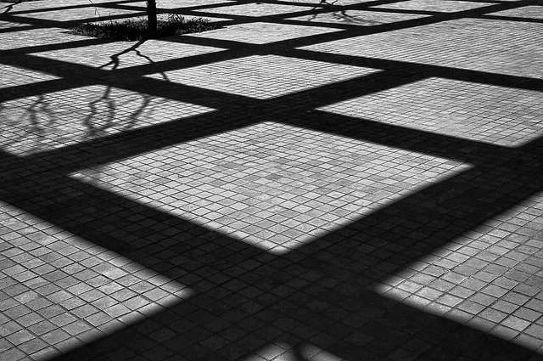
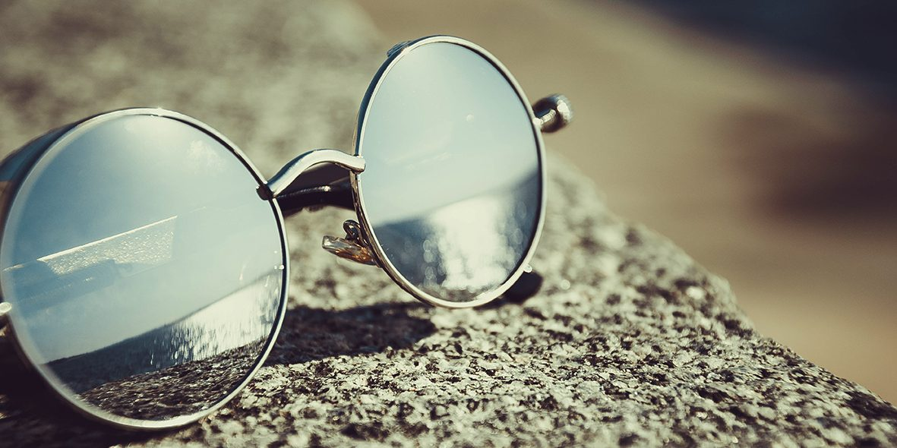
Nicholas Goodden
Geometric shapes
Geometric shapes are perfect and regular.
Geometric shapes are mathematical shapes, such as squares and circles. They are perfect and regular

Slide 20
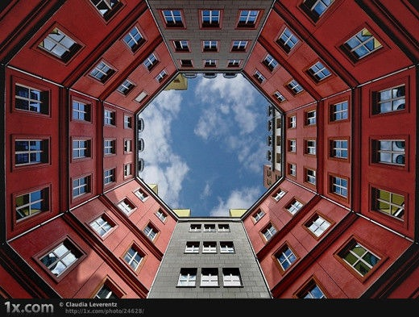
Shape

Slide 21
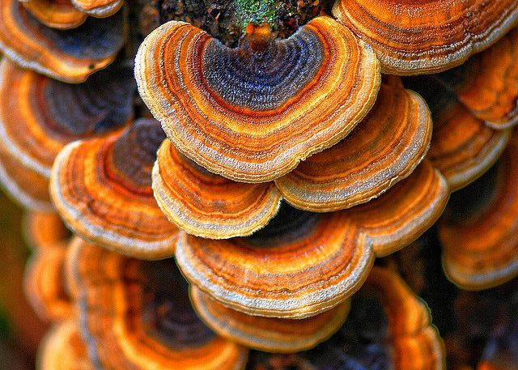
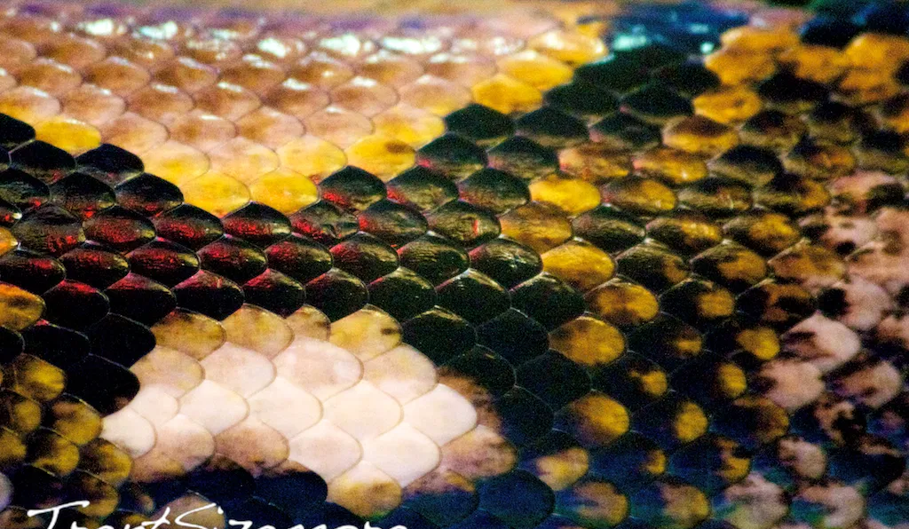
Organic shapes
Organic shapes are irregular and natural.
When looking for organic shapes – look at nature to find some.

Slide 22
Space
Space refers to objects and to the area around them.
Objects take up positive space, while negative space is the empty space around them.

Slide 23
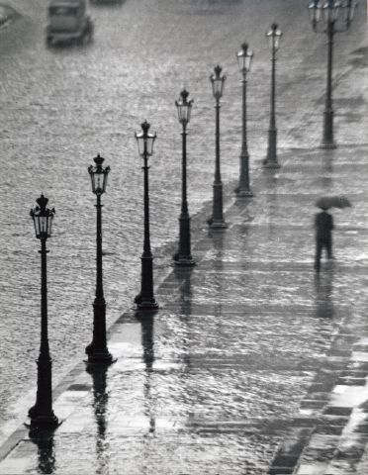
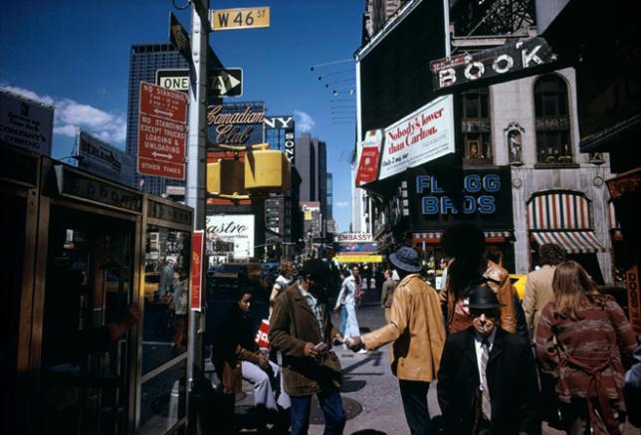
Space
Space can be filled or left empty (negative space).
These two images are both of urban life …

Slide 24
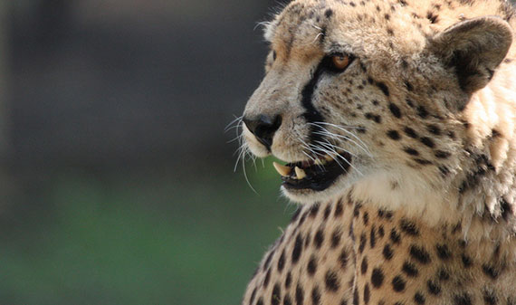

How is space used in photography is very important

Slide 25
Texture
How something feels

Slide 26
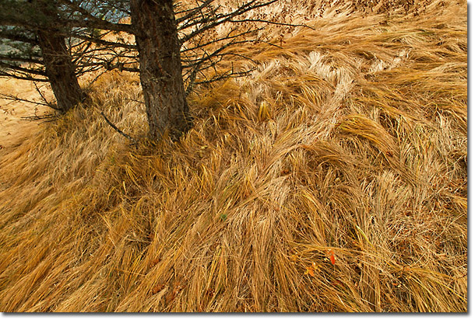
Texture

Slide 27
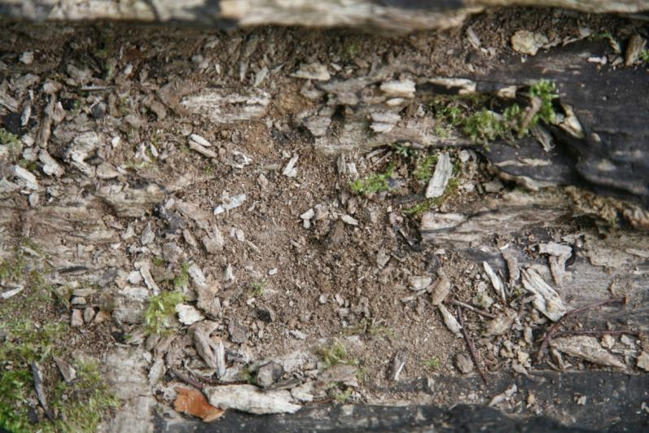
There are two types of texture: actual texture and visual texture.
Actual texture, or physical texture, means the actual physical surface of an artwork. It describes the tactile feeling you would get if you were able to run your hand over an artwork
However in photography an image can create a visual experience which suggests a particular tactile sensation.
For example, this photograph of dry rotting wood creates an impression or feeling of dry dustiness.
Whilst photographs normally only create an impression of texture, other artworks such as painting and sculpture can include actual textures.
Extension: How could you make a photograph include actual texture?

Slide 28
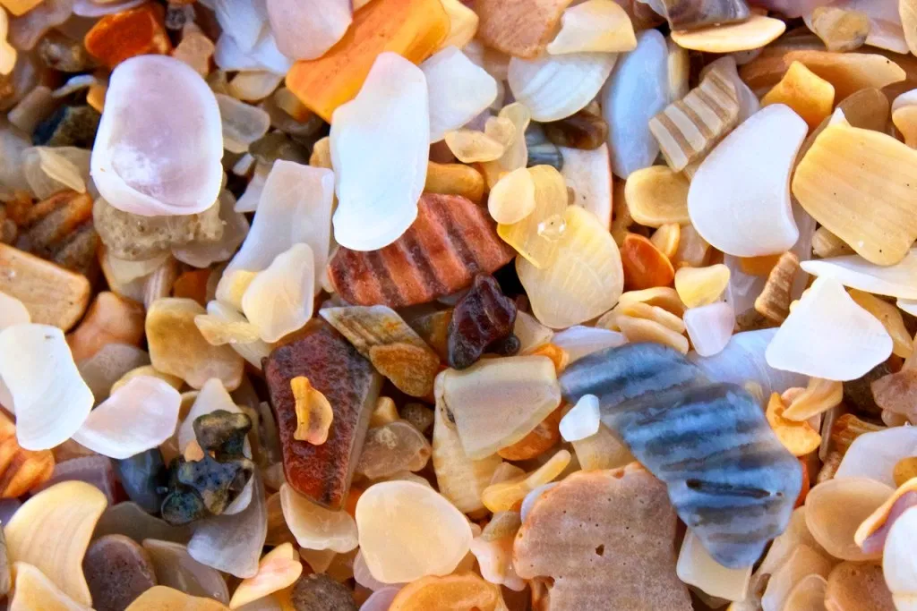
Macro
Texture in a macro shot can get really intriguing. When you get REALLY close to a subject, large or small, you can see textures clearer. These broken shells are all along the beach. Getting up close to them with the right lens brings out the details in the tiny shells. You can see every little line, hole, and mark.
**Macro photography is extreme close-up photography**

Slide 29
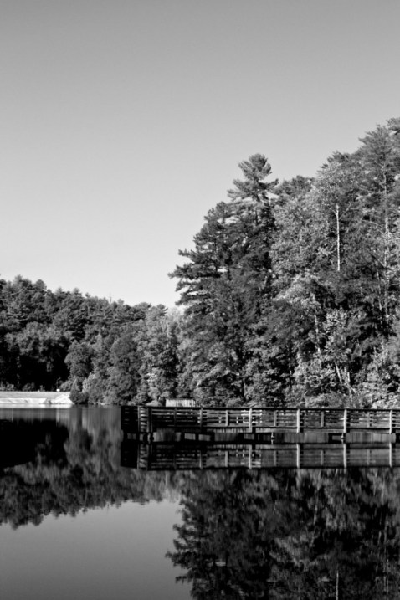
Texture in landscapes
Using texture in the right areas of a landscape photo can be used to draw a viewer’s eye to the area you want. Notice in the below photograph, even though the sky is bright, your eye will go straight to the trees and dock because of its texture. There is no texture in the sky, therefore is becomes less interesting.

Slide 30
Tone
Tonal range is the difference between the lightest and darkest parts of a photograph.

Slide 31
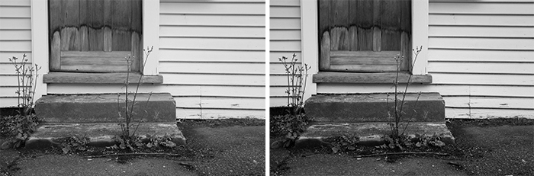
Tones in black and white photography

Slide 32
Form
Form refers to three dimensional objects
(height, width, depth)

Slide 33
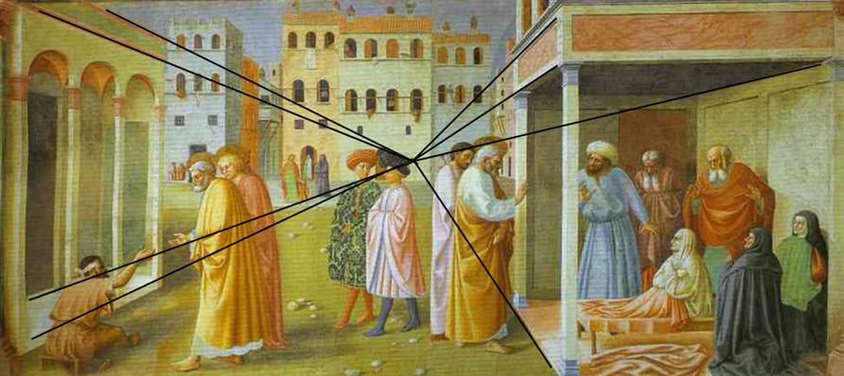
Form
(The three-dimensionality of the artwork)
Masolino, St. Peter Healing a Cripple and the Raising of Tabitha, 1425
The added black lines show the use of a ‘vanishing point’ to create a realistic impression of three dimensional space – commonly referred to as ‘realistic perspective’.

Slide 34
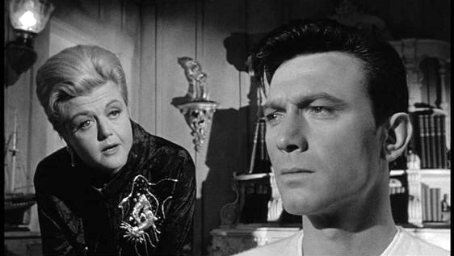
Film still from The Manchurian Candidate
How does the photographer suggest three-dimensional space (i.e. depth)?

Slide 35
Answers:
1. Man’s head is larger than woman’s so our brains interpret this as suggesting that he is nearer to the camera than the woman.
2. Background is out of focus suggesting depth
3. The lighting creates shading suggesting three dimensional form

Slide 36
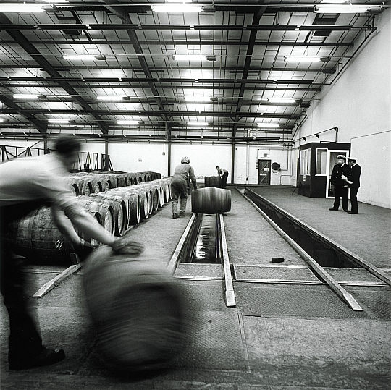
What visual element(s) help give this photograph ‘depth’ and a three-dimensional character?
Fay Godwin

Slide 37
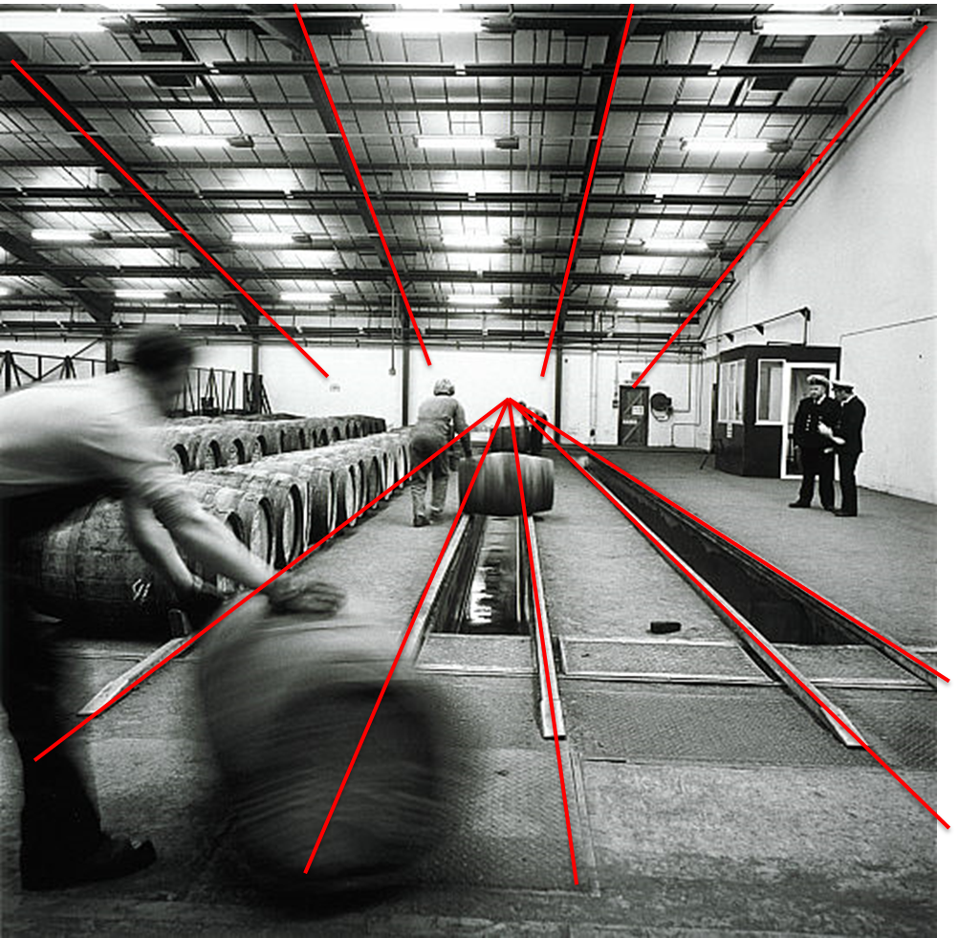
Answer: the converging lines formed by the tracks and ceiling supports.
Fay Godwin

