Slide 1
GCSE Computer Science (9-1)
This Photo by Unknown author is licensed under CC BY-SA.
Fundamentals of Algorithms
Lesson 5: Searching algorithms

Slide 2
Lesson Objectives
Today, you will be learning SEARCHING ALGORITHMS with the prime focus on LINEAR & BINARY Searching.
Understand how the linear and binary search algorithms work
Compare and contrast the linear and binary search algorithms

Slide 3
Come back here if you forget
Have you gone through the lesson and still don't get quite get what a Searching Algorithm is?
Click on this video for a demonstration to help you!

Slide 4
How are algorithms used to search?
Algorithms can be used to search through a list where items are compared
If the comparison does not return a positive/True value, the item is discarded and the search moves on
There are two types of search: binary and linear

Slide 5
Searching Algorithms
Searching algorithms are used to FIND a particular value within an indexed list.
Humans and computers do this differently. As a human, we can spot what we want in a list and select it. However, Computers need a set of instructions to follow to reach that value.
Consider the following image: If I wanted to find a particular game, I would start from the beginning and work my way along.

Slide 6
Deck of cards
Imagine you were going to search for a card within a deck
For example: 3 of clubs
How would you go about searching?

Slide 7
Unsorted data
An example of an unsorted dataset is a deck of cards
The suit and value of the next card is unknown as the dataset is randomly ordered

Slide 8
LINEAR - How does linear search work?
A linear search moves sequentially through a collection of consecutive items looking for a comparison that returns a match
It works by comparing the item to find with the current item
The item to find is often referred to as the “key”
In a linear search, the algorithm iterates through each item of the collection
A
B
C

Slide 9
LINEAR - Pseudocode for Linear Search
Key ← USERINPUT
Found ← FALSE
FOR Items IN Dataset
IF Item = Key THEN
OUTPUT “Item is in the dataset”
Found ← TRUE
IF Found = False THEN
OUTPUT “Item is not in the dataset”
Create an array of items called ‘dataset’ and program this algorithm!

Slide 10
BINARY - Half-n-half
If you were looking for the number 38, whereabouts on the number line would you begin looking?
Normally, one would start by looking in the first half, as 38 is clearly not a number above 50
Therefore, 50 and all numbers above it are discarded from our search
This principle applies to the binary search algorithm

Slide 11
Binary search
The linear search is slow as each item is sequentially checked – however, the binary search algorithm is quicker
The name is derived from the technique of half and half searching
The items of data are repeatedly split in half, until the item in question has been found
This means that only half the data is ever searched

Slide 12
BINARY - Algorithm
A binary search starts by looking at the midpoint of a data set
The algorithm then calculates if the sought item is higher or lower than the midpoint…
If it is greater than the midpoint, the search moves to the second half of the dataset by moving the lower-boundary pointer to one above the midpoint
If it is less than the midpoint, the search moves to the first half of the dataset by moving the upper-boundary pointer to one below the midpoint
This process repeats, each time looking at the midpoint
An item is found once it becomes the midpoint of a list
Items not in the list will cause the lower boundary to become greater than the upper boundary

Slide 13
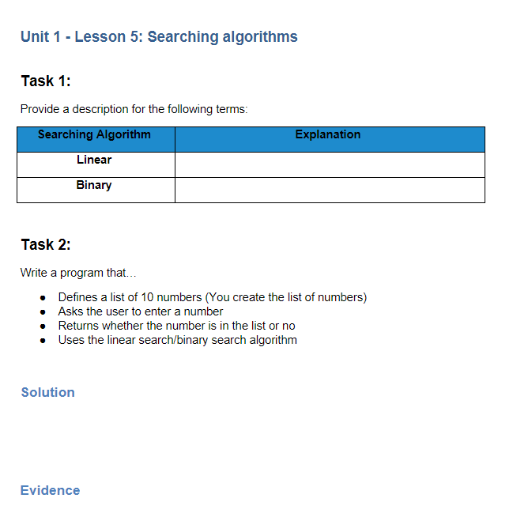
TASK - Worksheet
Complete Task 1 (explanation for each term). The answers are within this presentation. Use Abstraction to focus on the key details.
Complete Task 2 – Use Repl.it/Python IDLE to create a program which meets the user requirements. Use this link for assistance -> Python - Searching Algorithms - Tutorialspoint
Provide a screenshot of your program and the output window to display it works.

Slide 14
Challenge - Pseudocode for Binary Search
found ← False
LB ← 0
UB ← len(dataset)-1
item ← USERINPUT
WHILE found = False AND LB<=UB
midpoint ← (LB + UB) DIV 2
IF dataset[midpoint] = item THEN
OUTPUT “Item is in the list”
found ← True
BREAK
ELSE THEN
IF dataset[midpoint] > item THEN
UB ← midpoint – 1
ELSE
LB ← midpoint + 1
ENDIF
ENDIF
ENDWHILE
IF found = False THEN
OUTPUT “Item is not in the list”
ENDIF
Create an array of items called ‘dataset’ and program this algorithm!

Slide 15
Comparing Binary and Linear sort
Time effectiveness
The binary search is more effective on larger datasets, because it only ever searches half the data
In addition, the worst-case scenario for a binary search is much smaller than that for a linear search
Methodology
The binary search works on the principle of the midpoint of a dataset – it compares the item in question to this, and thus determines where the data cannot be – the principle of Divide and Conquer
The linear search, however, works on the principle of Brute Force or enumeration; it tries all possible combinations before determining whether the item is in the dataset or not

