Slide 1
GCSE Computer Science (9-1)
PROGRAMMING
LESSON 8: INPUT, OUTPUT AND FILE HANDLING

Slide 2
Penultimate Tutorial!!!
Notice the colour is a little different?
This will be your second to last tutorial for this topic.
So far we have covered:
Data types
Assignment
Variables and Constants
Selection
Iteration
Arithmetic operators
Relational operators
Boolean operators
Arrays
So far everything covered might be rather basic to KS3/4 programmers – In Year 10/11 we are delving into the trickier stuff!

Slide 3
Lesson Objectives
Be able to obtain user input from the keyboard
Be able to output data and information from a program to the computer display
Be able to read/write from/to a text file
Tasks for today:
Task 1 - Slide 11
Task 2 - Slide 20
Task 3 - Slide 27

Slide 4
What have we covered so far…
Data types
Assignment
Variables and Constants
Selection
Iteration
Arithmetic operators
Relational operators
Boolean operators
Arrays

Slide 5
Getting an input
In computer programming, we can get many inputs from many different sources
How many can you think of?
In an arcade machine, we use the joysticks/buttons to input controls for a character
In a supermarket, a barcode scanner is used to input an item’s unique code
In some exam marking offices, scanners input the scripts and an OMR is used to examine the responses

Slide 6
Getting an input
In pseudocode, we can represent user inputs through the USERINPUT key-command
Name 🡨 USERINPUT
Now write this program out in your programming language
OUTPUT “Please enter your name”
Name 🡨 USERINPUT
OUTPUT “Hello there”, Name
OUTPUT “I am a computer program!”

Slide 7
Python Solution
Demonstrations for this unit will be done in Python
An example response, run in interactive move, might be..

Slide 8
Handling inputs and outputs
By now, we should all have basic experience of Inputs and Outputs
BUT – variables and memory addresses in computer programs, such as the one we just wrote, are considered to be volatile
This means that once the program stops running, the memory addresses are re-written
How might we use a non-volatile storage method? (e.g. Hard Drive)

Slide 9
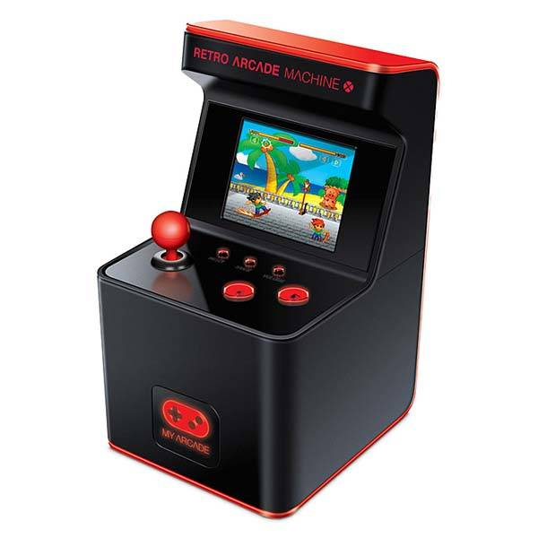
Introduction to File Handling
In programming, we can use text files and csvs to store data used in a program
For example – our arcade machine example takes inputs for a character moving
How might we store the highscores for each player?

Slide 10
Reading and Writing to a text file
Try this out!
Write a program/algorithm that stores a USER INPUT to a variable called “score”
Then, print the value of score

Slide 11
Task 1
Create your own Input/Output using formatting.

Slide 12
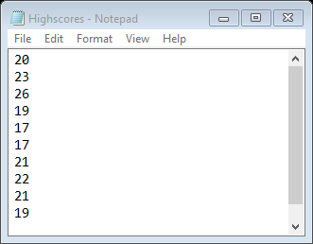
Text file operations
Taking our example, we might have a text file that stores the highscores of a game

Slide 13
Reading from a file
In programming, we can read files using a simple command
READLINE(file, n) 🡨 this returns the nth line of a file
We might also want to read each line from a file, and store each line (as an array, where each line is at one index) in a variable
File 🡨 READLINES(file)

Slide 14
File handling operations
There are three file-handling operations we can use in programming
R Read a file
W Overwrite a file
A Add to a file

Slide 15
Now try this…
Copy out and run this code in Python

Slide 16
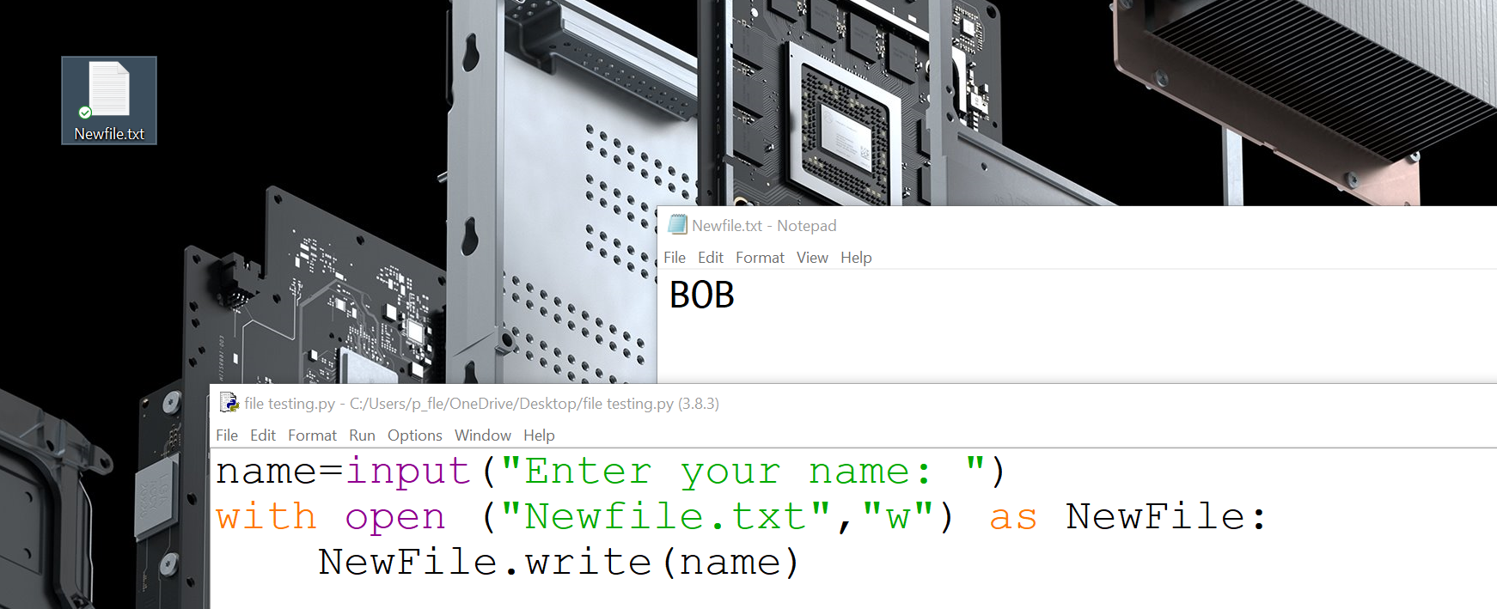
Copy out and run this code in Python
The “w” method means that the file created/overwritten.
The write function allows lines to be individually written to a file

Slide 17
Now try this…
What does this code do?
The “r” method means that the file is opened to read it.
We can then store each line of the program in a new variable, where each line is stored
Add the following lines to your code and run the program:
File = Newfile.readlines()
print(type(File)

Slide 18
Output of previous program

Slide 19
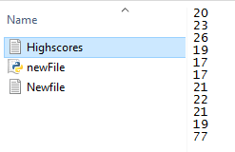
Now try this!

Slide 20
Task 2 : Pseudocode Commands
You have now been practicing with your file handling operations, now try and translate the examples from Pseudocode (Unit 1 Algorithms).
Use the link on the Task sheet for Pseudocode terms.

Slide 21
File handling
By now you should
Know how to read lines from a file
Know how to overwrite a file
Know how to add to a file

Slide 22
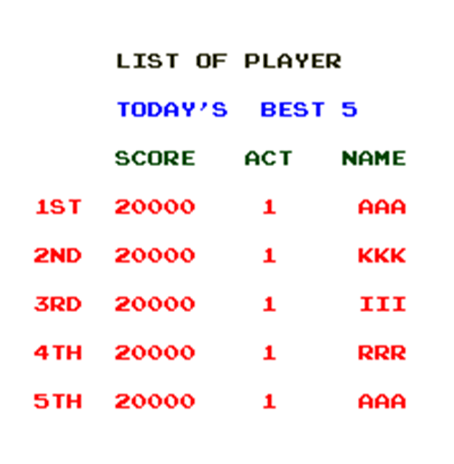
Consider
How might we replicate/mimic this in a text file?

Slide 23
Arrays of Arrays…
Remember: What happened when you checked the type of the variable that stored the readlines() function?
This means that each line in a file, stored, works like a list
Consider: Could we further subdivide these lists?

Slide 24
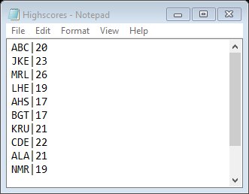
Delimiting data
In a text file, we want to replicate the idea of a table/a grid
We can do this using delimiters – these are boundary identifiers
For example – this might be a | in a text file, where the headings structure follows Name|Score

Slide 25
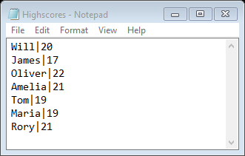
Using delimiters
How would we divide this up?
Index [1]
Score
Index [0]
Name

Slide 26
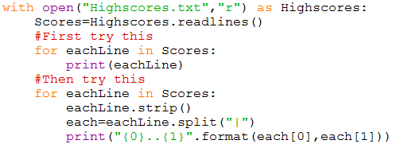
Try this!
Copy & run this code and explain what it does using this Highscores.txt file

Slide 27
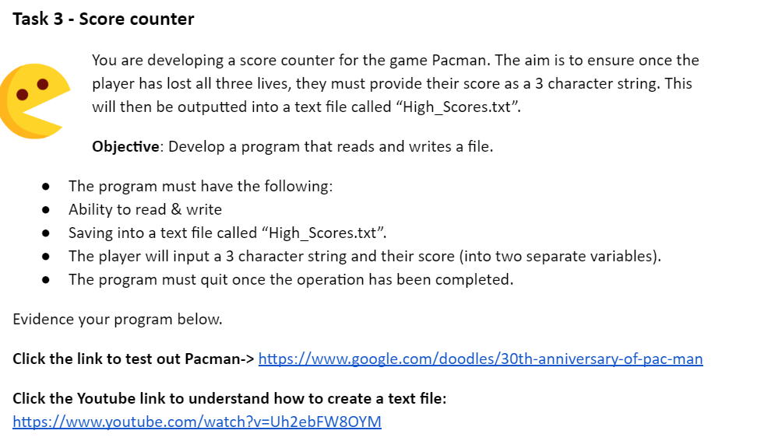
Task 3 - Score Counter
Task 3 requires a python program being developed to WRITE then READ a file containing scores.
Using the “Now Try This” examples from the previous slides, create a program that reads/writes a file and takes in 2 inputs to allow a user to enter their name & score for a game of pacman.

