Slide 1
ASCII/Unicode

Slide 2
Recall
Convert the following Hexadecimal to binary:
AA7
Convert the following binary to Hexadecimal
11001010

Slide 3
Recap - What will we be learning this term?
Base values(Binary & Calculations)
Hexadecimal values
ASCII & UNICODE
File Size Calculations
Image Development
Digital Sound creation
Compression Techniques
Encryption Methods

Slide 4
Text representation
Objectives
Explain how ASCII is used to represent characters, and its limitations
Explain what a character set is
Explain the need for Unicode
Be able to calculate the number of bits needed to store a piece of text

Slide 5
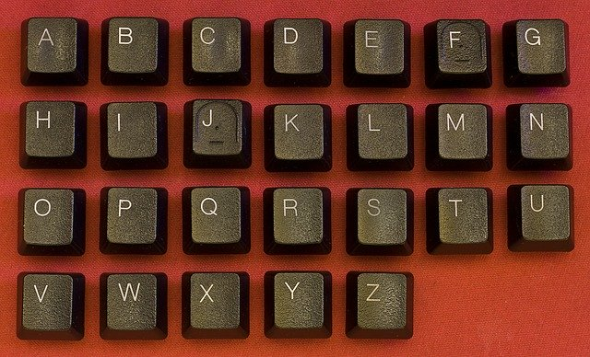
Representing the alphabet (Challenge)
Binary numbers are used to represent letters. In pairs, respond to the questions below. (3 minutes)
How many different letters you could represent with four bits.
With four bits, you can have 16 different combinations
b) How many bits would you need to represent the English alphabet.
With five bits, you can have 32 different combinations.
Notes:
Image source: https://pixabay.com/photos/keyboard-abc-alphabet-button-key-933090/

Slide 6
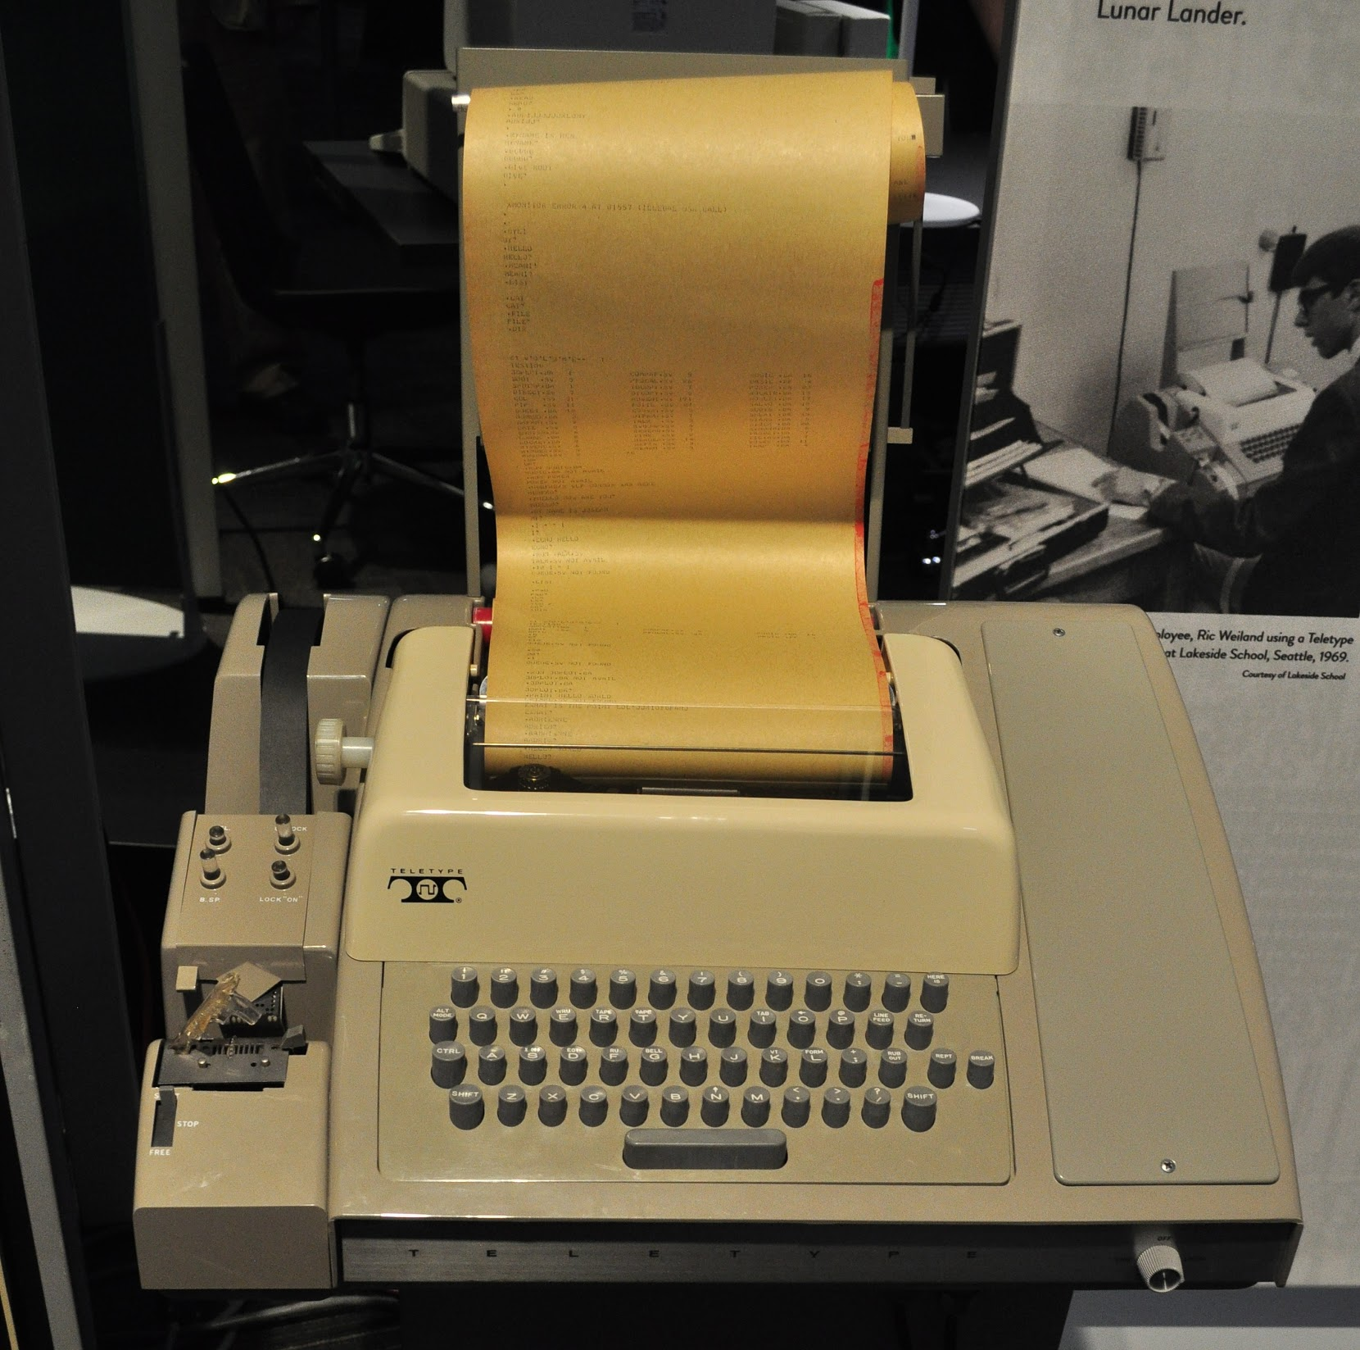
Representing text (Background)
ASCII was created in the 1960s to standardise the codes used by teleprinters.
Teleprinters were used from the 1880s to around the 1970s.
They were used to send and receive typed messages over telegraph, telephone lines, etc.
ASCII was used on the World Wide Web until 2008.
Notes:
Image source: https://commons.wikimedia.org/wiki/File:LCM_-_1960s_Teletype_computer_printer_02.jpg (CC BY-SA 3.0)

Slide 7
Representing text
In ASCII,
Decimal 65 represents A
Decimal 66 represents B
What decimal number represents F?
Decimal 70 represents F
What binary number represents D?
01000100
Decimal | Hex | Binary | Character
65 | 41 | 01000001 | A
66 | 42 | 01000010 | B
67 | 43 | 01000011 | C

Slide 8
What is ASCII?
Code number 67
Binary 01000011
C
C button is pressed
Different sets of codes are available for different types of computer.
PCs use a character set called ASCII, American Standard Code for Information Interchange.
A Character Set is the group of symbols that a computer can represent and includes letters, digits, punctuation marks and control characters. Technically, ASCII is used for text representation.

Slide 9
ASCII Table
www.asciitable.com
Computers only understand numerical values, interpreted using binary
Character codes are grouped by lowercase, uppercase, symbols and numbers
7-bit ASCII uses 7 bits as an identifier for a character, covering a-z, 0-9 and symbols.
Original ASCII used 7-bits – how many combinations(How many characters can be represented)?

Slide 10
Representing text
Task 2: Decode a decimal ASCII message using the ASCII table that you have. (In Pairs)
Decimal 32 in ASCII is a space.
Here it is in binary:
01001001 00100000 01101000 01100001 01110110 01100101 00100000 00110001 00110010 00100000 01100001 01110000 01110000 01101100 01100101 01110011
73 | 32 | 104 | 97 | 118 | 101 | 32 | 49 | 50 | 32 | 97 | 112 | 112 | 108 | 101 | 115
73 | 32 | 104 | 97 | 118 | 101 | 32 | 49 | 50 | 32 | 97 | 112 | 112 | 108 | 101 | 115
I |  | h | a | v | e |  | 1 | 2 |  | a | p | p | l | e | s

Slide 11
Special characters
ASCII worked fine for English languages.
However, new symbols, letters and notation started to come in.
7 bits was essentially not enough to encode all these characters.
Latin American countries required communication with North American states, enforcing the need for an extra bit.

Slide 12
Extended ASCII
It was decided that another 128 characters could be stored using the 8th bit – this developed into extended ASCII
This system was used by countries that had their own unique/shared characters
However, the first 128 characters remained as A-Z, 0-9 etc. – for some languages, such as Chinese, this was useless!

Slide 14
Questions Sheet
How ASCII is used to represent text in a computer system.
To represent text in a computer system, each character in the character set is given its own special number. This number is called its code. This code is then stored in the computer system using binary ones and zeros.
What is a character set?
A Character Set is the group of symbols that a computer can represent and includes letters, digits, punctuation marks and control characters.
The German language includes the characters ä, ö and ü. Explain why these cannot be represented in ASCII.
With just 7 bits, ASCII cannot generate enough binary patterns to represent all the letters and symbols in common use across the world. An 8-bit version known as ‘extended ASCII’ attempted to overcome this problem, but even using 256 binary patterns does not enable it to support a large enough character set.
The letter ‘M’ has the ASCII binary code 0100 1101. Derive the code for the letters ‘Q’ and ‘L’. (Do not look them up in the table.)
Q: 01010001 and L: 01010001

Slide 15
Unicode
ASCII was extended into Unicode in the 1980s.
You might like to look at:
Emojis and pictographs 😂 📵 🌞
Currency symbols ¥ ₯ ₻
Musical symbols ♩ ♫ ♭
Braille codes ⠓ ⠑ ⠇ ⠇ ⠕
Notes:
The slide includes the word ‘hello’ expressed in Braille.

Slide 16
Unicode and ASCII
Activity 2
Unicode uses up to 4 bytes per character.
It includes character codes for nearly 138,000 different characters.
Unicode is an extension of ASCII.
The first 256 Unicode codes are the same as in ASCII.
Decimal | ASCII | Unicode | Character
65 | 0100 0001 | 0000 0000 0100 0001 | A
255 | 1111 1111 | 0000 0000 1111 1111 | ÿ
9820 |  | 0010 0110 0101 1100 | ♜

Slide 17
