Slide 1
Lesson 12: Assembly language programming I
Save a copy
KS4 - Computer systems
Notes:
This resource is available online at ncce.io/cpst-12-s. Resources are updated regularly — please check that you are using the latest version.
This resource is licensed under the Open Government Licence, version 3. For more information on this licence, see ncce.io/ogl.

Slide 2
High-level programming
Starter activity
To start you must design and create a Python program that does the following:
Inputs two numbers
Adds them together
Outputs the result
Write out your ideas on the worksheet first as either Python statements or pseudocode.

Slide 3
High-level programming
Starter activity
Pseudocode
num1 <- USERINPUT
num2 <- USERINPUT
result <- num1 + num2
OUTPUT result

Slide 4
High-level programming
Starter activity
Pseudocode
num1 <- USERINPUT
num2 <- USERINPUT
OUTPUT num1 + num2

Slide 5
Lesson 12: Assembly language programming I
Objectives
In this lesson, you will:
Understand that assembly language has a 1:1 relationship with machine code
Explain the basic commands in the LMC’s assembly code: INP, OUT, STA, LDA, ADD, SUB, and BRP

Slide 6
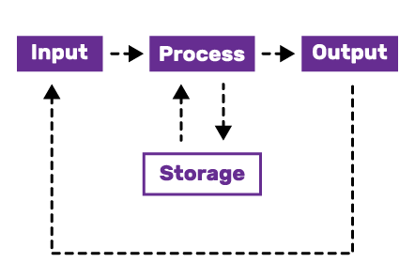
High to low
Activity 1
1
2
3
4
num1 = input()
num2 = input()
print(num1 + num2)
Have a look at line #1 — which of the stages of the computing cycle does the line accomplish?
How about line #4?

Slide 7
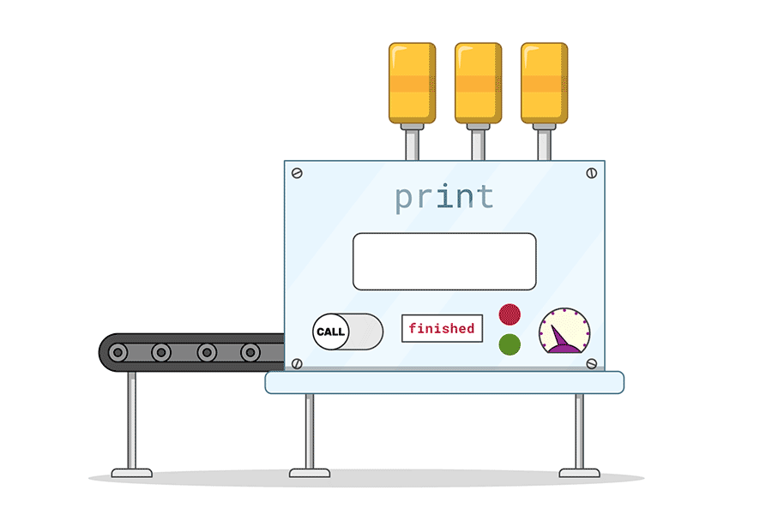
High to low
Activity 1
In a high-level programming language, each line or command accomplishes multiple things.
This makes high-level languages easy to use, but difficult to optimise. Low-level languages will accomplish one of the stages with each line.
This is an example of abstraction.

Slide 8
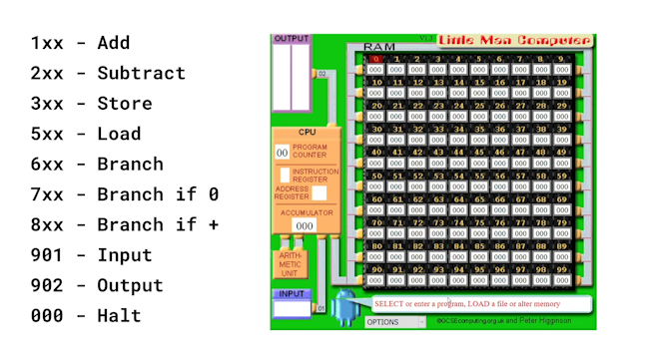
High to low
Activity 1
You are going to play the part of a translator, going line by line through the program and changing it into an assembly language.
Assembly languages are specific to a processor, and you are going to use the Little Man Computer.
https://peterhigginson.co.uk/lmc/

Slide 9
High to low
Activity 1
To help you remember the commands, you have been given a cheat sheet to fill out in your own words.
The names of the commands have been given to you, but you need to fill out the mnemonic, opcode, and give a description of what the command does.

Slide 10
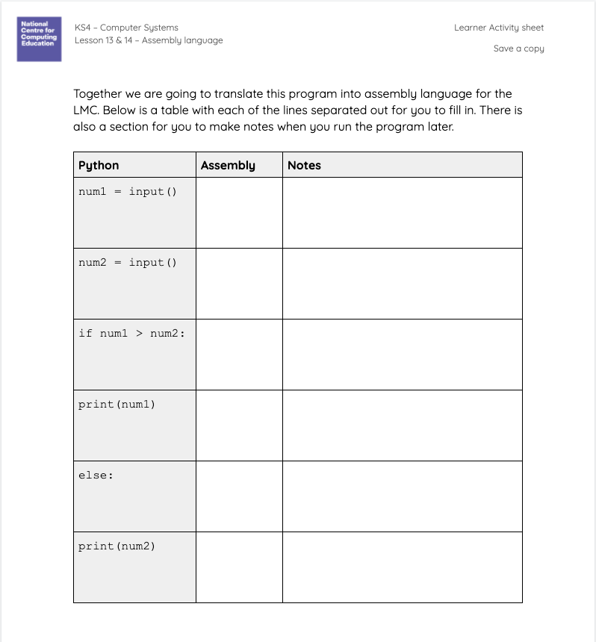
High to low
Activity 1
You can follow along as you translate the Python code on your worksheet.
There is space for you to write the assembly commands and to make notes as you run it later.
Make sure to leave room in the notes section for the next exercise.

Slide 11
High to low
Activity 1
Python
num1 = input()
num2 = input()
print(num1 + num2)
Assembly
The first line in the Python program does two things.
It takes in information from the user and stores it in a variable.

Slide 12
High to low
Activity 1
Python
num1 = input()
num2 = input()
print(num1 + num2)
Assembly
INP
STA NUM1
Program Counter . :
Input . :
Accumulator . :
Output . :
As you step through the program, the labels above will show you what is held in some of the important registers inside the CPU.
These values will change as you go through.

Slide 13
High to low
Activity 1
Python
num1 = input()
num2 = input()
print(num1 + num2)
Assembly
INP
STA NUM1
Program Counter . : 00
Input . : 10
Accumulator . :
Output . :
So first use the input command, which uses the mnemonic INP.
The value entered by your user is captured, in this case it is 10. This value is then placed in the accumulator.

Slide 14
High to low
Activity 1
Python
num1 = input()
num2 = input()
print(num1 + num2)
Assembly
INP
STA NUM1
Program Counter . : 00
Input . : 10
Accumulator . :
Output . :
Then store this value, giving it a variable name just like do in Python. The store command uses the mnemonic STA and opcode 3XX.

Slide 15
High to low
Activity 1
Python
num1 = input()
num2 = input()
print(num1 + num2)
Assembly
INP
STA NUM1
Program Counter . : 01
Input . :
Accumulator . : 10
Output . :
Using this as an example, what do you think the second line will translate to?

Slide 16
High to low
Activity 1
Python
num1 = input()
num2 = input()
print(num1 + num2)
Assembly
INP
STA NUM1
INP
STA NUM2
Program Counter . : 02
Input . : 14
Accumulator . : 14
Output . :
The main difference is the variable you use to store the input.
This time it should be called NUM2.

Slide 17
High to low
Activity 1
Python
num1 = input()
num2 = input()
print(num1 + num2)
Assembly
INP
STA NUM1
INP
STA NUM2
Program Counter . : 03
Input . :
Accumulator . : 14
Output . :
Next you need to add the two numbers together.
From your toolbox, which command do you think you need to use?

Slide 18
High to low
Activity 1
Python
num1 = input()
num2 = input()
print(num1 + num2)
Assembly
INP
STA NUM1
INP
STA NUM2
ADD NUM1
Program Counter . : 04
Input . :
Accumulator . : 14
Output . :
The ADD command will add the data stored at the given address (in this case NUM1) to the value in the accumulator.

Slide 19
High to low
Activity 1
Python
num1 = input()
num2 = input()
print(num1 + num2)
Assembly
INP
STA NUM1
INP
STA NUM2
ADD NUM1
Program Counter . : 04
Input . :
Accumulator . : 24
Output . :
NUM1 was 10, so the accumulator now holds 24 (the result).

Slide 20
High to low
Activity 1
Python
num1 = input()
num2 = input()
print(num1 + num2)
Assembly
INP
STA NUM1
INP
STA NUM2
ADD NUM1
OUT
Program Counter . : 05
Input . :
Accumulator . : 24
Output . : 24
Finally, use the OUT command to output the value stored in the accumulator.
Although Python is finished, you still have to do two things.

Slide 21
High to low
Activity 1
Python
num1 = input()
num2 = input()
print(num1 + num2)
Assembly
INP
STA NUM1
INP
STA NUM2
ADD NUM1
OUT
HLT
Program Counter . : 05
Input . :
Accumulator . : 24
Output . : 24
You need to tell the program to stop — using the halt (HLT) command.
You also need to set up the variables. Unlike in Python, this isn’t done for you.

Slide 22
High to low
Activity 1
Python
num1 = input()
num2 = input()
print(num1 + num2)
Assembly
INP
STA NUM1
INP
STA NUM2
ADD NUM1
OUT
HLT
NUM1 DAT
Program Counter . : 05
Input . :
Accumulator . : 24
Output . : 24
Every time you use a variable in a program, you need to add a DAT command to the end of the program.
This reserves a memory location.

Slide 23
High to low
Activity 1
Python
num1 = input()
num2 = input()
print(num1 + num2)
Assembly
INP
STA NUM1
INP
STA NUM2
ADD NUM1
OUT
HLT
NUM1 DAT
NUM2 DAT
Program Counter . : 05
Input . :
Accumulator . : 24
Output . : 24
Every time you use a variable in a program, you need to add a DAT command to the end of the program.
This reserves a memory location.

Slide 24
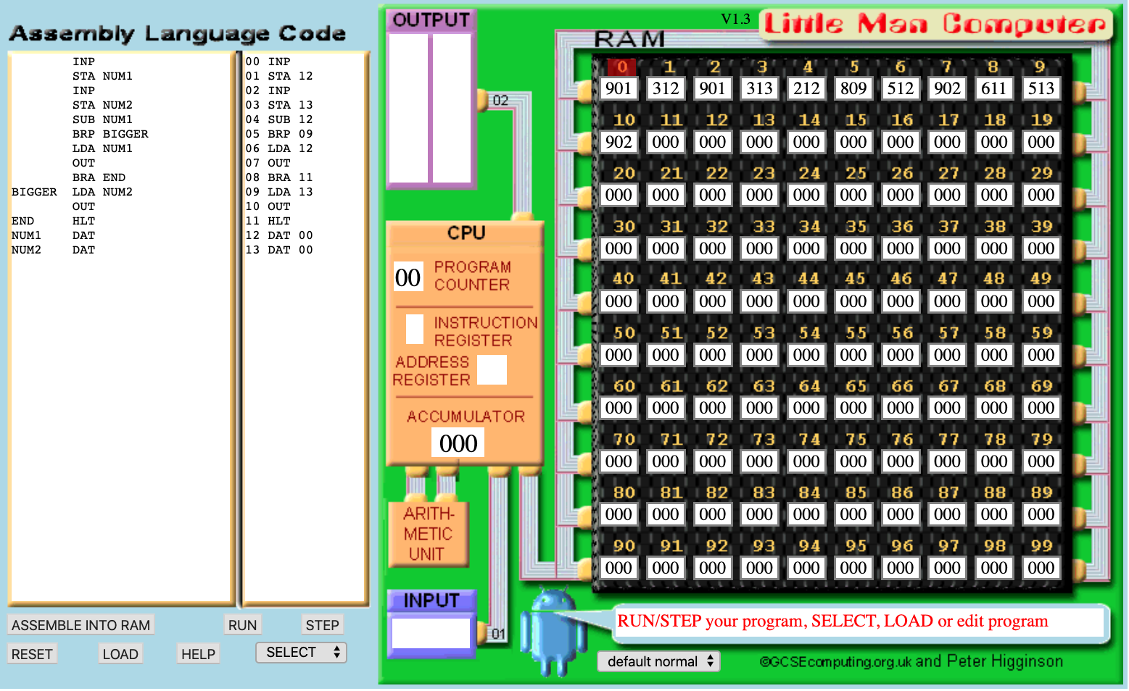
Tracing the LMC
Activity 2
Next you are going to run the program inside of a simulator for the LMC made by Peter Higginson.
The simulator will allow you to write and run your assembly language programs inside your browser.
https://peterhigginson.co.uk/lmc/
You can type the program in yourself or load it from the text file.

Slide 25
Tracing the LMC
Activity 2
As you go through the program, make notes on what happens with the different parts of the processor.
You also need to fill in the appropriate opcodes for each command by examining the RAM.
The code is on your worksheet, you can make notes in the space next to each line.

Slide 26
Over to you
Activity 2
INP
STA NUM1
INP
ADD NUM1
OUT
HLT
NUM1 DAT
NUM2 DAT
Now I want you to really make the program your own.
Edit the program so that it:
Inputs a third number
Adds all three together
Outputs the result

Slide 27
Over to you
Activity 2
INP
STA NUM1
INP
STA NUM2
INP
ADD NUM1
ADD NUM2
OUT
HLT
NUM1 DAT
NUM2 DAT
Notice how you can call the ADD command twice in a row, because it just keeps adding to the accumulator.
Check your program is the same as this one and then run it to make sure it works.

Slide 28
Analysing assembly language
Activity 3
INP
STA NUM1
INP
STA NUM2
SUB NUM1
BRP BIGGER
LDA NUM1
OUT
BRA END
BIGGER LDA NUM2
OUT
END HLT
NUM1 DAT
NUM2 DAT
Here is another LMC assembly program.
The program is also on your worksheet.
In pairs, have a look at the program and make a prediction of what it will do when it runs?
What new commands is it using?

Slide 29
Analysing assembly language
Activity 3
INP
STA NUM1
INP
STA NUM2
SUB NUM1
BRP BIGGER
LDA NUM1
OUT
BRA END
BIGGER LDA NUM2
OUT
END HLT
NUM1 DAT
NUM2 DAT
Load the program into the LMC.
You can use the text file provided.
Run the program a few times with different inputs, to test your predictions.
What does it do?

Slide 30
Analysing assembly language
Activity 3
num1 = input()
num2 = input()
if num1 > num2:
print(num1)
else:
print(num2)
This is the same program in Python.
This one is a bit more complex.
It includes an if statement, which means you will need to use branches.
Have a look at the assembly code again and see if you can spot the branches in it.

Slide 31
Analysing assembly language
Activity 3
INP
STA NUM1
INP
STA NUM2
SUB NUM1
BRP BIGGER
LDA NUM1
OUT
BRA END
BIGGER LDA NUM2
OUT
END HLT
NUM1 DAT
NUM2 DAT
To see how it works, let’s step through it together on the LMC.
Be sure to write the new commands into your toolbox so you can use them later.

Slide 32
Analysing assembly language
Activity 3
INP
STA NUM1
INP
STA NUM2
SUB NUM1
BRP BIGGER
LDA NUM1
OUT
BRA END
BIGGER LDA NUM2
OUT
END HLT
NUM1 DAT
NUM2 DAT
Program Counter . : 00
Input . : 10
Accumulator . : 10
Output . :
We are going to use the same input as last time.
The first line will get the user input and store the value in the accumulator.
Where will the second line store the data?

Slide 33
Analysing assembly language
Activity 3
INP
STA NUM1
INP
STA NUM2
SUB NUM1
BRP BIGGER
LDA NUM1
OUT
BRA END
BIGGER LDA NUM2
OUT
END HLT
NUM1 DAT
NUM2 DAT
Program Counter . : 01
Input . :
Accumulator . : 10
Output . :
It will store it in the memory location assigned to NUM1 in this case 12.
The same thing will happen again for lines 3 and 4, except the data will be stored at location 13 for NUM2.

Slide 34
Analysing assembly language
Activity 3
INP
STA NUM1
INP
STA NUM2
SUB NUM1
BRP BIGGER
LDA NUM1
OUT
BRA END
BIGGER LDA NUM2
OUT
END HLT
NUM1 DAT
NUM2 DAT
Program Counter . : 02
Input . : 14
Accumulator . : 14
Output . :
It will store it in the memory location assigned to NUM1 in this case 12.
The same thing will happen again for lines 3 and 4, except the data will be stored at location 13 for NUM2.

Slide 35
Analysing assembly language
Activity 3
INP
STA NUM1
INP
STA NUM2
SUB NUM1
BRP BIGGER
LDA NUM1
OUT
BRA END
BIGGER LDA NUM2
OUT
END HLT
NUM1 DAT
NUM2 DAT
Program Counter . : 03
Input . :
Accumulator . : 14
Output . :
It will store it in the memory location assigned to NUM1 in this case 12.
The same thing will happen again for lines 3 and 4, except the data will be stored at location 13 for NUM2.

Slide 36
Analysing assembly language
Activity 3
INP
STA NUM1
INP
STA NUM2
SUB NUM1
BRP BIGGER
LDA NUM1
OUT
BRA END
BIGGER LDA NUM2
OUT
END HLT
NUM1 DAT
NUM2 DAT
Program Counter . : 04
Input . :
Accumulator . : 4
Output . :
On the LMC there is no ‘greater than’ command, so we need to find another way to do it.
We are going to use the subtract command to take away the first number from the second number.

Slide 37
Analysing assembly language
Activity 3
INP
STA NUM1
INP
STA NUM2
SUB NUM1
BRP BIGGER
LDA NUM1
OUT
BRA END
BIGGER LDA NUM2
OUT
END HLT
NUM1 DAT
NUM2 DAT
Program Counter . : 04
Input . :
Accumulator . : 4
Output . :
As you can see here, if NUM2 is bigger, the result will be positive.
We can use a branch, which will cause our code to skip forward or carry on depending on the result currently in the accumulator.

Slide 38
Analysing assembly language
Activity 3
INP
STA NUM1
INP
STA NUM2
SUB NUM1
BRP BIGGER
LDA NUM1
OUT
BRA END
BIGGER LDA NUM2
OUT
END HLT
NUM1 DAT
NUM2 DAT
Program Counter . : 05
Input . :
Accumulator . : 4
Output . :
This branch is called branch if positive and uses the mnemonic BRP. BIGGER is the marker it should jump to.
Where is the BIGGER marker?

Slide 39
Analysing assembly language
Activity 3
INP
STA NUM1
INP
STA NUM2
SUB NUM1
BRP BIGGER
LDA NUM1
OUT
BRA END
BIGGER LDA NUM2
OUT
END HLT
NUM1 DAT
NUM2 DAT
Program Counter . : 06
Input . :
Accumulator . : 10
Output . :
If the value in the accumulator was not positive, then the first number would have been the larger.
In which case the program needs to load that value in order to output it.
This will be skipped if NUM2 is larger.

Slide 40
Analysing assembly language
Activity 3
INP
STA NUM1
INP
STA NUM2
SUB NUM1
BRP BIGGER
LDA NUM1
OUT
BRA END
BIGGER LDA NUM2
OUT
END HLT
NUM1 DAT
NUM2 DAT
Program Counter . : 07
Input . :
Accumulator . : 10
Output . : 10
If the value in the accumulator was not positive, then the first number would have been the larger.
In which case the program needs to load that value in order to output it.
This will be skipped if NUM2 is larger.

Slide 41
Analysing assembly language
Activity 3
INP
STA NUM1
INP
STA NUM2
SUB NUM1
BRP BIGGER
LDA NUM1
OUT
BRA END
BIGGER LDA NUM2
OUT
END HLT
NUM1 DAT
NUM2 DAT
Program Counter . : 07
Input . :
Accumulator . : 10
Output . : 10
Then we just need to output the number to our users.
This will be skipped if NUM2 is larger.

Slide 42
Analysing assembly language
Activity 3
INP
STA NUM1
INP
STA NUM2
SUB NUM1
BRP BIGGER
LDA NUM1
OUT
BRA END
BIGGER LDA NUM2
OUT
END HLT
NUM1 DAT
NUM2 DAT
Program Counter . : 08
Input . :
Accumulator . : 10
Output . :
At this point, the program has done what it needs to if NUM1 is the larger.
Our next pieces of code will be the else block We need to provide another jump point so that the code can skip the next bit.

Slide 43
Analysing assembly language
Activity 3
INP
STA NUM1
INP
STA NUM2
SUB NUM1
BRP BIGGER
LDA NUM1
OUT
BRA END
BIGGER LDA NUM2
OUT
END HLT
NUM1 DAT
NUM2 DAT
Program Counter . : 08
Input . :
Accumulator . : 10
Output . :
We are going to use branch-always with the mnemonic BRA. The marker this time will be END.
This command will always cause the program to skip to the marker.

Slide 44
Analysing assembly language
Activity 3
INP
STA NUM1
INP
STA NUM2
SUB NUM1
BRP BIGGER
LDA NUM1
OUT
BRA END
BIGGER LDA NUM2
OUT
END HLT
NUM1 DAT
NUM2 DAT
Program Counter . : 09
Input . :
Accumulator . : 14
Output . :
Earlier, you told the LMC that if the result of a subtraction was positive, it should move to the BIGGER branch.
Now we need to tell it where BIGGER is in our program.

Slide 45
Analysing assembly language
Activity 3
INP
STA NUM1
INP
STA NUM2
SUB NUM1
BRP BIGGER
LDA NUM1
OUT
BRA END
BIGGER LDA NUM2
OUT
END HLT
NUM1 DAT
NUM2 DAT
Program Counter . : 10
Input . :
Accumulator . : 14
Output . : 14
We then do the same thing for NUM2 that we did for NUM1.
Load it into the accumulator and then output the value.

Slide 46
Analysing assembly language
Activity 3
INP
STA NUM1
INP
STA NUM2
SUB NUM1
BRP BIGGER
LDA NUM1
OUT
BRA END
BIGGER LDA NUM2
OUT
END HLT
NUM1 DAT
NUM2 DAT
Program Counter . : 11
Input . :
Accumulator . :
Output . :
The final lines end the program — after jumping to the END marker.
We also need to set up the data locations for our variables.

Slide 47
Check your toolbox!
Plenary
Command | Description | Op
INP | Get user input and load it into the accumulator. | 901
OUT | Output the contents of the accumulator. | 902
LDA | Load the accumulator with the data located at the supplied memory address. | 5XX
STA | Store the current value in the accumulator to the memory address supplied. | 3XX

Slide 48
Check your toolbox!
Plenary
Command | Description | Op
BRP | Branch (jump) to the memory address if the accumulator value is zero or positive. | 8XX
BRZ | Branch (jump) to the memory address provided if the accumulator value is zero. | 7XX
BRA | Branch (jump) to the memory address provided. | 6XX

Slide 49
Check your toolbox!
Plenary
Command | Description | Op
ADD | Add the contents of a memory location to the accumulator | 1XX
SUB | Subtract the contents of a memory location from the accumulator | 2XX
HLT | Stop the program. | 000
DAT | Used to assign a memory address to a label, so you can use variables in your machine code. | XX
Make sure you have all of these commands in your cheat sheet.

Slide 50
Next lesson
Summary
In this lesson, you…
Translated a high-level program into assembly language
Traced an assembly language program in the LMC
Next lesson, you will…
Design and create your own program in assembly language

