Slide 1
Lesson 1: What are networks?
Save a copy
KS4 Computer Science – Networks
Notes:
Last updated: 01-07-20
This resource is available online at ncce.io/netw-1-s. Resources are updated regularly — please check that you are using the latest version.
This resource is licensed under the Open Government Licence, version 3. For more information on this licence, see ncce.io/ogl.

Slide 2
Computer network definition
Starter activity
How would you define a computer network?
Notes:
Ask the class the question and take a few answers.

Slide 3
Computer network definition
Starter activity
A computer network is two or more computing devices connected together in order to share resources.
Notes:
After learners have given a few responses, read through the defintion with the class.
Remind learners that they should use a broad definition of what a computing device is; we are not just talking about PCs and laptops here!
Ask learners to name some of the different computer networks that they already know. If they need some prompting, here are some examples:
School PC network
Internet
Home wireless network
Mobile phone 3G/4G/5G network
Mobile phone GSM network
Satnav network
CCTV system
Intercom/door entry system
Highlight to learners that modern computing systems are heavily reliant on networks. Ask learners to indicate which of the networks identified they have already made use of this week.

Slide 4
Lesson 1: What are networks?
Objectives
In this lesson, you will:
Define what networks are
Describe the hardware components required to build networks of devices
Analyse the benefits and problems associated with them

Slide 5
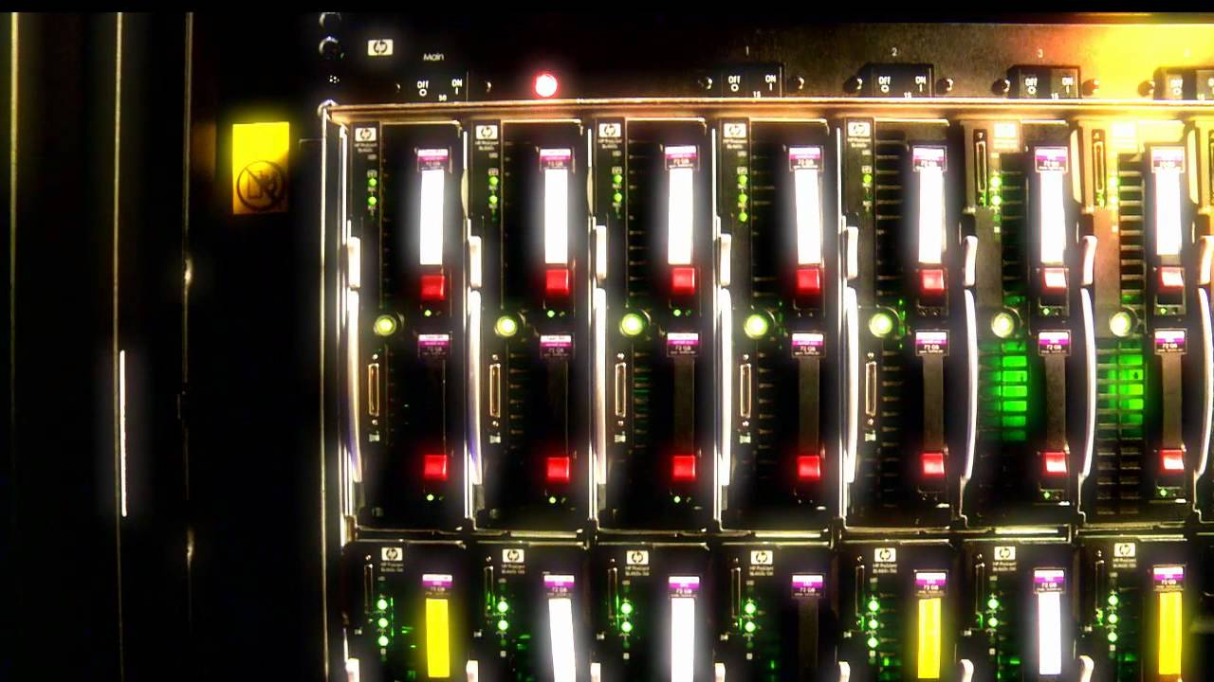
ARPANET — The team behind the Internet
Activity 1
Watch this video:
Notes:
Introduce the video before you play it. Let learners know that it is a short video that gives some historical background to the creation of the internet, the world’s largest computer network.
If you cannot access YouTube, the video is also available at archive.org/details/ARPAnet_-_the_team_behind_the_internet.

Slide 6
Networking hardware – Card sort
Activity 2
Match the pictures of the networking devices to their names on your worksheets.
Notes:
Distribute the ‘Card sort’ activity to learners. Learners can work on their own or in pairs. Ask them to match the picture of the piece of networking hardware to the name.
Image source: https://pixabay.com/photos/poker-playing-king-ace-game-686981/

Slide 7
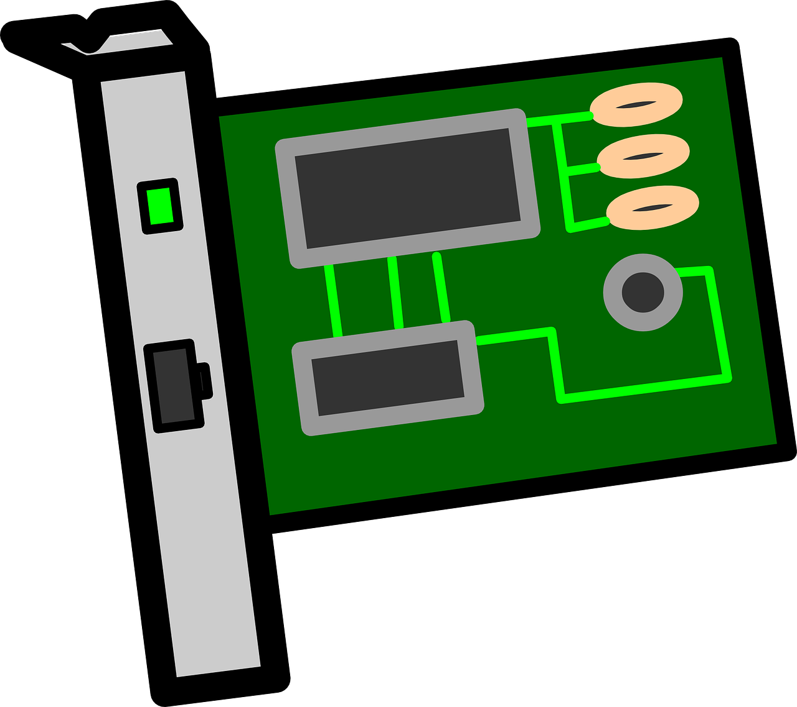
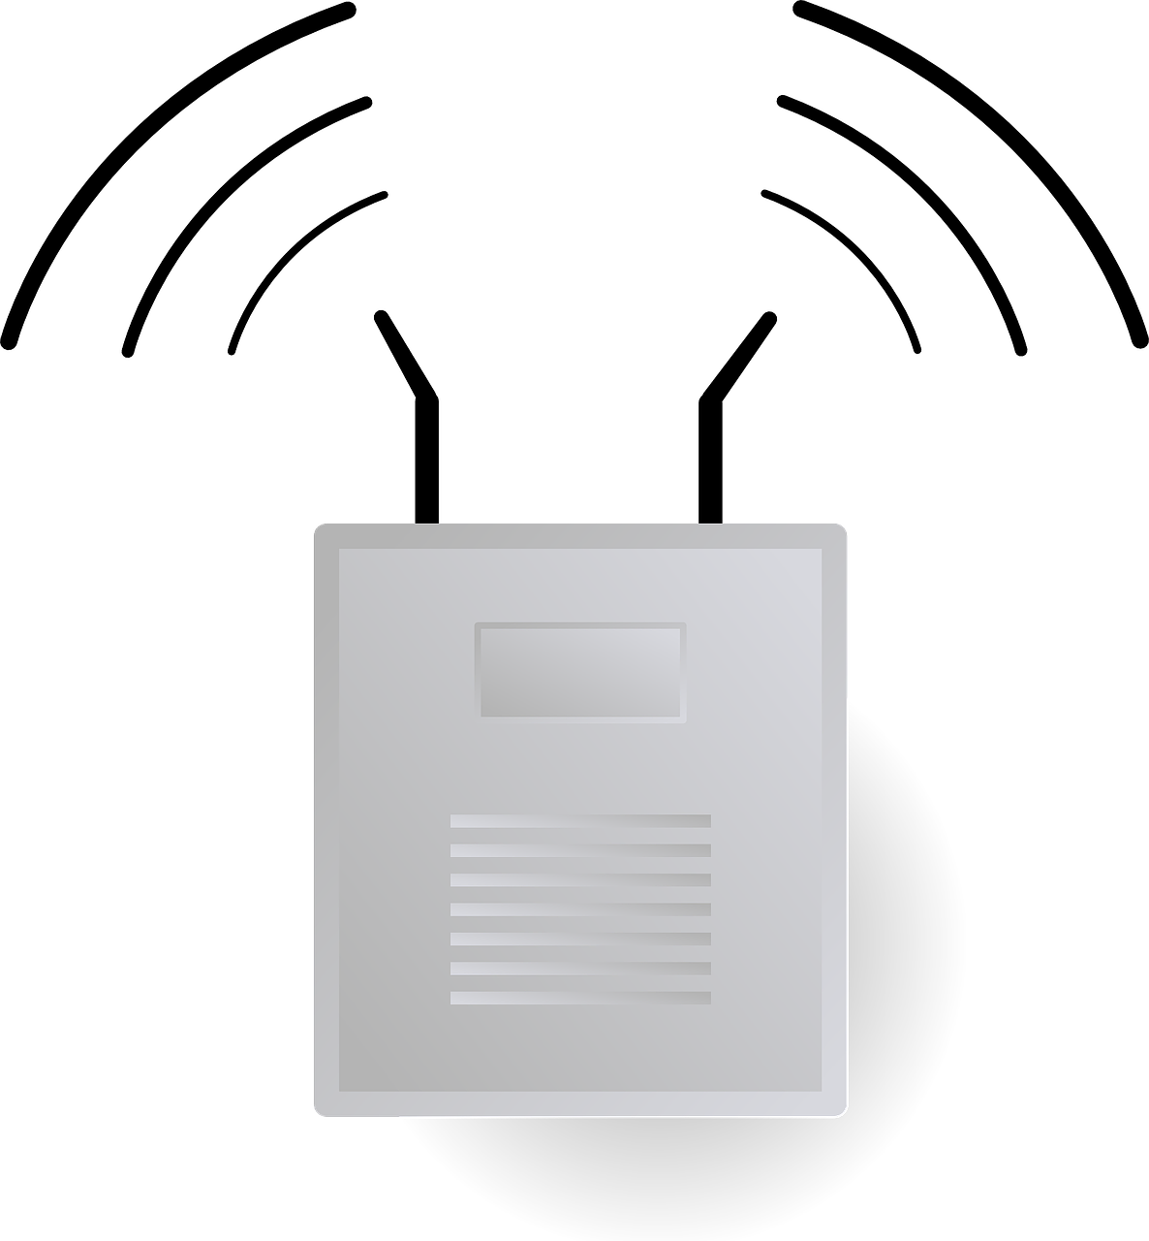
Networking hardware — functions
Activity 2
Network interface card (NIC)
Wireless access point (WAP)
Enables a wired network connection between a computer and another networked device
Connects to a wired network and provides wireless network radio signal for wireless devices to connect to
Notes:
Once learners have completed the ‘Card sort’ exercise, talk through each piece of hardware, describing its function in a network, as shown on these slides. If you have physical examples of these pieces of hardware, pass them around the class for learners to handle whilst you talk through their functions.
Network interface card: This card is inserted into the motherboard of a PC to enable a wired network connection to be established. Note that many motherboards now include this as standard (referred to as an ‘onboard network interface card’).
Wireless access point: This device connects to a wired network and provides a wireless network radio signal for wireless network devices to connect to.
Images sources:
https://pixabay.com/vectors/card-circuit-electronics-interface-161279/
https://pixabay.com/vectors/router-wifi-wireless-connector-23240/

Slide 8
Networking hardware — functions
Activity 2
Switch
Router
Enables multiple wired devices to connect, and uses packet switching to direct data to the correct device
Responsible for moving data from one network to another, e.g. from your home network to the internet
Notes:
Switch: It enables multiple wired networking devices to connect to a central point on the network. This device uses packet switching to ensure that the correct device receives the data required and that all connected devices can access available resources.
Router: A router is responsible for moving data from one network to another. Most home networks will have a router that directs traffic from the home network to the internet and vice versa. Routers will often look very similar to a switch, and some switches (often known as ‘layer 3 switches’) will combine both switching functions and routing functions.
Image sources:
https://pixabay.com/photos/switch-technology-company-router-686296/
https://pixabay.com/vectors/router-switch-symbol-network-30140/

Slide 9
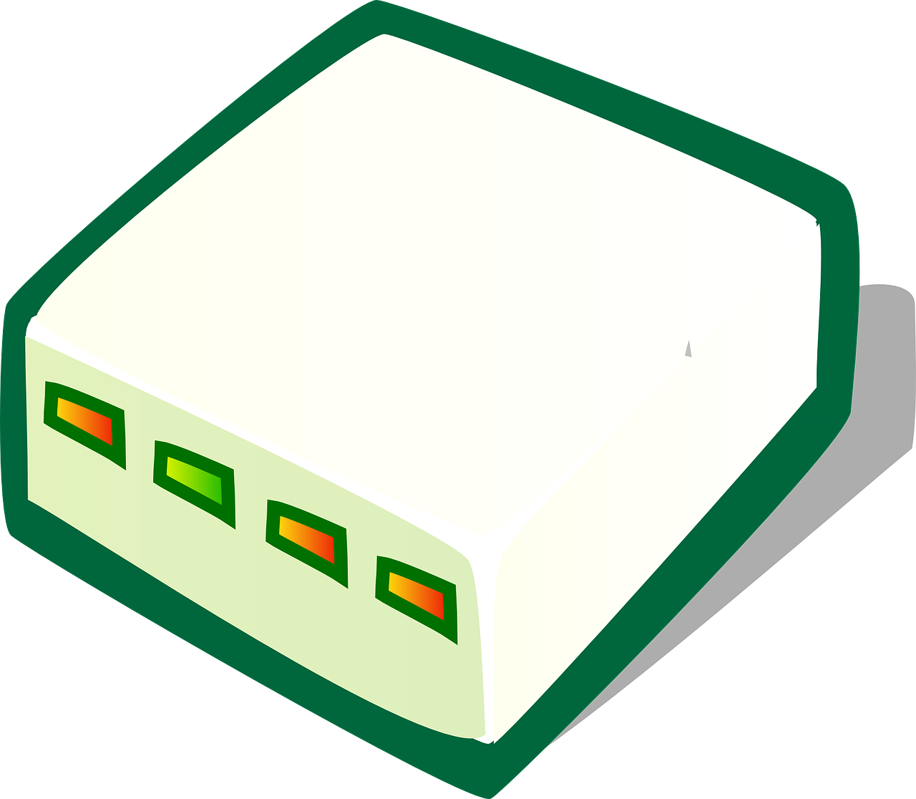
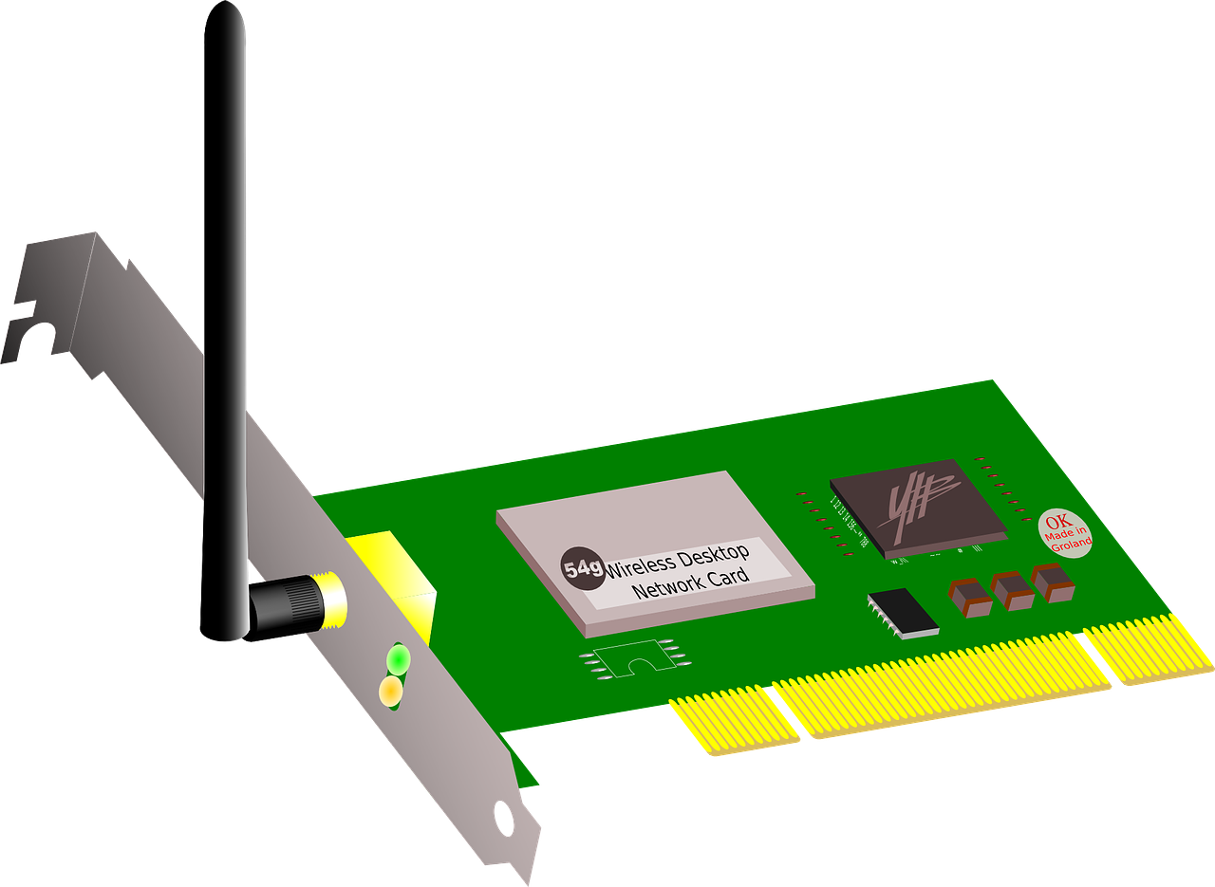
Networking hardware — functions
Activity 2
Modem
Wireless network interface card
Converts data from analogue to digital signals so that it can be transmitted across different media — traditionally, telephone cables
Performs a similar function to the network interface card but uses radio signals to connect to the network
Notes:
Modem: A modem is responsible for converting data from analogue to digital signals so that it can be transmitted across different media — traditionally, telephone cables. Its name is a portmanteau of ‘modulator-demodulator’. Modems are still required for most types of home internet connection. Home wireless network devices (like a BT Home Hub) often combine a modem, a router, a wireless access point, and a switch into one single device.
Wireless network interface card: Similar to a network interface card, this provides a networked device with a connection to a wireless network using radio signals. Most laptops and mobile devices will now have wireless network interface cards built into them as standard.
Image sources:
https://pixabay.com/vectors/modem-router-theme-communication-28089/
https://pixabay.com/vectors/network-card-wireless-interface-37139/

Slide 10
Paper network
Activity 3
Work in groups to create a paper network from your cards.
Use string to indicate network connections between devices.
How many devices can your network support? Where would you connect to the internet?
Notes:
Ask learners to create a network by connecting images of devices with string.
Remind learners that each networked device (PC, laptop, smartphone, etc.) will need a network interface card, be it wired or wireless. These will need to connect to the correct networking device (switch or wireless access point). Before data can move from their network to the internet, it must pass through a router, and then a modem will be required to convert data to travel across the telephone media. Refer to the worked example for guidance.
Image from: https://pixabay.com/vectors/network-communication-technology-4348644/

Slide 11
Benefits and disadvantages of networked computer systems
Activity 4
Nominate a scribe and presenter.
Complete the table of benefits and disadvantages of networked computer systems.
Be prepared to justify your decisions to the rest of the class.
Notes:
Ask each group to nominate a scribe and presenter, and complete the table of benefits and disadvantages of networked computer systems in this worksheet.
Ask each group’s presenter to explain their choices to the rest of the class.
Correct any misconceptions and suggest points that have been missed.
Image source: https://pixabay.com/vectors/information-feedback-3011747/

Slide 12
Recap learning and check understanding
Plenary
Now work on your own to complete the ‘Recap’ worksheet. Answer the questions to demonstrate your understanding of the topics covered in this lesson.
Notes:
Collect in the materials from the ‘Cart sort’ activity. In closing, ask learners to complete the ‘Recap’ worksheet, answering the questions on their own. Use the solutions to check learners’ understanding.

Slide 13
Homework: What are networks?
Homework
Complete the ‘What are networks?’ worksheet.
Due: Next lesson

