Slide 1
The FDE cycle
Save a copy
KS4 – Computer systems
Notes:
This resource is available online at ncce.io/cpst-3-s. Resources are updated regularly — please check that you are using the latest version.
This resource is licensed under the Open Government Licence, version 3. For more information on this licence, see ncce.io/ogl.

Slide 2
Key components of the CPU — retrieval practise
Recall activity
Carries data around the CPU
Instructs the other components
Regulates the cycles per second
Fast access memory locations in the CPU
Carries out mathematical operations

Slide 3
Key components of the CPU — retrieval practise
Starter activity
Carries data around the CPU
Buses
Instructs the other components
Regulates the cycles per second
Control unit
Clock
Fast access memory locations in the CPU
Carries out mathematical operations
Registers
ALU

Slide 4
What is the role of the clock as part of the CPU?
Recall
The CPU contains an internal clock that is used to regulate the number of cycles carried out per second, and synchronise the other components.

Slide 5
Lesson 3: The fetch-decode-execute cycle
Objectives
In this lesson, you will:
Explain how the fetch-decode-execute cycle works by describing what happens at each stage
Describe the role of each part of the CPU as part of fetch-decode-execute cycle

Slide 6
High-level language — recall activity
Activity 1
12
3
4
5
6
7
8
9
time <- ""
WHILE time is not equal to "dinner time"
time <- INPUT(“What is the time Mr Wolf?”)
IF time is not equal to “dinner time” THEN
OUTPUT (“Step forward”)
ENDIF
ENDWHILE
OUTPUT (“RUN AWAY!”)
Questions:
What is the purpose of this program?
On which line is selection used?
What is the conditional test?
What is the operator used in the test?
On what line is variable assignment used?
What type of loop is used in this program?
What will output if the user types “Dinner Time”?

Slide 7
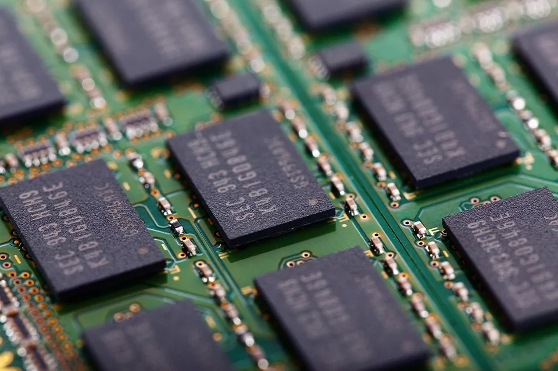
The fetch-decode-execute cycle
Activity 2
The fetch-decode-execute cycle describes the basic operation of modern computers.
Each of the components you learnt about last lesson has a part to play in the cycle. Memory plays an important role as well.
This is the final part of von Neumann architecture.
Notes:
Image source: https://pixabay.com/photos/board-card-chip-computer-data-22098/

Slide 8
The fetch-decode-execute cycle
Activity 2
Fetch
Instructions are loaded into memory (RAM) before the processor starts running the program.
Each instruction is then fetched from memory (in order), and put into the appropriate registers. The control unit can then access the instruction for the next stages.
Notes:
Image source: https://pixabay.com/photos/board-card-chip-computer-data-22098/

Slide 9
The fetch-decode-execute cycle
Activity 2
Decode
The binary representation of an instruction needs to be decoded before it can be run. This is the process the control unit uses to work out what the other components need to do.
Each processor will have slightly different encodings for instructions.
Notes:
Image source: https://pixabay.com/photos/board-card-chip-computer-data-22098/

Slide 10
The fetch-decode-execute cycle
Activity 2
Execute
Once the instruction is understood, the instruction will be executed.
The control unit will tell the other components what they need to do in order for the instruction to work.
Notes:
Image source: https://pixabay.com/photos/board-card-chip-computer-data-22098/

Slide 11
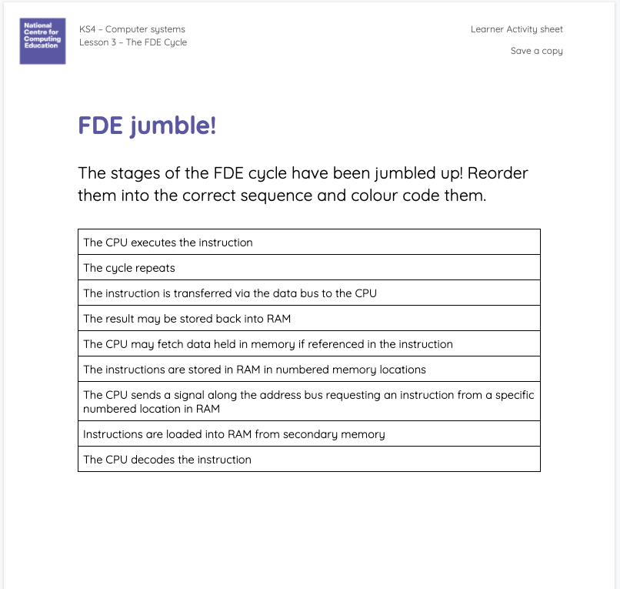
The fetch-decode-execute cycle jumble!
Activity 2
Longer descriptions stages of the FDE cycle are on your sheet but have been jumbled up!
Reorder them into the steps of the FDE cycle.
Colour code them with a key into:
Fetch
Decode
Execute

Slide 12
The fetch-decode-execute cycle jumble!
Activity 2
Instructions are loaded into RAM from secondary memory
The CPU decodes the instruction.
The instruction is transferred via the data bus to the CPU.
The result may be stored back into RAM
The instructions are stored in RAM in numbered memory locations
The CPU may fetch data held in memory if referenced in the instruction
The CPU executes the instruction
The CPU sends a signal along the address bus requesting an instruction from a specific numbered location in RAM
The cycle repeats
Fetch
Decode
Execute

Slide 13
The fetch-decode-execute cycle jumble!
Activity 2
Instructions are loaded into RAM from secondary memory
The instructions are stored in RAM in numbered memory locations
The CPU sends a signal along the address bus requesting an instruction from a specific numbered location in RAM
The instruction is transferred via the data bus to the CPU
The CPU decodes the instruction
The CPU may fetch data held in memory if referenced in the instruction
The CPU executes the instruction
The result may be stored back into RAM
The cycle repeats
Fetch
Decode
Execute

Slide 14
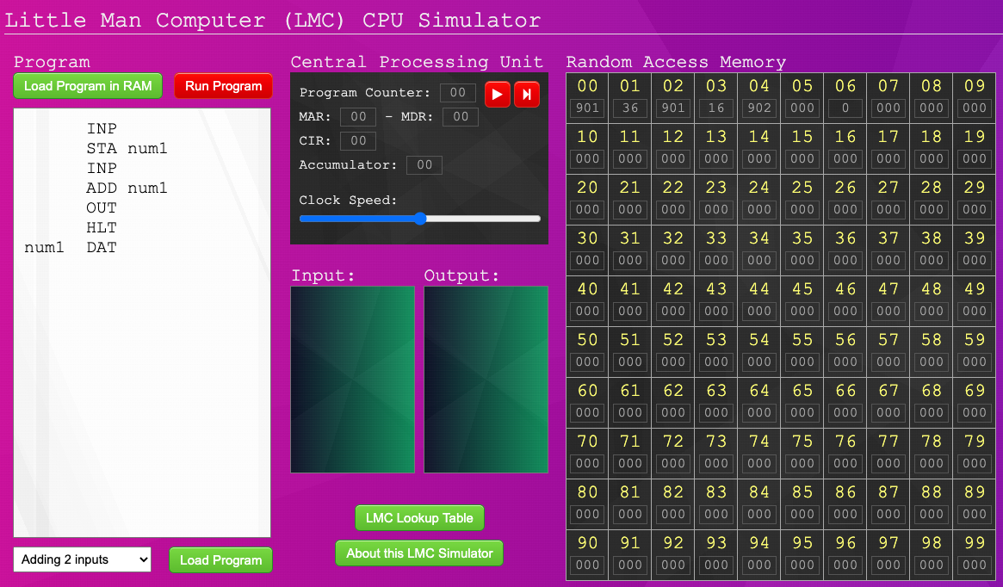
The FDE cycle in action
Activity 3

Slide 15
The FDE cycle in action
Activity 3
Use the LMC simulator to carry out the following activities and record your answers on your worksheet:
Try running the program using the Run Program button. Watch as the log goes through the cycle.
What does the num1 represent on lines 2 and 4?
What is the instruction number for INP?

Slide 16
The FDE cycle in action
Activity 3
What does the number 99 represent on lines 2 and 4?
A memory address
What is the instruction number for INP?
901

Slide 17
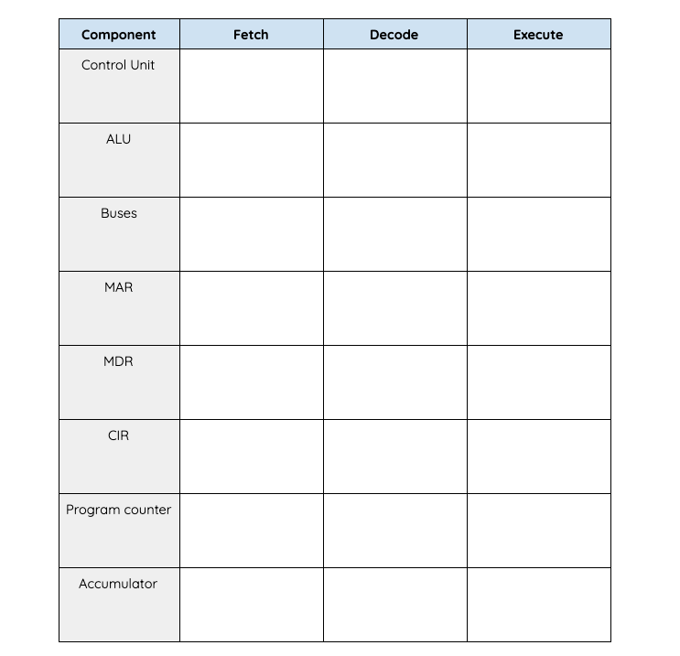
The FDE cycle in action
Activity 3
12
3
4
5
6
7
INP
STA num1
INP
ADD num1
OUT
HLT
num1 DAT
`
Step through and make note of what each component does in the FDE cycle as the program runs.
Not all components are visible, so you will have to remember what they are doing.

Slide 18
The FDE cycle inside the CPU
Activity 3
Fetch
Control unit sends the fetch instruction.
ALU adds one to the program counter.
Buses carry the instruction to memory and carry the data back.
MAR holds the address to fetch the instruction from.

Slide 19
The FDE cycle inside the CPU
Activity 3
Fetch
MDR receives the instruction fetched from RAM.
CIR gets a copy of the instruction.
Program counter goes up by one.

Slide 20
The FDE cycle inside the CPU
Activity 3
Decode
Control unit decodes the instruction.
Buses carry the instruction to the control unit.
CIR provides the instruction to the control unit.

Slide 21
The FDE cycle inside the CPU
Activity 3
Execute
Control unit tells other components what they need to do.
ALU performs calculations.
Buses carry any data required or received from the instruction.
Accumulator holds any data that is produced.

Slide 22
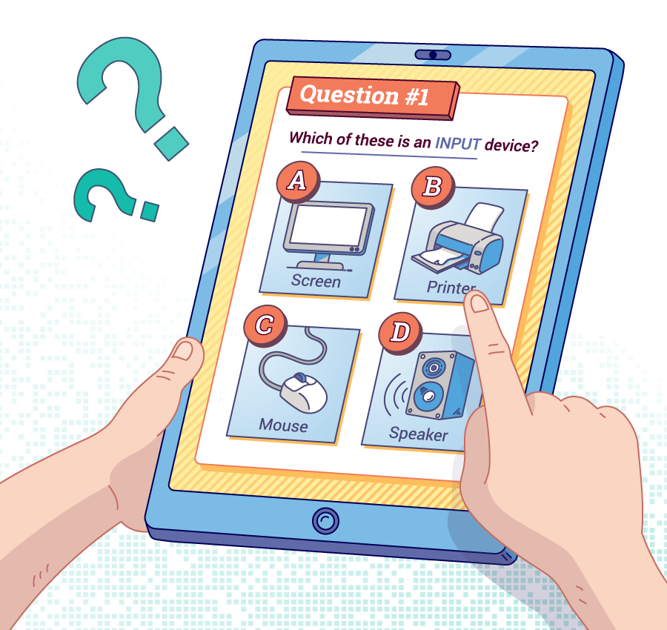
Revision questions
Plenary
In your question log, write a question on one component you learnt about today.
You could pick a question about something that you got wrong originally, or something you want to make sure to revise.
Write it in your question log.
Notes:
Image Source: Raspberry Pi online courses

Slide 23
Next lesson
Summary
In this lesson, you…
Learnt how the components work together in the fetch-decode-execute cycle
Next lesson, you will…
Learn about generations of programming languages

