Slide 1
Main memory
Save a copy
KS4 – Computer systems
Notes:
This resource is available online at ncce.io/cpst-4-s. Resources are updated regularly — please check that you are using the latest version.
This resource is licensed under the Open Government Licence, version 3. For more information on this licence, see ncce.io/ogl.

Slide 2
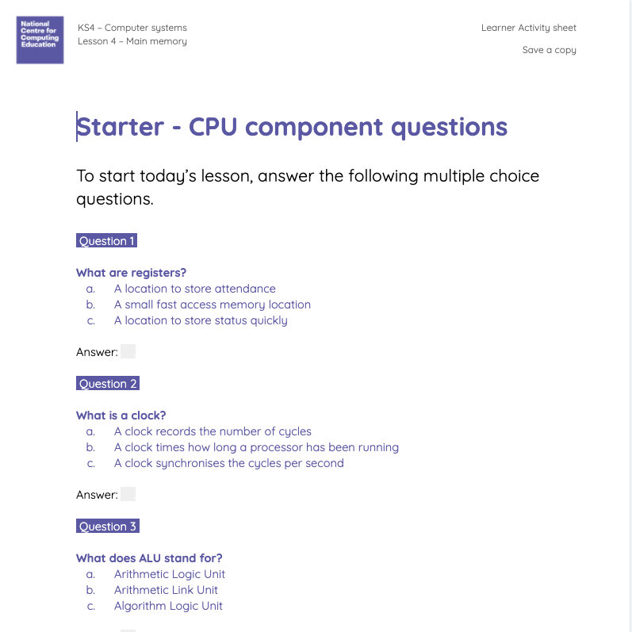
Retrieval practise: the CPU
Starter
The components of the CPU are key to this unit. Let’s check your understanding to start this lesson.
Use the worksheet to select an answer to the multiple choice questions.

Slide 3
Retrieval practise: the CPU
Starter activity
1: What is a register?
A location to store attendance
A small, fast access memory location
A location to store status quickly
2: What is a clock?
A clock records the number of cycles
A clock times how long a processor has been running
A clock synchronises the cycles per second

Slide 4
Retrieval practise: the CPU
Starter activity
3: What does ALU stand for?
Arithmetic logic unit
Arithmetic link unit
Algorithm logic unit
4: What is a bus?
A single wire that transfers data
A set of wires that transfer data
A set of wires that transmit data
5: What is a control unit?
A unit that regulates the speed of the system
A unit that executes instructions
A unit that tells the other components how to respond to instructions
6: What is the role of the ALU?
The ALU carries out logical and mathematical operations
The ALU helps to save to memory
The ALU controls the bus system

Slide 5
Memory and computer systems
Objectives
In this lesson, you will:
Describe the characteristics of RAM and ROM
Explain the role main memory as part of a computer system
Define cache memory
Describe the role of cache memory in a computer system

Slide 6
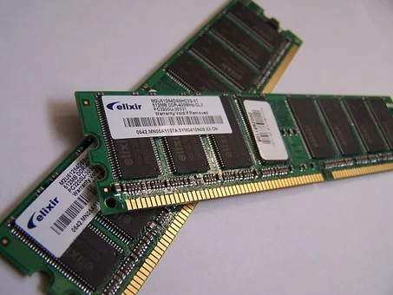
Main memory
Activity 1
Think, pair, share
What do the terms RAM and ROM mean in a computer system?
Notes:
Image source: https://pixabay.com/photos/computer-memory-chips-technology-857098/

Slide 7
Main memory
Activity 1
RAM: Random access memory
ROM: - Read-only memory
Annotate your graphic organiser with the full names of main memory.
Notes:
Image source: https://pixabay.com/photos/computer-memory-chips-technology-857098/

Slide 8
Main memory
Activity 1
RAM and ROM are both types of main memory.
This means that they are directly accessible by the CPU.
Memory is used to store instructions for the CPU to execute.
They are much faster to access than secondary storage — i.e. a hard drive.
Notes:
Image source: https://pixabay.com/photos/computer-memory-chips-technology-857098/

Slide 9
Main memory
Activity 1
? | Read only
? | Read and write
Notes:
Image source: https://pixabay.com/photos/computer-memory-chips-technology-857098/

Slide 10
Main memory
Activity 1
ROM | Read only
RAM | Read and write
Notes:
Image source: https://pixabay.com/photos/computer-memory-chips-technology-857098/

Slide 11
Main memory
Activity 1
? | Stores instructions and data ready for a CPU to execute
? | Stores permanent instructions that tell a computer how to ‘boot up’
Notes:
Image source: https://pixabay.com/photos/computer-memory-chips-technology-857098/

Slide 12
Main memory
Activity 1
RAM | Stores instructions and data ready for a CPU to execute
ROM | Stores permanent instructions that tell a computer how to ‘boot up’
Notes:
Image source: https://pixabay.com/photos/computer-memory-chips-technology-857098/

Slide 13
Main memory
Activity 1
If a computer system does not have enough RAM, it will run slowly.
As a program executes, the instructions are loaded into RAM from secondary storage.
The CPU then takes the instructions from RAM and executes them.
Notes:
Image source: https://pixabay.com/photos/computer-memory-chips-technology-857098/

Slide 14
Main memory
Activity 1
Volatile is a term that means ‘data is lost when the power is switched off’.
Non-volatile means the opposite it ‘does not lose memory when the power is switched off’.
Notes:
Image source: https://pixabay.com/photos/computer-memory-chips-technology-857098/

Slide 15
Main memory
Activity 1
? | Volatile
? | Non-volatile
Notes:
Image source: https://pixabay.com/photos/computer-memory-chips-technology-857098/

Slide 16
Main memory
Activity 1
RAM | Volatile
ROM | Non-volatile
Notes:
Image source: https://pixabay.com/photos/computer-memory-chips-technology-857098/

Slide 17
Main memory
Activity 1
? | 6–8MB
? | 1–256GB
Notes:
Image source: https://pixabay.com/photos/computer-memory-chips-technology-857098/

Slide 18
Main memory
Activity 1
ROM | 6–8MB
RAM | 1–256GB
Notes:
Image source: https://pixabay.com/photos/computer-memory-chips-technology-857098/

Slide 19
Main memory
Activity 1
A computer system may also use virtual memory.
If a program needs more memory than is available, the operating system will reserve some in secondary storage that acts as an extension of main memory.
Notes:
Image source: https://pixabay.com/photos/computer-memory-chips-technology-857098/

Slide 20
Main memory — showdown
Activity 2
If we already have two types of main memory, why does a computer system need a form of secondary memory, such as a hard disk drive?
Why do computers perform better with more RAM?
Notes:
Source image: https://pixabay.com/illustrations/couple-cowboy-boy-girl-love-man-1456936/

Slide 21
Meet cache
Activity 3
There is one other type of main memory called cache (pronounced cash).
This memory plays an important role in improving the performance of a computer system by saving frequently used instructions and data, so they are quickly available for the CPU to retrieve.
Notes:
Source image: https://pixabay.com/vectors/money-cash-dollars-pennies-coins-29047/

Slide 22
Meet cache
Activity 3
There are three levels of cache. Draw a triangle in your notes and add the following facts:
Level one cache is usually part of the CPU.
The closer the cache is to the CPU, the faster it is at reading and writing data. But it is also the smaller it is (can store less).
Even though level three is the slowest cache, it is still twice as fast as RAM!
CPU
L1
Speed
L2
Size
L3
RAM

Slide 23
How does cache speed up a computer?
Activity 3
Cache is there to help speed up the process of fetching instructions from RAM.
I need:
2 X CPUs
2 X Buses
2 X RAM
Notes:
Image source: https://pixabay.com/illustrations/volunteer-hands-help-colors-2055010/

Slide 24
How does cache speed up a computer?
Activity 3
As I call out instruction numbers, the CPU will send a request along the bus for an instruction from RAM.
The bus will return an instruction to the CPU, who will write it on the board.
CPU
L1
Speed
L2
Size
L3
RAM

Slide 25
How does cache speed up a computer?
Activity 3
Both the CPUs made it through the program, but it could have been quicker.
Now I need another volunteer to be cache.
Notes:
Image source: https://pixabay.com/illustrations/volunteer-hands-help-colors-2055010/

Slide 26
How does cache speed up a computer?
Activity 3
This time the cache will save the instructions that CPU 1 executes.
Let’s see what happens.
CPU
L1
Speed
L2
Size
L3
RAM

Slide 27
How does cache speed up a computer?
Activity 3
CPU 1 was faster!
Why was that — what did we cut out of the process?
What would happen if I were to run the program again without resetting?
CPU
L1
Speed
L2
Size
L3
RAM

Slide 28
How does cache speed up a computer?
Activity 3
Why was that — what did we cut out of the process?
There was less fetching from RAM.
What would happen if I were to run the program again without resetting?
CPU 1 would be even faster.
CPU
L1
Speed
L2
Size
L3
RAM

Slide 29
How does cache speed up a computer?
Activity 3
Let’s try it again with a more complex program.
CPU
L1
Speed
L2
Size
L3
RAM

Slide 30
How does cache speed up a computer?
Activity 3
You cannot hold instructions in cache permanently — eventually they will be written over for newer instructions.
Out of the three levels of cache — which would hold the most used commands and why?
CPU
L1
Speed
L2
Size
L3
RAM

Slide 31
How does cache speed up a computer?
Activity 3
Out of the 3 levels of cache — which would hold the most used commands and why?
L1 would hold the most used instructions and data.
L3 would hold least frequently used instructions and data.
CPU
L1
Speed
L2
Size
L3
RAM

