Slide 1
GCSE Computer Science (9-1)
You will need:
Theory books
Log onto TEAMS
Load either IDLE or REPL
FUNDAMENTALS OF PROGRAMMING
LESSON 3: ITERATION (DEFINITE/INDEFINITE)

Slide 2
Recall
What is a variable?

Slide 3
Lesson Objectives
Students will understand and know how the following statement types can be combined in programs:
Definite Iteration
Indefinite iteration
Nested iteration

Slide 4
Produce a chatbot that can use a minimum of 4 variables to store data which can be recalled.
Develop the program using your REPL account to ask questions such as: What is your name, age, your favourite food etc.
Extension: Add an element of validation into your program by using Casting methods to prevent unnecessary data inputs.

Slide 5
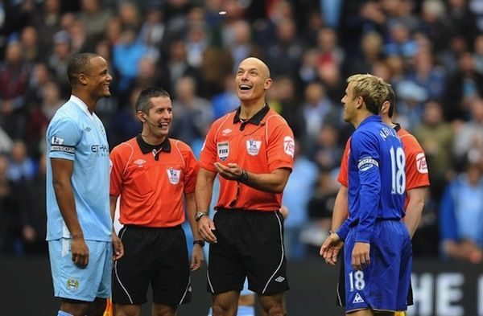
Think about it...
Can you rig a coin toss?

Slide 6
Yes...but no...but yes
Sorry...but you will never be a winner...with this program!

Slide 7
Looping Programs
Programming is fundamentally about using logic to solve a problem.
Sometimes, a task is not solved in one go – it needs to be repeated until it is solved.
Take, for example, getting a stain out of fabric
Is it time to wake up yet?
TRUE
FALSE
Extra 5 mins
Stop

Slide 8
Iteration types
There are two types of iteration: Definite and Indefinite

Slide 9
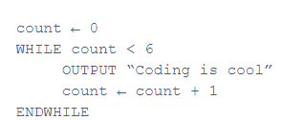
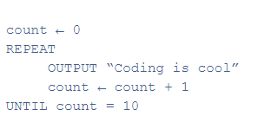
Indefinite iteration
Indefinite iteration repeatedly executes a section of code until a condition is met - or no longer met. There are two types of indefinite iteration:
WHILE loops - uses the statements WHILE and ENDWHILE
REPEAT UNTIL loops - uses the statements REPEAT and UNTIL

Slide 10
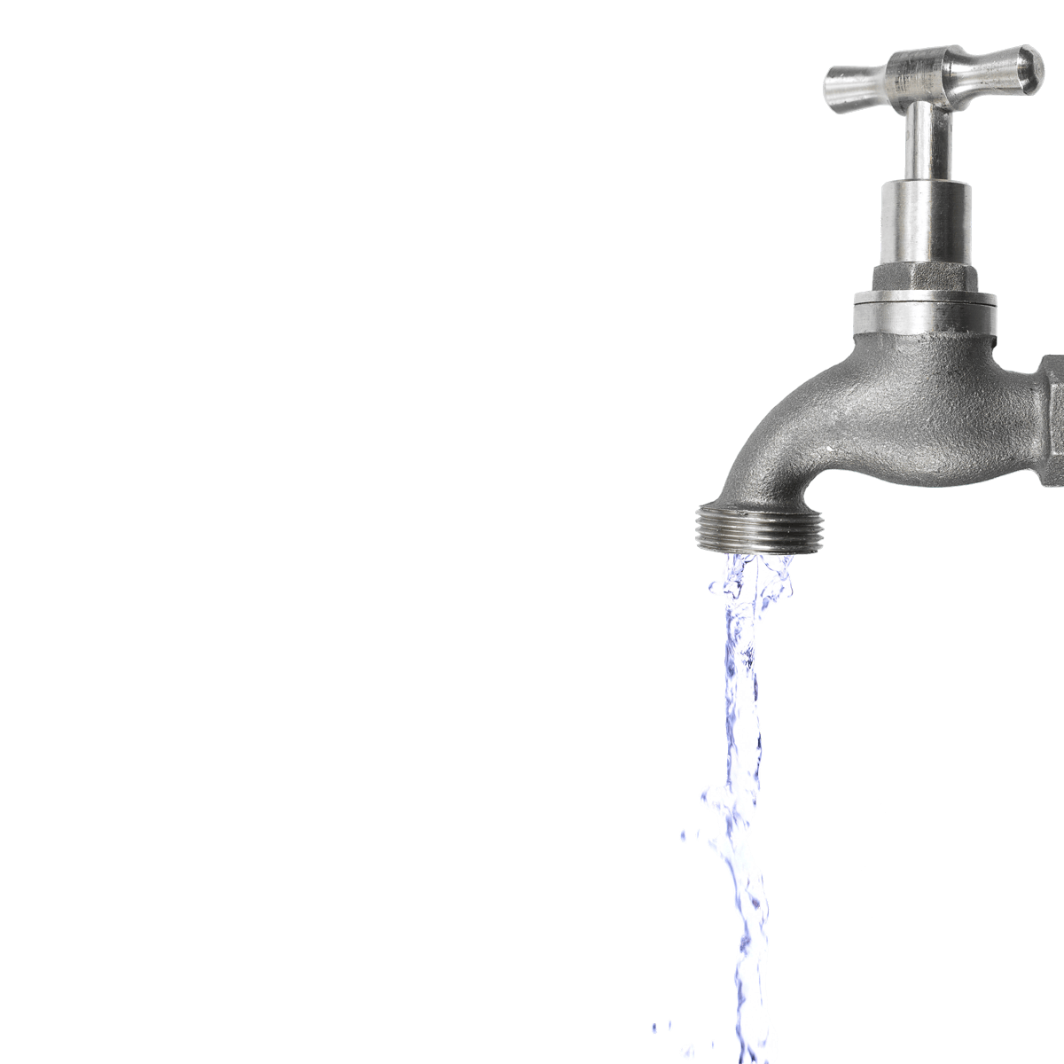
INDEFINITE ITERATION – While Loops
Indefinite Iteration refers to when we’re unsure of when the condition will be met.
So while the condition is not met, a block is repeated
While loops are similar to REPEAT…UNTIL (You will see this later) , however the loop is run using an entry condition, whereas REPEAT…UNTIL loops run initially, and use a condition at the end to determine if the block needs to be iterated again

Slide 11
Let's learn our loops (Indefinite)
Now, we will learn about a While Loop (keep repeating a set of instructions until a condition has been met)
When your teacher starts, Keep clapping until your teacher says "STOP".
Think about what you are doing as you are clapping.

Slide 12
TRY THIS: Indefinite Iteration
What is the output of this program?

Slide 13
Let's learn our loops (Definite)
First we will learn about a FOR LOOP (Repeat an instruction for a set amount of times).
When your teacher starts, clap your hands 3 times.
Think about what you are doing as you are clapping.

Slide 14
Definite Iteration
Definite iteration uses the statements FOR and ENDFOR to determine what code is repeatedly executed and how many times. This program would also print out a message six times:

Slide 15
TRY THIS: Definite Iteration
What is the output of this program?
Think what the purpose of i is

Slide 16
DEFINITE ITERATION - FOR Loops
WHILE Loops are examples of indefinite iteration – we don’t know when the condition will be met?
FOR Loops, on the other hand, are definite iteration (we know when it will end)
This means that we know how many times a section of code will be repeated

Slide 17
FOR Loops in Pseudocode
We can show for loops in pseudocode like this
FOR i = 1 TO 10
OUTPUT i #This will simply output i 10 times
ENDFOR
# i is a counter which counts how many times it has gone through the loop

Slide 18
Challenge
WRITE A PROGRAM TO ASK YOUR USER TO ENTER THEIR NAME AND DISPLAY THE NAME THREE TIMES.
Alter this program to ask your user to enter a number and print their names that number of times.

Slide 19
Research Starter - Task 1
Open your worksheet to answer the first two questions.

Slide 20
REPEAT…UNTIL
One form of iteration is REPEAT…UNTIL
This is where we repeat a section of code, until a condition is met
The condition is checked at the end of a program
#Check for indentation
Answer <-32
Solved <- False
REPEAT
OUTPUT “Enter your guess”
Number <- USERINPUT
IF Number = Answer THEN
OUTPUT “Well done, you guessed correctly!”
Solved <- True
ELSE THEN
OUTPUT “Nope, try again!”
UNTIL Solved = True
OUTPUT “Well done, you guessed correctly!”

Slide 21
Challenge slides WHILE Loop Example
Counter <- 1
WHILE Counter < 10 THEN
OUTPUT Counter
Counter <- Counter + 1
Task 1
Rewrite this while loop as a REPEAT…UNTIL loop
Task 2
Hence, explain the differences in the programs

Slide 22
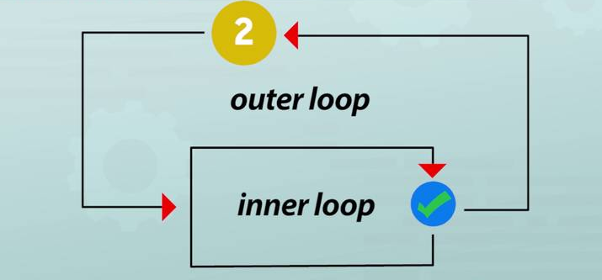
NESTED Iteration
Nested iteration, in simple terms, is the use of a Loop within a Loop.
This can be used as a FOR LOOP in a FOR LOOP, WHILE in a WHILE or a combination of the two.
Think about it like this:
Can you clap your hands and count to 10 at the same time?

Slide 23
Nested Loop in Programming
This is an example of both uses of iteration whilst displaying the use of a nested loop.

Slide 24
NESTED Iteration (Past paper question)
Iteration can be nested like using the algorithm below.
We could use the example of a school day & the timetable.
AtSchool <- True
OUTPUT “Let’s Start Registration”
WHILE AtSchool = True
FOR Classes = 1 TO 6
OUTPUT “I’m in lesson” + Classes
ENDFOR
AtSchool <- False
ENDWHILE
OUTPUT “Time to go home!”

Slide 25
While Loop Examples
Version 1
Version 2
Explanation
Counter <- 1​
REPEAT..​
OUTPUT Counter​
Counter <- Counter + 1​
UNTIL Counter <- 10​
Counter <- 1
WHILE Counter < 10 THEN
OUTPUT Counter
Counter <- Counter + 1
The differences between these two algorithms is their outputs.
The first program will output 1 to 10, however the second will only output up to 9… once the value of Counter is equal to 10, the loop is broken out of.​

Slide 26
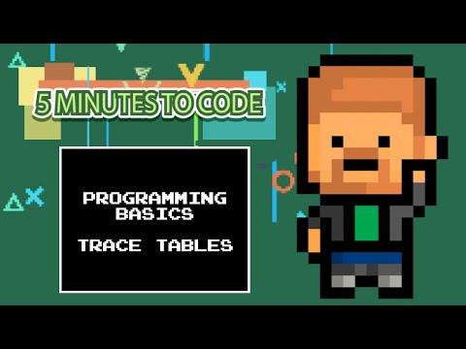
Trace Table
We can use trace tables to simulate iteration within an algorithm
Take our example, using test data: 17, 9, 14, 20, 32

Slide 27
Trace Table example
Answer <- 32
Solved <- False
REPEAT
OUTPUT “Enter your guess”
Number <- USERINPUT
IF Number = Answer THEN
OUTPUT “Well done, you guessed correctly!”
Solved <- True
ELSE THEN
OUTPUT “Nope, try again!”
UNTIL Solved = True
OUTPUT “Well done, you guessed correctly!”
Answer | Number | OUTPUT
32 | 17 | “Enter your guess” “Nope, try again!”
 | 9 | “Enter your guess” “Nope, try again!”
 | 14 | “Enter your guess” “Nope, try again!”
 | 20 | “Enter your guess” “Nope, try again!”
 | 32 | “Enter your guess” “Well done, you guessed correctly!”

Slide 28
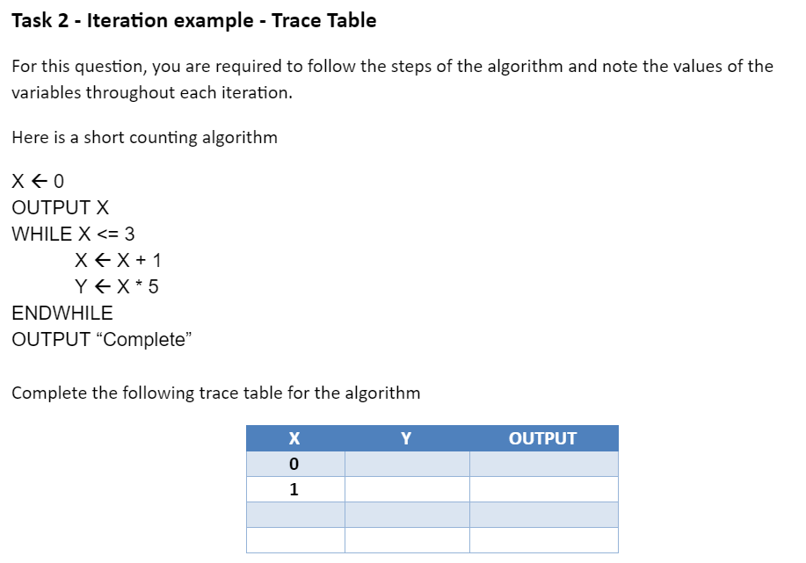
Tutorial 3 Worksheet - Task 2
Go back to the worksheet and attempt Task 2.
Read through step by step and enter the values for both X & Y throughout each iteration.

Slide 29
Review
Today we have covered:
Definite Iteration
Indefinite iteration
Nested iteration

Slide 30
Challenge
Review all that we have covered so far and complete the task below.
Write a program to ask the user to enter a number and store it in user_num.
The program should count from the number that the user entered and display this message on screen ” your current number is:” along with the current number. This should be printed the same number of times as the number the user entered.

Slide 31
Solution

Slide 32
Review
Today we have covered:
Definite Iteration
Indefinite iteration
Nested iteration
Test yourself by answering a past paper question. Copy the link and go to QUESTION 6
https://filestore.aqa.org.uk/sample-papers-and-mark-schemes/2018/june/AQA-85201-QP-JUN18.PDF

