Slide 1
GCSE Computer Science (9-1)
YES
NO
FUNDAMENTALS OF PROGRAMMING
LESSON 4: CONDITIONAL STATEMENTS

Slide 2
Recall
Please complete in your book:
Write a short program to accept the user’s favourite food as a string (str) and print it out three times on screen.
Fav_food=str(input(“Enter your favourite foods”))
For I in range(0,3):
print(fav_food)

Slide 3
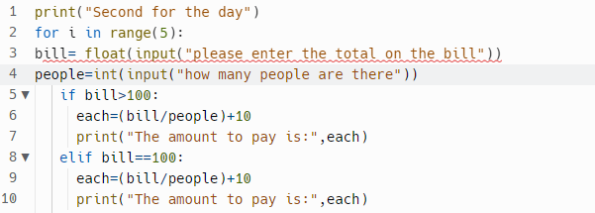
Error
This program currently produces an error.
Identify the error and state how you would fix it. Why was the data type float used?

Slide 4
Lesson Objectives
Use, understand and know how the following statement types can be combined in programs:
Selection operations
Nested Selection terms

Slide 5
Consider How can we change the flow of data within a program? How would we decide how the flow is changed?

Slide 6
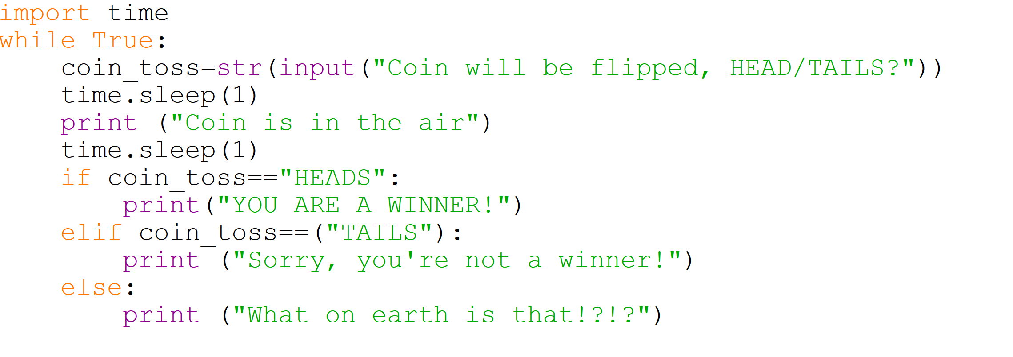
A modified version of the Coin flip program
Each point has an option is a condition has been met. E.g. IF the variable for COIN_TOSS contains “HEADS” then you win!
If you put anything ELSE than HEADS/TAILS then program will output a nice friendly message...kind of

Slide 7
Conditional Sequences
Sequencing in Python is a construct whereby the program takes a different pathway based on a certain condition
The syntax for selection, or an IF…ELSE statement, is rather basic – you will have come across it before in Python
IF <condition> THEN
<commands>
ELSE THEN
<commands>
ENDIF

Slide 8
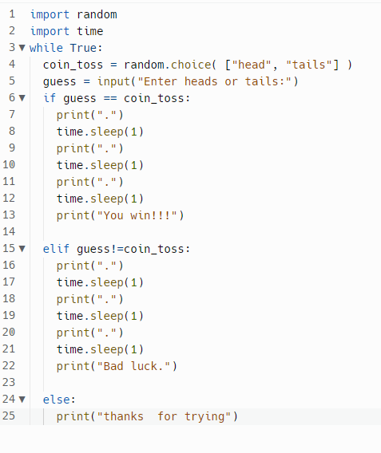
Time toss random selection

Slide 9
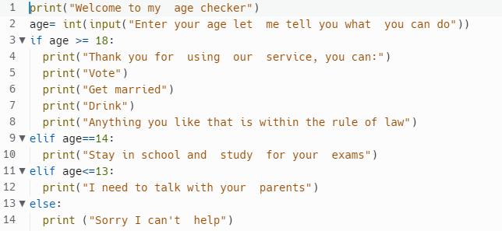
Age checker

Slide 10
Flowcharting Selection
YES
NO
Carry out Process A
Carry out Process B
Is <condition>?
End

Slide 11
Task 1 - Worksheet
Go to Task 1 of your worksheet and answer the following question. Don’t forget, the answers are within the presentation!

Slide 12
Where would ELIF & ELSE be used...
Whenever there is more than one option available, we would not be able to use multiple IFs. The use of Multiple IFs would mean there won’t be a sequence of checks, rather if the first option has been met, then the others won’t be checked.

Slide 13
Multiple Pathways
Selection can take on multiple statements
We can use multi-pathway selection using ELSE IF
IF <condition> THEN
Do this
ELSE IF <another condition> THEN
Do that
ELSE THEN
Do the other
END IF

Slide 14
Task 2 - Worksheet
Go to Task 2 of your worksheet and answer the following question. Don’t forget, the answers are within the presentation!

Slide 15
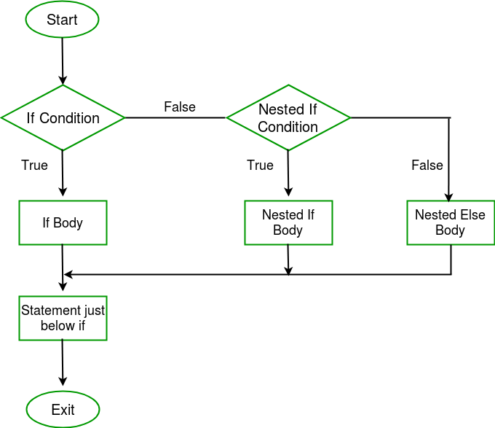
NESTED IF
A “Nested IF” statement refers to when there is selection within selection
Imagine a game of Rock, Paper Scissors but the computer only knows a set path of instructions to follow.
Take the variable cpu to be assigned as “Paper” and the variable player to be assigned a value…
Using selection, determine the conditions of what happens next depending on the USERINPUT

Slide 16
Algorithm Solution
1 CPU ← “Paper”
2 OUTPUT “Enter Rock, Paper or Scissors”
3 Player ←USERINPUT
4 IF Player = CPU THEN
5 OUTPUT “Draw”
6 ELSE THEN
7 IF Player = “Rock” THEN
8 OUTPUT “Lose”
9 ELSE THEN #Assuming player has input “Scissors”
10 OUTPUT “Win”
11 ENDIF
12 ENDIF
This is the code for your first Rock, Paper Scissors program.
This contains a NESTED IF on line 7 which branches off into a different option
e.g. IF the user inputs anything other than PAPER, then it will perform Line 7 and check for other options.

Slide 17
Task 3 - Worksheet (Hard mode)
Go to Task 3 of your worksheet and create a game of Rock, paper Scissors. A starting point has been given to you already.

