Slide 1
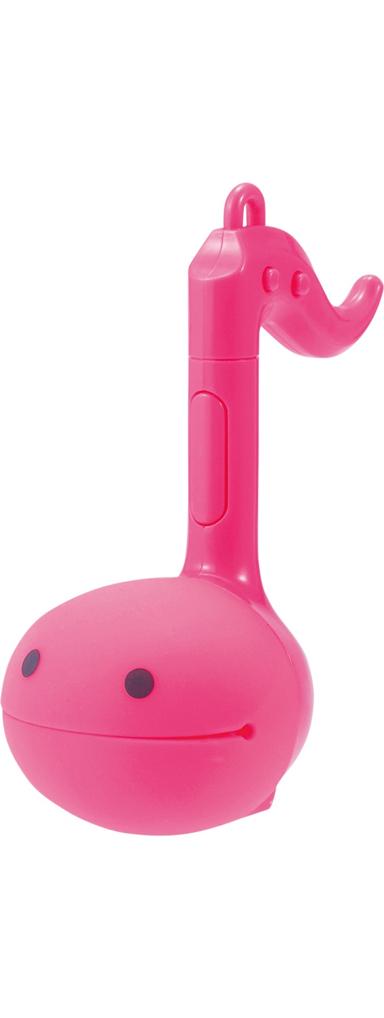
GCSE Computer Science (9-1)
FUNDAMENTALS OF PROGRAMMING
LESSON 5: SUBROUTINES (Procedures & Functions)

Slide 2
Recall
Describe two types of iteration.
There are two types of iteration: Definite and Indefinite

Slide 3
Lesson Objectives
Use, understand and know how the following statement types can be combined in programs:
Procedures
Arguments
Functions

Slide 4
Consider…
How can we repeat a section of code in a program, but not sequentially?

Slide 5
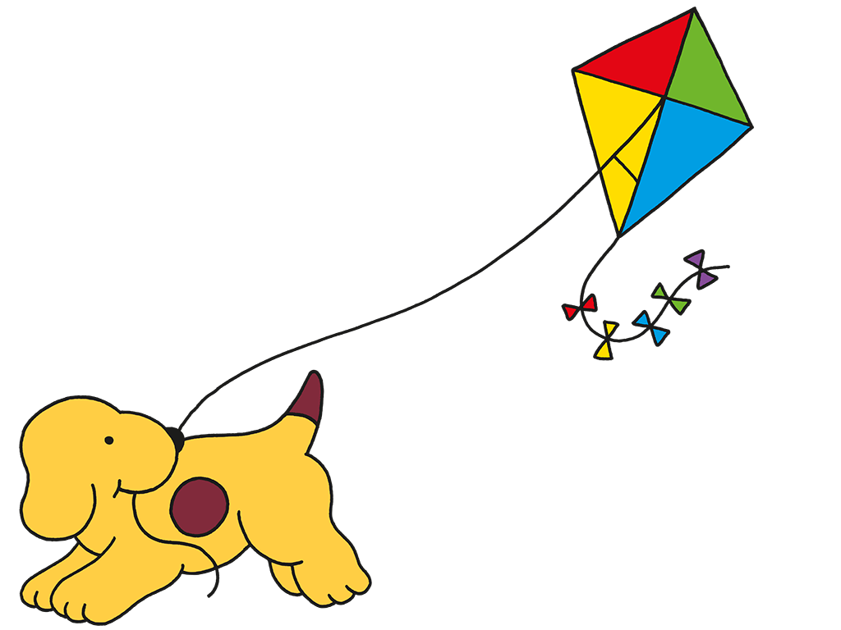
REMINDER - Sequence
A program will read from the beginning and execute any instruction given to it from top to bottom...
But what if we want to create a piece of code and save it for later?

Slide 6
Subroutines
Subroutines are blocks of code, written separately from the normal program, that are “called” within the main body
They operate semi-independently of the main program
There are two types of subroutine
Procedure
Function

Slide 7
Procedures
Procedures are blocks of code that perform a specific task
Procedures are run by being called within a program at anytime, even if the program is not running
Think about the term decomposition – breaking down a problem into several subproblems.
How might the use of procedures work with the concept of decomposition?

Slide 8
Saying hello
Here is a program calling, and running, subroutine to say hello
SUBROUTINE Hello()
Name <- USERINPUT
OUTPUT “Hello”+ Name
Hello()

Slide 9
Try this out -> Saying hello
Try out the program and make sure you have your RECALL e.g. hello() AFTER your definition

Slide 10
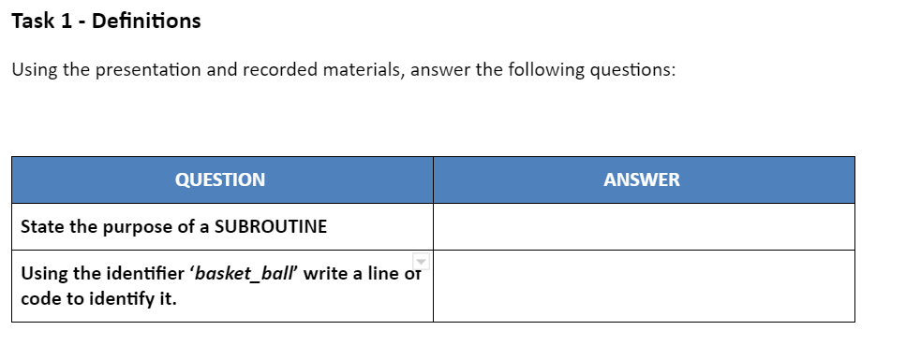
TASK 1
Go to Task 1 of your worksheet and answer the following question. Don’t forget, the answers are within the presentation!

Slide 11
How about song lyrics?
You may have created a few song lyrics using subroutines to make it easier to remember.
Try the example out or tailor it so it is one of your favourite songs. We can use arguments to predetermine something within the program before it has been made! As an example - name

Slide 12
TASK 2
Go to Task 2 of your worksheet and answer the following two questions. You will need to test the program.

Slide 13
Consider…
Here is another program – how is it different?
SUBROUTINE Hello(Name)
OUTPUT “Hello”+ Name
Name <- USERINPUT
Hello(Name)
The variable name is passed in as an argument

Slide 14
Recall
What are subroutines?

Slide 15
Arguments
With subroutines, we might want to repeat the block of code but with different sets of data
In this, we use arguments
We can pass data into a subroutine by taking a variable identifier as an argument when we call the procedure
When written, the procedure will expect a function – whatever is written there is what the data it receives will be identified as.
SUBROUTINE Hello(Name)
OUTPUT “Hello”+ Name
X <- USERINPUT
Hello(X)

Slide 16
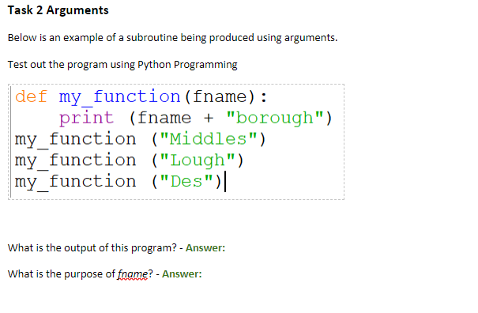
TASK 3
Go to Task 3 of your worksheet and answer the following two questions. You will need to test the program.

Slide 17
We have a problem…
What if we make a calculation within a procedure, but we want the result to be used in our main program?

Slide 18
Functions
In programming, functions are subroutines that return values to the main body
We can call a function by declaring a variable and assigning it with the value of the subroutine identifier
Thus, whatever is returned is stored in the memory address created
Think of functions as like a dog fetching a ball – it returns what you give to it to you after being processed (well, chewed..)
SUBROUTINE IsBigger(Number)
IF Number > 42 THEN
RETURN True
ELSE THEN
RETURN False
Number <- USERINPUT
Bigger <- IsBigger(Number)

Slide 19
Functions example
As a program reads the data in a sequence, the data in isBigger has already been stored (so it knows what to do when it is being called upon).

Slide 20
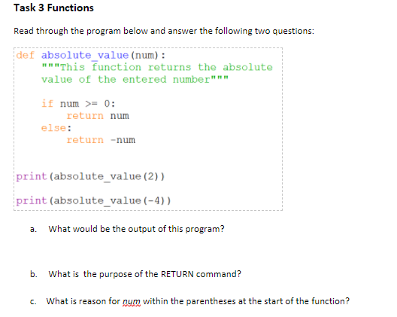
TASK 4
Go to Task 4 of your worksheet and answer the following two questions. Create a program that matches the requirements of Task 3.
Go to the final slide for a challenge!

Slide 21
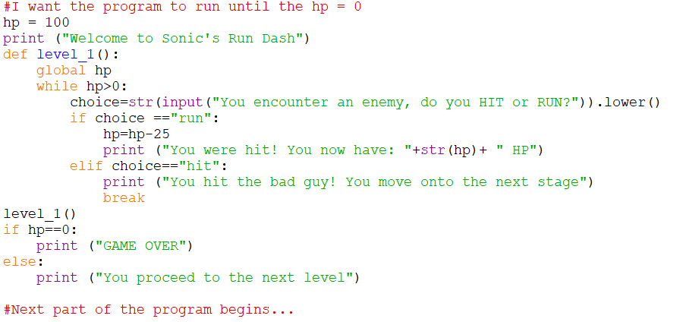
EXTRA – Global Variables in Subroutines
Global variables are used to change the value of a variable within a subroutine.
The program provided details the use of global variables being used within a subroutine. This will change the value which is hp to a different value after each time the player chooses either HIT or RUN.

Slide 22
EXTRA – Global Variables in Subroutines
Try out this program, it may come in handy for your storybook game!

