Slide 1
Logic Gates The Basic Gates and Circuits
Notes:
TES

Slide 2
Recall
Add the following Binary numbers:
10101111 + 10110111

Slide 3
Recall
Multiply the following binary number by 2. (Hint: Logical binary shift)
10110111

Slide 4
Lesson Objectives
Understand the functions of the main logic gates
Know how to design simple circuits using logic gates
Understand how to construct a Truth Table for simple logic circuits

Slide 5
Logic Gates
A logic gate is a digital circuit which either allows a signal to pass or stops it
Logic gates allow the computer to:
Add
Divide
Multiply
Do simple Yes and No reasoning

Slide 6
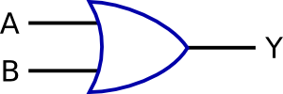
Overview
There are six basic logic gates: AND, OR, NOT, NAND, NOR, and XOR
AND GATE
OR GATE
NOT GATE

Slide 7
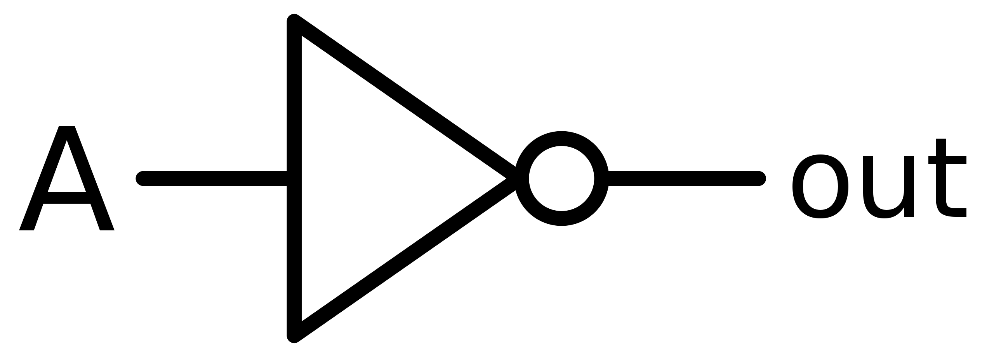
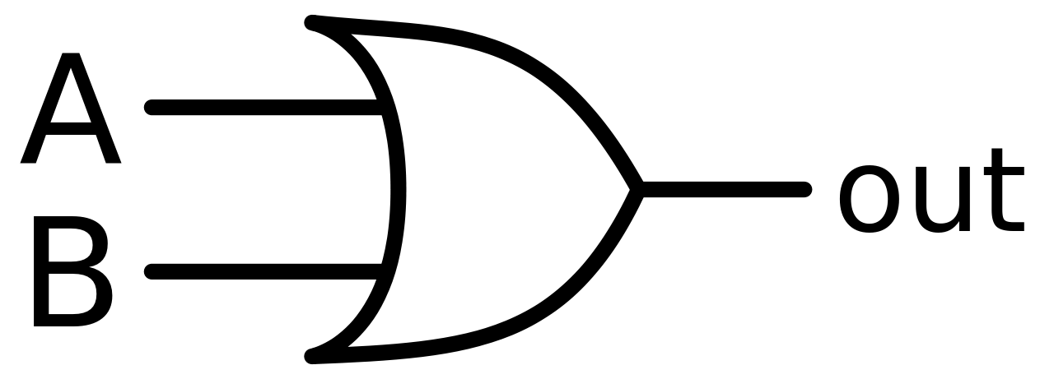
NOT
AND
OR
Exclusive OR

Slide 8
Truth Tables
Every Logic Gate has a Truth Table to describe the output of a particular Boolean logic operation.
Inputs and outputs
are labelled
A | B | Y
0
0
There are two inputs giving four possible values
0
1
1
0
1
1

Slide 9
AND Gates
Gives a TRUE result (1) if both inputs are TRUE (1)
A
Y
B
A | B | Y = A AND B
0 | 0
0 | 1
1 | 0
1 | 1
0
0
0
1

Slide 10
OR Gates
Gives a TRUE result (1) if any input value is TRUE (1)
A
Y
B
A | B | Y = A OR B
0 | 0
0 | 1
1 | 0
1 | 1
0
1
1
1

Slide 11
NOT Gates
Changes the input value to its opposite value
This Logic Gate only has one input
A
Y
A | Y = NOT A
0
1
1
0

Slide 12
NAND Gates
Gives an output of 1 if both input values are NOT 1 (the opposite of an AND Gate)
A
Y
B
A | B | A NAND B
0 | 0
0 | 1
1 | 0
1 | 1
1
1
1
0

Slide 13
NOR Gates
Gives an output of 1 if both the inputs are 0 (the opposite of an OR Gate
A
Y
B
A | B | A NOR B
0 | 0
0 | 1
1 | 0
1 | 1
1
0
0
0

Slide 14
XOR Gates
Gives an output of 1 if the two input values are different
A
Y
B
A | B | A XOR B
0 | 0
0 | 1
1 | 0
1 | 1
0
1
1
0

Slide 16
Summary
Name | Symbol | Description
AND Gate
Output is 1 only if all inputs are 1
NAND Gate
NOT-AND Gate – Opposite of AND Gate.
Output is 1 only if any input is NOT 1
OR Gate
Output is 1 if either input is 1
Output is 0 only if both inputs are 0
NOR Gate
NOT-OR Gate – Opposite of OR Gate
Output is 1 only if both inputs are 0
XOR Gate
Exclusive OR gate - Output is only 1 if either input is 1.
If both inputs are 1, the output is 0
NOT Gate
Reverses the input
Also known as an inverter gate
Notes:
Optional Retrieval Practice – print from last section of this presentation

Slide 17
Produce a Truth Table for the following logic circuit
A
P
B
R
Q
X
C

Slide 18
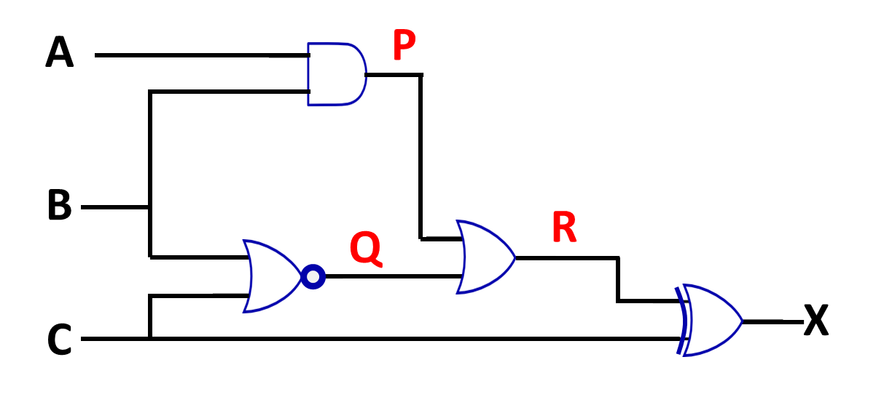
Input Value |  |  | Intermediate Values |  |  | Output
A | B | C | P | Q | R | X
0 | 0 | 0
0 | 0 | 1
0 | 1 | 0
0 | 1 | 1
1 | 0 | 0
1 | 0 | 1
1 | 1 | 0
1 | 1 | 1

Slide 19
P = A AND B
Q = B NOR C
Input Value |  |  | Intermediate Values |  |  | Output
A | B | C | P | Q | R | X
0 | 0 | 0
0 | 0 | 1
0 | 1 | 0
0 | 1 | 1
1 | 0 | 0
1 | 0 | 1
1 | 1 | 0
1 | 1 | 1
0
1
0
0
0
0
0
0
0
1
0
0
1
0
1
0

Slide 20
R = P OR Q
X = C XOR R
Input Value |  |  | Intermediate Values |  |  | Output
A | B | C | P | Q | R | X
0 | 0 | 0
0 | 0 | 1
0 | 1 | 0
0 | 1 | 1
1 | 0 | 0
1 | 0 | 1
1 | 1 | 0
1 | 1 | 1
0
1
1
1
0
0
0
1
0
0
0
0
0
0
0
1
0
1
1
1
0
0
0
1
1
0
1
1
1
0
1
0

Slide 21
Exercise One
A
C
X
D
E
B
Notes:
3.12 a

Slide 22
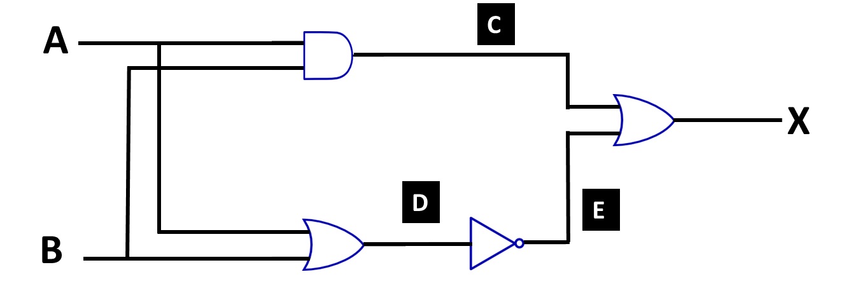
Exercise One – Truth Table
Input Value |  | Intermediate Values |  |  | Output
A | B | C | D | E | X
0 | 0
0 | 1
1 | 0
1 | 1
0
0
1
1
0
1
0
0
0
1
0
0
1
1
0
1

Slide 23
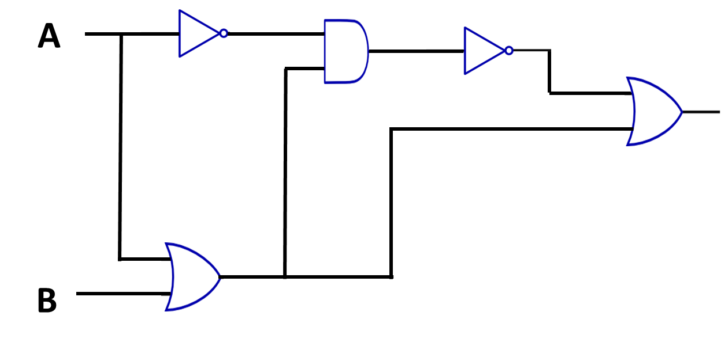
Exercise Two
Notes:
3.2 b

Slide 24
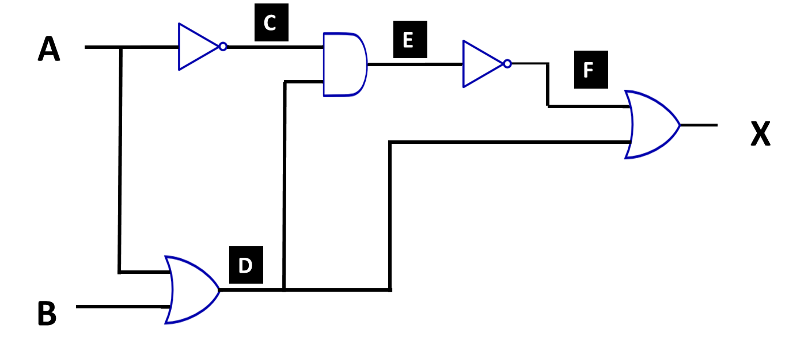
Exercise Two – Truth Table
Input Value |  | Intermediate Values |  |  |  | Output
A | B |  |  |  |  | X
0 | 0
0 | 1
1 | 0
1 | 1
C
D
E
F
1
0
0
1
1
1
1
1
0
1
0
1
0
1
1
0
1
0
1
1

Slide 25
Exercise Three
A
D
F
X
E
B
C
Notes:
Teach need to labl the intermediate points

Slide 26
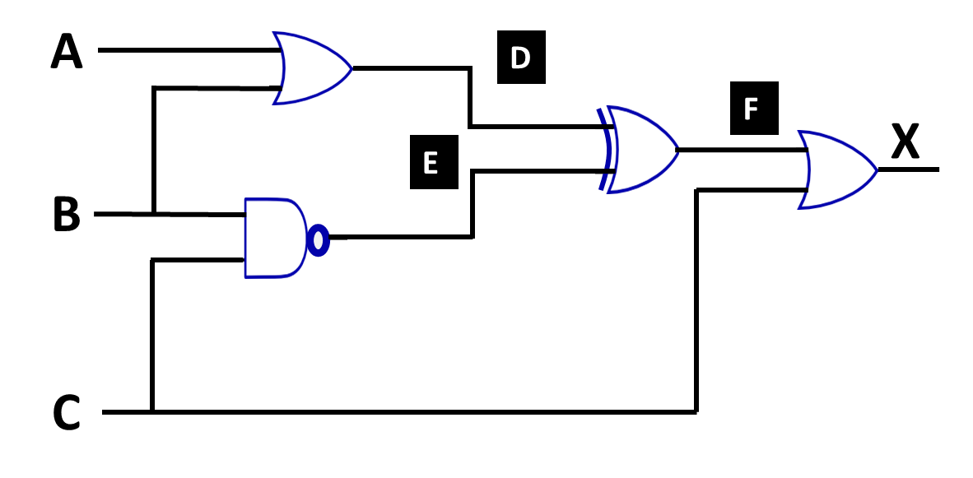
Exercise Three – Truth Table
Input Value |  |  | Intermediate Values |  |  | Output
A | B | C |  |  |  | X
0 | 0 | 0
0 | 0 | 1
0 | 1 | 0
0 | 1 | 1
1 | 0 | 0
1 | 0 | 1
1 | 1 | 0
1 | 1 | 1
D
E
F
0
1
1
1
0
1
1
1
1
1
0
0
1
0
1
1
1
1
0
0
1
1
0
1
1
1
0
0
1
0
1
1

Slide 27
Exercise Four
A
D
F
G
X
B
E
C

Slide 28
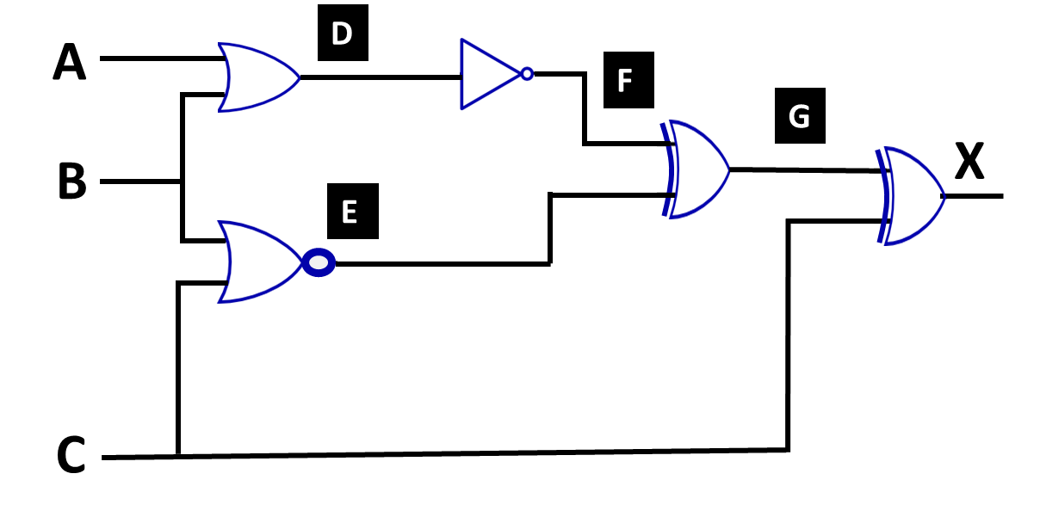
Exercise Four – Truth Table
Input Value |  |  | Intermediate Values |  |  |  | Output
A | B | C |  |  |  |  | X
0 | 0 | 0
0 | 0 | 1
0 | 1 | 0
0 | 1 | 1
1 | 0 | 0
1 | 0 | 1
1 | 1 | 0
1 | 1 | 1
D
E
F
G
0
1
1
0
0
0
0
1
1
0
1
0
0
0
0
1
0
0
0
1
1
1
0
1
1
1
0
0
0
1
1
0
0
0
0
1
0
0
0
1

Slide 29
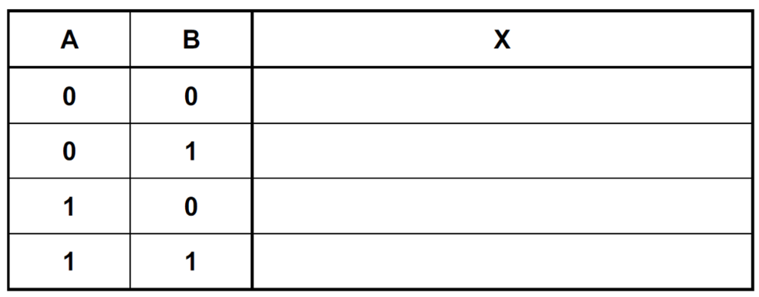
Exercise Five - Tricky Question?
A
X
B
[2]
What Gate does this circuit produce? [1]
OR Gate

Slide 30
Summary
Name | Symbol | Description
AND Gate
NAND Gate
OR Gate
NOR Gate
XOR Gate
NOT Gate
Notes:
Optional Retrieval Practice

Slide 31
Exercise One
A
C
X
D
E
B
Notes:
3.12 a

Slide 32
Exercise Two
C
A
E
F
X
D
B
Notes:
3.2 b

Slide 33
Exercise Three
A
D
F
E
B
C
Notes:
3.2 c

Slide 34
Exercise Four
A
D
F
G
B
E
C

