Slide 1
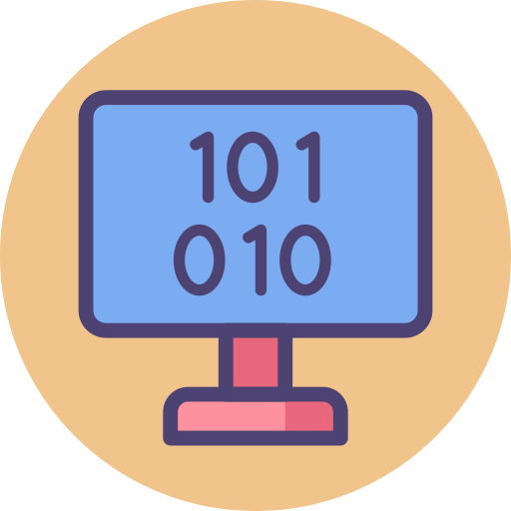
GCSE Computer Science (9-1)
Unit 3:
FUNDAMENTALS OF DATA REPRESENTATION
LESSON 1: NUMBER BASES

Slide 2
Recall
A list is made up of the numbers
38, 27,43,3,9,82,10
Show the first step of a merge sort algorithm to arrange the list of numbers in ascending order.

Slide 3
What will we be learning this term?
Base values(Binary & Calculations)
Hexadecimal values
ASCII & UNICODE
File Size Calculations
Image Development
Digital Sound creation
Compression Techniques
Encryption Methods
You may have been taught these already

Slide 4
Lesson Objectives
Today’s lesson
Understand the following number bases
Decimal
Binary
Understand that all computers use binary to represent instructions
Comprehend the units of data for measurement

Slide 5
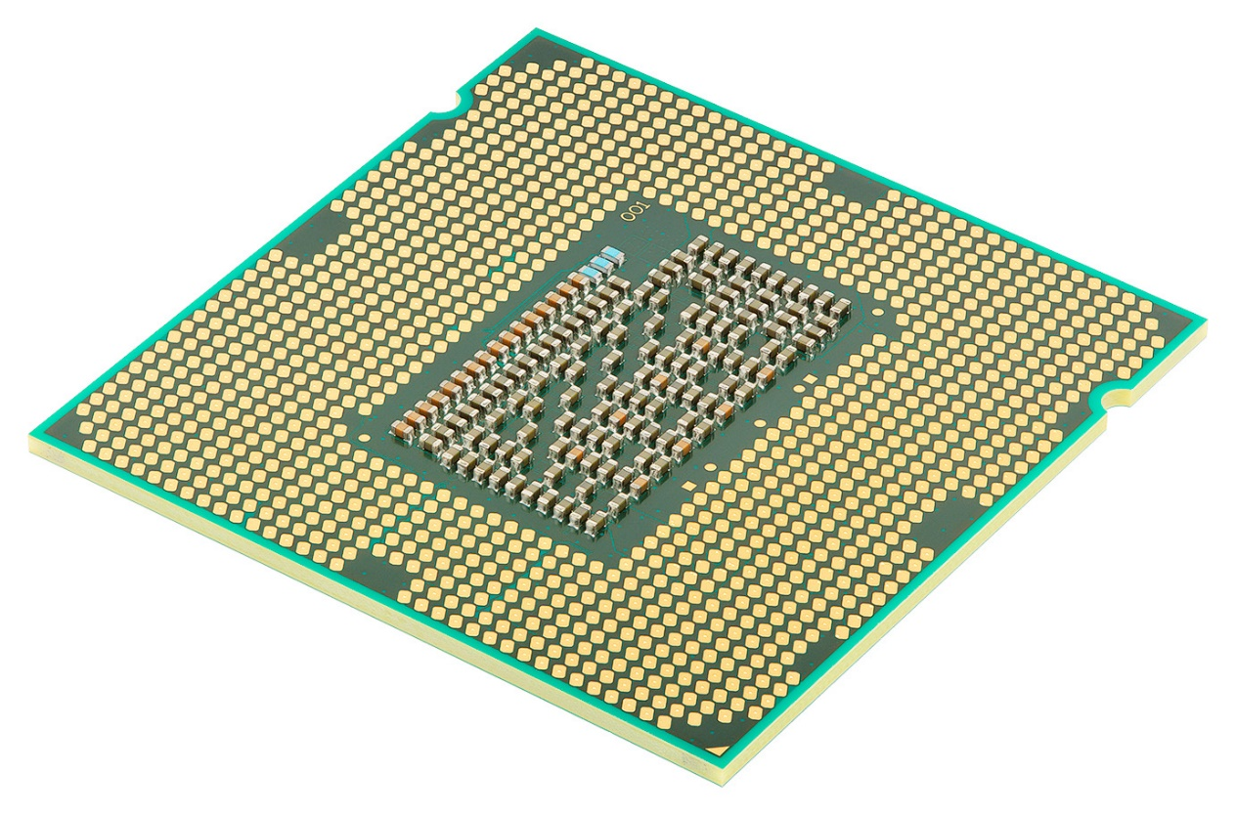
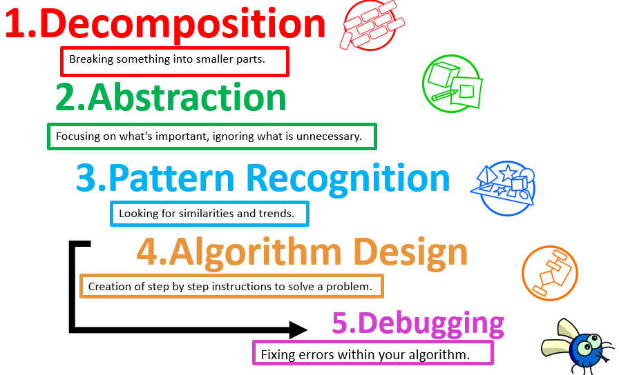
Digital Data
We will start this lesson with a short recap from the previous unit (Algorithms): How do computer processors think/operate logically?
Consider the purpose of Computational Thinking (the 4 steps involved)

Slide 6
Compilers and Interpreters
When programs are written in high-level code, they must be compiled into low-level code so that a computer can understand it
The on/off or positive/negative states of computer processor transistors represent 0 and 1 – does this symbol look familiar?

Slide 7
Introducing Binary
Binary is a base 2 number system comprised of 0s and 1s
Everything a computer does to operate is based off this number system, so that they can base themselves off of logic gates (which we already explored)
Binary numbers can be translated into “normal” decimal values

Slide 8
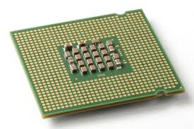
CPU / Processor/ Chip
The CPU is the brain of the computer – it tells the computer what to do and when.
Has millions of tiny switches that can either be:
on or off
1 or 0
Notes:
Why is it just 0 and 1? Electricity is on or off!

Slide 9
Denary System
0 , 1, 2, 3, 4, 5, 6, 7, 8, 9
We use a number system that uses 10 different numbers. (Base 10 number system)
This is called the Denary System.
However computers don’t understand this as they only understand 0’s and 1’s.
on or off

Slide 10
Lets check!
What is the difference between Binary and denary(decimal) number systems?
Draw the decimal place value chart.

Slide 11
Understanding Denary
People use the denary (or decimal) number system in their day-to-day lives. This system has 10 digits that we can use: 0, 1, 2, 3, 4, 5, 6, 7, 8 and 9.
The value of each place value is calculated by multiplying by 10 (i.e. by the power of 10). The first few place values look like this:
Working out 1024
Thousands | Hundreds | Tens | Units
1000 | 100 | 10 | 1
Thousands | Hundreds | Tens | Units
1 | 0 | 2 | 4
1 x 1000 | 0 x 100 | 2 x 10 | 4 x 1
+
+
+

Slide 12
Represent a positive integer in decimal
Activity 3
Given nine of each coin, how could you make £6,569?
6 × £1,000 coins
5 × £100 coins
6 × £10 coins
9 × £1 coin
1,000 | 100 | 10 | 1
6 | 5 | 6 | 9
£1,000
£100
£10
£1
Notes:
Image source: Gold coin vector created by freepik (www.freepik.com). Free for personal and commercial purpose with attribution.

Slide 13
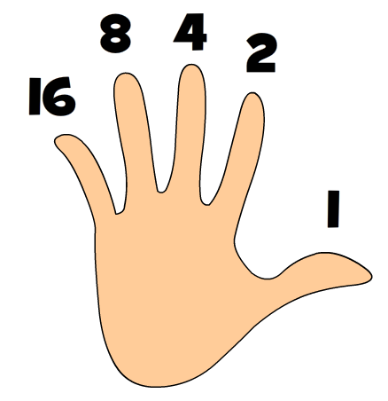
Brain teaser: What is the Highest number you can count to on one hand in one iteration (1 go)?

Slide 14
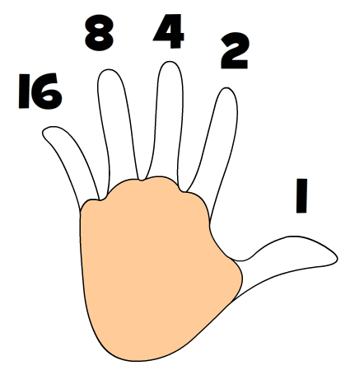
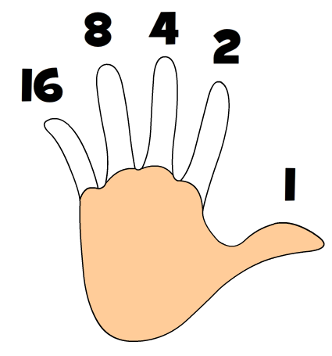
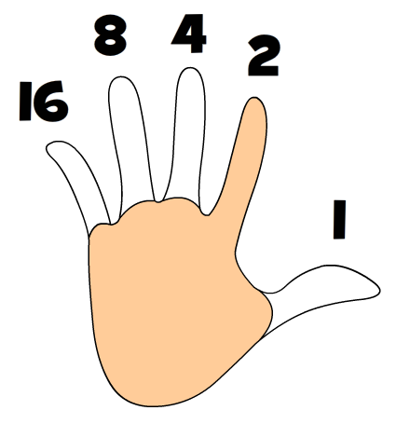
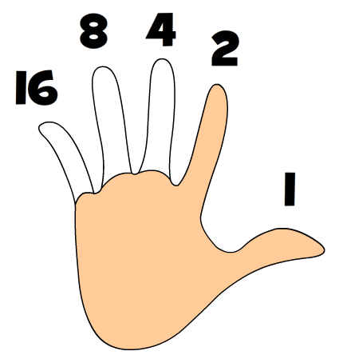
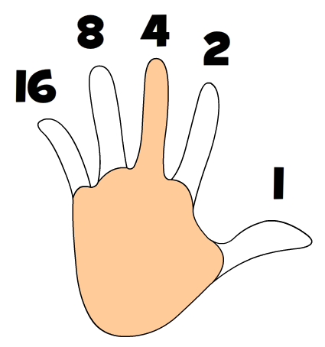
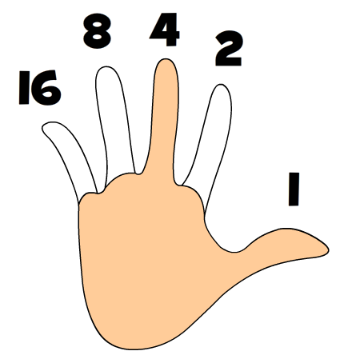
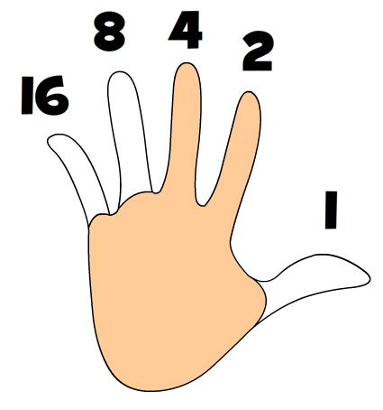
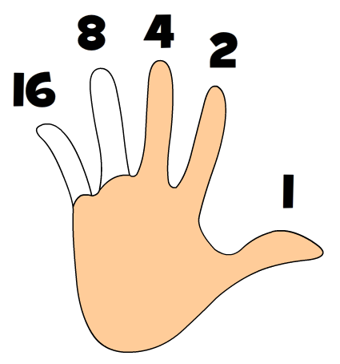
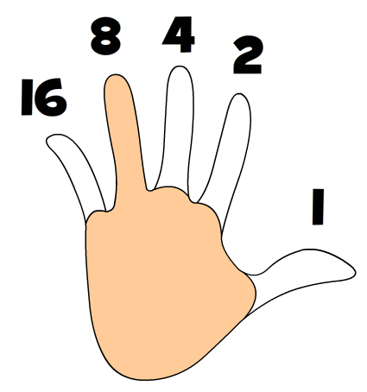
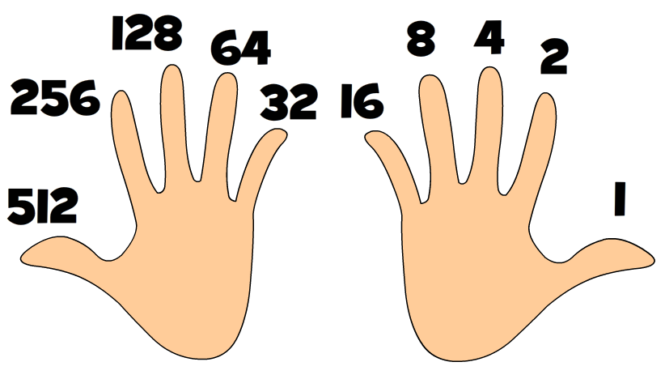
Binary Fingers!
Forget about counting to 10 on your fingers ... you can count past 1,000 if you want!
Right Hand
With just your right hand you can count to 31:
No fingers up is 0
Thumb is 1
Index finger is 2
2 and 1 makes 3
Middle finger is 4
Add your thumb for 5
4 and 2 makes 6
4 and 2 and 1 makes 7
Fourth finger is 8
Task: Practice counting from 0 to 31 on your fingers, just like above.
Do it many times until it becomes easy.
When you can do it well, demonstrate it to your teacher or a friend.
Extension: Want bigger numbers? Your left hand can help:

Slide 15
What is Binary?
Binary is a number system that only uses two digits: 1 and 0. All information that is processed by a computer is in the form of a sequence of 1s and 0s. Therefore, all data that we want a computer to process needs to be converted into binary.
The binary system is known as a ‘base 2’ system. This is because:
there are only two digits to select from (1 and 0)
when using the binary system, data is converted using the power of two.

Slide 16
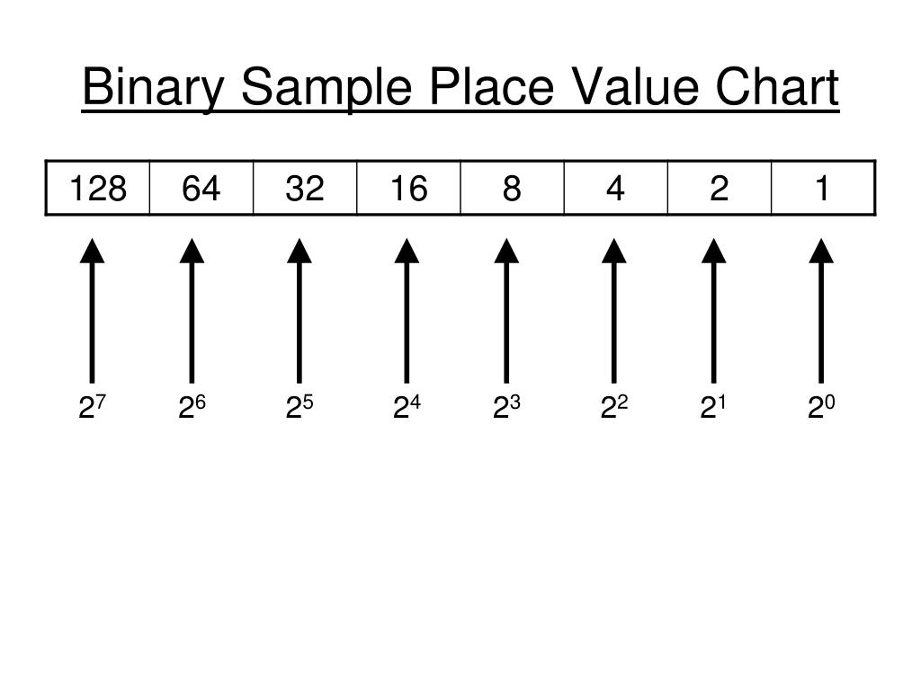
Binary place value chart

Slide 17
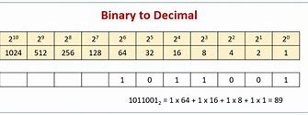
Binary place value chart

Slide 18
Converting decimal to binary
Activity 3
In binary, we can imagine that we have one coin for each binary place value.
In pairs, find out how you could use these coins to represent 104₁₀ in binary.
Explorer task: Using the 1, 2, 4, and 8 coins, are there any numbers between 0 and 15 that you cannot represent?
128
64
32
16
8
4
2
1
128 | 64 | 32 | 16 | 8 | 4 | 2 | 1
Notes:
Image source: Gold vector created by freepik (www.freepik.com). Free for personal and commercial purpose with attribution.

Slide 19
How Computers Work – Binary!
Computers are made up of complicated hardware that stores and processes data.
If you break a computer down into its most basic components you have millions of circuits that either allow electricity to flow, or not.
Imagine a whole row of light switches that you can switch on and off in different combinations to mean different things.
Each switch is either on or off. It only has two states. That is why everything stored in a computer can be stored as a series of 1s and 0s. This is called binary.

Slide 20
GCSE Computer Science (9-1)
Unit 3:
FUNDAMENTALS OF DATA REPRESENTATION
LESSON 1: NUMBER BASES

Slide 21
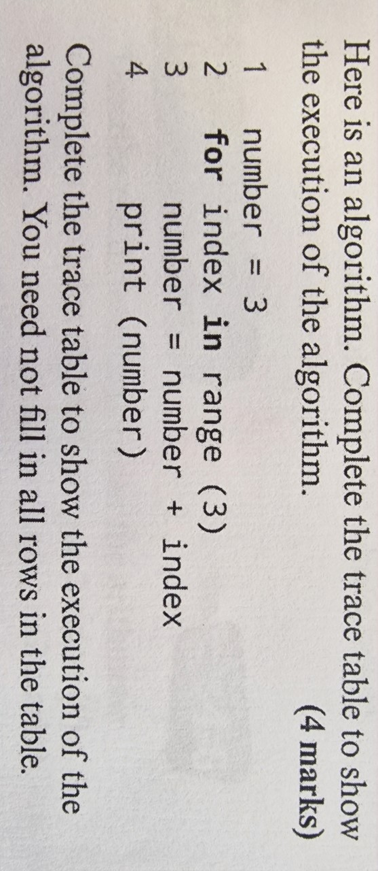
Recall

Slide 22
Number bases
Activity 2
Sometimes you need to make it clear what number base you are using:
If 101 is decimal, its value is one hundred and one
If 101 is binary, its value is five in decimal
Use subscripts to show the number base:
101₁₀ is decimal
101₂ is binary

Slide 23
Number bases
Activity 2
Explorer task: Which is bigger and why: 1111₂ or 1111₁₀?
You can predict that 1111₁₀ will be bigger because the place values are 1000, 100, 10, and 1 in decimal, and only 8, 4, 2, and 1 in binary.
To work this out:
1111₂ is 8 + 4 + 2 + 1 = 15₁₀
1111₁₀ is bigger than 15₁₀

Slide 24
Converting Binary to Denary
To convert a binary number to denary, start by writing out the binary place values. In denary, the place values are 1, 10, 100, 1000, etc. – each place value is 10 times bigger than the last.
In binary, each place value is 2 times bigger than the last (i.e. increased by the power of 2). The first few binary place values look like this:
128 | 64 | 32 | 16 | 8 | 4 | 2 | 1
Working out the value of 1010 1000:
128 | 64 | 32 | 16 | 8 | 4 | 2 | 1
1 | 0 | 1 | 0 | 1 | 0 | 0 | 0
1 × 128 | 0 × 64 | 1 × 32 | 0 × 16 | 1 × 8 | 0 × 4 | 0 × 2 | 0 × 1
128 | 0 | 32 | 0 | 8 | 0 | 0 | 0
Place value
Binary
Calculation of numbers
+
+
+
+
+
+
+
Total numbers = 168
So 1010 1000 in binary is equal to 168 in denary.

Slide 25
Working out binary numbers
How would you convert the Binary value of 01010101 into Denary?
First, create a table starting with 1, which increases by x2 each time starting right to left;
128 | 64 | 32 | 16 | 8 | 4 | 2 | 1 | Answer
0 | 1 | 0 | 1 | 0 | 1 | 0 | 1 | 85
0 | 64 | 0 | 16 | 0 | 4 | 0 | 1
+
+
+
+
+
+
+
=
2. Numbers with a zero next to them are not included. Add only the numbers with a one next to them…
3. Add the numbers up. In this instance; 64+16+4+1 = 85
1. Add the binary into the table…

Slide 26
Working out Binary Numbers
Convert the following binary numbers into their denary values using the table below:
128 | 64 | 32 | 16 | 8 | 4 | 2 | 1 | Answer
0 | 0 | 0 | 0 | 1 | 0 | 1 | 0
0000101
+
+
+
+
+
+
+
10111000
+
+
+
+
+
+
+
01010000
11111111
The table above makes working out binary really easy.
“1” means the number has been selected
“0” means the number has not been selected
Add up all the numbers that have been selected
Using this method, can you work out the binary numbers above?

Slide 27
Converting decimal to binary
Activity 3
128 | 64 | 32 | 16 | 8 | 4 | 2 | 1
0 | 1
 | 104-64 =40
How can we represent the decimal number 104 in the binary grid?
Is there a group of 128 in 104?
No. Write a 0 under 128.
Is there a group of 64 in 104?
Yes. Write a 1 under 64.
We have now represented 64, so take this away from 104, leaving 40.
Notes:
Image source: Gold vector created by freepik (www.freepik.com). Free for personal and commercial purpose with attribution.

Slide 28
Tip – Always use 8 bits for binary!
So far we have only looked at numbers using eight columns. This is an 8-bit number, or a byte.
00000011 is binary for 3 but so is 11.
You do not need the leading zeros for it to be a valid number but we tend to write groups of 8 bits because computers usually store data in bytes.

Slide 29
Creating Binary Numbers
128 | 64 | 32 | 16 | 8 | 4 | 2 | 1 | Answer
 |  |  |  |  |  |  |  | 20
 |  |  |  |  |  |  |  | 99
 |  |  |  |  |  |  |  | 150
 |  |  |  |  |  |  |  | 125
The table above can be used to create binary number too.
Work from the largest number you can include in the number you wish to create (for example, 16 will fit into the first answer, 20, but 32 wont).Therefore you would write a “1” under 16.
As you have 4 remaining, you would add a zero under the 8 and a 1 below the 4. The rest of the numbers are not required and therefore have a zero below them.
So, the binary code for 20 is: 10100
See if you can work out the rest of the answers!

Slide 30
Converting decimal to binary
Activity 3
128 | 64 | 32 | 16 | 8 | 4 | 2 | 1
0 | 1 | 1 | 0 | 1 | 0 | 0 | 0
 | 104-64 =40 | 40-32 =8 |  | 8-8 =0
Represent 104 in the binary grid:
Put a 0 under the 128
Put a 1 under the 64 104 - 64 = 40
Put a 1 under the 32 40 - 32 = 8
Put a 1 under the 8 8 - 8 = 0
Put 0s under the 4, 2, and 1 because the whole value has been represented
Copy this example onto the worksheet and then do the exercises, showing all workings.

Slide 31
Converting decimal to binary
Activity 3
128 | 64 | 32 | 16 | 8 | 4 | 2 | 1
0 | 1 | 1
 | 104-64 =40 | 40-32 =8
We have 40 left to represent.
Is there a group of 32 in 40?
Yes. Write a 1 under 32.
We have now represented another 32, so take this away from 40, leaving 8.

Slide 32
Converting decimal to binary
Activity 3
128 | 64 | 32 | 16 | 8 | 4 | 2 | 1
0 | 1 | 1 | 0 | 1 | 0 | 0 | 0
 | 104-64 =40 | 40-32 =8 |  | 8-8 =0
We have 8 left to represent.
Is there a group of 16 in 8?
No. Write a 0 under 16.
Is there a group of 8 in 8?
Yes. Write a 1 under 8.
We have represented the whole value. Write 0s under the 4, 2, and 1 place values.

Slide 33
Convert the following to there Base2 equivalent.
149
63
129
255

Slide 34
Converting decimal to binary – Solutions
Activity 3
149
63
129
255
128 | 64 | 32 | 16 | 8 | 4 | 2 | 1
1 | 0 | 0 | 1 | 0 | 1 | 0 | 1
128 | 64 | 32 | 16 | 8 | 4 | 2 | 1
0 | 0 | 1 | 1 | 1 | 1 | 1 | 1
128 | 64 | 32 | 16 | 8 | 4 | 2 | 1
1 | 0 | 0 | 0 | 0 | 0 | 0 | 1
128 | 64 | 32 | 16 | 8 | 4 | 2 | 1
1 | 1 | 1 | 1 | 1 | 1 | 1 | 1

Slide 35
Plenary
Discuss in pairs:
What do you notice about these answers from the worksheet?
63₁₀ is
255₁₀ is
How does this relate to what we discussed at the start of this lesson?
There are 64 different bit combinations with 6 bits
There are 256 different bit combinations with 8 bits
2⁶ is 64 and 2⁸ is 256
128 | 64 | 32 | 16 | 8 | 4 | 2 | 1
0 | 0 | 1 | 1 | 1 | 1 | 1 | 1
128 | 64 | 32 | 16 | 8 | 4 | 2 | 1
1 | 1 | 1 | 1 | 1 | 1 | 1 | 1

Slide 36
Number bases – Solutions
Activity 2
Task 2 Converting from binary to decimal
128 + 32 + 16 + 8 + 2 + 1 = 187₁₀
128 | 64 | 32 | 16 | 8 | 4 | 2 | 1
1 | 0 | 1 | 1 | 1 | 0 | 1 | 1
128 |  | 32 | 16 | 8 |  | 2 | 1

Slide 37
Number bases – Solutions
Activity 2
Task 2 Converting from binary to decimal
b.
16 + 8 + 4 + 2 + 1 = 31₁₀
128 | 64 | 32 | 16 | 8 | 4 | 2 | 1
0 | 0 | 0 | 1 | 1 | 1 | 1 | 1
 |  |  | 16 | 8 | 4 | 2 | 1

Slide 38
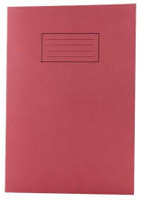
Binary Task
Work out the following numbers in binary:
Number | Binary
165
117
61
224
39
139
170
186
255
223
84

Slide 39
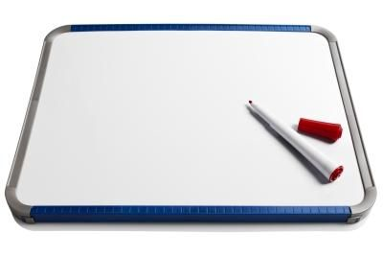
Put these into Size Order – 30secs
Megabyte (Mb)
Terabyte (Tb)
Kilobyte (Kb)
bit
Byte
Gigabyte (Gb)

Slide 40
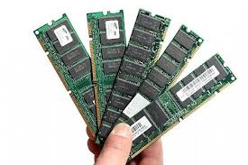
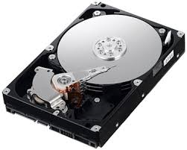
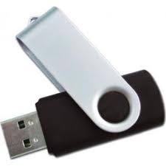
Rank these types of data storage in size
RAM
4-8Gb
700Mb
128Gb
Hard Drive
4Tb
256Gb
4.7Gb

Slide 41
Data Storage Capacities
bit (a single 0 or 1 is a binary digit)
8 bits = 1 byte
1024 bytes = 1Kb
1024 Kilobytes = 1Mb
1024 Megabytes = 1Gb
1024 Gigabytes = 1Tb
Did you know?
Half a byte (4 bits) is called a
nibble?

Slide 42
Why 1024? It’s Binary! 0 and 1’s!
2^0 = 1
2 ^ 1 = 2
2 ^ 2 = 4
2 ^ 3 = 8
2 ^ 4 = 16
2 ^ 5 = 32
2 ^ 6 = 64
2 ^ 7 = 128
2 ^ 8 = 256
2 ^ 9 = 512
2 ^ 10 = 1024

Slide 43
Conversion chart
byte → kibibyte → mebibyte → gigibyte → tebibyte
/1024
/1024
/1024
/1024
x1024
x1024
x1024
x1024

Slide 44
Extension
Can you create a spreadsheet that will automatically work out the denary number from the binary you type in (or vice versa?)
Validate it so you can only enter a 0 or 1

Slide 45
Next lesson
Summary
In this lesson, you…
Explored the concept of a number base
Defined the term ‘bit’
Converted numbers between binary and decimal
Next lesson, you will…
Do some binary maths

