Slide 1
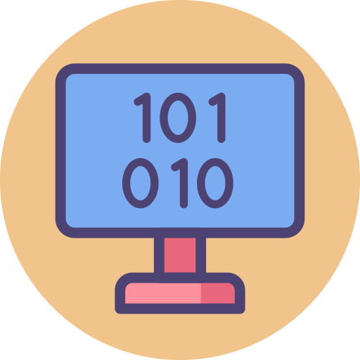
GCSE Computer Science (9-1)
Unit 3:
FUNDAMENTALS OF DATA REPRESENTATION
Hexadecimal values

Slide 2
Recall
A list is made up of the numbers
38, 27,43,3,9,82,10
Show the first step of a merge sort algorithm to arrange the list of numbers in ascending order.

Slide 3
Lesson Objectives
Today’s lesson
Explain why hexadecimal is often used in computer science
Understand how binary can be used to represent whole numbers
Understand how hexadecimal can be used to represent whole numbers

Slide 4
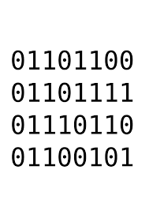
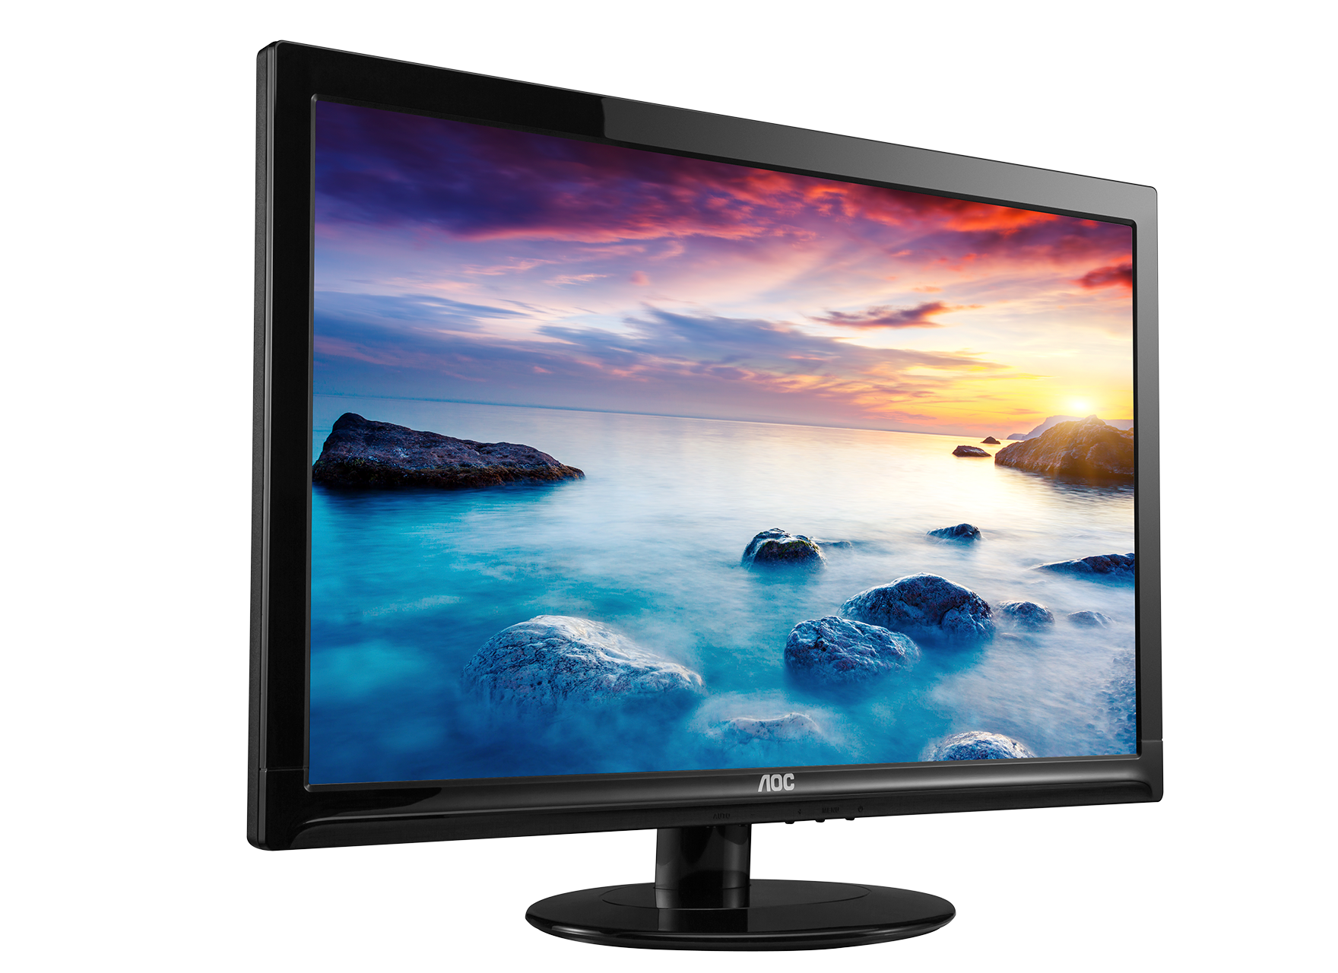
What will we be learning this term?
Lesson 1 - Base values (Binary & Denary)
Lesson 2 - Binary Calculations
Lesson 3 - Hexadecimal values
Lesson 4 - ASCII & UNICODE
Lesson 5 - File Size Calculations
Lesson 6 - Image Development
Lesson 7 - Digital Sound creation
Lesson 8 - Compression Techniques
Lesson 9 - Encryption Methods

Slide 5
Theory - Hexadecimal
Hexadecimal (or hex) is a base 16 system used to simplify how binary is represented. A hex digit can be any of the following 16 digits:
0 1 2 3 4 5 6 7 8 9 A B C D E F.
Each hex digit reflects a 4-bit binary sequence.
This table shows each hex digit with the equivalent values in binary and denary.
This means an 8-bit binary number can be written using only two different hex digits - one hex digit for each nibble (or group of 4-bits). It is much easier to write numbers as hex than to write them as binary numbers.
For example:
11010100 in binary would be D4 in hex
FFFF3 in hex would be 11111111111111110011 in binary
Denary | Binary | Hexadecimal
0 | 0000 | 0
1 | 0001 | 1
2 | 0010 | 2
3 | 0011 | 3
4 | 0100 | 4
5 | 0101 | 5
6 | 0110 | 6
7 | 0111 | 7
8 | 1000 | 8
9 | 1001 | 9
10 | 1010 | A
11 | 1011 | B
12 | 1100 | C
13 | 1101 | D
14 | 1110 | E
15 | 1111 | F

Slide 6
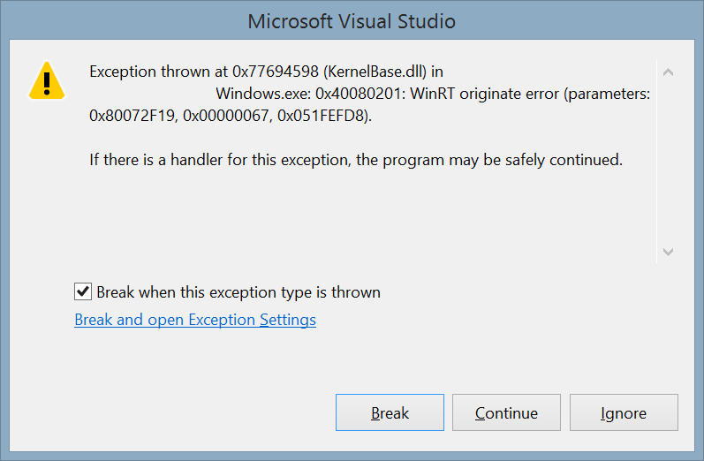
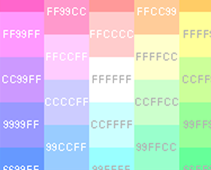
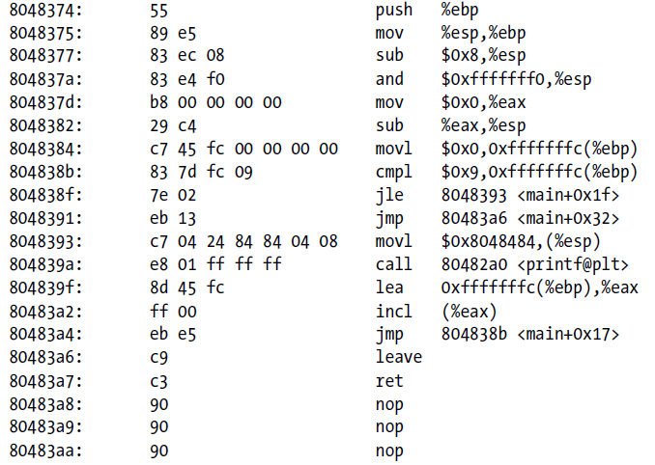
Using Hexadecimal
Hex codes are used in many areas of computing to simplify binary codes. It is important to note that computers do not use hexadecimal - it is used by humans to shorten binary to a more easily understandable form.
Hexadecimal is translated into binary for computer use. Some examples of where hex is used include:
Colour references (graphics software and websites)
Assembly language programs
Error messages

Slide 7
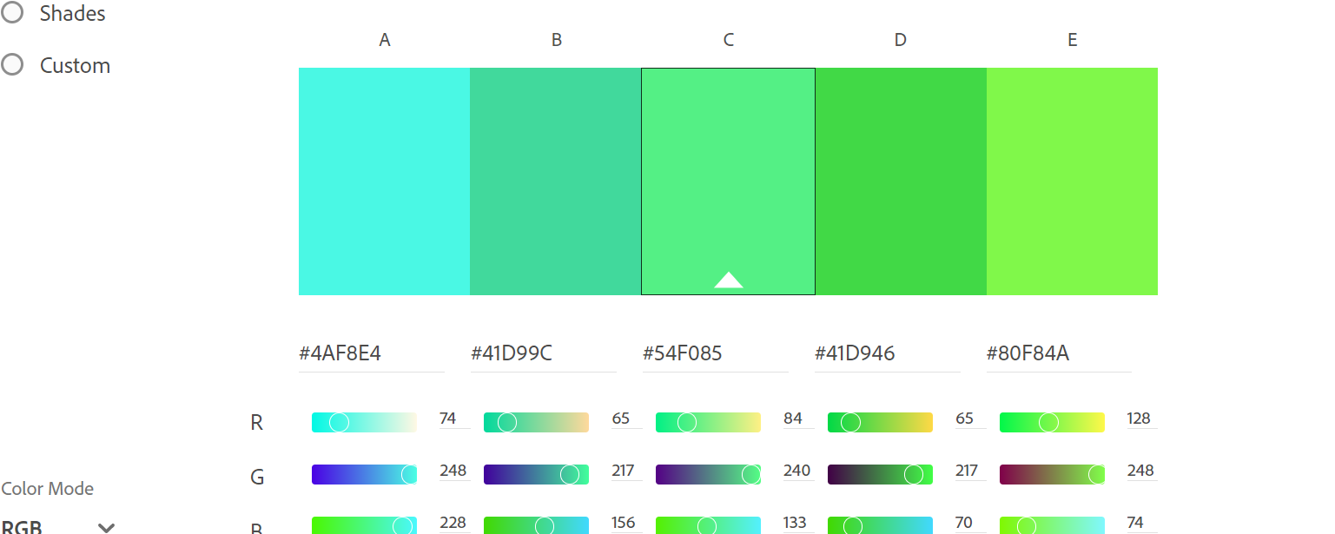
Hex and it’s uses
Try out this link to view how Hex values are used in Web Scripting - Color wheel, a color palette generator | Adobe Color

Slide 8
Why use hex?
A hexadecimal value is much easier to read and remember than a string of binary digits
It is quicker to write or type, since a hex digit takes up only one character, not four
There is less chance of making an error when typing hex characters than a string of 1s and 0s
It is used to define colours, in MAC addresses, in assembly languages and machine code
It is very easy to convert to and from binary

Slide 9
The Hexadecimal Number System
The hex number system is base 16 – 16 values (0-F)
The place value tends to use the first 3 bases of 16
Hex | 0 | 1 | 2 | 3 | 4 | 5 | 6 | 7 | 8 | 9 | A | B | C | D | E | F
Dec | 0 | 1 | 2 | 3 | 4 | 5 | 6 | 7 | 8 | 9 | 10 | 11 | 12 | 13 | 14 | 15
Base | 16² | 16¹ | 16⁰
Value | 256 | 16 | 1
Digit

Slide 10
Significance of 16
16 is the fourth power of 2
This means that base 16 numbers can be translated from 4 consecutive bits of a binary value
This makes it simple to translate binary numbers into hexadecimal values and back again
 |  | 8 | 4 | 2 | 1 | 8 | 4 | 2 | 1
216 | = | 1 | 1 | 0 | 1 | 1 | 0 | 0 | 0
 | = | D |  |  |  | 8

Slide 11
Converting Denary / Binary to Hexadecimal
Convert the number 106 into Hexadecimal;
Hexadecimal | 0 | 1 | 2 | 3 | 4 | 5 | 6 | 7 | 8 | 9 | A | B | C | D | E | F
Denary | 0 | 1 | 2 | 3 | 4 | 5 | 6 | 7 | 8 | 9 | 10 | 11 | 12 | 13 | 14 | 15
1. First convert the number into binary
128 | 64 | 32 | 16 | 8 | 4 | 2 | 1 | No.
0 | 1 | 1 | 0 | 1 | 0 | 1 | 0 | 106
8 | 4 | 2 | 1 |  | 8 | 4 | 2 | 1
0 | 1 | 1 | 0 |  | 1 | 0 | 1 | 0
2. Split the byte into two nibbles;
3. Finally, Convert each nibble into a hex number;
 | 16x | 1x | Answer
Hex | 6 | A | 6A
Why it works;
Hexadecimal is a base 16 system (0 to 15), therefore one hex digit contains as many bits of information as can be stored within one binary nibble (0 to 15).

Slide 12
Converting between HEX and Decimal
Decimal to HEX is an easy process – HEX to Denary is considered not so easy
To convert a decimal value, simply write the digits out in a place value table and multiply
Example: Convert 35 into Hex
=16x3 + 1x5
=53
16 | 1
3 | 5

Slide 13
Converting Hexadecimal to Denary
Work out the Hexadecimal value of 5AA into Denary;
Hexadecimal | 0 | 1 | 2 | 3 | 4 | 5 | 6 | 7 | 8 | 9 | A | B | C | D | E | F
Denary | 0 | 1 | 2 | 3 | 4 | 5 | 6 | 7 | 8 | 9 | 10 | 11 | 12 | 13 | 14 | 15
First, create a table starting with 1, which increases by x16 each time starting right to left;
1. Add the values to the table…
 | 256x | 16x | 1x | Answer
1. Hex | 5 | A | A | 1450
2. Denary | 5 | 10 | 10
3. Multiply | 1280 | 160 | 10
+
+
2. Use the table to convert the separate values into denary.
4. Add the numbers to give you the denary answer.
3. Multiply them by the according number…

Slide 14
Converting from HEX to Binary
To convert from HEX to binary, we use two nibbles
Each digit is equal to one nibble (16 values), so we write them in and translate from there
E.g: Convert D6 into a binary value
8 | 4 | 2 | 1 | 8 | 4 | 2 | 1
D |  |  |  | 6
= 13 = 1 1 0 1 |  |  |  | = 6 = 0 1 1 0
11010110

Slide 15
Try this out - Convert 3C into a decimal number
Use a place value table
Base | 16¹ | 16⁰
Value | x16 | x1
Digit | 3 | C
16 x 3
+
1 x 12
=60

Slide 16
Binary to HEX
Converting to HEX from Binary is the same principle
Use two nibbles, and convert the values into hex digits
E.g: 00101101
= 2D
8 | 4 | 2 | 1 | 8 | 4 | 2 | 1
0 | 0 | 1 | 0 | 1 | 1 | 0 | 1
= 2 |  |  |  | = D

Slide 17
TASK 1
Your worksheet contains a list of 3 Hexadecimal values which must be converted into Denary (decimal) and Binary values.
Use the table to convert the HEX values into Denary (use the table above to guide you).

Slide 18
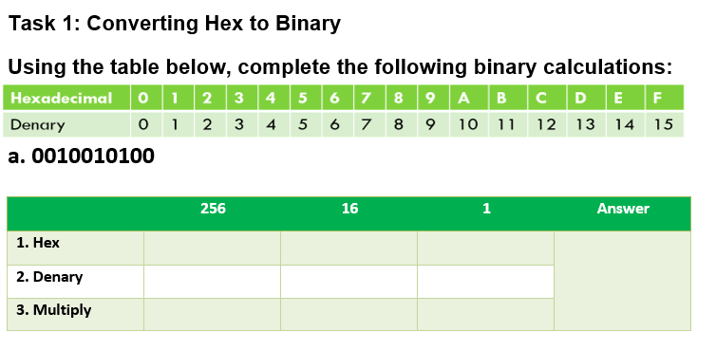

Slide 19
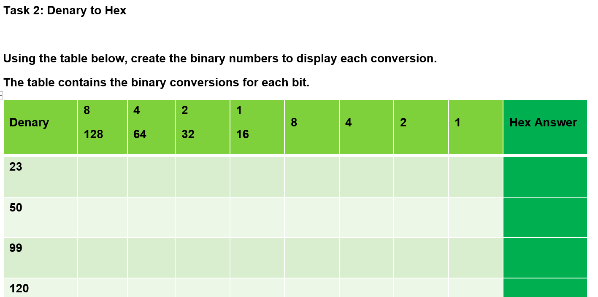
TASK 2
Don’t forget to check the Extension questions on the following page!
Your worksheet contains a series of Denary values which you must convert into Hexadecimal values.
Using the table, convert the Denary values into Binary, then finally providing a Hex number in the green column.

