Slide 1
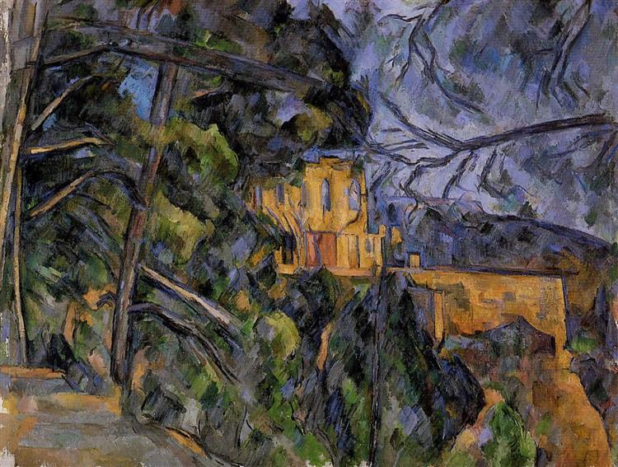
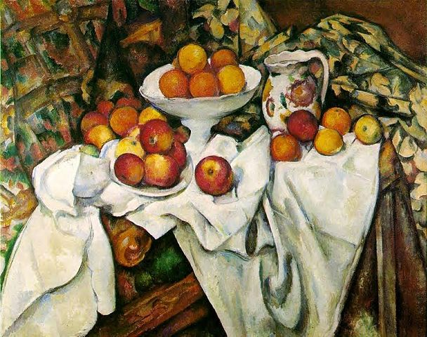
Paul Cézanne

Slide 2
Complete the research questions on the artist Paul Cézanne use the internet to help you!
What year was Cézanne born?
What year did Cézanne die?
What movement was Cézanne part of?
What movement influenced Cézanne?
What themes did Cézanne paint?
Write at least 100 words on the types of paintings Cézanne created.
Select one of Cézanne's paintings that you like. Give the title and year. Give your opinion on the painting and explain why you selected this. (one paragraph)

Slide 3
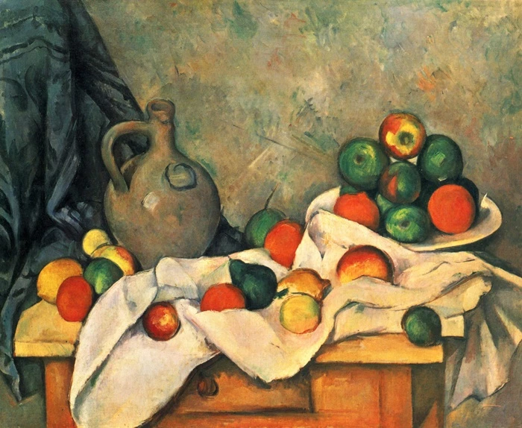
Curtain, Jug and Fruit 1893–1894, Paul Cézanne.
Write a paragraph discussing the artwork.
Discuss:
What do you see? How would you describe the art?
What medium was used?
Why did he create this?
What is your opinion of the piece?
What does it remind you of?

