Slide 1
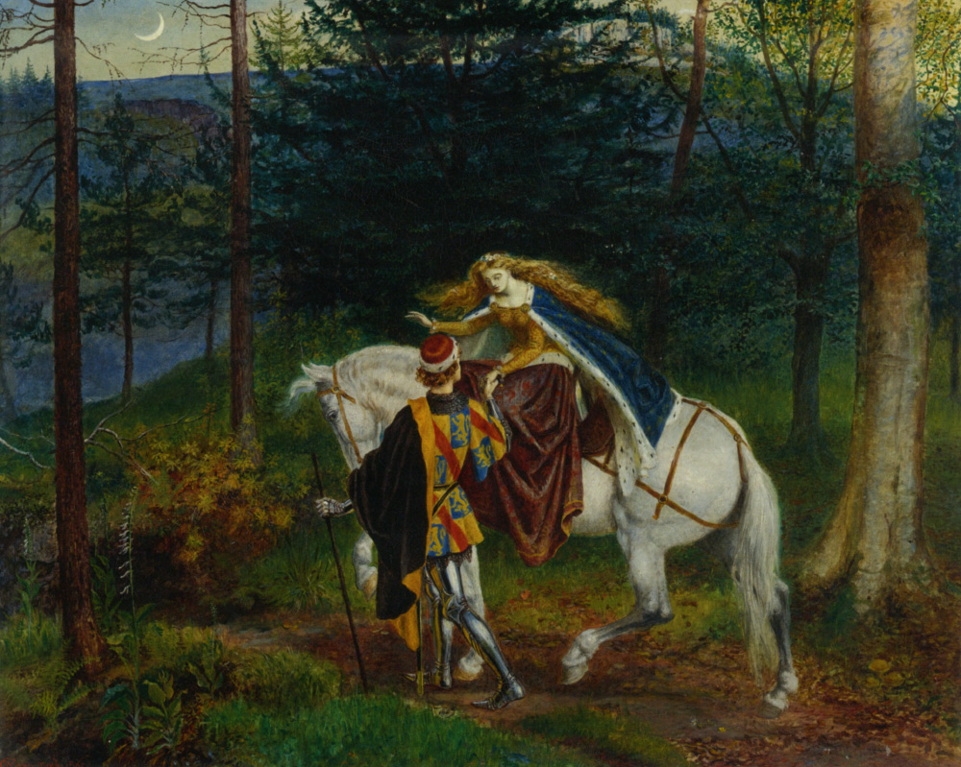
Exploring ideas
Complete the attached worksheet to compare Keats’s use of language, form and imagery with the conventions listed in the table.
I will give you some possible answers to self-assess your work next lesson.

