Slide 1
Revision - sentences
Find the simple, compound and complex sentences.
Despite his very humble background and beginnings, Barack Obama has risen to the highest position in America.
Malala Yousafzai made a remarkable recovery.
Tony Blair won with a landslide victory but now a lot of people doubt his legacy.
Jennifer Lawrence is best known for her role in the Hunger Games.
John Lennon was born in Liverpool and Ozzy Osbourne was born in Birmingham.
Katy Perry is best known for pop music although she does have other interests.

Slide 2
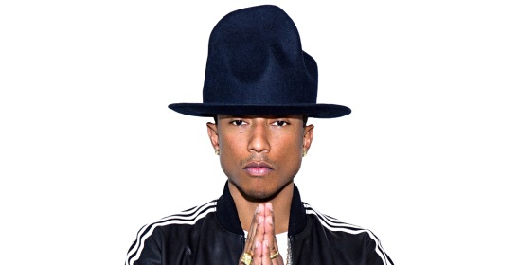
Complex sentences
Beginning the sentence
Embedded
Ending the sentence
Separate with a comma
Despite his ridiculous hat, Pharrell is often seen as a fashion icon.
These always go between the noun and the verb
Pharrell, despite his ridiculous hat, is often seen as a fashion icon.
Does not need a comma
Pharrell is often seen as a fashion icon despite his ridiculous hat.
Notes:
Students can be encouraged to experiment with their own complex sentence.

Slide 3
Persuasion bingo
Draw a 3 x 3 grid in your books and fill in the boxes with 9 of the following persuasive techniques.
Alliteration Rule of three
Facts Humour
Opinion Anecdotes
Rhetorical question Hyberbole
Repetition Imagery
Emotive Language Inclusive language
Statistics
Notes:
Add or delete techniques according to the ability of the class

Slide 4
Topic sentences
Each paragraph should start with a topic sentence which lets the reader know what you will say in this paragraph.
Beyoncé's music is not only great to listen to but can also be inspiring.
For higher marks, link topic sentences to previous paragraphs so that your speech flows well.
Come up with a list of topic sentences that you could start your paragraphs with.

Slide 5
Levelling
Read the three sample paragraphs on your sheet.
Give a WWW and EBI for each one.

Slide 6
Mid-Point Review!
STOP!
Look over the work you have done so far.
Capital letters
Full stops/question marks/exclamation marks
Variety of sentences
Correct use of commas
Topic sentences to start your paragraphs
Use of persuasive techniques

Slide 7
Target levels
Level 6
A range of different ideas
Personal voice and opinion
Use of persuasive techniques
Logical sequence with topic sentences
Linked paragraphs
Variety of sentence types
Correct punctuation including all capital letters correct
Use more advanced vocabulary
Level 7
Detailed ideas including abstract
Confident personal viewpoint
Persuasive techniques used fluently appropriate to the topic
Clear sense of organisation
Appropriate range of sentence structures for effect
All comma use correct
Punctuation used correctly for effect
Varied and ambitious vocabulary

Slide 8
Self-assessment
Look at the levelling criteria – give yourself a whole level.
Give a WWW and EBI.

