Slide 1
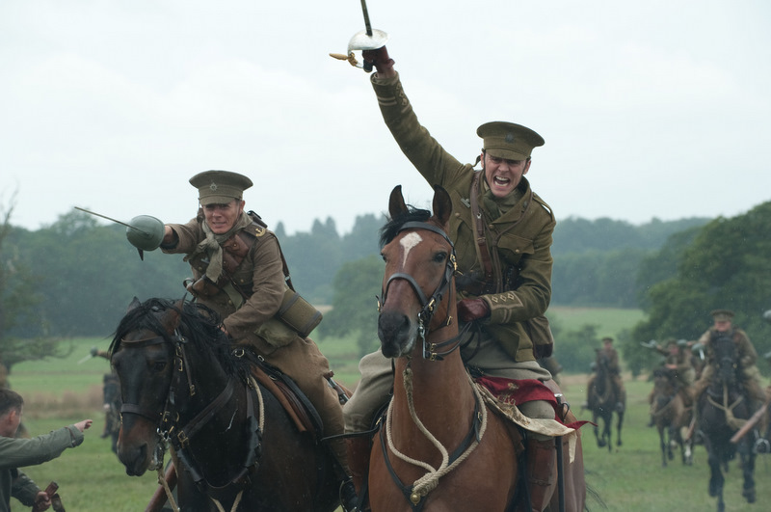
Chapter 11
Comprehension questions

Slide 2
Questions
Why is Joey happier pulling the hay cart rather than the ambulance cart? What does this tell us about him as a character? p92
Find a simile on p93 and comment on its effectiveness in creating an image of an unknown character.

