Slide 1
What was life like in Nazi Germany?
In 1933 Hitler was made Chancellor of Germany, by 1934 Hitler became the dictator (Fuhrer) of Germany. He had complete control, and peoples lives changed forever.
Hitler and his Nazi party completely changed, and controlled, the lives of all German Citizens. Over this topic we are going to find about out what life was like in Nazi Germany.

Slide 2
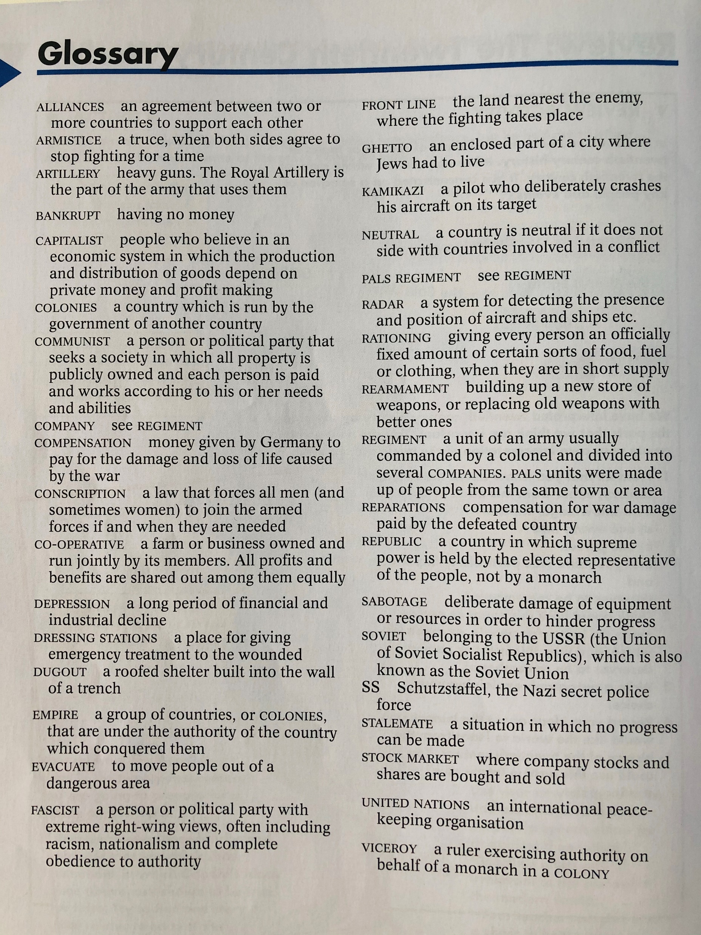
Glossary… You may need to refer to this throughout the topic to help you with words you may not understand. Activities… For each lesson you will need to type up your answers and ideas, and then email them to your teacher. Complete all of the Activity and Discuss Boxes for each lesson. All of your work will then be checked and filed – so don’t fall behind! Good luck!

Slide 3
Lesson 6
Now that you have learnt all about Life in Nazi Germany you must write a story about a family living in Nazi Germany.
Who are your characters?
What happens to each Character?
How do their lives change over time (refer to the key dates)
How are their lives effected by the Nazis?
Can you include examples of courage, compassion and commitment?
You could write it as a dairy if you wish.

Slide 4
Key dates…
January 1933 – Hitler becomes Chancellor of Germany
September 1939 – World War 2 begins
April/May 1945 – War in Europe is over

Slide 5
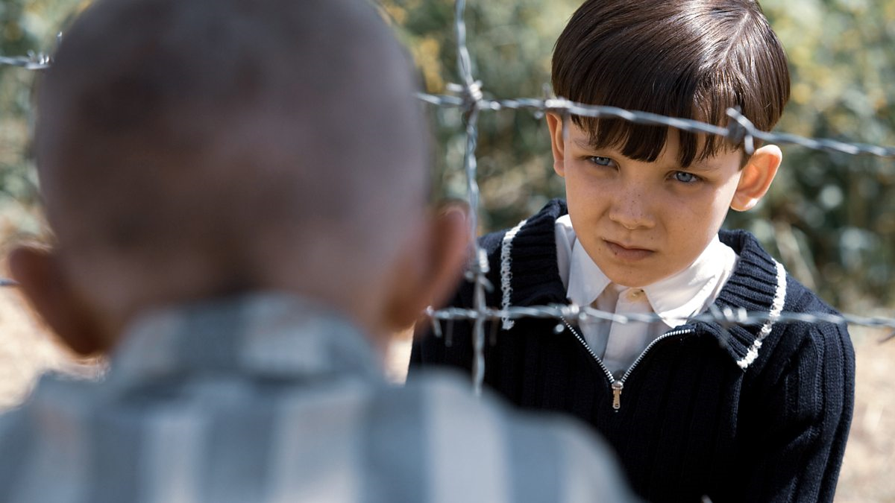
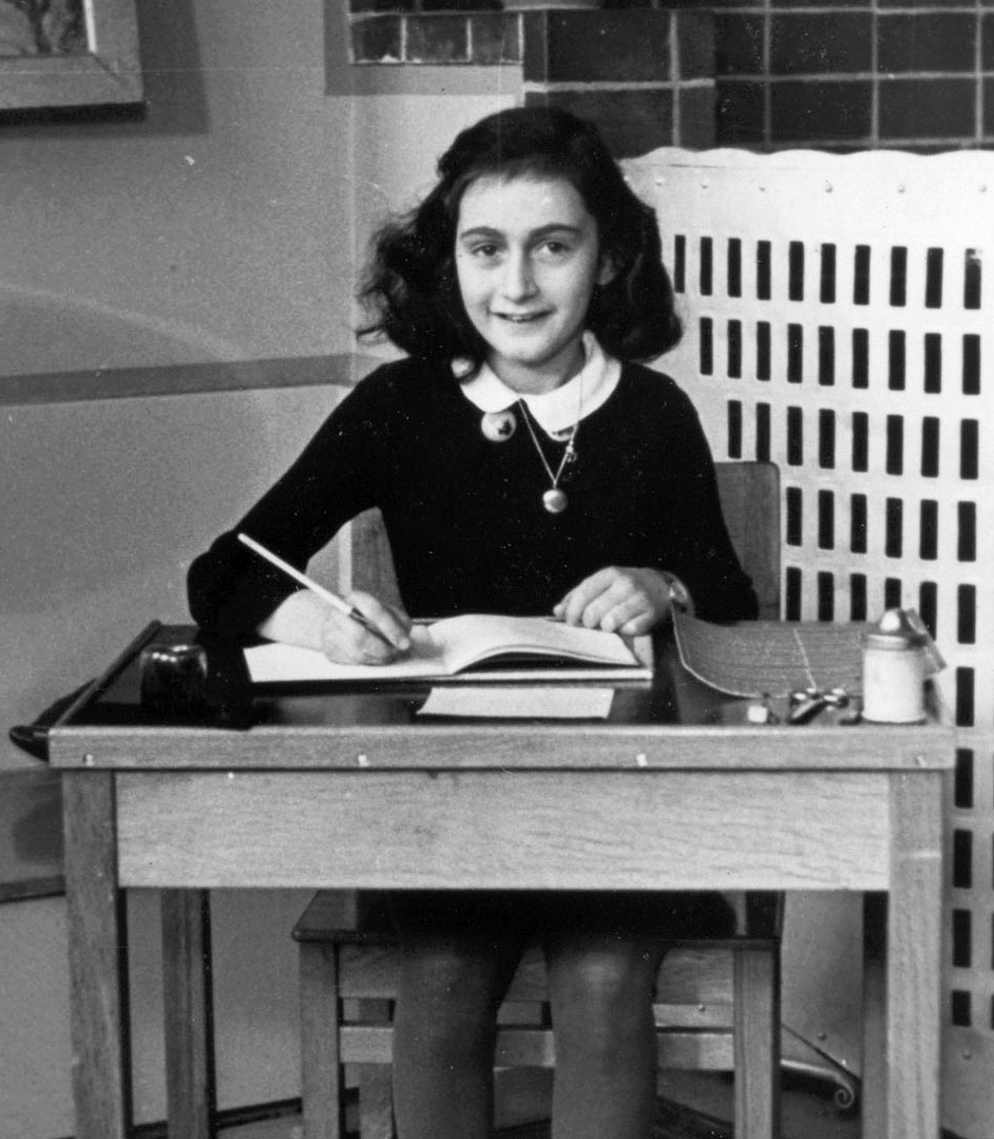
Inspiration…
You may have read the book (or watched the film) The Boy in striped Pyjamas, you could use this as inspiration to write your story.
You may also know the real story of Anne Frank, you can also use this as inspiration to write your story.

