Slide 1
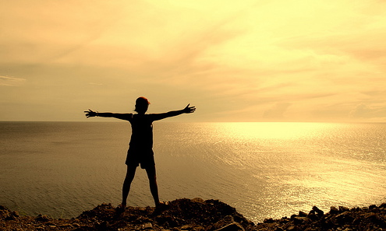
Term 5 Assignment 2
Write a short article in Spanish about your plans for when Lockdown is over
Write in Spanish (using your own words not Google translate!)
Use the future tense (voy a jugar/ir/comer....). Keep it simple using the words you already know.
You can write about a planned holiday or more generally about what you are going to do after Lockdown is over.
Use the vocabulary on the next 2 slides. Also use your work from this lesson.
Think about what you would really like to do when social distancing measures have been eased and life starts to return to normal. What have you missed doing? Would you like to try something new?

Slide 2
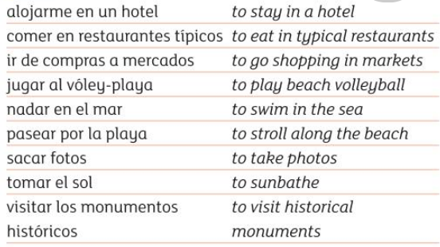
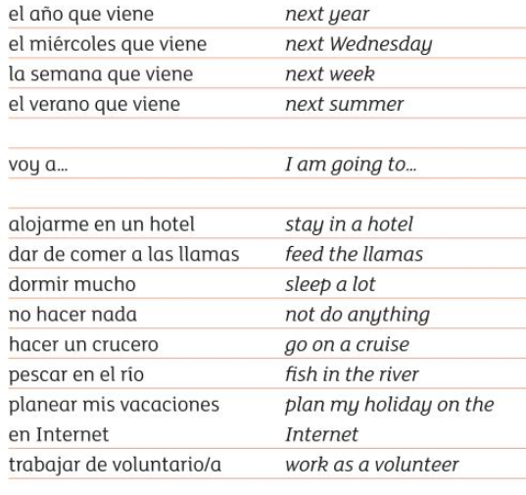
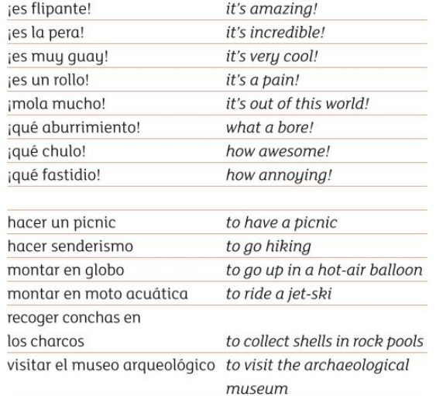
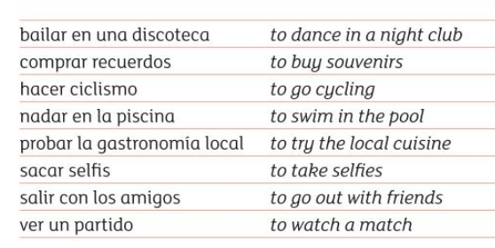
Vocabulario

Slide 3
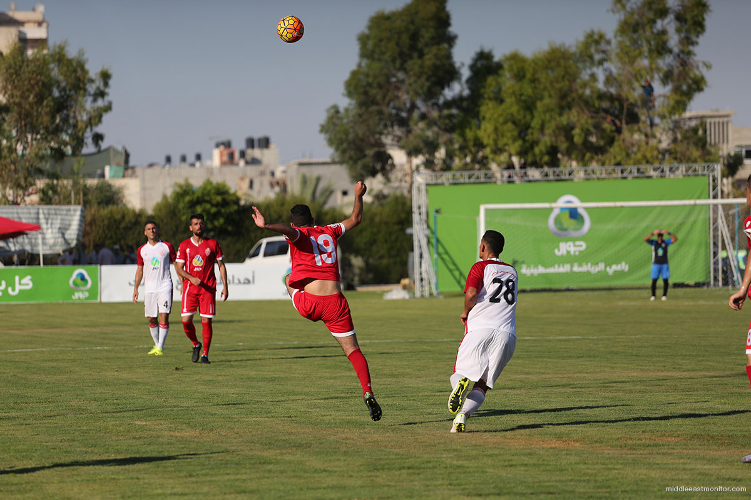
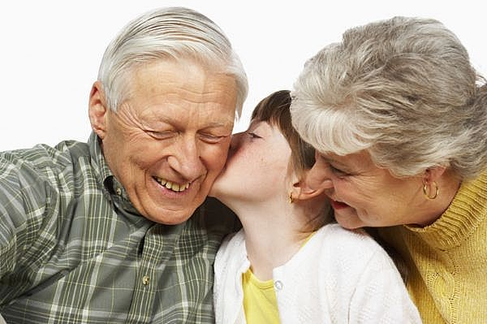
Cuando termina el encierre.......... (when lockdown is over)
Voy a …..... | I am going to
Salir con mis amigos | Go out with my friends
Ir al centro | Go into town
Jugar en el parque | Play in the park
Ir al instituto | Go to school
Visitar mis abuelos | Visit my grandparents
Jugar al futbol con mi equipo | Play football with my team
Ir de compras con mi madre | Go shopping with my Mum
Pasar todo el dia fuera | Spend all day outside
Ir a la playa con mucha gente | Go to the beach with lots of people
Todos los dias | Everyday
Sin..../con.... | without/with
Va a ser | It is going to be...
genial/fantastico/fenomenal | great/fantastic/brilliant

Slide 4
Extension task
Either;
1. Design a poster for young Spanish children to help them understand about Coronavirus
or
2. Produce a leaflet in Spanish giving information and advice about Coronavirus
https://www.youtube.com/watch?v=9U7UVR-Vhi4
Here are a couple of videos for you to watch about the Cornavirus to help you. There are lots of useful Spanish words and phrases!
https://www.youtube.com/watch?v=_Nbi4eoC7gA

