Slide 1
Speaking starter!
¿Qúe hay en tu casa?
En mi casa hay …..
un salón
un dormitorio
un garaje
un comedor
un aseo
una cocina
un pasillo
un baño
arriba
abajo
afuera

Slide 2
Term 5 lesson 5
Se Vende
LO: to understand and create a description of a house for sale

Slide 3
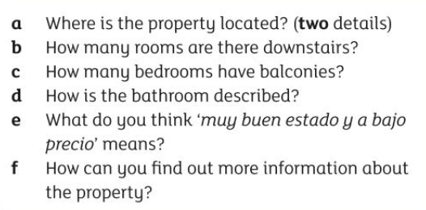
Leer Read this advert for a house for sale. Answer the questions in English

Slide 4
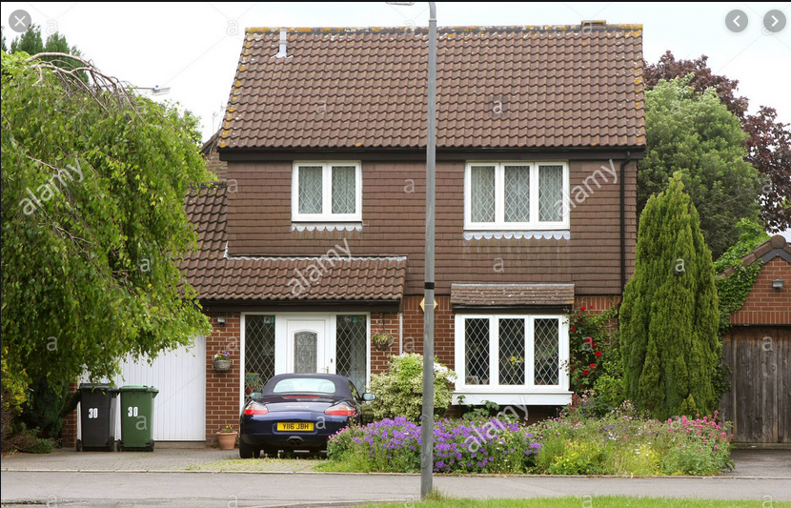
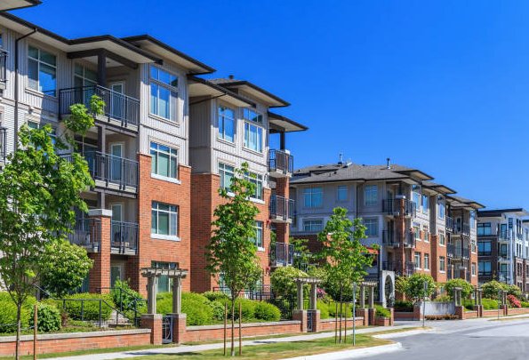
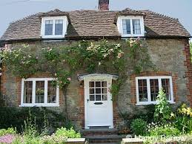
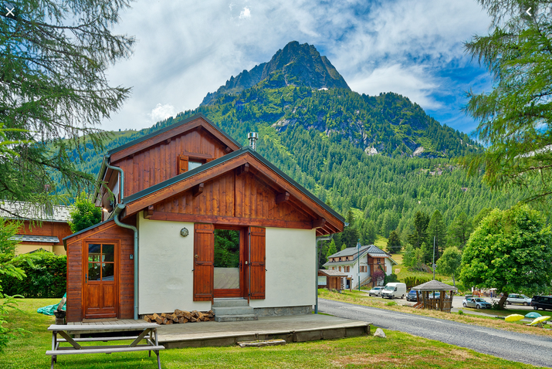
Success criteria (Total 20 marks)
Include
location
type of property
number and position of rooms
description
how to get more information
price
picture
Use
‘house’ vocabulary
correct spellings
correct verbs
adjectives
correct word order
TASK
You are working for an estate agent in Spain.
Your task is to create an advert for a property that is for sale.
Write a detailed description in Spanish and include pictures

Slide 5
Useful expressions
Se Vende = for sale espacioso/a = spacious Arriba = upstairs cómodo/a = comfortable
Hay = there is/are viejo/a = old
Afuera = outside lujoso/a = luxurious
Abajo = downstairs nuevo/a – new
está situado/a en = situated
en buen estado = in good condition
a bajo precio = low price
es = is
son = are
READ THIS!
Use the text on slide 3 to help you
Use the language you know and keep it simple
No online translation!
Describe your house for sale, research your own online or invent one
Include a picture
Present your advert on Word or Powerpoint
Submit on Teams to be marked!

