Slide 1
Examples of Grade 8/9 boards and sketchbook pages.
Think about:
Structure of pages/ Presentation
Experimentation! This is important!- Drawings, painting, textiles, mixed mediums.
Skill and ability (Quality of your drawings, painting and ideas) Are the realistic or do they reflect the artists styles?
Annotation- explain what you have done, why and how it links to the topic or artist. How can you improve

Slide 2
Flow of the sketchbook
Title page/ Mind Map/ Photomontage
- All linked to the topic and style.
Idea development- Experimentation/ Investigation
Using your own photographs you explore your artists and topic.
Work should explore your theme and your idea about your work.
What are you trying to say in your art?
- You must use at least 4 different mediums.
Think about backgrounds and colleges.
Quality work at all times
At least 15-20 pages of experimentation.
Pages should look fun and exciting.
- ANNOTATION- written information about what you have done, How it links to the artists and topic, and what you can do to develop and improve.
AO1, 2, 3 & 4
Observational Drawings
- Skilful pencil or pen drawings linked to the topic (around 5 drawings, with own pictures to support)
AO1, 2
AO1 & 2
Artist Research
You must have a minimum of 2 artists.
Quality images of their work
Biography about them and their work.
You must include a Pastiche (copy of their work by you)
Think about your background and style.
Final Piece design
2-4 examples of your final piece in different styles and mediums.
AO4
Photography Page
- All linked to the topic and the artists. Your own photography's.
Final Piece
Final outcome from your investigation.
Quality and best work you can produce.
AO1, 2 & 3

Slide 3
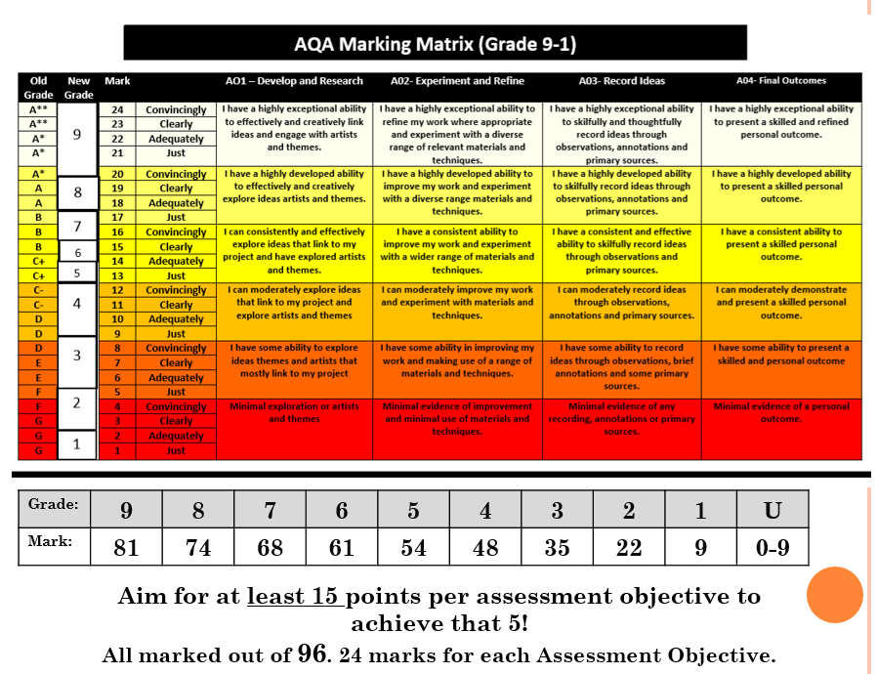
On the next few pages are examples of level 7,8 and 9 works. Marks 68 and above.
Works are mostly artists researches, Experimentation/Idea development and Final piece designs.

Slide 4
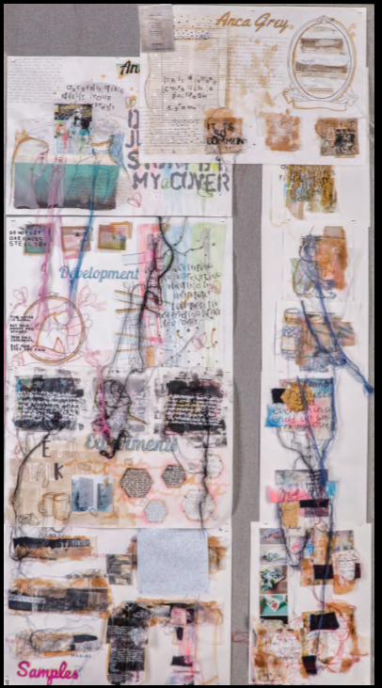
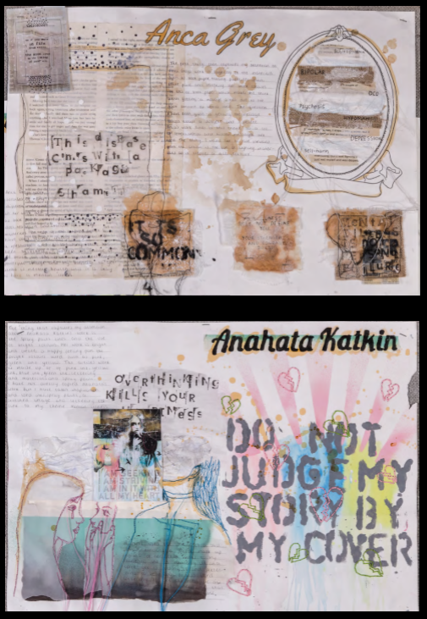
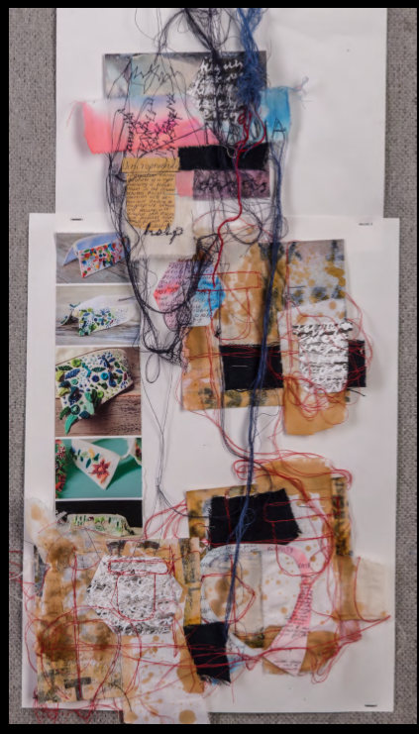

Slide 5
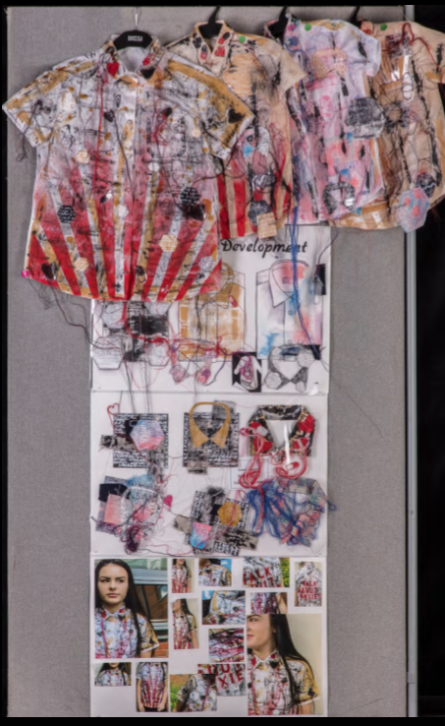
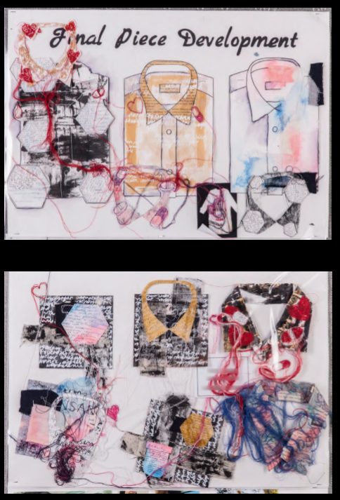
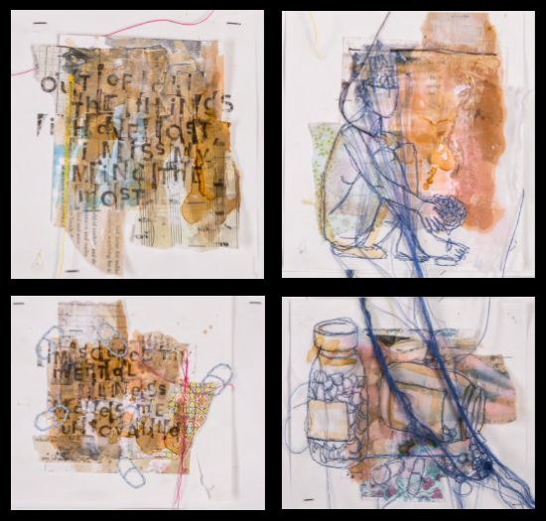

Slide 6
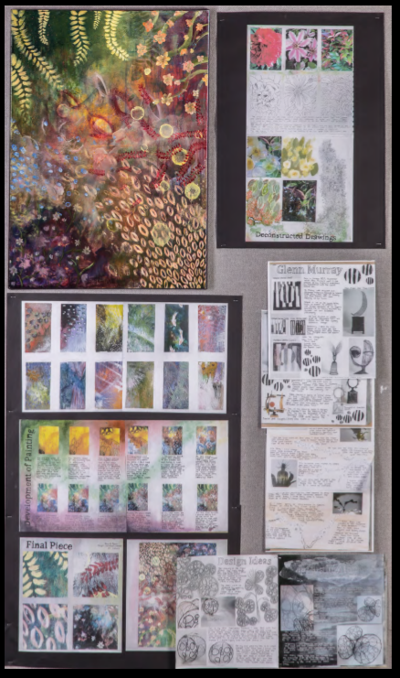
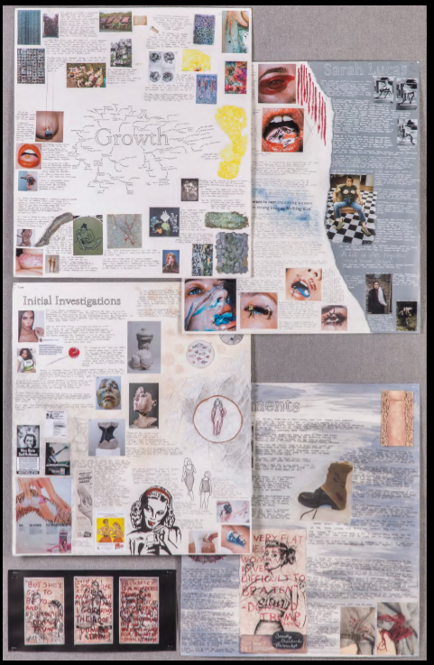
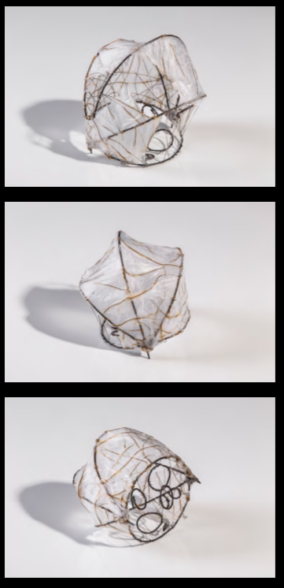

Slide 7
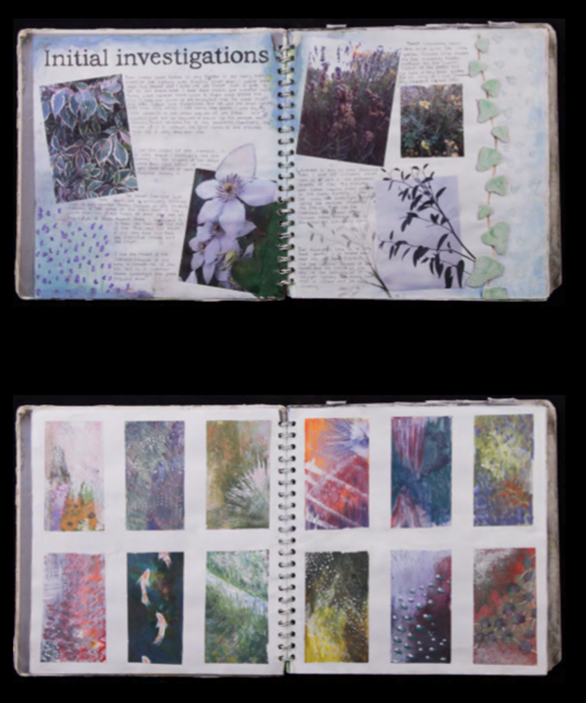
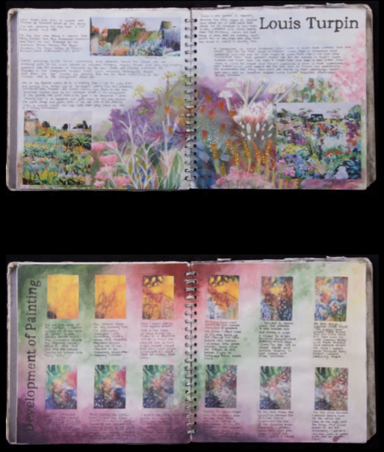

Slide 8
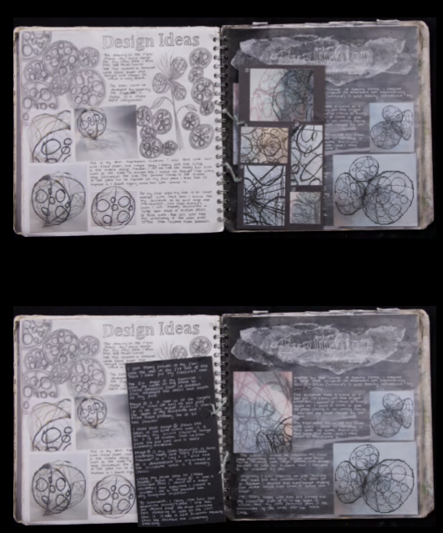
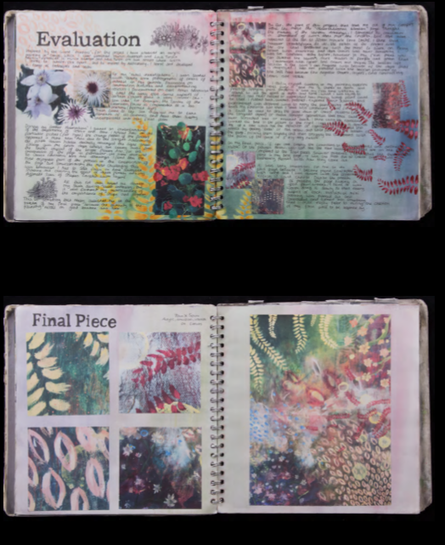

Slide 9
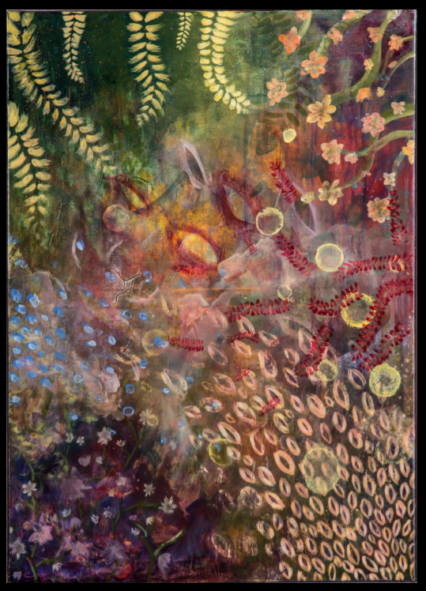
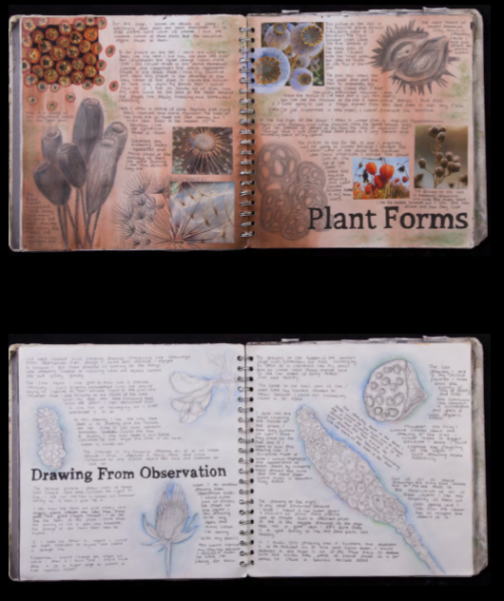

Slide 10
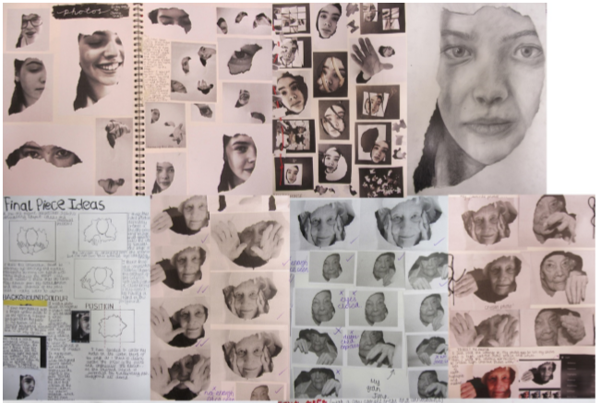
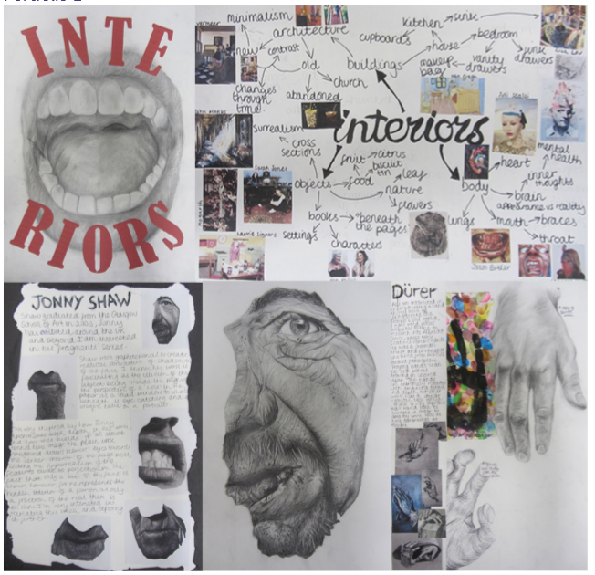
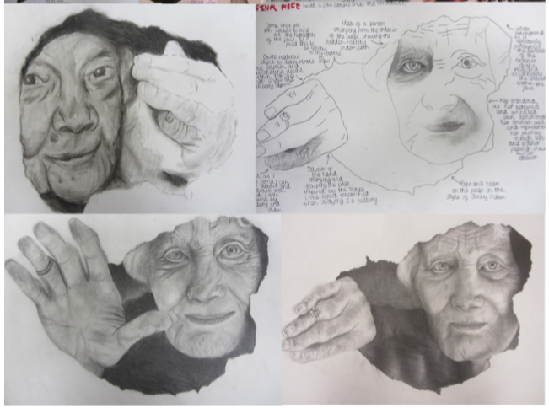

Slide 11
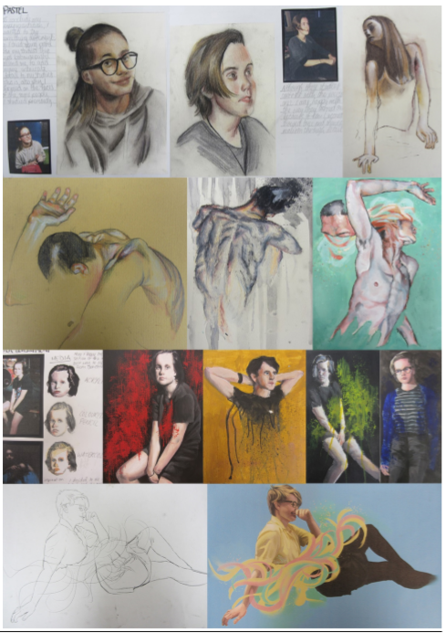
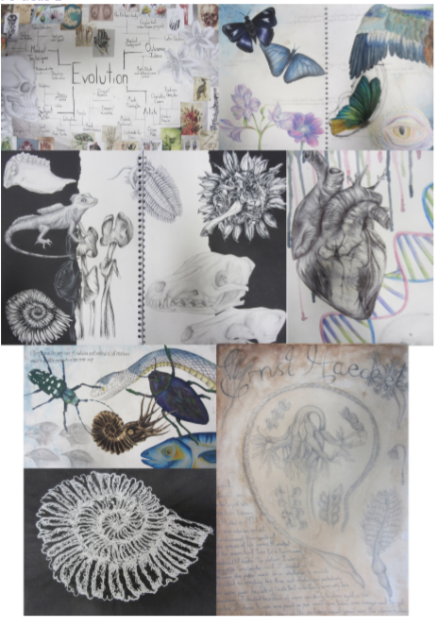

Slide 12
