Slide 1
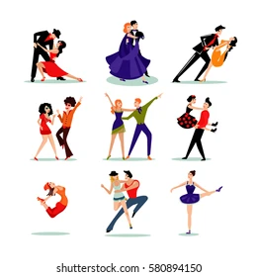
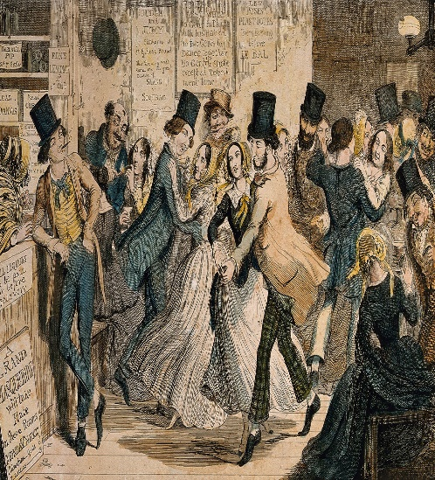
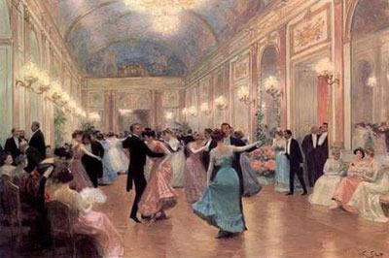
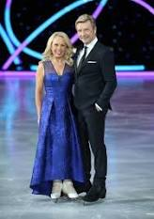
Different types of dance
Dance has been part of our culture for thousands of years. There are many forms of dance performed all over the world today, from ballet to ballroom and salsa to street. Most of the dancing we now see is about recreation and self-expression, and it’s also an enjoyable way for people of all ages, shapes and sizes to stay fit and healthy.
Key Vocabulary
Beat of 8 | An 8-count is a rhythmic grouping of 8 beats.
Canon | A dance technique that requires dancers to take it in turns to perform a movement.
Choreography | The sequence of steps and movements in dance or figure skating, especially in a ballet or other staged dance.
Co-ordination | The ability to use different parts of the body together smoothly and efficiently.
Count | An act of reciting numbers in ascending order, up to the specified number.
Dance | Move rhythmically to music, typically following a set sequence of steps.
Fluency | The ability to express oneself easily and articulately.
Routine | A sequence of actions regularly followed.
Tutting | Tutting is a style of dance that involves making shapes and angles (usually 90-degree angles) with the body, limbs, hands, fingers, etc.
Unison | Two or more dancers performing the same movement at the same time.
Year 5/6 - PE - Dance
Sticky Knowledge/Skills
The first thing to do is decide on your style of dance. The type of steps you choose will depend on this. There are lots of different types of dance style; ballet, modern, tap, ballroom, jazz and hip hop are examples although there are many more.
Include a range of different movements and patterns to make your dance interesting. Working with a partner gives you chance to use sequences involving canon or unison.
Link movement patterns together and have some fluency about it. Remember it is a sequence of movements so you need the dance to flow from one movement to the next.
A good dance routine will show movement confidently and safely in your own and general space, using changes of speed, level, and direction.
Themed dances will take or the characteristics of the era they are from. More traditional, older dances may include unison movements at a slower pace whereas more modern may include canon or unison movements at a more faster pace.
The earliest historical records showing the origins of dance are cave paintings in India dating to about 8000 BCE
Famous Dance Acts
Diversity is a British street dance troupe formed in 2007 and based in London. They are best known for winning the 3rd series of Britain's Got Talent in 2009. Diversity consists of friends from London (Leytonstone and Dagenham) and Essex (Basildon), including four sets of siblings and eight other members. At the time they appeared on Britain's Got Talent, some were still at school or university, while others had jobs of their own.
The British figure-skating team of Jayne Torvill and Christopher Dean made history at the 1984 Winter Olympics by receiving perfect scores for artistic impression from all judges. Their victory made them the first non-Russian team in Olympic history to win the gold medal in ice-dancing competition.

