Slide 1
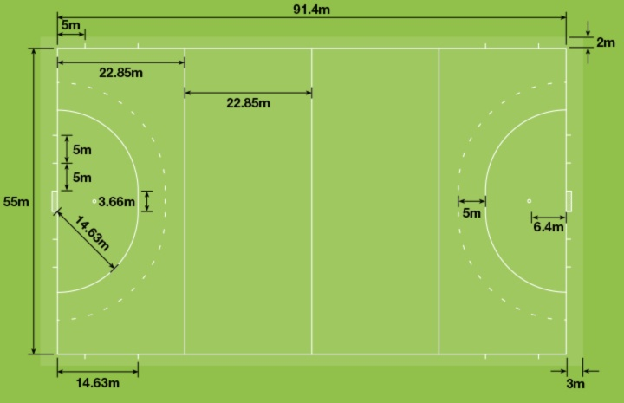
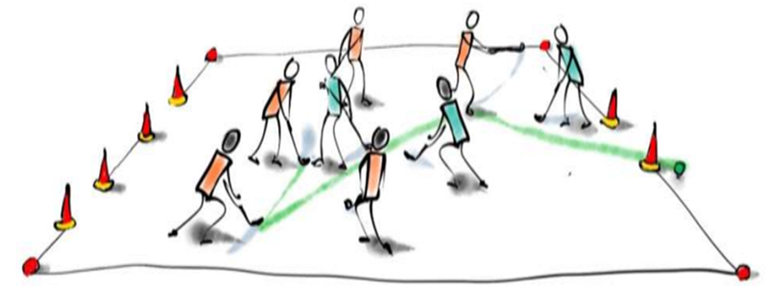
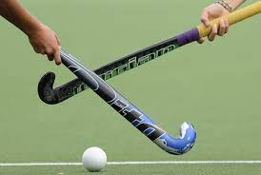
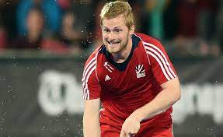
Key Vocabulary
Attack | To make a forceful attempt to score a goal or point or otherwise gain an advantage against an opposing team or player.
Control | The skill of controlling the ball in a game.
Defence | The action or role of defending one's goal or wicket against the opposition.
Direction | A course along which someone or something moves.
Dribbling | To take (the ball) forwards past opponents with slight touches of the feet or the stick, or (in basketball) by continuous bouncing.
Passing | The action of passing a ball to another team member.
Possession | Temporary control of the ball by a player or team.
Push Pass | Used to move the ball speedily over shorter distances. With no backlift, the stick stays in contact with the ball as the stick is followed through.
Slap Pass | For passing over a middle distance to a teammate or for shooting on goal. A slap shot is stronger and faster for hitting the ball than a push pass.
Teamwork | the combined action of a group, especially when effective and efficient.
Year 3/4 - PE - Hockey
The Hockey Pitch
Since the 1970s, hockey has been played on artificial turf. The surface of the pitch has to be totally even and normally it’s either blue, green or turquoise. More surprisingly, whenever you watch a semi-pro, pro or international hockey match, it will be played on a water-based pitch. This is because when the pitch is wet it allows for a much better quality and speed of play, preventing the ball from bouncing up and hitting the players.
Sticky Knowledge/Skills
Each hockey team consists of 11 players that comprise attackers, defenders, and a goalkeeper. Attackers try to hit, dribble, push, and pass the hockey puck in the opposite team’s goal to score a goal. Defenders make an effort to stop the opposing team from scoring a goal, by counter-hitting the ball with their sticks. The goalkeeper is the only one who can use his feet to stop or redirect the ball, besides using his stick.
Players need to be able get into good positions if they want to receive the ball. Leading well allows you to have more time on the ball and to make better decisions. There are various types of leads you can make and can vary depending upon your position.
To control the ball with short strokes of the stick while on the move, alternating the ball from the right side of the body to the left side of the body in order to elude defenders.
Timing is a crucial factor to consider as a great lead is not great unless your timing is spot on. Great leading comes from understanding the player on the ball as well as your ability to anticipate what is going to happen next.
The roots of hockey are buried deep in antiquity. Historical records show that a crude form of the game was played in Egypt 4,000 years ago and in Ethiopia around 1,000BC, whilst an ancient form of the game was also played in Iran in around 2,000BC.
Famous Hockey Players
Samantha Ann Quek, MBE is an English former field hockey player and television personality. She played as a defender for both the England and Great Britain teams, wearing squad number 13, and won gold as part of the British team at the 2016 Summer Olympics.
Ashley Steven Jackson is an English field hockey player who plays club hockey as a defender or midfielder for Old Georgians'.He represented the England and Great Britain national teams from 2006 until 2021.
In December 2014 Jackson began playing ice hockey for Invicta Dynamos, scoring a goal on his debut against London Raiders.

