Slide 1
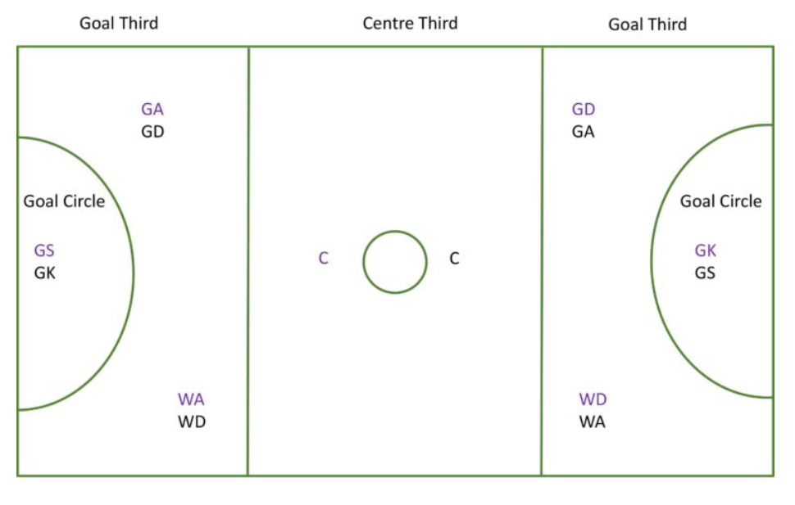
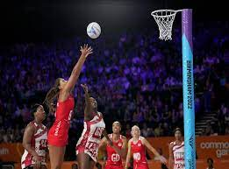
Year 5/6 - PE - Netball
Key Vocabulary
Accuracy | The ability to control movement in a given direction or at a given intensity.
Bounce Pass | A pass to a teammate that is made by bouncing the ball once.
Chest Pass | A pass in which the ball is quickly propelled from the chest by the hands and arms.
Control | The skill of controlling the ball in a game such as football, tennis or netball.
Direction | A course along which someone or something moves.
Passing | The action of passing a ball to another team member.
Power | Denoting a sports player, team, or style of play that makes use of power rather than finesse.
Score | The number of points, goals, runs, etc. achieved in a game or by a team or an individual.
Shoot | To kick, hit, or throw the ball or puck in an attempt to score a goal.
Technique | A way of carrying out a particular task, especially the execution or performance of an artistic work or a scientific procedure.
The Netball Court
A competitive netball match is played on a large rectangular court and can be played both indoors and outside. An official court is measured at 30.5 m (100 ft) long and 15.25 m (50 ft) wide. Netball post - the vertical height should be 3.05 metres from the ground.
Sticky Knowledge/Skills
Netball is a non-contact sport therefore you are not allowed to come into contact with any other player. It is played with a netball on a rectangular court, which is divided into thirds with a goal at each end. The object of the game, is for teams to pass the ball around and to score more goals than the opposing team.
Netball players need: Hand-eye coordination: This skill is super important for throwing and catching the ball in netball, but also for shooting and scoring points. Without having this skill, the player could drop the ball or send it in the wrong direction, leading to their opponent taking control of the ball. Teamwork: Players need to trust each other and work together to win the game. Because players cannot move too much once they have the ball, they have to rely on their teammates to keep the ball moving in the right direction. It’s important to keep eye-contact and clear verbal communication between players. Players should shout if they are free and say when and where the ball should be passed. Most importantly, they should cheer each other on for encouragement!
You cannot travel (move) with the ball. There are only seven players on court from each team at all times, You cannot snatch or hit the ball out of a player’s hands. When the ball goes out of court, the team who last touched the ball hands the ball over to the opposing team.
Passing is key and using a range of passing such as bounce, chest and shoulder pass are key to successful movement in a game situation.
The origins of netball can be traced back to 1891 when Dr James Naismith created the game of basketball. Although basketball was originally designed for men, in 1892 it was adapted for female students with the aim of maintaining female etiquette.
Famous Netball Players
Stacey Francis-Bayman, is a former England netball international. She was a member of the England teams that won bronze medals at the 2010 Commonwealth Games and at the 2011 and 2015 Netball World Cups. At club level she has played for both Team Bath and Yorkshire Jets in the Netball Superleague, for Canterbury Tactix in the ANZ Championship and for West Coast Fever in Suncorp Super Netball.
Eleanor 'Ellie' Cardwell is an English international netball player. She plays in goal attack and goal shooter for England, and at the club level represents Manchester Thunder in the Netball Superleague. Cardwell was born in Blackpool, joining Blackpool Netball Club at the age of 10.

