Slide 1
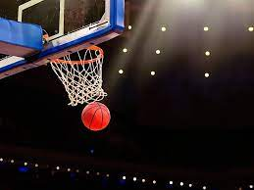
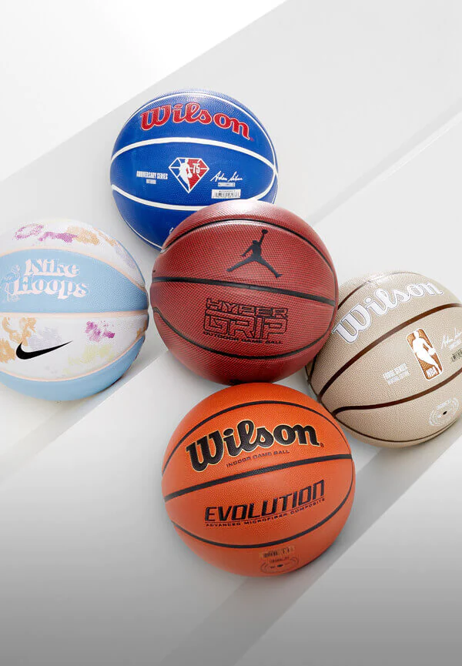
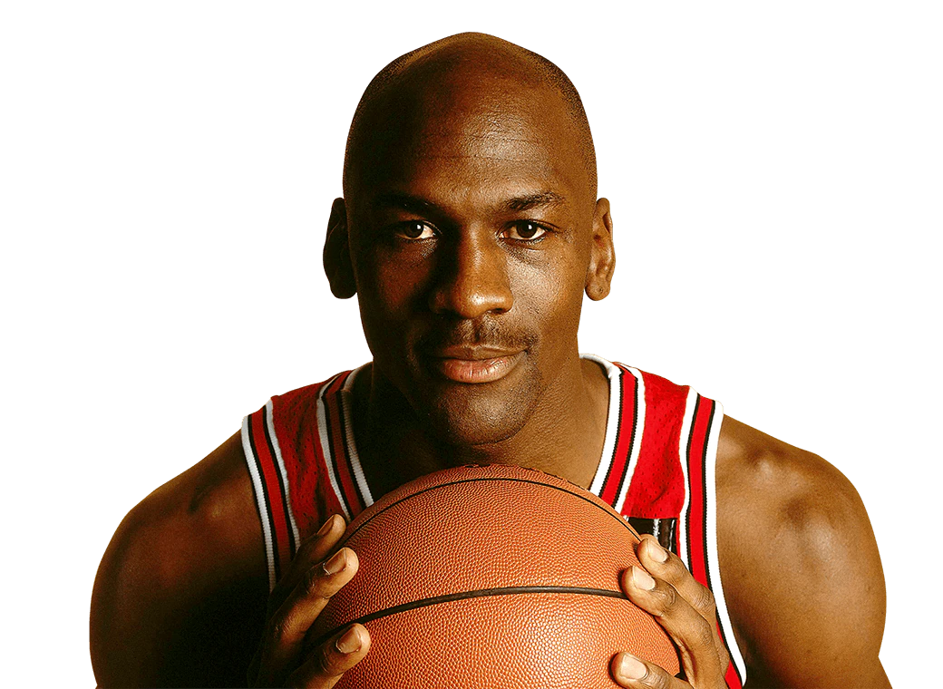
Key Vocabulary
Awareness | Knowledge or perception of a situation
Chest Pass | A pass in which the ball is quickly propelled from the chest by the hands and arms.
Dribbling | To bounce (the ball) as in advancing or keeping control of it.
Net | To score (a goal or point) by hitting, kicking, or shooting a ball or puck into a net.
Possession | The amount of time a team controls the ball during a match.
Plays | A strategically planned and choreographed sequence of movements to get open shots and score points.
Principles | Training means engaging in activity to improve performance and/or fitness; this is best accomplished by understanding general sports training principles
Score | The number of points, goals, runs, etc. achieved in a game or by a team or an individual.
Shoot | To kick, hit, or throw the ball or puck in an attempt to score a goal.
Space | Any part of the field where there isn't a defender, but especially in the area you are attacking
Year 5/6 - PE - Basketball
The Basketball Court
In basketball, the basketball court is the playing surface, consisting of a rectangular floor, with baskets at each end. In professional or organized basketball, especially when played indoors, it is usually made out of a wood, often maple, and highly polished and completed with a 10 foot rim.
Sticky Knowledge/Skills
The goal of the game is to throw (shoot) the ball through a hoop mounted high on a backboard on the opponent's side of the court, while stopping the opponent from shooting it into your team's hoop. Each basket made is worth two points, while a basket made from outside the three-point line is worth three points.
Basketball players use skills such as dribbling (bouncing), shooting, running, and jumping.
The game lasts for four quarters and the team with the most points at the end of the four quarters wins the game. If the score is tied at the end of the game, there will be overtime, which is additional playtime to allow one team to win the match.
A game of basketball is made up of four different quarters, each ten (or in the NBA, 12) minutes long. At the start of every game, the referee throws the basketball up in the air, and one player from each team tries to hit it to their teammates. That is called a "jump ball."
At the start of each quarter, the team who has the possession arrow pointing toward their hoop gets the ball. Then the arrow is switched, and the next team gets the ball the next quarter.
For the first game of basketball in 1891, Naismith nailed two half-bushel peach baskets onto 20-foot poles, which gave the sport its name. He told the enthusiastic students the rules he had written and began the game. After much running and shooting, William R. Chase made a midcourt shot, which was the only score in that historic contest.
Famous Basketball Players
Paul Sturgess is a British former professional basketball player. He was officially measured by Guinness World Records in November 2011 at 7 ft 7.26 in and 325 lb. Sturgess was the tallest college basketball player in the United States.
Michael Jordan is an American businessman and former professional basketball player. He is sometimes references as the greatest basketball player of all time." He played fifteen seasons in the National Basketball Association (NBA), winning six NBA championships with the Chicago Bulls.

