Slide 1
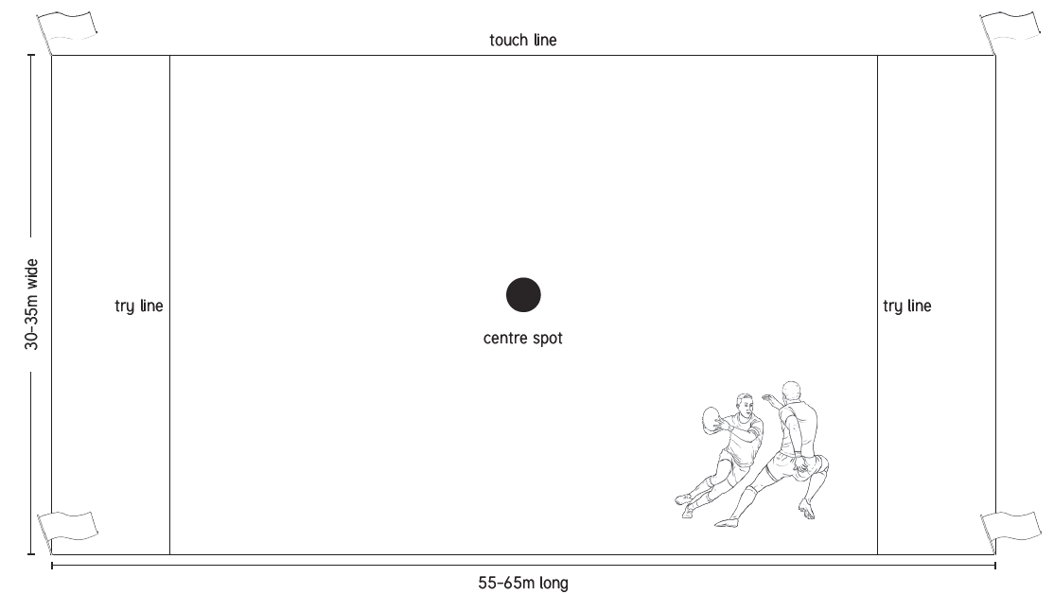
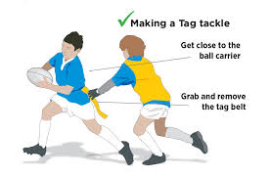
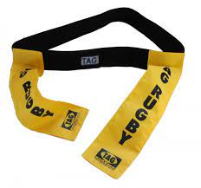
Key Vocabulary
Attack | To make a forceful attempt to score a goal or point or otherwise gain an advantage against an opposing team or player.
Defend | To protect one's goal or wicket rather than attempt to score against one's opponents.
Dummy | Where the ball carrier moves as if to pass the ball to a team-mate, but then continues to run with the ball himself
Knock-on | When a player loses possession of the ball and goes forward off the hands or arms of a player and hits either the ground or another player.
Mark | To stay close to (an opponent) in order to prevent them getting or passing the ball.
Movement | The movements of the body, coordination, the use of motor skill areas and reflex actions.
Pass | To kick, hit, or throw (the ball) to another player of one's own side.
Rugby | Tag rugby is a non-contact team game in which each player wears a belt that has two velcro tags attached to it, Attacking players attempt to dodge, evade and pass a rugby ball while defenders attempt to prevent them scoring by "tagging“.
Tag | To grab an opponents Velcro tag, providing a non-contact way of tackling them.
Year 5/6 - PE – Tag Rugby
The Tag Rugby Pitch
A Tag Rugby pitch can be between 35 and 70 metre long depending on the format. 7-a-side and 8-a-side Pitches are between 42 and 50 metres wide, with 6-a-side pitches being between 30 and 35 metres wide.
Sticky Knowledge/Skills
A game begins with a pass backwards from the centre spot. When a try is scored, the game is restarted by a free pass from the centre of the pitch by the non-scoring team.
A try can only be scored when the ball is touched to the ground.
The only contact allowed between players is the removal of a tag by a defender from the belt of the ball carrier. Once the tag is removed, the defender must shout ‘tag’ and return it to the attacker.
After being tagged, the ball carrier must pass the ball within three seconds or steps. If the player takes longer than this, the ball will be given to the other team. Once a player is tagged, the defending team must move one metre behind the ball carrier to allow them to pass, otherwise, they will be in an offside position and penalized.
Tag rugby was first developed in Gibraltar by the Gibraltar Rugby Union. They were looking for a way to continue playing rugby when they were lacking grass pitches.
Famous Rugby Players
Owen Andrew Farrell is an English professional rugby union player, currently captain of RFU Championship side Saracens and is captain of the England National Team. Farrell has played international rugby for England since 2012. Farrell is one of the top points scorers in test history, having scored 1050 points from 97 tests.
Alun Wyn Jones is a Welsh rugby union player. He is the captain of the Wales national team, and the Ospreys. He is Wales' most capped lock forward and Wales' second most capped player behind Gethin Jenkins. He has also won seven caps for the British and Irish Lions.

