Slide 1
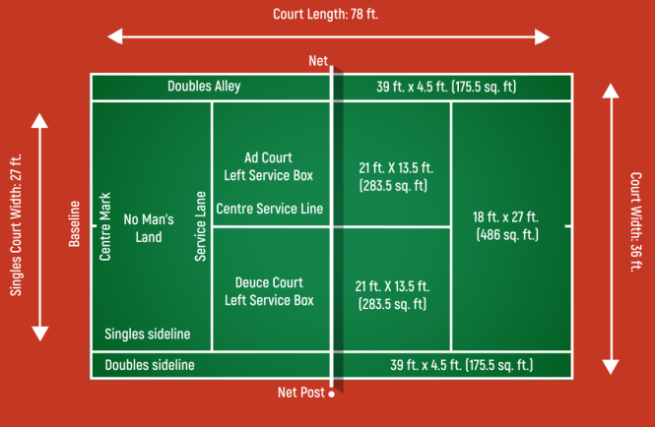
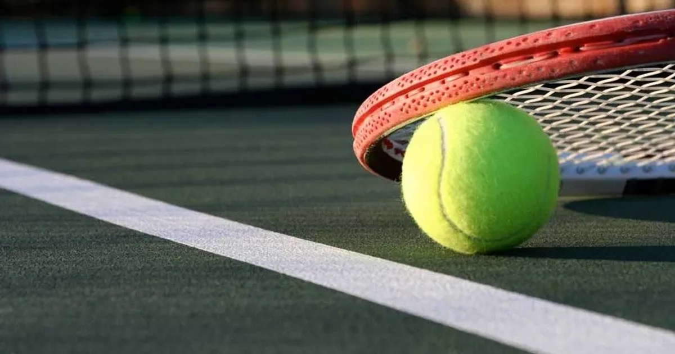
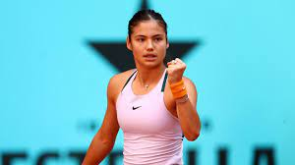
Key Vocabulary
Aim | To point or direct (the ball or object) at a target.
Bounce | To move quickly up, back, or away from a surface after hitting it.
Control | The skill of controlling the ball in a game such as football or tennis.
Cooperative | When players work with one another in order to achieve a common objective.
Direction | A course along which someone or something moves.
Power | The ability to exert a maximal force in as short a time as possible
Racket | A bat with a round or oval frame strung with catgut, nylon, etc., used especially in tennis, badminton, and squash..
Rally | An extended exchange of strokes between players..
Serve | An act of hitting the ball or shuttlecock to start play.
Swing | The backward motion of a swing that moves the tennis racquet into position in preparation to swing forward and strike the ball.
Year 3/4 - PE - Tennis
The Tennis Court
Types of tennis courts – grass, clay and hard. Though the measurements of all tennis courts are the same, the variety of surfaces on which matches are played can be segregated into three primary types – grass courts, hard courts and clay courts. Grass courts are the most traditional tennis courts.
Sticky Knowledge/Skills
A tennis match is composed of points, games, and sets. A game is won by the first side having won at least four points with a margin of two points or more over their opponent. A set is won by the first side to win 6 games, with a margin of at least 2 games over the other side (e.g. 6–3 or 7–5). If the set is tied at six games each, a tie-break is usually played to decide the set.
The score starts at 0-0 which is known as ‘love all’. The score then increases as follows: - first point: 15 - second point: 30 - third point: 40 fourth point: game 40-40 is called deuce. The umpire will always call the server’s score first.
Tennis is a non-contact sport therefore you cannot come into contact with any other player or deliberately hit another player with a racket or tennis ball.
To serve, the player stands behind the baseline. They throw the ball up into the air and hit it diagonally over the net and into their opponents service area, where they will be standing to return the serve.
Historians believe that the game originated in 12th century northern France, where a ball was struck with the palm of the hand. Louis X of France was a keen of jeu de paume ("game of the palm"), which evolved into real tennis, and the first person to construct indoor tennis courts in the modern style.
Famous Tennis Players
Andy Murray is a British professional tennis player from Scotland. represents Great Britain in his sporting activities and is a three-time Grand Slam tournament winner, two-time Olympic champion and Davis Cup champion. Murray was born in Glasgow.
His brother, Jamie Murray, is also a tennis player.
Emma Raducanu is a British tennis player. She is the current women's singles US Open champion. She won it without losing a set in the tournament. Raducanu has a career-high singles ranking of world #150, got on 23 August 2021. Before she played at Wimbledon in 2021, her highest WTA singles ranking was #333, on 9 March 2020.

