Slide 1


Welcome to Clarendon Junior School
Clarendon Junior School
Where Learners Grow

Slide 2
Key Staff for you to know
Mrs Evans – Executive Head
Mrs Brown – Head of School
Miss Hayday – Assistant Head
SENCo – Mrs Westall
Pastoral Team – The Pastoral Team work with all staff to ensure children are safe and happy in school
  Mrs Allen – Pastoral Team Lead
  Miss Newman – Pastoral Team

Slide 3
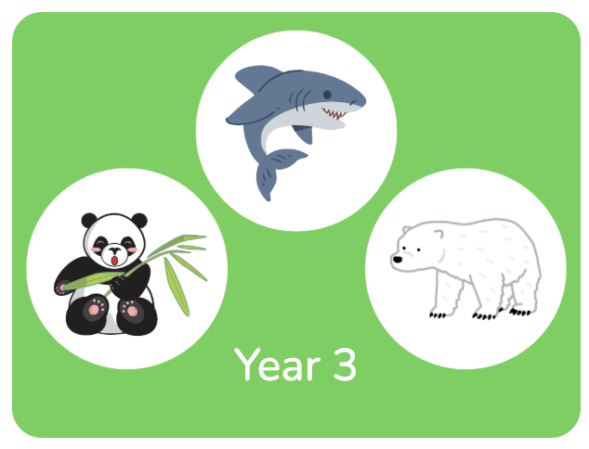
Year 3 classes
Shark Class – Miss Downing
Panda Class – Mrs Peill
Polar Bear Class (Y3/4 split) – Mrs Longbourne

Slide 4
Clarendon Juniors Snapshot
We want children to love their education, enjoy coming to school and achieve the very best they can.
We are an exciting school with a lot going on.
All year groups aim to go on trips during the school year.
We have clubs that operate after school. Please look out for the letters about these.
The children can earn golden time in Y3 to have on Friday afternoon. This is treated as a reward for hard work and positive behaviour during the week.
Our houses are named after trees – Ash (red), Beech (blue), Elm (green) and Willow (yellow). Children collect house points and the totals are added up weekly. The winning house gets the house points cup and a leaf on their tree. The house with the most leaves on their tree gets a treat at the end of the term.

Slide 5

The Clarendon Promise
At the heart of our federation are values we live by every day. This is the Clarendon Promise — a set of principles that guide how we learn, work, and grow together:

Slide 6
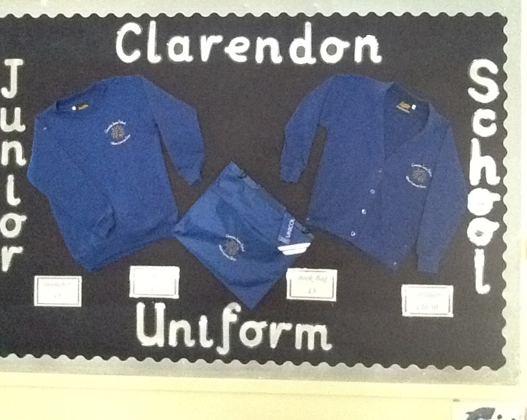
Uniform
Blue school jumper/cardigan
White shirt/polo shirt
Black or grey trousers/skirt
White/black or grey socks/tights
Black school shoes
PLEASE ENSURE ALL CLOTHING IS NAMED

Slide 7

PE kit
White T-shirt
Black or dark blue shorts
Black or dark blue tracksuit bottoms in winter
Trainers for games
Black plimsolls for indoor PE
Hair tied up for PE sessions
Blue PE kit bag (optional)
Earrings removed or tape provided to cover them
PLEASE ENSURE ALL PE KIT IS NAMED

Slide 8
Outline of the year
Autumn Term 1 – ‘Take One World’
Autumn Term 2 – ‘Take One Book’
Spring Term 1 – ‘Take One Picture’
Spring Term 2 – ‘Take One Investigation’
Summer Term 1 – ‘Take One Artefact’
Summer Term 2 – ‘Take One Culture’

Slide 9


Snacks & Lunchtime
Snacks
  Healthy fruit snacks
  Drink
Lunch
  A balanced lunch box
  Drink
  Dolce Catering – option to buy lunch, choice of hot meal either meat or vegetarian, jacket potato or wrap / baguette / sandwich
Children have access to their water bottles throughout the day

Slide 10
Reading at Clarendon Juniors
During the 1st 2 weeks at the Junior School, your child will undertake a reading fluency assessment
This gives a reading age that we match to a colour banded level (this is a different banding system to the Infant School)
Children are encouraged to be more independent so will be responsible for changing their books when they have finished. Time is set aside during the day for children to go to the library and change their books when they are ready (initially this will be with an adult as they become more familiar with our library system)

Slide 11


Maths
We have a Mastery approach to mathematics - a ‘small steps’ approach to developing fluency, variation and mathematical reasoning.
Use Times Table Rock Stars to aid acquiring fluency in multiplication facts and support home learning.
All children will receive a login to keep at home during the first few weeks

Slide 12
Homework
Given out weekly on a Friday and handed in on the following Wednesday (each child will be given an orange homework book to bring home every week)
Spellings
  Children are given 5-10 words to practice at home
Times Tables/division fact practise
Reading
  Children are encouraged to read at least 5 times a week and record it in their reading journal

Slide 13
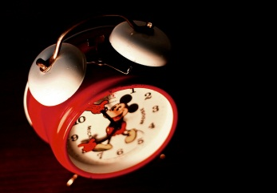
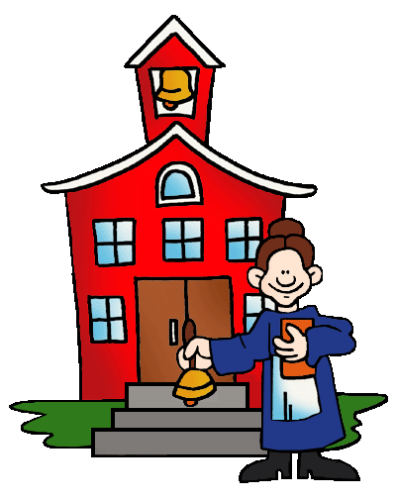
Early Days
First day of term is Wednesday 3rd September
Gates open at 8.40am and school starts at 8.45am
Please meet your child’s class teacher on the lower playground (next to the Infant playground)
At the end of the day the teachers will bring the children out to meet you at 3.15pm on the lower playground.

Slide 14
General Information
All school information is now sent home via Parent Hub
Our website www.clarendonfederation.co.uk also has up-to-date information
Please ensure the school has your updated contact details should any numbers change
Please ensure any medicines kept in school (inhalers for example) are in date and clearly labelled. If a child needs any new medication there isa form that needs to be filled out
Please can you make sure you have completed the registration form online or on paper
Breakfast Club operates in the Junior School hall – please ask for more information

Slide 15
Any questions?
Contact the school reception by email on
admin@clarendon-jun.wilts.sch.uk
Please remember to complete the contact information as soon as possible!

